Slide 1

URP 4301 – Final Year Research Project
End-Term Presentation on Deepfake Detection Using Deep Learning
Supervised By
Mr. ABDUL ATIF KHAN
Assistant Professor
Centre for AI&ML
Presented By
Kaibalya prasad nayak (2241014084)
Rupali bisoyi (2241002192)
Sameera kar (2241011022)
saswat kumar Nayak (2241014125)
Group No- 3208
Centre for AI&ML, Department of CSE
Faculty of Engineering and Technology, Institute of Technical Education & Research (ITER)
Siksha ‘O’ Anusandhan Deemed to be University, Bhubaneswar
May 2026

Slide 2
Contents
Introduction
Problem Statement
Motivations
Project Objectives
Literature Review
Research Gaps and Improvements
Proposed Solution and Architecture
Data Description
Data Preprocessing
Exploratory Data Analysis
Model Selection
Model Architecture
Software and Platform Information
Results
Discussion
References

Slide 3
introduction
Deepfake technology uses AI to generate or manipulate facial images and videos, making fabricated content appear highly realistic.
The rapid advancement of Generative Adversarial Networks (GANs) has made deepfakes increasingly difficult to detect with the human eye.
Deepfakes pose serious threat to misinformation, identity fraud, political manipulation, and digital media integrity.
Existing detection methods often fail to generalize across different deepfake generation techniques and datasets.
This project proposes a deep learning pipeline combining EfficientNet – B0 (CNN Baseline) and a CNN – Transformer Hybrid model to accurately detect deepfake faces

Slide 4
Problem Statement
The widespread availability of deepfake generation tools has made it trivially easy to create convincing fake videos, threatening public trust in digital media.
Current deepfake detection models are often trained on a single dataset and fail to generalize when tested on unseen deepfake types or generation methods.
Several existing approaches rely purely on CNNs, which capture local spatial features but struggle to model long-range dependencies across facial regions.
Existing deepfake detection models fail in real-world scenarios as compression artifacts destroy the subtle manipulation traces they rely on, yet most models are trained only on high-quality uncompressed media.

Slide 5
Problem Statement
There is a lack of robust, cross – data detection systems that can handle multiple manipulation techniques such as FaceSwap, Face2Face, NeuralTextures and Deepfakes simultaneously.
This project addresses the gap by building a dual model detection system trained on two large-scale data sets (CelebDF-V2 and FaceForensics++) covering multiple manipulation methods.
No prior work provides a side-by-side benchmark of a lightweight CNN baseline vs an attention-based hybrid on identical data. This project fills that gap by evaluating EfficientNet-B0 against a CNN-Transformer Hybrid under the same training pipeline and metrics.

Slide 6
Motivations
Real World Harm -
Deepfake videos have been used in political disinformation campaigns, non- consensual intimate imagery, and financial fraud, causing serious harm to individuals and institutions.
Platform Gap -
Social media platforms currently lack reliable automated tools to detect and flag AI-manipulated face content at scale.
Accessibility of Tools -
The rise of accessible deepfake apps (e.g. FaceApp, DeepFaceLab) means even non-technical users can now generate convincing fakes, making detection more urgent than ever.
.

Slide 7
Motivations
Cross-Dataset Gap -
Existing academic models are rarely tested across multiple datasets simultaneously — this project directly tackles that by combining CelebDF-V2 and FaceForensics++ for training.
Research Insight -
Comparing a pure CNN model against a CNN-Transformer hybrid provides valuable insight into whether attention mechanisms genuinely improve deepfake detection over strong baselines.

Slide 8
Project Objectives
Build an automated deepfake face detection system capable of classifying facial images as real or fake with high accuracy.
Preprocess and combine two large-scale benchmark datasets — CelebDF-V2 and FaceForensics++ (C23) — covering Deepfakes, FaceSwap, Face2Face, NeuralTextures, FaceShifter, and DeepFakeDetection.
Implement and train a pretrained EfficientNet-B0 model as a strong CNN baseline for deepfake detection.
Design and train a Hybrid CNN-Transformer model (EfficientNet-B3 + Transformer Encoder) that captures both local spatial features and global long-range dependencies.
Compare both models using Accuracy, Precision, Recall, F1-Score, and AUC-ROC metr to identify the stronger approach.
Generate comprehensive visualizations including confusion matrices, ROC curves, and precision-recall curves for result analysis.

Slide 9
Literature Review
Table 1:Summary of Existing Approaches and Research Limitations
Sl. No. | Author & Year | Methods/Techniques Used | Dataset Used | Research Outcomes | Findings
1 | Pravallika & Tejaswini (2026) [7] | ResNeXt Architecture, Temporal Artifact & Visual Inconsistency | Custom Dataset + FaceForensics++ | Effective automated forensic system | Strong on temporal artifacts; limited cross-dataset generalization
2 | Srinivasan et al. (2025) [8] | GAN + Autoencoder + CNN (DDM) for real-time forgery​ | FF++, FakeAVCeleb, DFFMD, Custom Celebrity Dataset | Accuracy: 92.3% | Real-time detection feasible; performance drops on high-quality GAN fakes
3 | Ekatpure et al. (2025) [9] | CNN + Hybrid LSTM for image, video & audio detection | Custom multi-modal dataset | Effective temporal manipulation detection | Auto feature extraction outperforms handcrafted; audio adds complexity
4 | Deshpande et al. (2025) [10] | Automated CNN with resizing & transform optimization | Custom image & video dataset | Accuracy: 95.775% | Optimized CNN outperforms traditional forensics; limited to image/video only

Slide 10
Research Gap & Improvements
Research Gaps
(i) Most models are trained and tested on a single dataset, making them overfit to specific manipulation types and fail in cross-dataset scenarios.
(ii) Pure CNN-based methods capture local features but miss global dependencies across facial regions — critical for detecting subtle manipulations.
(iii) Few studies combine multiple deepfake generation techniques (FaceSwap, Face2Face, NeuralTextures, FaceShifter) in a unified training pipeline.

Slide 11
Research Gap & Improvements
Our Improvements
(i) Combined CelebDF-V2 and FaceForensics++ into a single unified dataset covering 6 manipulation methods for robust cross-dataset training.
(ii) Introduced a CNN-Transformer Hybrid model that uses a Transformer Encoder on top of EfficientNet-B3 to capture long-range facial dependencies.
(iii) Applied RandAugment, ColorJitter, warmup scheduling, cosine annealing LR, and AMP training for improved generalization and efficiency.

Slide 12
Proposed Solution & Architecture
Model – 1 : EfficientNet – B0 (CNN Baseline) Model 2: CNN-Transformer Hybrid
(i) Pretrained EfficientNet-B0 backbone (ImageNet weights) (i) Used EfficientNet-B3 as the CNN backbone for .
extracting spatial feature maps
(ii) Custom classification head : Linear layer (1280 → 512)
→ ReLU activation → Dropout (0.4) → Final Linear (ii) Generated spatial features in the form (B, C, H, W).
layer (512 → 2)
(iii) Applied Layer Normalization and Linear Projection to
(iii) Used a single learning rate of 1e-4. embedding dimension 256
(iv) Backbone layers were frozen during the initial warmup (iv) Transformer Encoder configuration : ( 2 layers, 4
phase of 3 epochs. attention heads, pre-layer normalization, Dropout
rate of 0.3.
.
Input Images
CelebDF-V2 & Faceforensics++ raw frames
MTCNN Face Detection
Crop and align faces to 224 x 224
Data Augmentation
RandAugment, ColorJitter, Flip
Model Training
EfficientNet-B0
CNN Transformer Hybrid
Evaluation & Visualization
Accuracy, AUC-ROC, Confusion Matrix

Slide 13
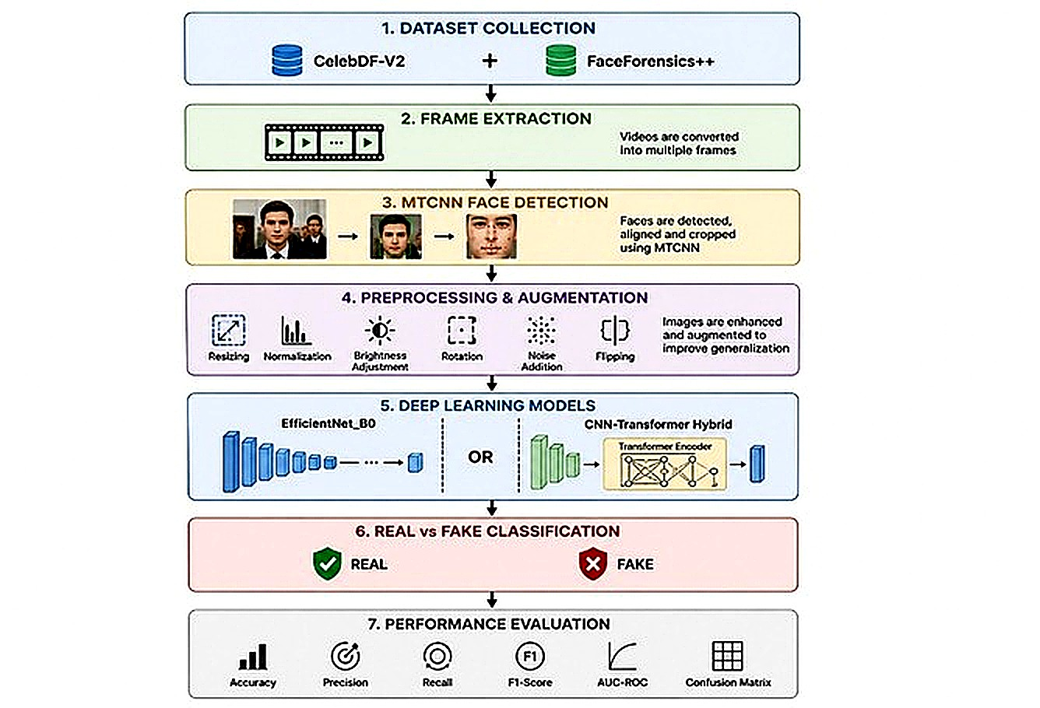
Proposed Solution & Architecture

Slide 14
Dataset Description
Dataset 1 : CelebDF - V2 (https://www.kaggle.com/datasets/reubensuju/celeb-df-v2)
Sources : | Youtube celebrity videos
Real Videos : | 590 real videos
Fake Videos : | 5,639 deepfake videos (GAN-based face swap)
Image Split : | Train / Val / Test (pre-split)
Train Images : | ~ 40,933 real + ~ 41,254 fake faces
Val Images : | ~ 5,718 real + ~ 5,762 fake faces
Test Images : | ~ 5,742 real + ~ 5,805 fake faces
Resolution : | 224 x 224 px (after MTCNN crop)

Slide 15
Dataset Description
Dataset FaceForensics++(C23)
(https://www.kaggle.com/datasets/greatgamedota/faceforensics)
Source : | Youtube videos, H.264 compressed (C23)
Real Videos : | 1,000 original videos
Fake Methods : | Deepfakes, Face2Face, FaceSwap, NeuralTextures, FaceShifter, DeepFakeDetection
Train Videos : | 200 real + 200 fake (10 frames each)
Val Videos : | 50 real + 50 fake (10 frames each)
Test Videos : | 50 real + 50 fake (10 frames each)
Total frames : | ~ 5,000 train + 1,000 val + 1,000 test
Resolution : | 224 x 224 px (after MTCNN crop)

Slide 16
Data Preprocessing
01 — Face Detection with MTCNN
Applied MTCNN (Multi-Task CNN) to detect and crop faces from all images and video frames. Margin of 20px added around each face. Images resized to 320x320 before detection, output saved as 224x224.
02 — CelebDF-V2 Processing
Iterated over Train/Val/Test splits. Sampled every 2nd image to reduce redundancy. Extracted ~20,000 train, ~2,500 val, ~2,500 test faces per class (real/fake).
03 — FaceForensics++ Processing
Extracted 10 frames per video at every 10th frame. Processed 200 train, 50 val, 50 test videos each for real and fake. Saved ~2,000 train, 500 val, 500 test faces per class.

Slide 17
Data Preprocessing
04 — Dataset Merging
Combined CelebDF-V2 and FaceForensics++ outputs into a single directory. Final combined size: ~82,187 train, ~11,480 val, ~11,547 test images. Duplicate filenames handled with 'dup_' prefix.
05 — Augmentation (Training Only)
Applied RandomHorizontalFlip, RandomRotation(15), ColorJitter (brightness, contrast, saturation, hue), and RandAugment(num_ops=2, magnitude=9). Normalized with ImageNet mean/std.

Slide 18
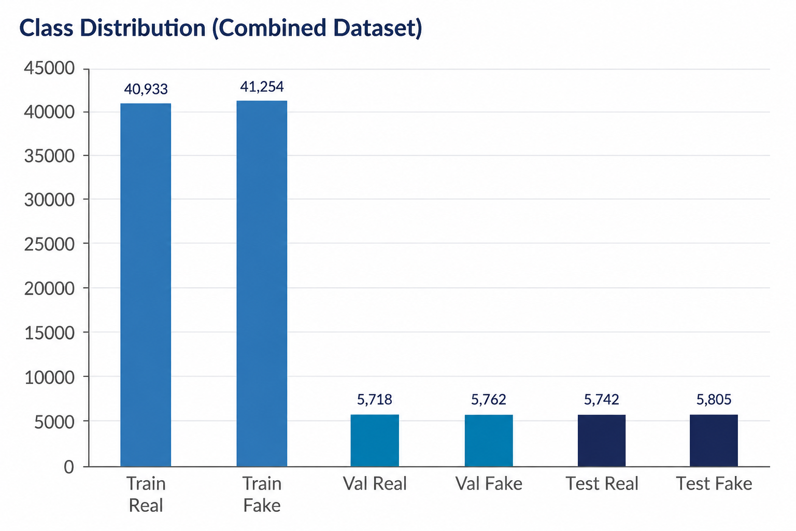
Exploratory Data Analysis (EDA)
Class Distribution (Combined Dataset) Key Dataset Statics
82,187 - Total Training Images
11,480 - Total Validation Images
11,547 - Total Testing Images
~ 50 / 50 - Real / Fake Balance
224 x 224 - Image Resolution
2 Classes - Real vs Fake

Slide 19
Model Selection
We evaluated multiple architectures before selecting our final models :
Model Name - | Pros - | Cons - | Chosen / Not Chosen
ResNet – 50 | Simple, fast, well-tested baseline | Weaker on fine grained face features | Not Chosen
EfficientNet - B0 | Execellent accuracy/efficiency tradeoff, pretrained ImageNet weights, low GPU usage | Pure CNN – No global Attention | Chosen
VGG - 16 | Simple architecture, interpretable | Very large model, slow training, outdated | Not Chosen
Vision Transformer(ViT) | Global attention mechanism, strong on large datasets | Requires massive data, underperforms on small sets | Not Chosen
CNN – Transformer Hybrid (EfficientNet – B3 + Transformer) | Combines local CNN features with global transformer attention | Slower training, more parameters | Chosen

Slide 20
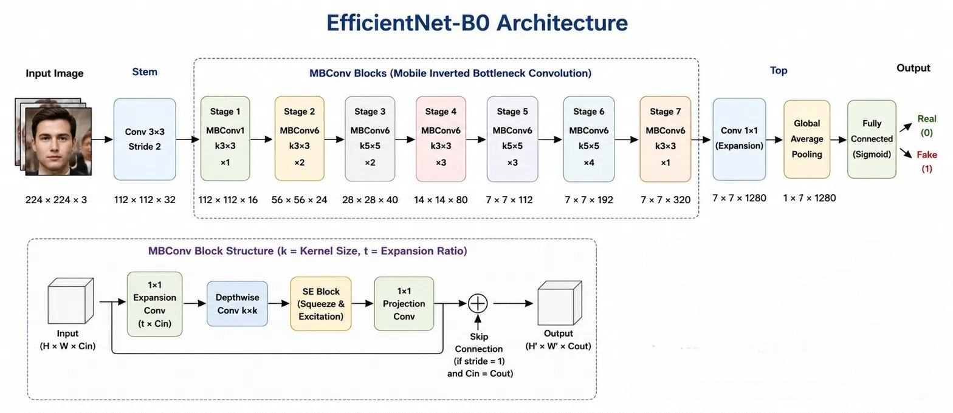
Model Architecture
EfficientNet – B0 Architecture

Slide 21
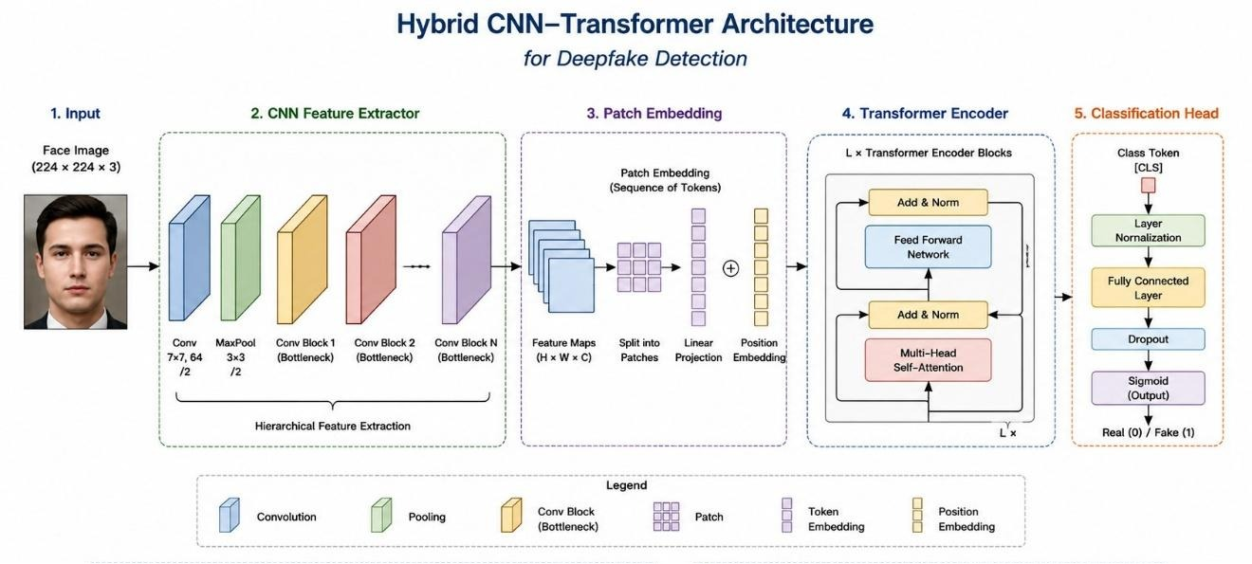
Model Architecture
Hybrid CNN – Transformer Architecture

Slide 22
Software Tools & Platform information
Category | Information
Hardware Platform | Kaggle GPU — NVIDIA Tesla T4, 16GB VRAM
Operating System | Ubuntu Linux (Kaggle cloud environment)
Programming Language | Python 3.12
Development Environment | Kaggle Notebooks (Jupyter-based)
Deep Learning Frameworks | PyTorch 2.2.2 with CUDA 12.8
Backbone Library | timm (PyTorch Image Models) — EfficientNet-B0 & B3
Face Detection | facenet-pytorch (MTCNN)
Data Libraries | NumPy, Pandas, OpenCV (cv2), Pillow
Augmentation | torchvision.transforms — RandAugment, ColorJitter

Slide 23
Software Tools & Platform information
Category | Information
Metrics & Evaluation | scikit-learn — accuracy, F1, AUC-ROC, confusion matrix
Visualization | Matplotlib, Seaborn
Mixed Precision Training | torch.amp (Automatic Mixed Precision — AMP)
Model Training Platform | Kaggle (GPU T4 x1, 30 hours/week free)

Slide 24
Platform information
Category | Information
Version Control | Git, GitHub (source code management)
Experiment Tracking | Training history saved as Python dictionaries; graphs saved as .png files
Model Checkpointing | Best model weights saved as .pth files (EfficientNet_B0_best.pth, CNN_Transformer_best.pth)
Visualization Tools | Matplotlib — Loss curves, Accuracy curves, Confusion Matrices, Metrics bar charts
Dataset Sources | Kaggle Datasets — FaceForensics++ and CelebDF-V2
Optimization | AdamW optimizer with cosine annealing LR scheduler, gradient clipping (max norm 2.0), label smoothing (0.1)
Regularization | Dropout (0.3–0.4), Weight Decay (1e-4), RandAugment, backbone warmup freezing
Training Strategy | Warmup freeze (3 epochs) → partial unfreeze → full fine-tuning; separate LR per param group
Output Artifacts | 7 graphs (G1–G7): Loss, Accuracy, Validation Overlay, Confusion Matrix, Metrics Bar

Slide 25
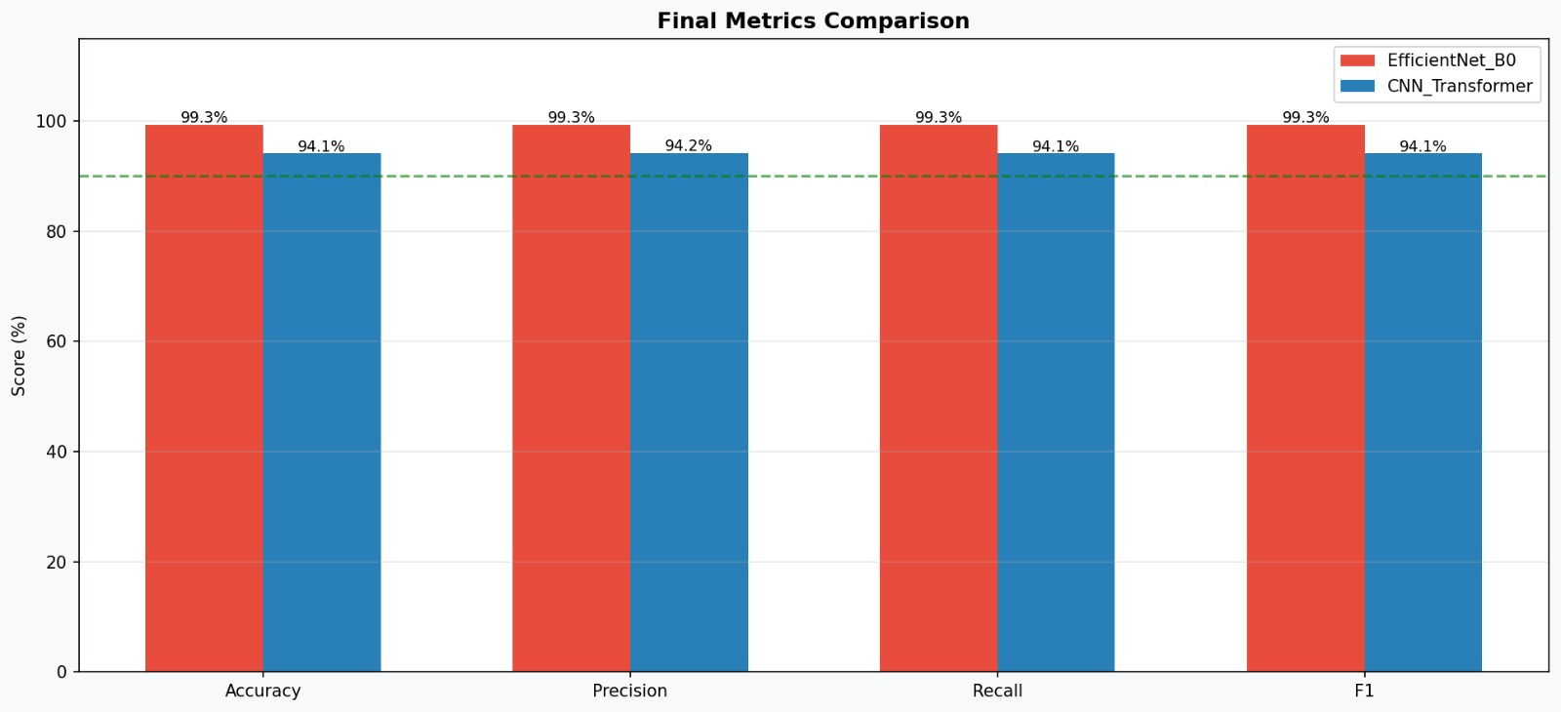
Results
Metrics Comparison (Validation Set) -

Slide 26
results
Final Model Performance Summary :-
Key Findings : -
(i) EfficientNet – B0 achieved 99.32% accuracy, likely due to aggressive fine – tuning.
(ii) CNN – Transformer reached 94.11%, demonstrating stable convergence.
(iii) Both models trained on ~82K images across 2 datasets and 6+ manipulation methods
(iv) AMP (mixed precision) training reduced GPU memory usage and sped up training by ~30%
(v) Cosine annealing LR scheduler improved transformer convergence compared to fixed LR.
Model | Best Val Accuracy | Best Test Accuracy | Training Speed | GPU Usage
EfficientNet - B0 | 99.32 % | 96 % | Fast | Low
CNN – Transformer Hybrid | 94.11 % | 86 % | Medium | Medium

Slide 27
Discussion
Why EfficientNet-B0 Outperformed the Hybrid?
EfficientNet-B0 achieved 99.32% vs the hybrid's 94.11%. This is likely due to the CNN being fine-tuned with an aggressive unified LR (1e-4) on all parameters. CNNs also converge faster on face classification tasks when data is abundant (~82K images).
Transformer Needs More Tuning
The CNN-Transformer Hybrid's 94.11% is within expected range but underperformed relative to the pure CNN. Transformers typically require larger datasets, longer training, or ViT-style pretraining to surpass strong CNN baselines.
Suspected Overfitting in EfficientNet-B0
A 99.32% validation accuracy may indicate overfitting to the training distribution —particularly since both datasets share similar GAN-based deepfake patterns. Real-world generalization may be lower on unseen manipulation methods.

Slide 28
Discussion
Strengths of the Pipeline
The system successfully combined two large benchmark datasets, applied robust augmentation(RandAugment,ColorJitter), and used AMP training for efficiency. The dual-model comparison provides valuable baseline and hybrid insights.
Limitations & Future Work
Future work includes:
(i) Testing on DFDC dataset for cross-dataset generalization.
(ii) Applying stronger transformer pretraining (e.g., DeiT or MAE).
(iii) Adding explainability tools (Grad-CAM) to visualize detected manipulation regions.

Slide 29
References
1)K. Soppari, M. S. Thumnoori, S. Gangalam, and D. K. R. Bhatraju, “A survey on deep-fake detection algorithms,” Journal of Artificial Intelligence Research, June 2025.
2) M. Abhineswari, K. S. Charan, B. Shrikarti, and R. S. Kanmani, “Deep fake detection using transfer learning: A comparative study of multiple neural networks,” International Journal of Advanced Research in Computer Science, August 2024.
3) F. Bagherzadeh and R. Rastgoo, “Deepfake image detection using a deep hybrid convolutional neural network,” Expert Systems with Applications, December 2023.
4) J. Jheelan and S. Pudaruth, “Using deep learning to identify deepfakes created using generative adversarial networks,” International Journal of Computer Applications, February 2025.
5) V. Patel, P. R. Swity, and K. Patel, “Deepfake detection through deep learning: A comprehensive review,” Journal of Deep Learning and Digital Forensics, January 2026.

Slide 30
References
6) U. Kosarkar and G. Sakarkar, “Design an efficient varma lstm gru model for identification of deep fake images via dynamic window-based spatio-temporal analysis,” International Journal of Intelli gent Systems, May 2024
7) Pravallika, G. and Tejaswini, B. (2026), “Deep Fake Images and Videos Detection
Using Deep Learning”, International Journal of Digital Information Management.
8) Srinivasan, S., Nischitha, P., Mohana, and Chavan, A. (2025), “Deepfake Image
and Video Detection Using Deep Learning Algorithms”, IEEE Conference Proceedings.
9) Ekatpure, J. N., Ingavale, S. S., Jagtap, R. S., and Jachak, N. S. (2025), “Deep
Fake Detection Using Deep Learning: For Image and Video and Audio”, International
Journal on Advanced Computer Theory and Engineering, Vol. 14, Issue 1, pp. 693–696.
10) Deshpande, M., HL, S., and Mohammed Ibrahim, C. S. M. (2025), “Deep Fake
Detection in Images and Video”, ResearchGate Publication.

Slide 31


Slide 32
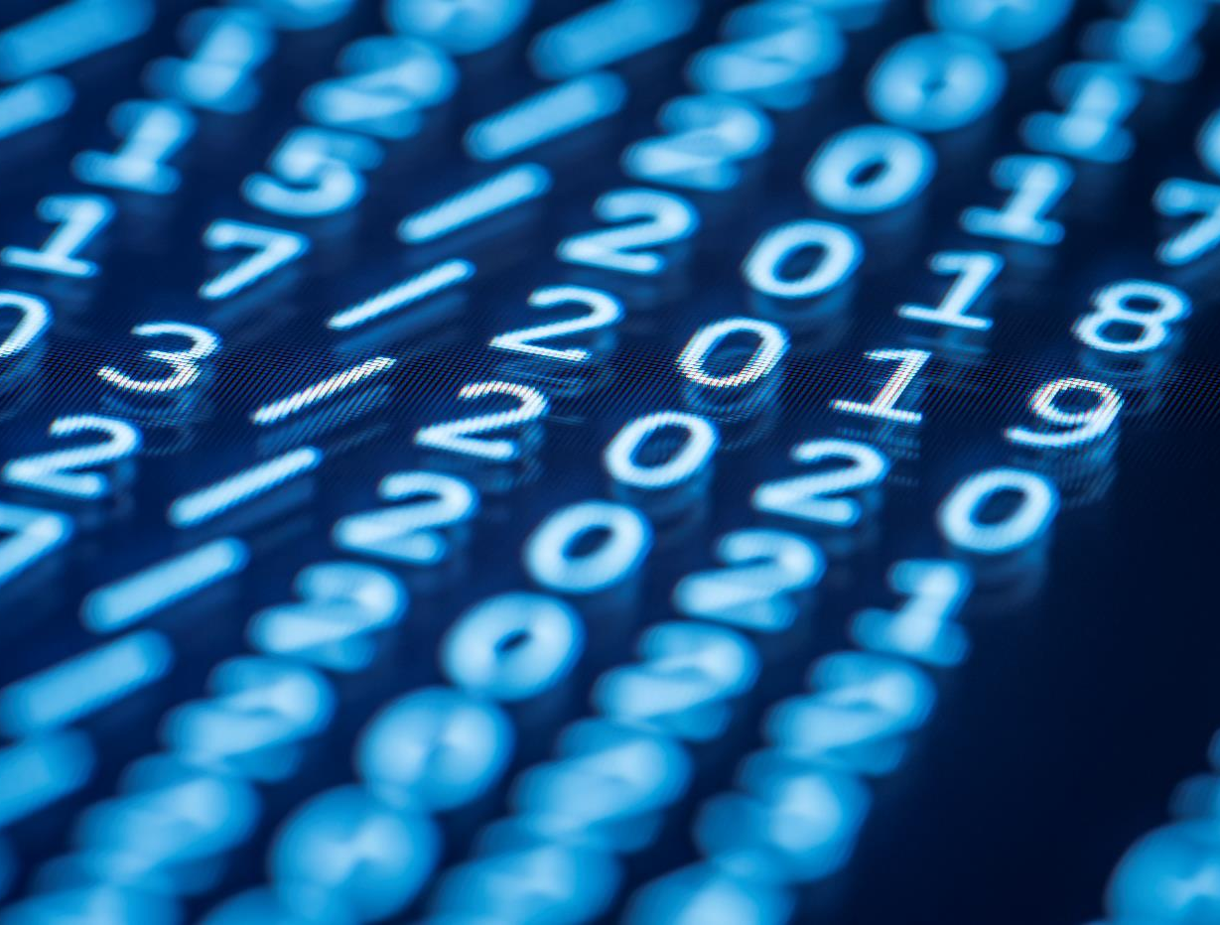
Thank You

