Slide 1
MongoDB Cluster
Sharding with Replica sets
Wu Kaibin
@Sunny Orange

Slide 2
Sharding Cluster
可水平扩展模式，将数据拆分在不同机器。
什么时候需要分片？
用光了当前机器的磁盘空间
单个的MongoDB已经无法提供你要的写入性能
把大部分数据驻留在内存中以提供更好的性能

Slide 3
Sharding
集群由以下3个服务组成：
Shards Server: 每个shard由一个或多个mongod进程组成，用于存储数据
Config Server: 用于存储集群的Metadata信息，包括每个Shard的信息和chunks信息(Chunks是指MongoDB中一段连续的数据块，默认大小是200M，一个Chunk位于其中一台Shard服务器上)
Route Server: 用于提供路由服务，由Client连接，使整个Cluster看起来像单个DB服务器

Slide 4
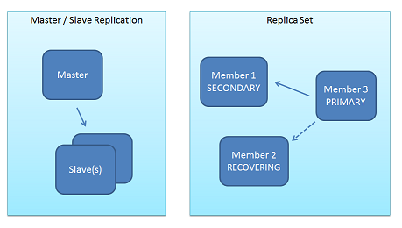
Replication
Two forms of replication are available:
Master-Slave Replication
Replica Sets (v1.6+): a functional superset of master/slave, and much newer, more robust code.

Slide 5
Replica Sets
保障整个系统的高可用.当primary down掉的时候,secondary可以迎难而上
Primary负责client的读写, Secondary热备,从Primary的oplog读取操作日志,以便与Primary保持一致.
Any(one) node can be primary
election of primary(consensus protocol )
if a majority of servers are not up (from this server's POV), remain in Secondary mode and stop.
Automatic failover
Automatic recovery

Slide 6
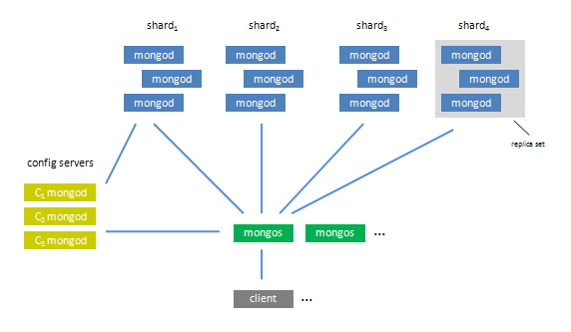
Classic Cluster Architecture
Replica sets work with sharding and are almost always used in sharded clusters

Slide 7
Cluster On 2 Machines
2 Shards (separated on 2 machines)
Each shard is a Replica Set which consists of 1 primary node and 2 secondary nodes.
1 Configsever : must be 1 or 3(for production level on 3 separated machines)
2 Mongos routers

Slide 8
procedure
启动复制集节点
配置复制集
配置config服务器
配置mongos路由器
添加分片
启用分片功能

Slide 9
IP and ports
Machine | IP | configuration
Server1 | 192.168.1.101 | mongod shard11:27017 mongod shard21:27018 mongod shard31:27019 mongod config :20000 mongs1 :30000
Server2 | 192.168.1.105 | mongod shard12:27017 mongod shard22:27018 mongod shard32:27019 mongs2 :30000

Slide 10
Adding shards
Connect to the admin database via mongos
./mongo 192.168.1.105:30000/admin
./mongo 192.168.1.101:30000/admin
Each shard can consist of more than one server (for replica sets)
db.runCommand({addshard:"set1/192.168.1.105:27017,192.168.1.105:27018,192.168.1.105:27019",name:"s1",maxsize:20480,allowLocal:true } );
db.runCommand({addshard:"set2/192.168.1.101:27017,192.168.1.101:27018,192.168.1.101:27019",name:"s2",maxsize:20480,allowLocal:true} );
Listing shards
db.runCommand( { listshards : 1 } );

Slide 11
Sharding a Collection
Enabling Sharding on a Database
db.runCommand( { enablesharding : "dbname" } );
Sharding a Collection
must specify the shard key!
If there is data in the collection, require an index
db.runCommand( { shardcollection : “database", key : {“_id":1}});

Slide 12
Shard Key
数据拆分依据，分片Key的选定直接决定了集群中数据分布是否均衡、集群性能是否合理
基数
写操作可扩展
可靠性
查询隔离
排序
索引优化

Slide 13
MongoDB 不足之处
在集群分片中的数据分布不均匀
单机可靠性比较差
大数据量持续插入，写入性能有较大波动
磁盘空间占用比较大

Slide 14
Reference
Official Sharding & Repl Doc
http://www.mongodb.org/display/DOCS/Sharding
http://www.mongodb.org/display/DOCS/Replica+Sets
淘宝 MongoDB sharding cluster
http://www.taobaodba.com/html/525_525.html
如何选择MongoDB Shard Key
http://blog.csdn.net/zhangzhaokun/article/details/6324389
Mongodb运行时添加分片复制集
http://blog.csdn.net/zhangzhaokun/article/details/6279613

