Slide 1
Pandas - II

Slide 2
Employee DataFrame
import pandas as pd
df = pd.DataFrame({
"employee": ["Amit", "Neha", "Raj", "Priya", "Amit", "Neha",
"Raj", "Priya", "Karan", "Karan"],
"department": ["IT", "IT", "HR", "HR", "IT", "IT",
"HR", "HR", "Sales", "Sales"],
"salary": [70000, 85000, 60000, 75000, 90000, 80000,
65000, 70000, 55000, 65000],
"region": ["North", "North", "South", "South", "North", "North",
"South", "South", "West", "West"],
"performance": [82, 91, 76, 88, 95, 86, 80, 90, 72, 85]
})
print(df)
employee | department | salary | region | performance
Amit | IT | 70000 | North | 82
Neha | IT | 85000 | North | 91
Raj | HR | 60000 | South | 76
Priya | HR | 75000 | South | 88
Amit | IT | 90000 | North | 95
Neha | IT | 80000 | North | 86
Raj | HR | 65000 | South | 80
Priya | HR | 70000 | South | 90
Karan | Sales | 55000 | West | 72
Karan | Sales | 65000 | West | 85
First, try df.groupby()

Slide 3
Groupby Commands
df.groupby(”department")["salary"].count()
df.groupby("region")["salary"].count()
df.groupby("region")["performance"].count()

Slide 4
Groupby -> apply()
Apply function func group-wise and combine the results together.

Slide 5
Groupby -> Transform
Call function producing a same-indexed DataFrame on each group.
Returns a DataFrame having the same indexes as the original object filled with the transformed values.
Transform() is very useful when you want to compare each employee's salary with their department's average salary.

Slide 6
Groupby -> Transform
df["dept_avg_salary"] = (df.groupby("department")["salary"].transform("mean")
employee | department | salary | dept_avg_salary
Amit | IT | 50,000 | 60,000
Ravi | IT | 70,000 | 60,000
Neha | HR | 40,000 | 50,000
Priya | HR | 60,000 | 50,000
Raj | Sales | 80,000 | 80,000
Because transform() gives the calculated value back to every original row belonging to that group.

Slide 7
Pandas nlargest() Method
DataFrame.nlargest(n, columns, keep='first')[source]
Return the first n rows with the largest values in columns, in descending order.
The columns that are not specified are returned as well, but not used for ordering.
Pandas keeps the first occurrence (keep='first’) when there is a tie.
This method is equivalent to df.sort_values(columns, ascending=False).head(n), but more performant.
nlargest() is specifically designed to find the largest values efficiently, so it can avoid a complete sort. Therefore: nlargest() is generally faster when you only need the top N values.

Slide 8
employee | department | salary | region | performance
Amit | IT | 70000 | North | 82
Neha | IT | 85000 | North | 91
Raj | HR | 60000 | South | 76
Priya | HR | 75000 | South | 88
Amit | IT | 90000 | North | 95
Neha | IT | 80000 | North | 86
Raj | HR | 65000 | South | 80
Priya | HR | 70000 | South | 90
Karan | Sales | 55000 | West | 72
Karan | Sales | 65000 | West | 85
Find the second-highest salary in each department.
df.groupby("department")["salary"].apply(lambda x: x.nlargest(2).min())
Lambda is a short way of writing a function. Here, x represents the data that Pandas gives to the function.

Slide 9
df.groupby("department")["salary"].apply(lambda x: x.nlargest(2).min())
IT group
↓
x = [50000, 90000, 70000]
↓
x.nlargest(2)
↓
[90000, 70000]
↓
.min()
↓
70000

Slide 10
Apply() vs Vectorization
Suppose every employee receives a 10% bonus.
Using apply()
df["bonus"] = df["salary"].apply(lambda x: x * 0.10)
Vectorized Approach
df["bonus"] = df["salary"] * 0.10
This is preferred.
Pandas/NumPy can perform the operation efficiently over the entire column instead of repeatedly invoking a Python-level function.
But it processes values by applying a Python function to each element.
apply() is useful when the operation cannot easily be expressed through vectorized Pandas operations.
a lambda function is a short, one-liner anonymous function used alongside methods like .apply() or .map() to manipulate data without defining a traditional function using def

Slide 11
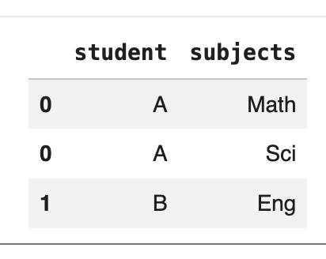
Explode()
Explode() method transforms each element of a list-like structure into its own row while replicating the index and non-exploded column values across those new rows.
It is primarily used to unnest, flatten, or normalize datasets where a single cell contains multiple values packaged in a list, tuple, set, or array.
df = pd.DataFrame({"student": ["A", "B"], "subjects": [["Math", "Sci"], ["Eng"]]})
df.explode("subjects")

Slide 12
Merge()
combines two DataFrames or named Series using SQL-style database joins based on common columns or indexes.
By default, it performs an inner join, keeping only the rows with matching keys in both datasets
Try other join types
If you merge two DataFrames on a column and don't specify how=, what happens to rows that exist in only one DataFrame?”
They're dropped. Default is how="inner" — a very common silent-data-loss bug in real pipelines.

Slide 13
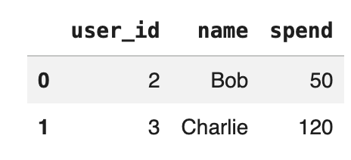
Merge() (contd..)
import pandas as pd
df1 = pd.DataFrame({'user_id': [1, 2, 3], 'name': ['Alice', 'Bob', 'Charlie']})
df2 = pd.DataFrame({'user_id': [2, 3, 4], 'spend': [50, 120, 10]})
pd.merge(df1, df2, on='user_id', how='inner')

Slide 14
Finding consecutive streak patterns with shift() and cumsum() in time-series analysis, attendance streaks, login sessions, stock movements, etc.
df = pd.DataFrame({
"day": [1, 2, 3, 4, 5, 6, 7],
"status": [
"Up", "Up", "Up",
"Down", "Down",
"Up", "Up"
]
})
df["previous"] = df["status"].shift()
shift() moves the values one row down.
day | status | previous
1 | Up | NaN
2 | Up | Up
3 | Up | Up
4 | Down | Up
5 | Down | Down
6 | Up | Down
7 | Up | Up

Slide 15
Finding consecutive streak patterns with shift() and cumsum() in time-series analysis, attendance streaks, login sessions, stock movements, etc.
df["status"] != df["status"].shift()
True
False
False
True
False
True
False
These Trues identify where a new streak starts.
df["streak_id"] = (
df["status"] != df["status"].shift()).cumsum()
True = 1
False = 0

Slide 16
Finding consecutive streak patterns with shift() and cumsum()
day | status | previous | streak_id
1 | Up | NaN | 1
2 | Up | Up | 1
3 | Up | Up | 1
4 | Down | Up | 2
5 | Down | Down | 2
6 | Up | Down | 3
7 | Up | Up | 3
Now Pandas treats:
True = 1
False = 0
and calculates cumulative sum:
True → 1
False → 1
False → 1
True → 2
False → 2
True → 3
False → 3
Day: 1 2 3 4 5 6 7
Status: Up Up Up Down Down Up Up
└─────┘ └─────┘ └─────┘
Streak: 1 2 3
Whenever the status changes, streak_id increases by 1. If the status stays the same, the streak_id remains the same.
So:
Days 1–3: Up → Streak 1
Days 4–5: Down → Streak 2
Days 6–7: Up → Streak 3

Slide 17
Finding consecutive streak patterns with shift() and cumsum()
This technique is commonly called streak/group identification and is useful for questions like:
Find consecutive days a student was present.
Find consecutive wins/losses.
Identify runs of the same machine status.
Find periods of continuous "Active" / "Inactive" status.

Slide 18
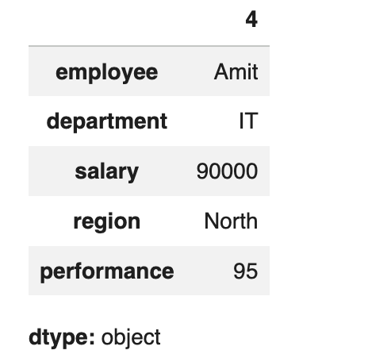
Idxmax() vs max()
max() → gives the VALUE idxmax() → gives the INDEX loc[] → gives the ROW
employee department salary region performance
0 Amit IT 70000 North 82
1 Neha IT 85000 North 91
2 Raj HR 60000 South 76
3 Priya HR 75000 South 88
4 Amit IT 90000 North 95
5 Neha IT 80000 North 86
6 Raj HR 65000 South 80
7 Priya HR 70000 South 90
8 Karan Sales 55000 West 72
9 Karan Sales 65000 West 85
df[‘performance’].max(). -> 95
Which employee has the highest performance?
df.loc[df["performance"].idxmax()]

