Slide 1
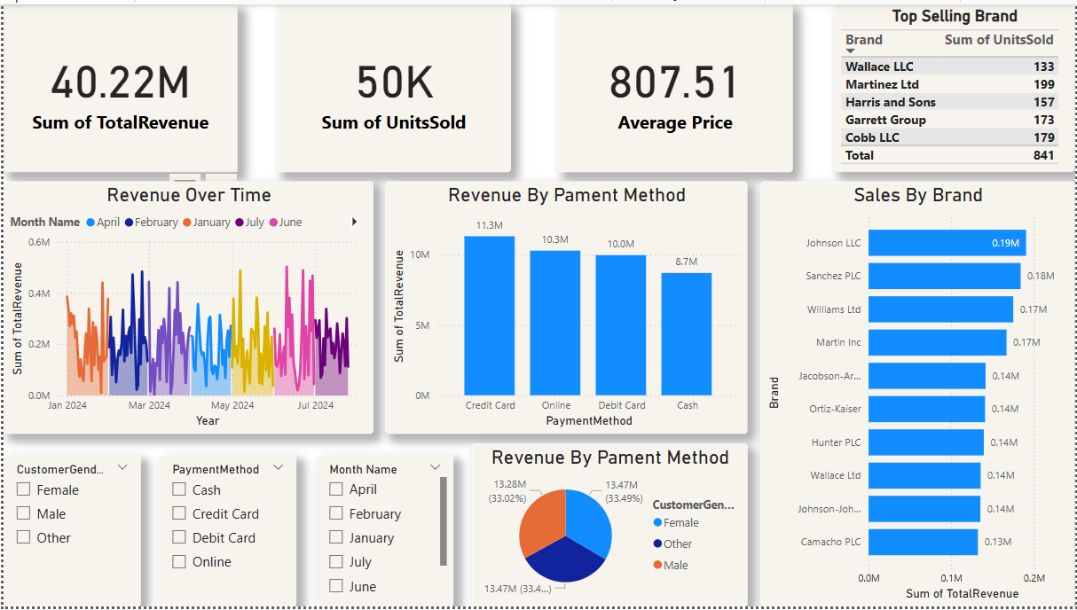

Slide 2
# Mobile Sales Dashboard
---Project
----Tools Used: Power BI
# Objective:
Design an interactive dashboard for stakeholders using Power BI.
# Key Focus:
- Track sales performance
- Monitor key metrics (KPIs)
- Enable smart filtering for quick insights

Slide 3
# Dataset: mobile_sales.csv
# Key Columns:
- Brand
- Product
- UnitsSold
- Price
- TotalRevenue
- PaymentMethod
- CustomerGender
- Location
- Date
# Key Performance Indicators:
- Total Revenue
- Total Units Sold
- Average Price
- Top Selling Brand
- Sales by Gender

Slide 4
# Interactive Slicers:
- Date Range
- Brand
- Gender
- Payment Method
#Charts in Dashboard:
- Bar Chart: Units Sold by Brand
- Line Chart: Sales Over Time
- Pie Chart: Sales by Payment Method
- Stacked Column Chart: Revenue by Brand & Gender
- Card Visuals: Total Revenue, Units Sold, Average Price
- Table: Top Selling Brand

Slide 5
# Business Value:
- Dashboard helps identify trends and top performers
- Enables smarter decisions based on real data
# Outcome:
Clean, interactive, and insight-driven dashboard made for business use.

