Slide 1
Monthly Sales Trend Report
An SQL-Based Analysis of Online Sales Data
Prepared by: KAIF KHAN

Slide 2
Project Objective
- Analyze monthly revenue and order volume
- Understand customer behavior from sales data
- Identify top spending patterns and trends

Slide 3
Dataset Summary
- Source: Online Shop Sales Data
- Key columns: Customer_id, Age, Purchase_DATE, Purchase_VALUE, Pay_Method

Slide 4
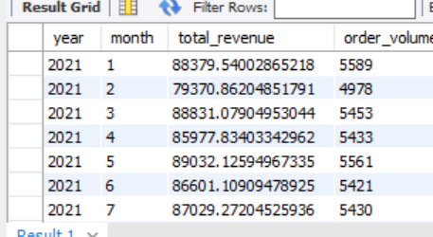
Monthly Revenue and Order Volume
SQL Query Used:
SELECT EXTRACT(YEAR...), EXTRACT(MONTH...), SUM(Purchase_VALUE), COUNT(*)
FROM online_sales GROUP BY year, month ORDER BY year, month;

Slide 5
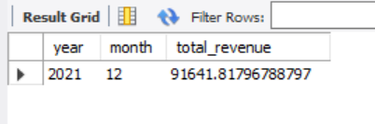
Highest Revenue Month
SQL:
...ORDER BY total_revenue DESC LIMIT 1;

Slide 6
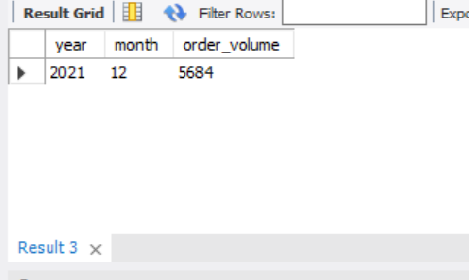
Busiest Month (Most Orders)
SQL:
...ORDER BY order_volume DESC LIMIT 1;

Slide 7
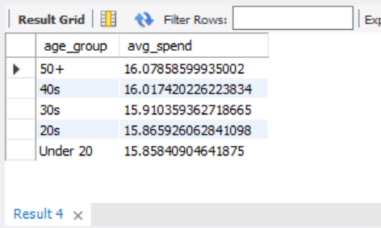
Average Spend by Age Group
SQL: CASE WHEN Age < 20 THEN 'Under 20' ...

Slide 8
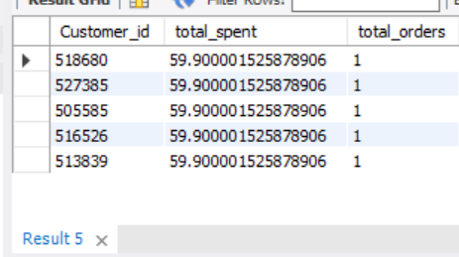
Top Customers by Total Spend
SQL: SELECT Customer_id, SUM(Purchase_VALUE) ...

Slide 9
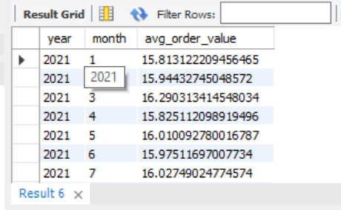
Monthly Average Order Value
SQL: SELECT EXTRACT(YEAR FROM ...) ...

Slide 10
Key Insights
- Peak revenue occurred in: October 2021
- Highest number of orders in: December 2021
- Most valuable age group: 30s
- High-spending customers: target for loyalty programs and exclusive offers

