Slide 1

SMART INDIA HACKATHON 2026
Problem Statement ID – SIH26262
Problem Statement- Integrated AICTE Approval Workflow Automation, Compliance Monitoring and Alert Management System
Theme- Smart Automation
PS Category- Software
Team ID- 199765
Team Name - Verifix 5

Slide 2








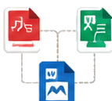

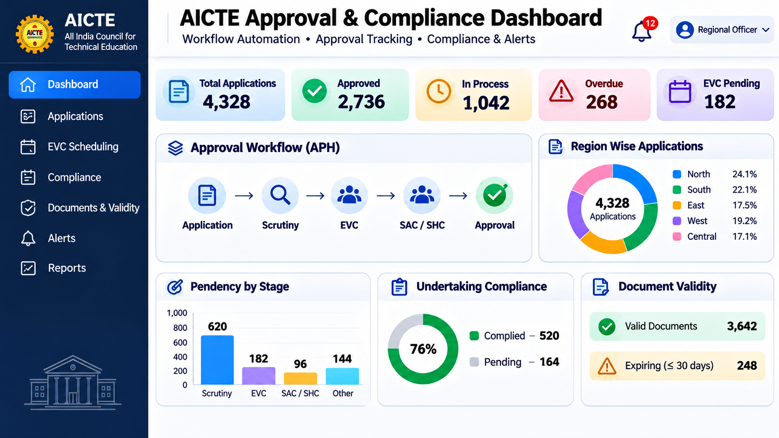


AICTE APPROVAL WORKFLOW & INSTITUTIONAL COMPLIANCE MONITORING
Verifix 5
Problem
OUR PROPOSED SOLUTION
INNOVATION & UNIQUENESS
High application volume
Our solution is a centralized platform that automates APH-based application routing, tracks institutional compliance and document validity, and alerts institutions and officials when action is due.
APH-Aligned Workflow Rules
Applications pass through multiple stages, Regions and responsible officials.
Configurable routing and timelines follow the applicable Approval Process Handbook.
1
2
3
4
Complete Digital Case History
Missed deadlines
Undertakings, EVC timelines and document renewals can be overlooked.
Every movement, observation, submission and decision is time-stamped and traceable.
Application
Received
Workflow
Routing
Track &
Verify
Alerts &
Reports
Collect applications and required documents
Route applications through APH-prescribed stages
Record observations and verify compliance documents
Notify users, escalate overdue cases, and show live status
Scattered information
Deadline & Document Tracking
Application status, inspection schedules and compliance records need repeated follow-up.
Live Dashboard Preview
Tracks EVC dates, undertakings, lease expiry and other prescribed document deadlines.
Manual coordination
Human Authority Retained
Automates reminders and routine routing; statutory verification and decisions remain with competent officials.
Officers spend time tracking cases, sending reminders and preparing reports.

Slide 3




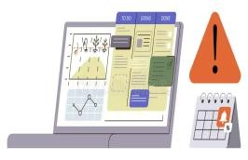











TECHNICAL APPROACH
Verifix 5
CAPTURE
INTEGRATE PROCESS MONITOR
Centralised Application & Apply APH workflow and Real-time Dashboard and Institution Data deadline rules Alerts
TECHNOLOGIES USED
Institutional & AICTE
APPLICATION & COMPLIANCE INPUTS
APPLICATION & COMPLIANCE INPUTS
APPLICATION & COMPLIANCE INPUTS
APPLICATION & COMPLIANCE INPUTS
Applications
Institutions
Regional Offices
AICTE Bureaus
Authorised systems
Institution ID and profile
Application details
Stage and assigned officer
Undertakings and documents
Determine next stage
Calculate ageing and due dates
Track EVC and compliance
Generate alerts
Stage-wise pendency
EVC and compliance status
Expiry and overdue alerts
Region-wise reports
APPLICATION MOVEMENT – EXAMPLE
KEY DESIGN PRINCIPLES
ABC Technical Institute
Secure Access Role-based access
for institutions and authorised officials
Human Oversight Officials verify evidence and take statutory decisions
EVC
SCRUTINY
Prototype
dashboard
https://si h261.netl ify.app/
Stage 2
EVC required after
preliminary scrutiny
Stage 1 Application documents rCeovimewpleetded
Dashboard Analytics
Centralised Records.One record per application and institution
Configurable
Rules Adapt stages and timelines to the applicable APH
Scheduling pending
Next Prescribed Stage
Application advances after stage approval.
.

Slide 4

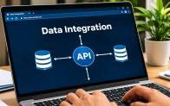
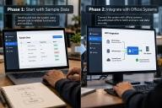












FEASIBILITY AND VIABILITY
Verifix 5
FEASIBILITY
Why is this idea feasible?
Proven Web Technologies
Web, database and notification technologies required are widely available.
POTENTIAL CHALLENGES AND RISKS
What needs careful handling?
Data Integration
Use approved interfaces and phased onboarding of existing systems.
STRATEGIES FOR OVERCOMING THESE CHALLENGES
How will we address them?
Phased Implementation
Start with sample data, then connect official systems through authorised APIs.
Modular Development
Build workflow, dashboard, EVC and compliance features as separate modules.
Legacy Data Integration Existing systems may store institution and application details in different formats.
Data Quality
Incomplete records or incorrect dates can affect routing and deadline calculations.
Privacy & Security
Application documents and institutional records require strict confidentiality.
Verified Institution Records
Use verified institution IDs and standardised records for reliable tracking.
Centralised Records
Integrate existing AICTE application and institution records through approved interfaces.
Scalable Architecture
Authorised APIs and role-based access can support phased integration with existing AICTE systems.
Data Validation
Validate mandatory fields and flag incomplete or inconsistent submissions.
Strong Security
Enforce role-based access, secure authentication and complete audit logs.
Cost Effective
Open-source technologies can reduce implementation and maintenance costs.
Change Management
Regions and committees may follow different authorised workflows and timelines.
Configurable APH Rules
Configure APH-based statuses, reminders
and officer-reviewed workflow updates.

Slide 5

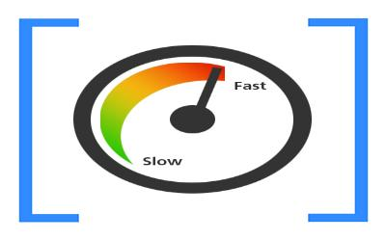

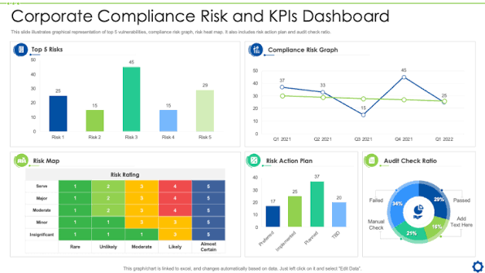




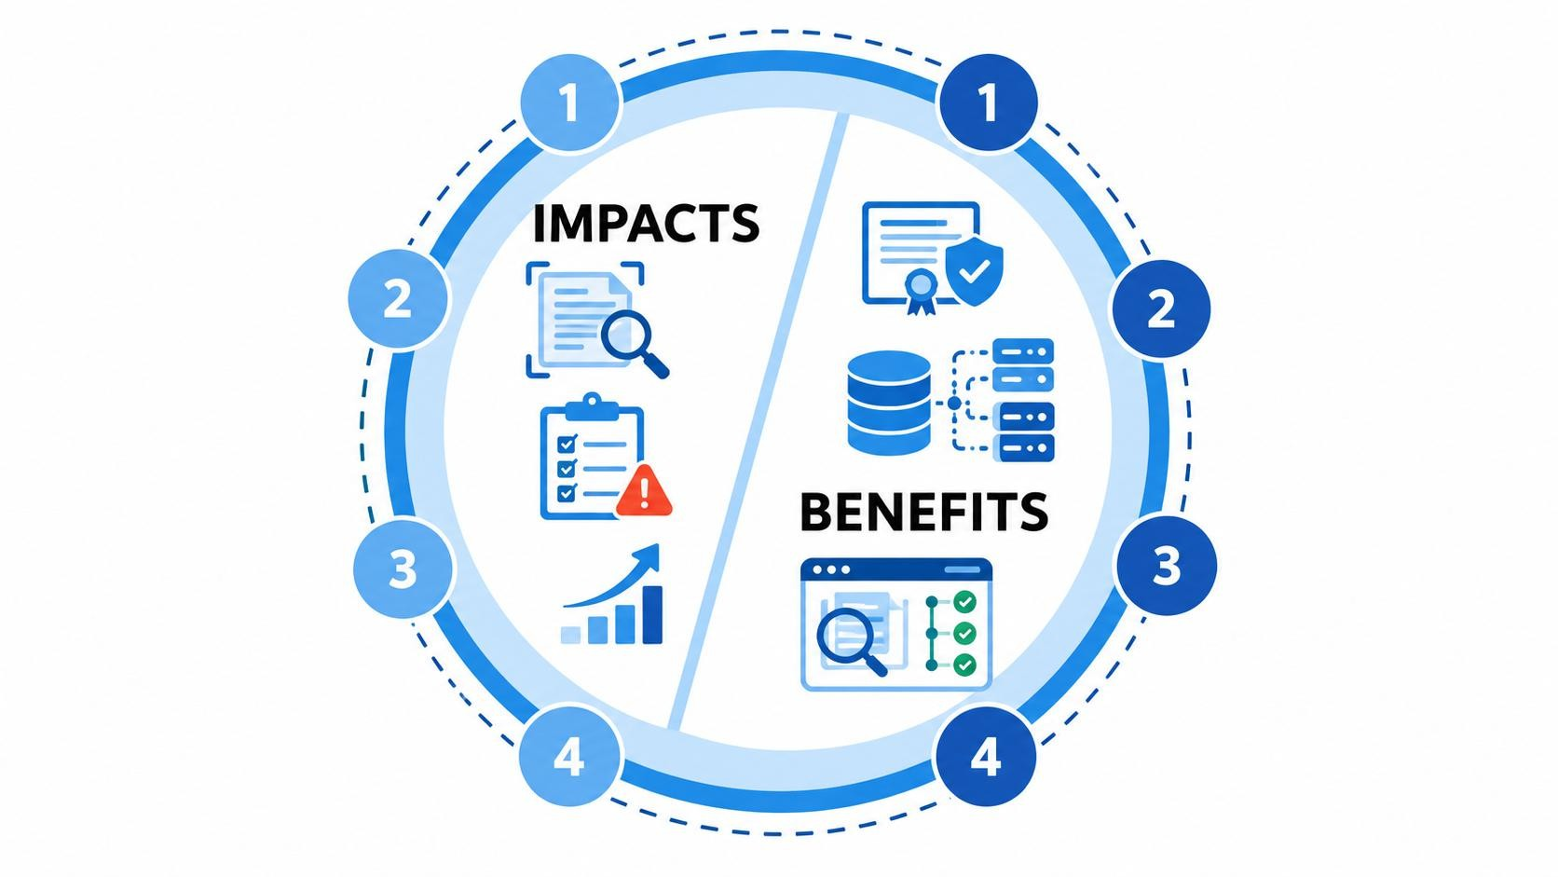



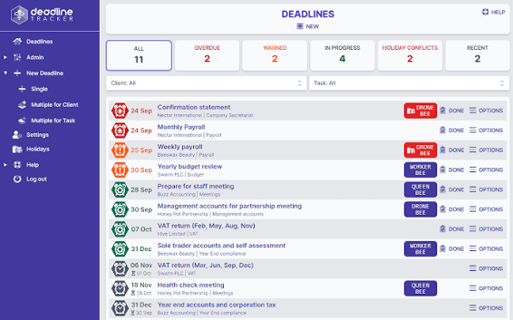















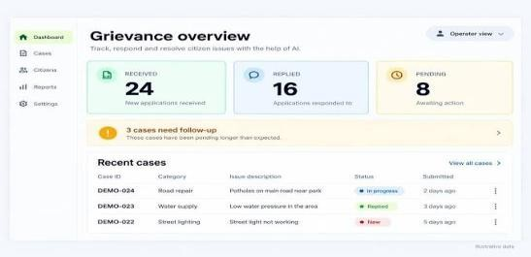





IMPACT AND BENEFITS
Verifix 5
Faster Processing Applications move through prescribed stages with less manual coordination.
One Integrated Platform Application status, EVC, compliance and documents are visible together.
Centralised monitoring Centralized monitoring of institutional compliance, submissions, and document validity.
Fewer Missed Deadlines Overdue undertakings and renewals are escalated to responsible officials.
Complete Audit Trail Every action, submission, verification and escalation is time-stamped.
Timely Alerts Institutions and officials receive reminders before deadlines and expiry dates.
Better Administrative Visibility Dashboards reveal bottlenecks, ageing cases and workload.
Reduced Manual Follow-up Automated routing, reminders and reports save officer time.

Slide 6

RESEARCH AND REFERENCES
Verifix 5
[1] All India Council for Technical Education (AICTE), Approval Process Handbook 2024–25 to 2026–27, New
Delhi, India. [Online]. Available: https://aicte-qa.aicte-india.org/sites/default/files/APH%20Final.pdf
[2] M. Oleś-Filiks and R. Waszkowski, "Optimizing Public Service Delivery Through Automated Stakeholder
Interaction: Low-code BPM Implementation" Decision Making in Manufacturing and Services, Special Issue,
pp. 83–93, 2025. doi: https://doi.org/10.7494/dmms.2024.si.6637
[3] J. Johansson, M. Thomsen, and M. Åkesson, "Public Value Creation and Robotic Process Automation:
Normative, Descriptive and Prescriptive Issues in Municipal Administration," Transforming Government:
People, Process and Policy, vol. 17, no. 2, pp. 177–191, 2023. doi:https://doi.org/10.1108/TG-11-2021-0193
[4] C. V. Marian, M. Neferu, and D. A. Mitrea, "Design and Evaluation of a Low-Code/No-Code Document
Management and Approval System," Information, vol. 17, no. 1, Art. no. 46, 2026. doi:
https://doi.org/10.3390/info17010046
https://github.com/Kaif01234/SIH-262-.git

