Slide 1


Introduction to CSE

Slide 2
Objectives
At the end of this lecture, student will be able to
Explain the types of computers and their ubiquitous presence
Explain the nature and types of computation
State the nature of requirements by computer applications

Slide 3
Contents
Computers
Computer Applications
Computation

Slide 4
Computer
An electronic device capable of performing computations and making logical decisions at high speed
Accepts data and instructions, stores in its memory, processes and gives the results to the user
The term computer is derived from the Latin word compute which means to calculate or to manipulate

Slide 5
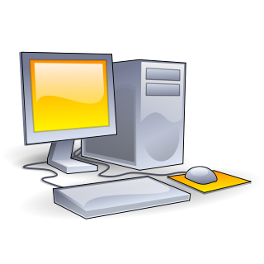
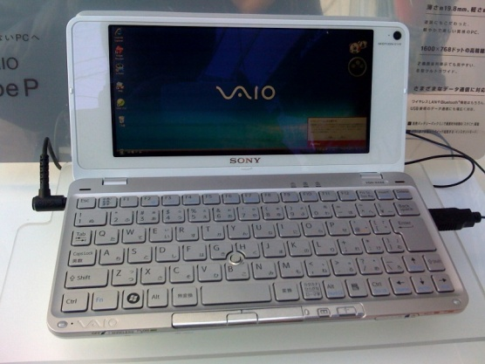
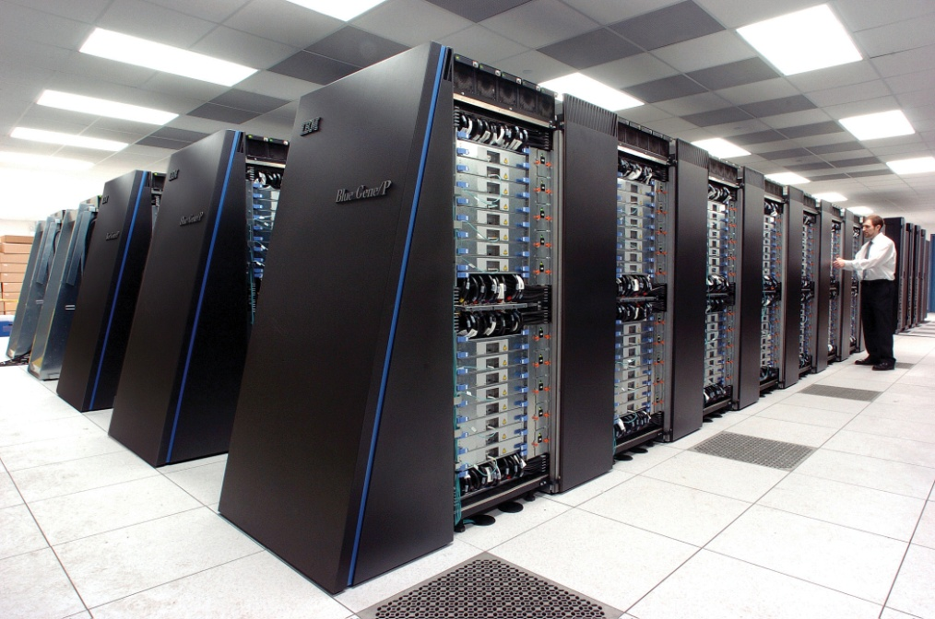
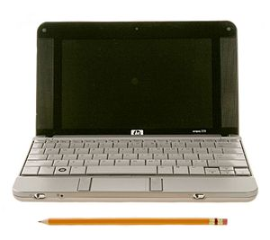
Computers are Everywhere and in Various Types

Slide 6
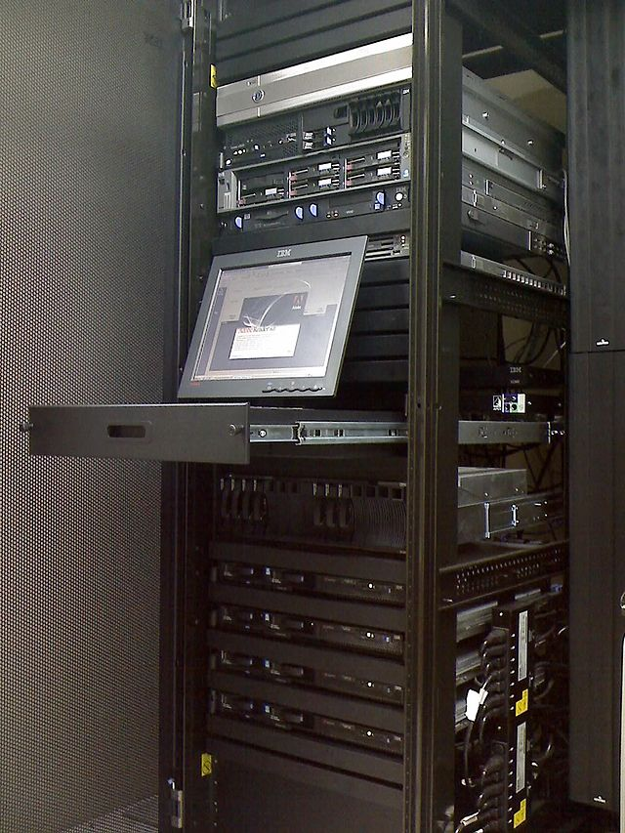
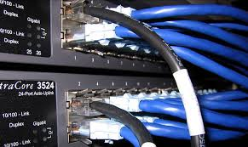
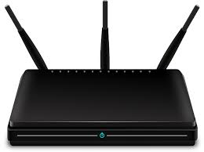
Computers are Everywhere and in Various Types
Not just traditional computing machines:
Email servers, File servers, Database servers, ...
Network switches, routers, ...

Slide 7
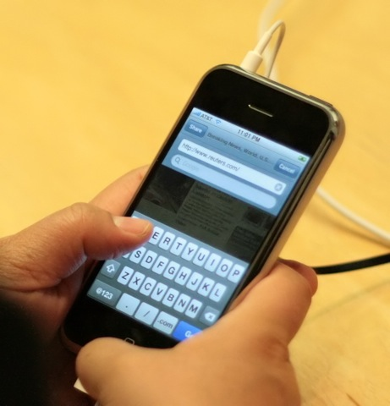
Is this a Computer?

Slide 8
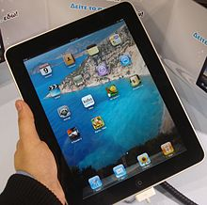
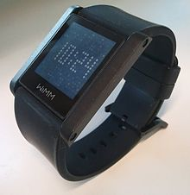
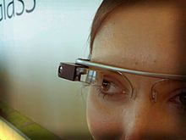
Newer and More Ubiquitous Types
Mobiles, Tablets
Wearable devices

Slide 9
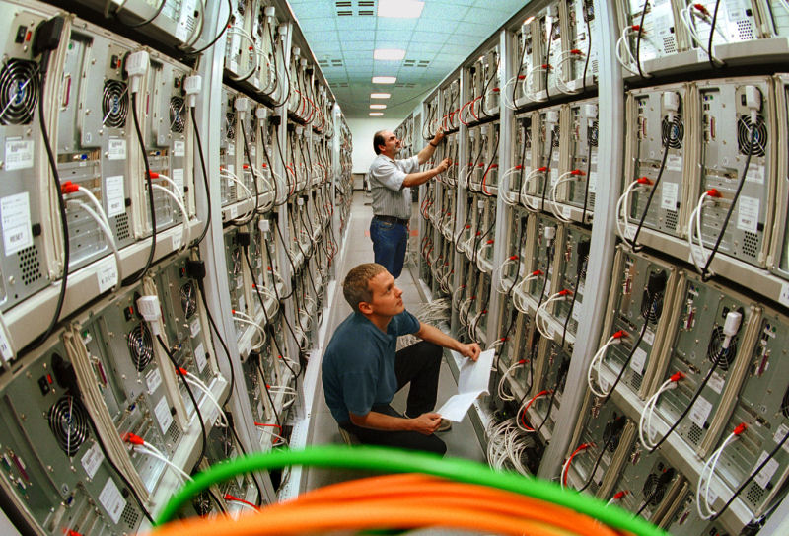
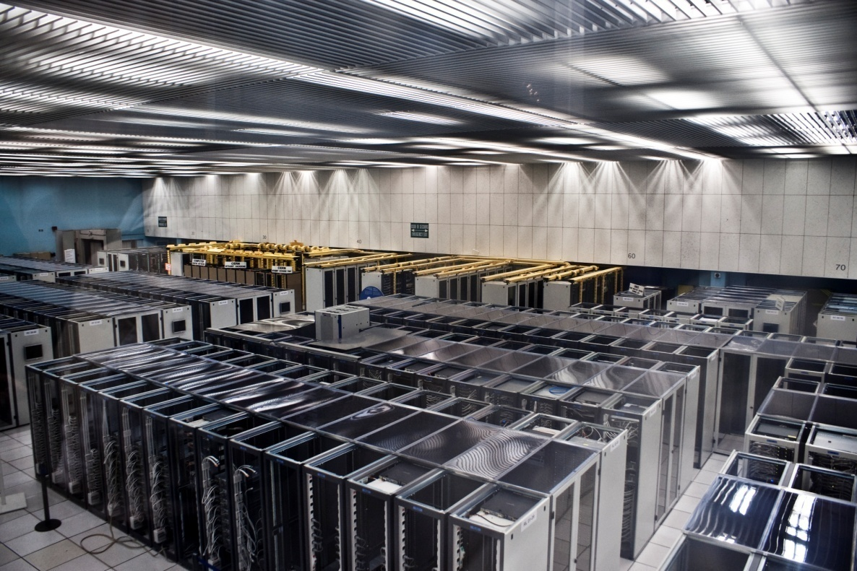
Computers Need Not be Single Units
Distributed computers
Data farms
Computing grids and clouds

Slide 10
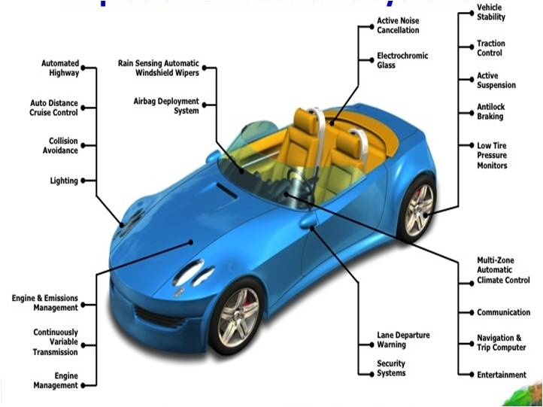
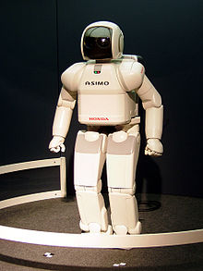
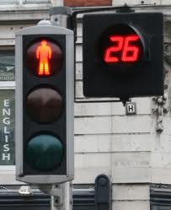
Can You See Computer(s) in These?
Embedded computers
ECUs in cars and other automobiles
Robots
Control units in industrial settings, traffic lights, etc.

Slide 11
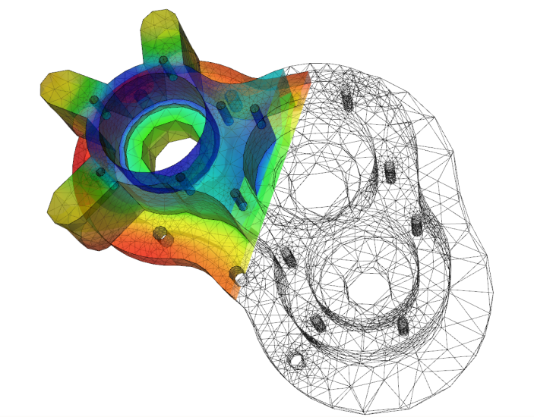
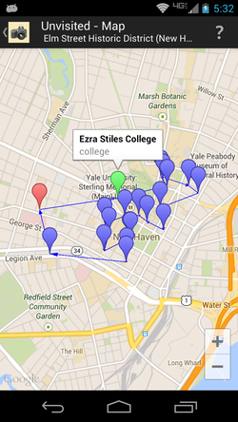
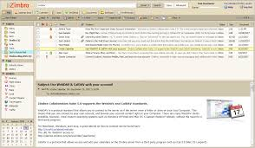
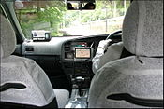
Computer Applications
Indirect use
Phone booking, Voice search on a mobile, Navigation , Driving a car, ...

Slide 12
Nature of Computation
Q. With such variety of uses, what should computers be designed to do?
Computation is what computers do (rather, are put to do)
Computation is what happens when an computer application is run
Computer applications reside in the computer
Q. What types of computations do computer applications require?
At first sight, there have to be as many types of computations as there are types of applications
A word processor requires a different type of computation than an autopilot?

Slide 13
Types of Computation
Different types of computations are needed by applications
Numerical computation
Forms a major component of all Science and Engineering applications
Data processing
Largely string processing
Storage, search, access and update
Input and Output
User interface
Textual or graphical
Web based
Communication

Slide 14
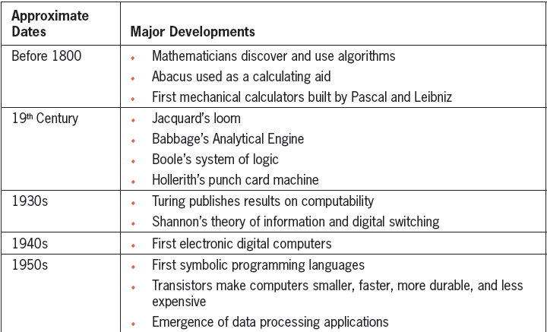
History of Computing
Figure summarizes some of the major developments in the history of computing

Slide 15
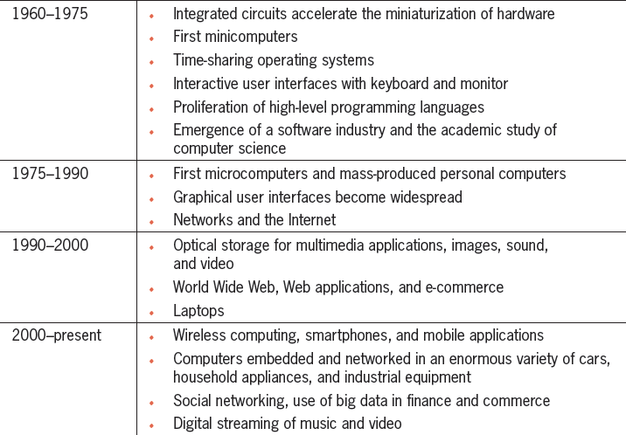
History of Computing contd.

Slide 16
Computer
System
A combination of components which cooperate and coordinate for a specific operation
Hardware
Physical devices that you can see and touch in a computer system
Keyboard, screen, memory, DVD, etc.,
Software
Programs and instructions makes the hardware to work

Slide 17
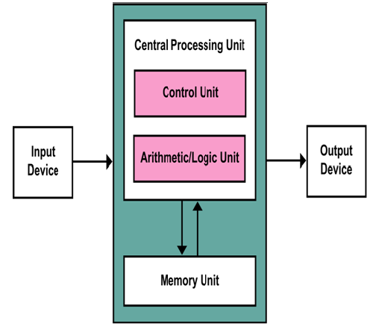
Basic Functional Units of a Computer

Slide 18
Basic Functional Units of a Computer contd.
Input unit
Obtains information (data and computer programs) from input devices
keyboard, mouse, etc.,
Output unit
Takes information that has been processed by the computer and place it in different output devices
Printer, screens, etc.,

Slide 19
Basic Functional Units of a Computer contd.
CPU – computer’s coordinator and is responsible for supervising the operations of other sections
Control unit – coordinates the activities of various components
Arithmetic unit –operations such as addition and subtraction
Logic unit – operations result in either TRUE or FALSE
Multiprocessor
Multiple processing units and hence, can perform many operations simultaneously

Slide 20
Basic Functional Units of a Computer contd.
Memory unit - A storage device
Memory is classified into
Main memory – primary memory, temporary memory
Rapid access, relatively low capacity, costly
RAM,ROM
Secondary memory – permanent memory
Long-term, high capacity, cheaper
disks, pen drive, etc.,
Cache memory
placed between CPU and main memory

Slide 21
Summary
Computers are employed in all aspects of human activities in the Information Age
There are a wide variety of the types of computers, from mobile handsets through workstations and servers to distributed computers
A computation is what happens when a computer is put to use by running a computer application
Computer applications are mainly software that reside in a computer to be run
A wide variety of computations are performed by applications: numerical computation, data processing, input/output, user interface and communication
Computers are designed to perform a basic set of computation: fetch, operate & store information from memory and perform input/output operations

