Slide 1


Fundamentals of Algorithms

Slide 2
Objectives
At the end of this lecture, student will be able to
Explain the process of arriving at a computer solution
Describe the basic features of a computer algorithm
Explain the role of memory in a computer program and hence the use of variable in algorithms

Slide 3
Contents
Algorithms
Role of Memory and its impact on computer algorithms

Slide 4
A Problem
Multiply
129837382
with
914147324
Given:
129837382
X 914147324
????????????
129837382
X 914147324
519349528
259674764
389512146
908861674
519349528
129837382
519349528
129837382
1168536438
118690495310465768

Slide 5
What Did You Do?
Write the numbers down
Multiply all digits of first number with single digit of second number
Write the result with offset if required
Repeat previous 2 steps for each digit of second number
Sum up all the products

Slide 6
Program Development
Problem
Step-by-step Solution
(Algorithm)
Program
(High Level Language)
Executable
(Machine Code)

Slide 7
Example: Problem
Q. Design and Develop a program to find factorial of a number
n! = 1 x 2 x 3 x … x (n-1) x n

Slide 8
Example: Algorithm
Algorithm factorial (var n:Integer)
var fact, iLoop: Integer; Begin
{assert: n>=0}
fact := 1;
for iLoop in range(1,n+1) do
begin
fact:= fact * iLoop;
end
end
Algorithm: factorial(n)
step1: START
step2: assign fact=1
Step3: get value of n
step4: for iLoop in range(1,n+1):
step5: fact = fact * iLoop
step6: STOP
OR

Slide 9
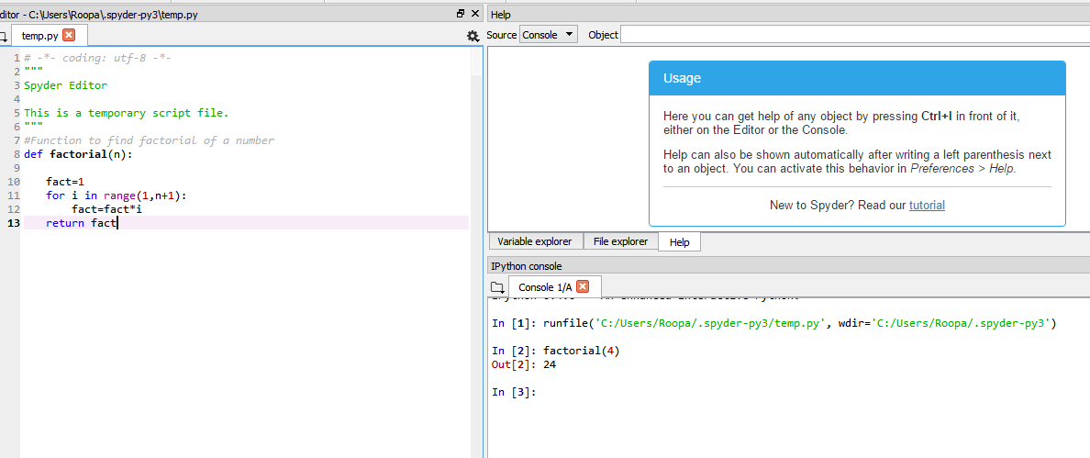
Example: Python Program

Slide 10
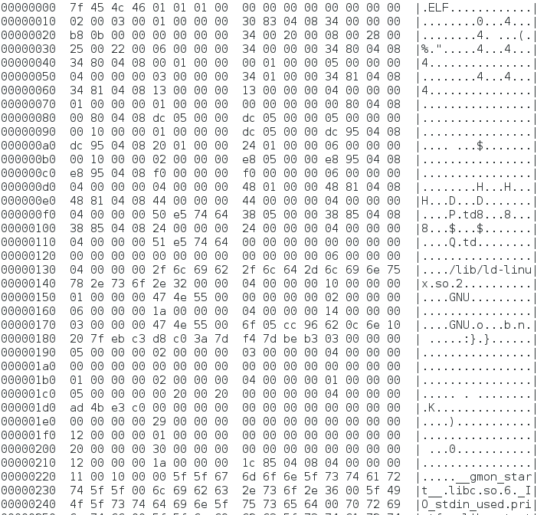
Example: Executable Code

Slide 11
Algorithms and Programs
An Algorithm
Sequence of steps or procedure to solve a problem
A procedure for solving a problem consists of
actions to be executed, and
order in which these actions are to be executed
A Computer Program
It is the algorithm to solve a problem, expressed in a programming language

Slide 12
Characteristics of an Algorithm
Input
May accept zero or more inputs
Output
Should produce at least one output
Definiteness
Each step of an algorithm must be precisely defined
Finiteness
An algorithm must always terminate after a finite number of steps
Effectiveness
Steps must be simple and can be done exactly and in a finite length of time, by person using pencil and paper

Slide 13
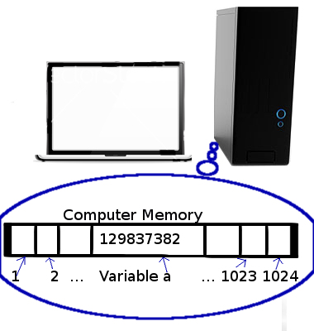
Memory, Storage and Variable
Computers store values in its memory
A value is associated with
Name (Variable)
Address
Hence in Computer algorithms
Variables are used
Variables are associated with type

Slide 14
Variable
Consider the assignment statement
num = 5;
{the variable num refers to integer object instance containing the value 5 }
int
5
num

Slide 15
Example: Swap 2 Variables
Swap values in two integer variables
Problem definition:
x has an integer value ‘k’
y has an integer value ‘l’
At end of execution
x must have integer value ‘l’
y must have integer value ‘k’
APPROACH
No initial checks are required
To Swap values of variables, we need a third variable
Take an example: a := 10 and b :=20

Slide 16
Example: Swap 2 Variables
10
20
a
b
10
10
b := a;
a
b
20
20
a := b;
a
b

Slide 17
Example: Swap 2 Variables contd.
10
20
10
10
temp := a;
a
b
a
temp
20
20
a := b;
temp
b
a
10
10
b := temp;
temp
b

Slide 18
Example: Swap 2 Variables contd.
Final Algorithm: Swapping two variables
Algorithm swap
var a,b,temp :integer; {The temporary variable}
begin
temp := a ;
a := b ;
b := temp ;
end

Slide 19
Practice Problems
Write an algorithm to
Calculate the sum of two numbers
Calculate the area of a circle
Find the largest of three numbers
Compute the sum of first N natural numbers

Slide 20
Summary
An algorithm is a set of explicit and unambiguous finite steps which when carried out for a given set of initial conditions, produce the corresponding output and terminate in a finite time
Computers programs work with memory and hence computer algorithms are written to work with variables
Computer solutions are called programs
A Program is a set of explicit and unambiguous instructions expressed in a programming language

