Slide 1


Number System

Slide 2
Objectives
At the end of this lecture, students will be able to
Explain decimal, binary, octal and hexadecimal number systems
Apply method for conversion between binary, hexadecimal and decimal number systems
Represent a binary number in 2’s Complement notation

Slide 3
Contents
Number Systems
Conversion of number systems
Complement Notation

Slide 4

Question
Computers understand numbers only… How can it work with other data such as strings, real values, etc?

Slide 5
Decimal Number Systems
Decimal Number System – What we generally use
1028
Units place: 8
Tenths place:2
Hundreds place:0
Thousands place:1
Actual meaning
8x10⁰+2x10¹+0x10²+1x10³
10 is the ‘Base’ as there are 10 possible symbols {0-9}
Hence we call the number system as ‘Decimal’

Slide 6
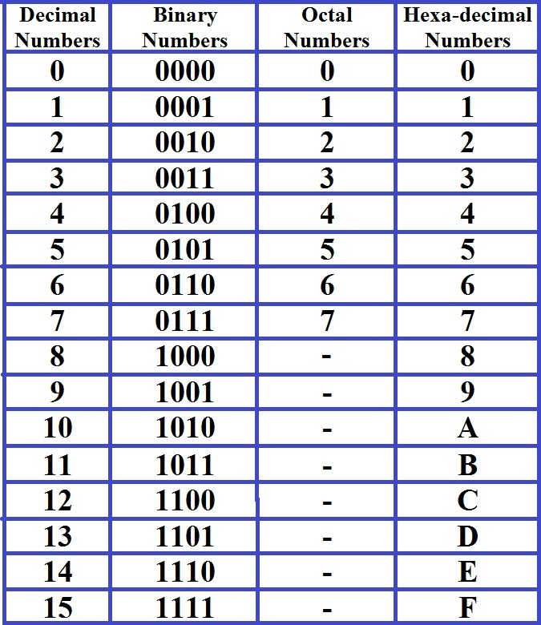
Numeral Systems Conversion Table

Slide 7
Binary Number System
Base 2
Number of symbols = 2 i.e. {0, 1}
Hence 1101 in Binary number system would mean
1x2⁰+0x2¹+1x2²+1x2³
1x1+0x2+1x4+1+8
1+0+4+8
13

Slide 8
Octal Number System
Base 8
Number of symbols = 8 i.e. {0-7}
Hence 23 in Octal number system would mean
3x8⁰+2x8¹
3x1+2x8
3+16
19

Slide 9
Hexadecimal Number System
Base 16
Number of symbols = 16 i.e. {0-9,a-f,A-F}
Hence 1f in Hexadecimal number system would mean
fx16⁰+1x16¹
15x1+1x16
15+16
31

Slide 10
Number Systems and Conversion
Conversion from any base system to Decimal number system
Multiply with respective base powers for that location
(1101)₂ = 1x2⁰+0x2¹+1x2²+1x2³ = (13) ₁₀
(1f)₁₆ = fx16¹+1x16¹ =(241) ₁₀
Conversion from Decimal number system to another base number system
Divide with the base of the number system recursively and find remainder
Reverse the order of remainder

Slide 11
Decimal to Binary
Decimal number system to Binary number system
(13) ₁₀
13/2 = 6 , remainder 1
6 /2 = 3, remainder 0
3 /2 = 1, remainder 1
1 /2 = 0, remainder 1
Hence (13) ₁₀ is (1101)₂

Slide 12
Decimal to Hexadecimal
Decimal number system to Hexadecimal number system
(241) ₁₀
241/16 = 15 , remainder 1
15/16 = 0 , remainder 15 (‘f’)
Hence (241) ₁₀ is (f1)₁₆

Slide 13
MSB and LSB
Most Significant Bit (MSB)
Least Significant Bit (LSB)
Consider a binary number, say 10101100
1 is called the MSB
Changes in MSB varies the value by a huge margin
0 is called the LSB
Changes in LSB varies the value by a the smallest margin possible

Slide 14
Binary Addition and Subtraction
0110
+0101
1011
0110
- 0101
0001

Slide 15
Rules for Binary Addition
0 + 0 = 0
0 + 1 = 1
1 + 0 = 1
1 + 1 = 0, and carry 1 to the next more significant bit
Example
0 0 0 1 1 0 1 0 = 26_{(base 10)}+
0 0 0 0 1 1 0 0 = 12_{(base 10)}
0 0 1 0 0 1 1 0 = 38_{(base 10)}

Slide 16
Rules for Binary Subtraction
0 - 0 = 0
0 - 1 = 1, and borrow 1 from the next more significant bit
1 - 0 = 1
1 - 1 = 0
Example
0 0 1 ¹0 0 1 0 1 = 37_{(base 10)}
- 0 0 0 1 0 0 0 1 = 17_{(base 10)}
0 0 0 1 0 1 0 0 = 20_{(base 10)}

Slide 17
1’s Complement
1’s Complement: Inversion of bits
1101
0010

Slide 18
2’s Complement
2’s Complement
Method: 1’s complement of number + 1
Actual meaning :
If there are N bits in a number ‘x’, 2’s complement of ‘x’ is 2^{N} – x where 2^{N} is a binary number that has 1 followed by N zeros
2’s Complement of 1101
0010+0001 = 0011 = 10000 - 1101

Slide 19
Data Sizes
1 Bit - 1 or 0 (bit is short for BInary digiT)
1 Nibble – 4 bits
1 Byte – 8 bits or 2 nibbles
1 Word – a sequence of 16 bits or 2 bytes
1 Kilobyte – 1024 bytes
1 Megabyte – 1024 Kilobytes
1 Gigabyte – 1024 Megabytes
1 Terabyte – 1024 Gigabytes
1 Petabyte – 1024 Terabytes

Slide 20
Summary
There are different number systems created with different symbols
Number systems are represented with base that specifies the number of symbols used
A number’s value in decimal system can be found by calculating the sum of the products of each digit and the base raised to the power of the digit’s position from right corner
Binary number system is used in computers
Computer memory sizes are expressed in bits, nibbles, and bytes
The complement of a number is the number obtained with inversion of its bits
The 2’s complement of a number is the number obtained by subtracting the number from 2^{N}, where N is number of bits in the number

