Slide 1


Introduction to Python
©Syncrocore Technologies

Slide 2
Objectives
At the end of this lecture, student will be able to
  Explain the ways to use a Python interpreter
  Understand how statements make up a Python script
  Use comments and docstrings to document Python programs
©Syncrocore Technologies

Slide 3
Topics
Python programming language
Python interpreter
Statements in Python
Comments in Python
©Syncrocore Technologies

Slide 4

Python Programming Language
Python is an interpreted, high-level programming language for general-purpose programming
  Processed at runtime by the interpreter
  Python is closer to human languages and further from machine languages
  Useful for writing software in the widest variety of application domains
Python is an open source software
©Syncrocore Technologies

Slide 5

Python Programming Language contd.
Python is created by Guido van Rossum and first released in 1991
The name ‘Python’ was derived from the reptile, adopted from a comedy series of the late seventies called ‘Monty Python’s Flying Circus’
©Syncrocore Technologies

Slide 6
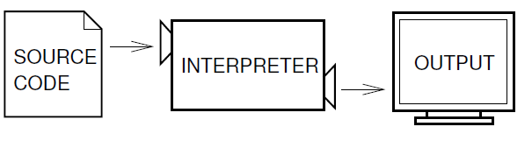


Python Interpreter
Python programs are executed by an interpreter
Python code is interpreted into machine instructions
interpret
source code
Hello.py
output
©Syncrocore Technologies

Slide 7
The First Program in Python
In Python, the program to display the words “Hello,World!” looks like this
>>>print('Hello, World!')
In this case, the result is the words
Hello, World!
The parentheses indicate that print is a function
The quotation marks in the program mark the beginning and end of the text to be displayed
  they don’t appear in the result
©Syncrocore Technologies

Slide 8
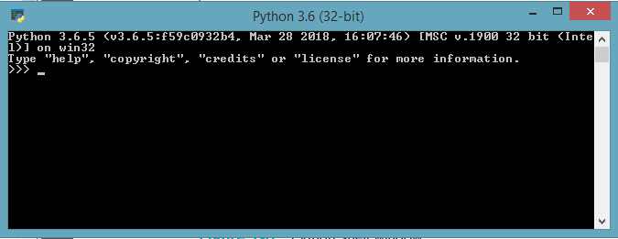
Running Python Code in Interactive Shell
Python is an interpreted language, and you can run simple Python expressions and statements in an interactive programming environment called the shell
The figure shows a shell prompt on Windows OS
See the version of Python
©Syncrocore Technologies

Slide 9
Running Python Code in Interactive Shell
Type Python programs and the interpreter displays the result
  >>> 1 + 1
  2
The chevron, >>>, is the Python prompt – the interpreter uses to indicate that it is ready
Working in interactive mode is convenient for testing small pieces of code
©Syncrocore Technologies

Slide 10
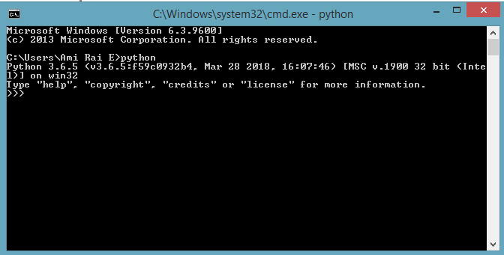
Running Python Code from a Terminal Command Prompt
Select a terminal command prompt
After the user has opened a terminal window, navigate or change directories until the prompt shows that user is attached to the directory that contains the Python script
©Syncrocore Technologies

Slide 11
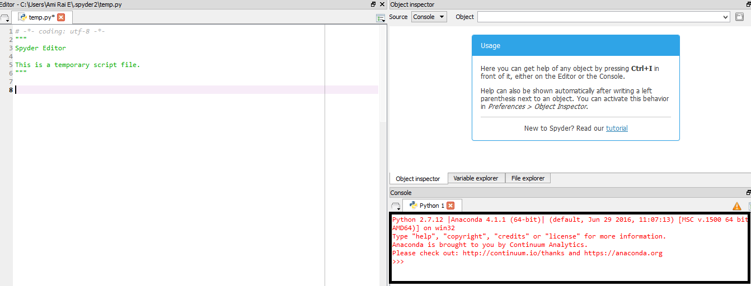
Running Python Code in IDE
The easiest way to open a Python shell is to launch the IDE (Integrated Development Environment)
The figure shows an integrated program development environment that comes with the Python installation
©Syncrocore Technologies

Slide 12
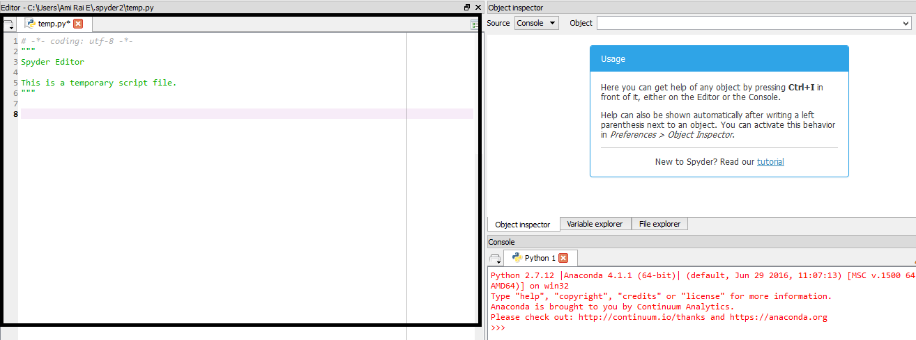
Running Python Code in Script mode
Store code in a file and use the interpreter to execute the contents of the file, which is called a script
By convention, Python scripts have names that end with .py
Anything more than a few lines, save the code as a script so that it can be modified and executed in the future
©Syncrocore Technologies

Slide 13
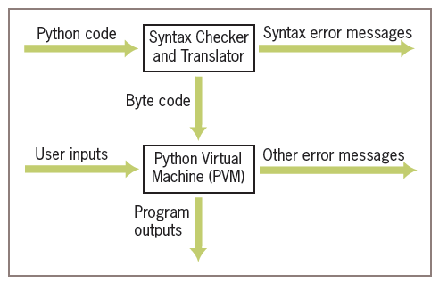
Working of Python Programs
Whether a Python code is running as a script or interactively in a shell, the Python interpreter does a great deal of work to carry out the instructions in the program
This work can be broken into a series of steps, as shown in Figure
©Syncrocore Technologies

Slide 14
Statements and Lines
Consider the program
  >>>print('Hello, World!')
A statement is a logical instruction to the interpreter
  The above program is made up of one statement
A line is a sequence of characters terminated by the newline character
  The above program is a 1-line program
©Syncrocore Technologies

Slide 15
One Statement Per Line
As long as there is one statement per line, there is no need of a semi-colon at the end of the line
  Other programming languages such as C,C++, and Java use semi-colon as the statement terminator
Example of one statement per line
  print('Hello, World!')
  print(‘Hi from India')
The output is
  Hello, World!
Hi from India
©Syncrocore Technologies

Slide 16
Multiple Statements Per Line
In Python, the role of semi-colon is to make sure that multiple statements can be written in one line and the translator is able to differentiate them as separate statements
Example of multiple statements per line
  >>>print('Hello, World!'); print(‘Hi from India')
The output is
  Hello, World!
Hi from India
There is no harm in ending a statement with semi colon, though it is neither required nor preferred
©Syncrocore Technologies

Slide 17
One Statement Spanning Multiple Lines
A single statement can span multiple lines if required
Any line that is going to be continued in the next line needs to end with a backslash (\)
Example of one statement spanning multiple lines
  print(\
  'Hello,\
  World!')
  print(‘Hi fr\
  om India')
The output is
  Hello, World!
Hi from India
©Syncrocore Technologies

Slide 18
Comments in Python
It is a good idea to add notes to the programs to explain in natural language what the program is doing
These notes are called comments, and they start with the # symbol
Comments are not executable
Interpreter ignores the contents of the comments
Everything from the # to the end of the line is ignored—it has no effect on the program
# compute the percentage of the hour that has elapsed
percentage = (minutes * 100) / 60
©Syncrocore Technologies

Slide 19
Comments in Python contd.
Comments can be put at the end of a line
percentage = (minute * 100) / 60 # percentage of an hour
The following comment is redundant with the code and is useless
v = 5 # assign 5 to v
The following comment contains useful information that is not in the code
v = 5 # velocity in meters/second
©Syncrocore Technologies

Slide 20
Docstrings in Python
Docstring is a multi-line string
The author of a program can include his or her name and a brief statement about the program’s purpose at the beginning of the program file
  """
  Wing Editor
  This is a temporary script file.
  The program is used to compute the area of a triangle
  """
©Syncrocore Technologies

Slide 21
Summary
Python is an interpreted high-level programming language for general-purpose programming
Python code is interpreted into machine instructions
Python scripts are programs that are saved in files and run from a terminal command prompt
A statement is a logical instruction to the interpreter
A line is a sequence of characters terminated by the newline character
Comments are pieces of text added within programs to improve code readability
Python interpreter ignores the contents of the comments
©Syncrocore Technologies

