Slide 1


Dictionaries

Slide 2
Topics
Creating dictionaries
Adding elements to a dictionary
Iterating through dictionary elements
Deleting elements from a dictionary

Slide 3
Dictionaries
In some situations, the position of a datum in a structure is irrelevant
We are interested in its association with some other element in the structure
For example,
you might want to look up Ethan’s phone number but don’t care where that number is in the phone book
A dictionary is a collection of key-value pairs subject to the constraint that all the keys should be unique
A dictionary organizes information by association, not position

Slide 4
Dictionaries in Python
A dictionary is a mapping between a set of indices (which are called keys) and a set of values
Each key maps to a value
The association of a key and a value is called a key-value pair
Example
{ ‘grapes’ : ‘green’ , ‘ apple’ : ‘red’ } # grapes and apple are keys with their corresponding values green and red respectively
Personal information: { "Name“ :“John", "Age“ :18}

Slide 5
Creating a Dictionary
Consider building a dictionary that maps from English to Spanish words, so the keys and the values are all strings
The function dict creates a new dictionary with no items
>>> eng2sp = dict()
>>> eng2sp
{}
The squiggly-brackets, {}, represent an empty dictionary

Slide 6
Adding Items to a Dictionary
To add items to the dictionary, use square brackets
>>> eng2sp['one'] = 'uno‘ #creates an item that maps from the key 'one' to the value 'uno‘
>>> eng2sp
{'one': 'uno'} # a key-value pair with a colon between the key and value
>>> eng2sp = {'one': 'uno', 'two': 'dos', 'three': 'tres'} #Create a new dictionary with three items
>>> eng2sp
{'one': 'uno', 'three': 'tres', 'two': 'dos'} #The order of the key-value pairs is not the same. the order of items in a dictionary is unpredictable

Slide 7
Accessing Dictionary Elements
The [] operator can be used to access a value in a dictionary given it’s key
>>> D = { ‘grapes’ : ‘green’ , ‘ apple’ : ‘red’ }
>>> D[‘apple’]
‘red’
>>> D[‘mango’] # key does not exists in the dictionary
Traceback (most recent call last):
File "/home/main.py", line 11, in <module>
KeyError: ‘mango'

Slide 8

Operators and Functions in Dictionaries
The len() function returns the number of key-value pairs
>>> eng2sp = {'one': 'uno', 'two': 'dos', 'three': 'tres'}
>>> len(eng2sp)
3
The in operator tells whether something appears as a key in the dictionary
>>> 'one' in eng2sp
True
>>> 'uno' in eng2sp
False

Slide 9

Iterating Through the Keys of a Dictionary
# The for loop is used to iterate through the keys of a dictionary
D = { 'grapes' : 'green' , 'apple' : 'red' }
for K in D:
print(K)
grapes apple
# the keys of a dictionary can be explicitly retrieved using dict.keys()
D = { 'grapes' : 'green' , 'apple' : 'red' }
K = D.keys()
for i in K:
print(i)
grapes
apple

Slide 10

Iterating Through the Values of a Dictionary
The dict.values() returns a view of all the values in the dictionary
D = { 'grapes' : 'green' , 'apple' : 'red' }
V = D.values()
for i in V:
print(i)
green
red
It is possible to iterate through the keys and print out the corresponding values
for K in D:
print(D[K])
green
red

Slide 11

Iterating Through the Key-Value Pairs
The dict.items() returns the key-value pair (each pair as a tuple) in the dictionary
D = { 'grapes' : 'green' , 'apple' : 'red' }
for K,V in D.items():
print(K,V)
grapes green
apple red

Slide 12

Deleting Elements From Dictionary
>>> D = { 'grapes' : 'green' , 'apple' : 'red' }
>>> del D[‘apple’] # del operator is used to delete an element
>>> D
{ 'grapes' : 'green'}
>>> D.popitem() # remove an element from the dictionary and return the pair in the form of tuple
( 'grapes‘, 'green‘)
>>> D.popitem()
KeyError: 'popitem(): dictionary is empty'

Slide 13
Program Based on Dictionaries
# program to display the capital of a country
capitals = { 'India' : 'Delhi' , 'Pakistan' : 'Islamabad' , 'China' : 'Beijing' }
while True:
country = input('Enter a country name or "end" to termiante: ')
if country == 'end':
break
print('The capital of', country, 'is', capitals[country])
Enter a country name or "end" to termiante: India
The capital of India is Delhi
Enter a country name or "end" to termiante: end

Slide 14

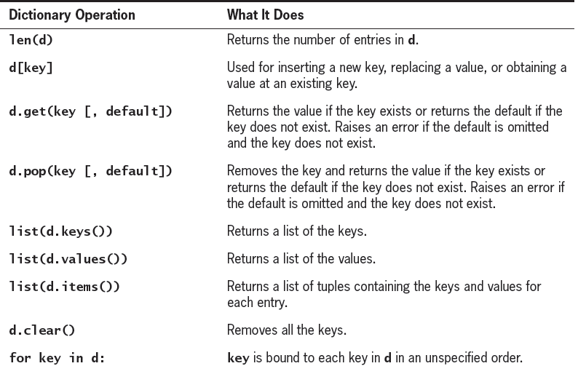
Some Commonly Used Dictionary Operations

Slide 15
Summary
A dictionary is a collection of key-value pairs subject to the constraint that all the keys should be unique
The elements of a dictionary can be accessed using the [] operator or the get() method with the key being used as the index
The len() function gives the number of pairs in a dictionary
The operations such as addition and deletion of elements can be performed on a dictionary

