Slide 1
Data Analysis and Visualization Using Python
Summer Training Project
Kaif Hashmi | 325104902
Arivani Technologies PVT LTD
Industry Mentor: Ashish Yadav

Slide 2
Project Overview
01
• Data analysis means collecting, cleaning and studying data to understand what it tells us.
• Data visualization means presenting important results through simple charts and graphs.
• This project uses Python to move from raw sales data to useful findings.
• The project follows a complete workflow: load → clean → analyze → visualize → test → report.
Data Analysis and Visualization Using Python | LPU Summer Training | 2

Slide 3
Objectives of the Training
02
Learning objectives
Practical objectives
• Understand the structure and quality of data.
• Clean missing values, duplicate records and outliers.
• Create useful features from existing data.
• Calculate important business indicators.
• Create clear charts and visualizations.
• Use basic statistical tests to understand relationships.
• Prepare a reproducible analysis and report.

Slide 4
Python Tools Used
03
Library | Purpose
Pandas | Read, clean, filter, group and summarize tabular data.
NumPy | Work with arrays, numbers and calculations.
Matplotlib | Create basic line, bar, pie and scatter charts.
Seaborn | Create statistical charts such as heatmaps, histograms and box plots.
• Also used: os, json and warnings where required.
• The analysis can be organized in one Python script or a Jupyter Notebook.
• A fixed random seed (42) can be used when generating simulated data so results are reproducible.
Data Analysis and Visualization Using Python | LPU Summer Training | 4

Slide 5
Project Workflow
04
1. Load & inspect
2. Clean data
3. Create features
4. Explore data
5. Statistical tests
6. Visualize & report
• Each step produces the input needed for the next step.
• The goal is not only to create charts, but to explain what the data means.
Data Analysis and Visualization Using Python | LPU Summer Training | 5

Slide 6
Understanding the Raw Data
05
Item | Value
Raw rows | 5,060
Columns | 13
Duplicate rows | 60
Missing values | 456 across 3 columns
Quantity outliers | 68
• The training presentation describes the dataset as simulated with realistic data-quality problems.
• Before analysis, the data must be checked for duplicates, missing values, incorrect text and extreme values.
Data Analysis and Visualization Using Python | LPU Summer Training | 6

Slide 7
Data Cleaning
06
Issue | Observed | Method used
Duplicate rows | 60 | drop_duplicates()
Missing ratings | 200 | Median imputation
Missing customer ages | 150 | Median imputation
Missing delivery days | 100 | Median imputation
Quantity outliers | 68 | IQR upper-fence capping
Text inconsistencies | 4 columns | strip() and title()
• Final result: 5,000 clean rows, with zero missing values and zero duplicate rows.
• Median imputation was used because it is less affected by extreme values than the mean.
• IQR capping reduces the influence of unusually large quantities.
Data Analysis and Visualization Using Python | LPU Summer Training | 7

Slide 8
Code Part 1 — Import and Inspect the Data
07
import pandas as pd
import numpy as np
import matplotlib.pyplot as plt
import seaborn as sns
pd.set_option("display.max_columns", None)
sns.set_theme(style="whitegrid")
df = pd.read_csv("sales_data.csv")
print(df.head())
print(df.shape)
print(df.info())
print(df.isnull().sum())
Data Analysis and Visualization Using Python | LPU Summer Training | 8

Slide 9
Code Part 2 — Clean the Data
08
# Remove duplicate records
df = df.drop_duplicates()
# Fill missing numeric values with median
df["rating"] = df["rating"].fillna(df["rating"].median())
df["customer_age"] = df["customer_age"].fillna(df["customer_age"].median())
df["delivery_days"] = df["delivery_days"].fillna(df["delivery_days"].median())
# Cap quantity outliers using IQR
q1 = df["quantity"].quantile(0.25)
q3 = df["quantity"].quantile(0.75)
iqr = q3 - q1
upper = q3 + 1.5 * iqr
df["quantity"] = df["quantity"].clip(upper=upper)
Data Analysis and Visualization Using Python | LPU Summer Training | 9

Slide 10
Code Part 3 — Create Useful Features
09
# Example derived fields
df["order_value"] = df["quantity"] * df["unit_price"] * (
1 - df["discount"] / 100
)
df["order_date"] = pd.to_datetime(df["order_date"])
df["month"] = df["order_date"].dt.month
df["month_name"] = df["order_date"].dt.strftime("%b")
df["weekday"] = df["order_date"].dt.day_name()
df["is_weekend"] = df["weekday"].isin(["Saturday", "Sunday"])
• Derived fields make analysis easier, for example order value, month and weekend/weekday status.
Data Analysis and Visualization Using Python | LPU Summer Training | 10

Slide 11
Key Business Indicators
10
Indicator | Result
Total revenue | ₹46.33 million
Orders | 5,000
Unique customers | 1,991
Average rating | 3.83 / 5
Average order value | ₹9,267
Median order value | ₹2,554
Average discount | 8.3%
Average delivery time | 3.8 days
• Average order value is much higher than the median, showing that a small number of expensive orders affect the average.
Data Analysis and Visualization Using Python | LPU Summer Training | 11

Slide 12
Code Part 4 — Business Analysis
11
# Business summaries
total_revenue = df["order_value"].sum()
total_orders = len(df)
avg_order_value = df["order_value"].mean()
revenue_by_category = (
df.groupby("category")["order_value"]
.sum()
.sort_values(ascending=False)
)
revenue_by_region = (
df.groupby("region")["order_value"]
.sum()
.sort_values(ascending=False)
)
Data Analysis and Visualization Using Python | LPU Summer Training | 12

Slide 13
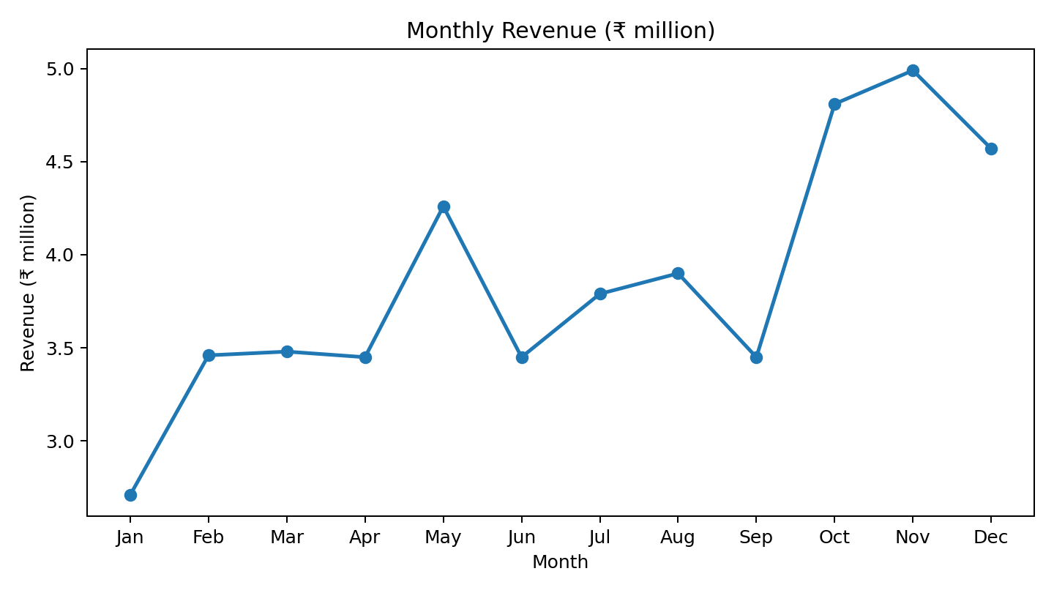
Monthly Revenue Pattern
12
• Lowest month: January — ₹2.71 M
• Highest month: November — ₹4.99 M
• October–December contribute about 31% of annual revenue.
• This suggests preparing stock and staff for Q4.
Data Analysis and Visualization Using Python | LPU Summer Training | 13

Slide 14
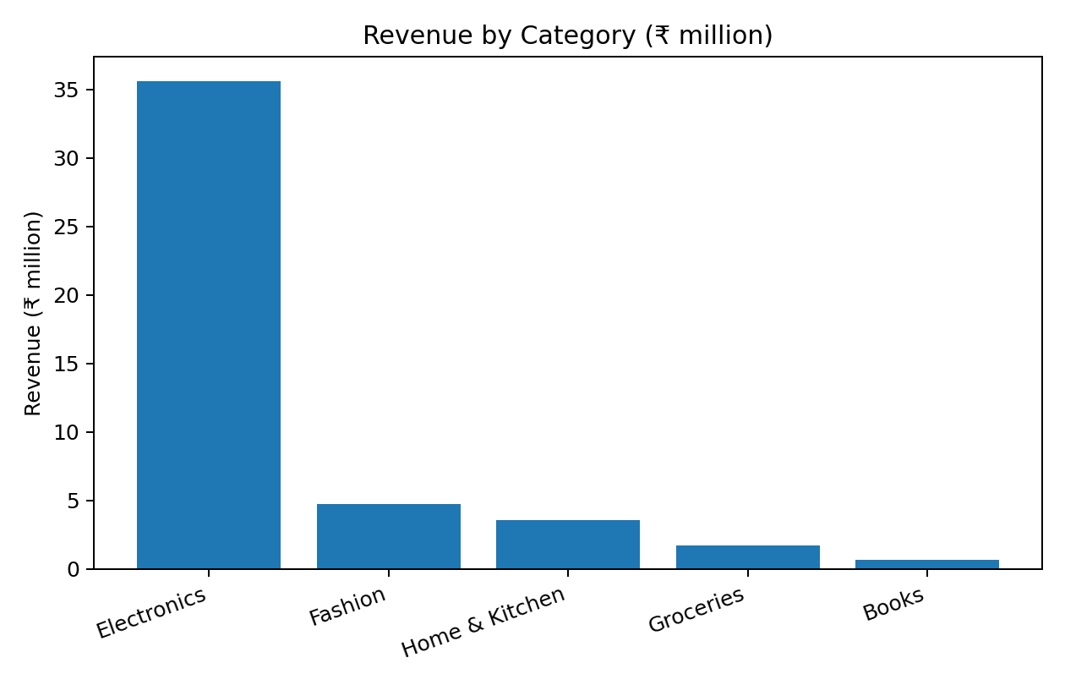
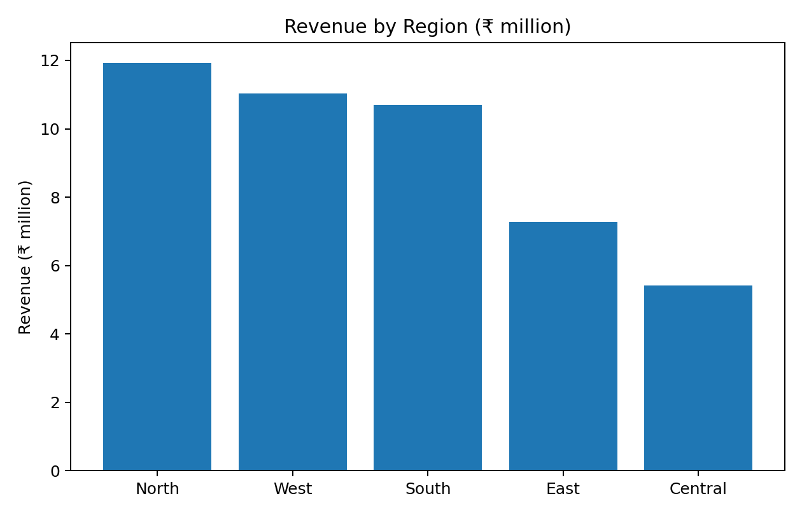
Category and Region Analysis
13
• Electronics generate 76.9% of revenue.
• North, West and South together contribute 72.6% of revenue.
Data Analysis and Visualization Using Python | LPU Summer Training | 14

Slide 15
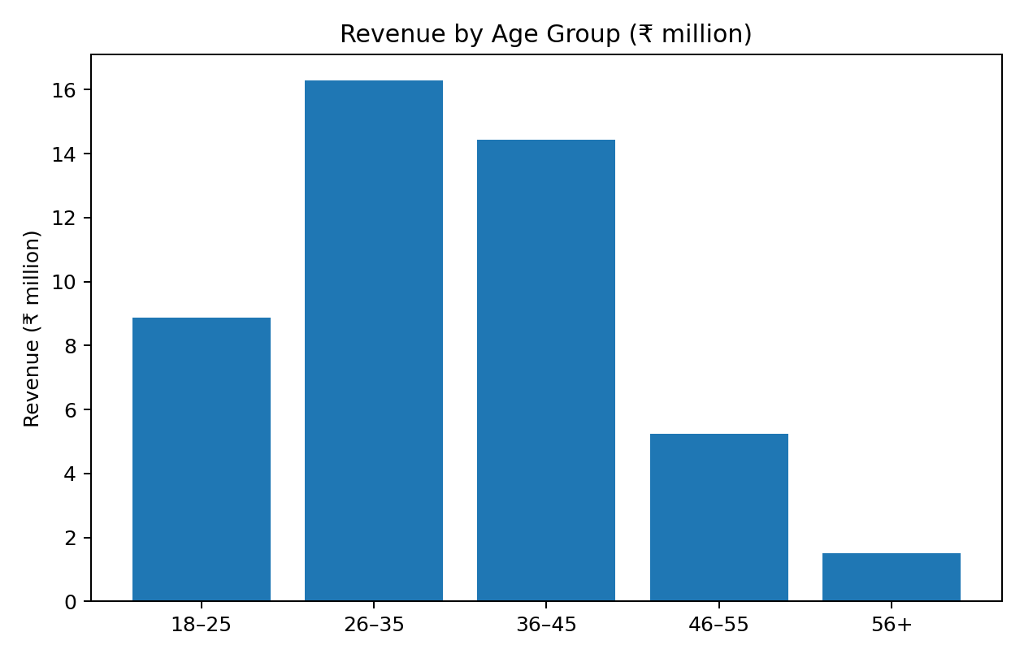
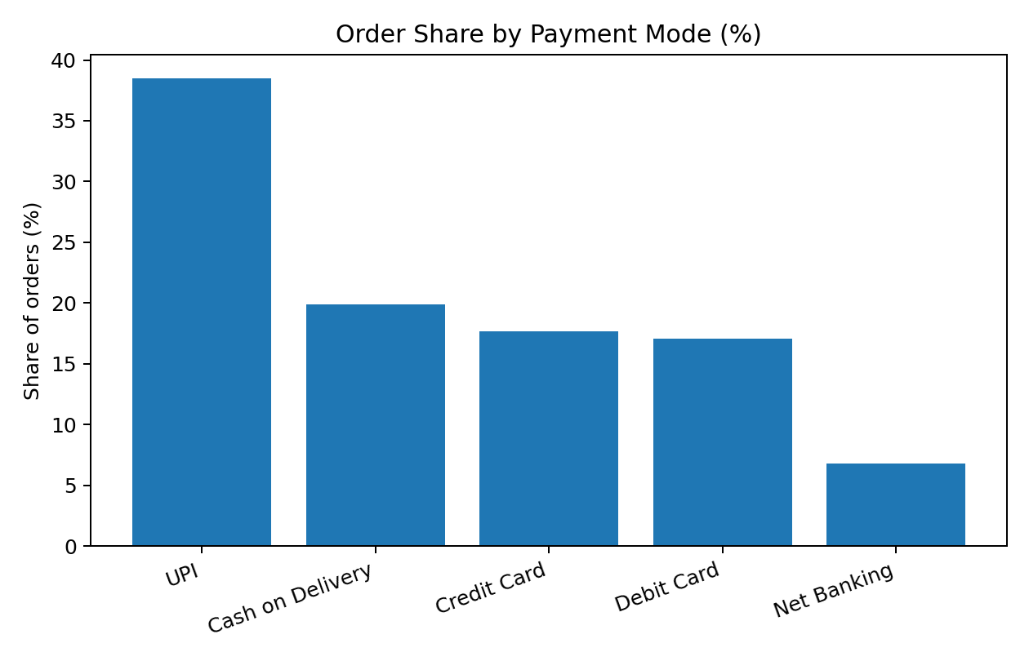
Customer and Payment Analysis
14
• Customers aged 26–45 contribute about two thirds of revenue.
• UPI is the leading payment mode at 38.5%; COD remains significant at 19.9%.
Data Analysis and Visualization Using Python | LPU Summer Training | 15

Slide 16
Code Part 5 — Visualization
15
# Monthly revenue
monthly_revenue = (
df.groupby("month")["order_value"].sum()
)
monthly_revenue.plot(kind="line", marker="o")
plt.title("Monthly Revenue")
plt.xlabel("Month")
plt.ylabel("Revenue")
plt.tight_layout()
plt.show()
# Correlation heatmap
sns.heatmap(
df.select_dtypes("number").corr(),
annot=True,
cmap="Blues"
)
plt.title("Correlation Heatmap")
plt.show()
Data Analysis and Visualization Using Python | LPU Summer Training | 16

Slide 17
Relationships in the Data
16
Relationship | Result | Interpretation
Unit price ↔ revenue | r = 0.829 | Strong positive relationship
Discount ↔ quantity | r = 0.127 | Weak positive relationship
20% discount vs no discount | +25% units/order | Increase stops after 20% in this data
• The source presentation notes that price and revenue are strongly related by construction.
• Discounts appear to increase quantity up to around 20%, but 25% does not show further gain in this dataset.
Data Analysis and Visualization Using Python | LPU Summer Training | 17

Slide 18
Statistical Tests
17
Test | Statistic | p-value | Result
Weekend vs weekday order value (t-test) | t = -0.342 | 0.7324 | Not significant
Rating across regions (ANOVA) | F = 1.723 | 0.142 | Not significant
Delivery days vs rating (Pearson) | r = -0.011 | 0.4416 | Not significant
• A p-value above 0.05 means the observed difference or relationship is not statistically significant at the 5% level.
• In this dataset, weekends do not significantly change order value, ratings are consistent across regions, and delivery days are not significantly related to rating.
Data Analysis and Visualization Using Python | LPU Summer Training | 18

Slide 19
Code Part 6 — Statistical Testing
18
from scipy.stats import ttest_ind, f_oneway, pearsonr
from sklearn.linear_model import LinearRegression
import numpy as np
# Weekend vs weekday order value
weekend = df.loc[df["is_weekend"], "order_value"]
weekday = df.loc[~df["is_weekend"], "order_value"]
t_stat, p_value = ttest_ind(weekend, weekday, equal_var=False)
# Delivery days vs rating
r, p = pearsonr(df["delivery_days"], df["rating"])
• For forecasting, the source presentation uses a simple linear trend: about ₹150k additional revenue per month, R² = 0.646, p = 0.0016.
• Indicative month 13–15 forecasts are approximately ₹4.84 M, ₹4.99 M and ₹5.14 M.
• A seasonal model such as SARIMA or Prophet would be a natural next step.
Data Analysis and Visualization Using Python | LPU Summer Training | 19

Slide 20
Findings and Recommendations
19
Main findings
Recommended actions
• Electronics generate 76.9% of revenue.
• Q4 contributes 31% of annual revenue.
• Customers aged 26–45 contribute about 66% of revenue.
• Discounts help quantity up to around 20%.
• Ratings are consistent across regions.
• Prepare stock and staff for October–December.
• Promote mid-priced categories.
• Keep routine discounts near 15–20%.
• Target Central, East and 45+ customer segments.
• Investigate 1-star and 2-star orders.
Data Analysis and Visualization Using Python | LPU Summer Training | 20

Slide 21
Conclusion and Learning
20
What was achieved
What was learned
• Completed the full data-analysis cycle.
• Cleaned and prepared 5,000 reliable records.
• Created business KPIs and visualizations.
• Performed 3 statistical tests.
• Prepared a simple revenue forecast.
• Good data preparation improves result quality.
• Median imputation is useful for skewed data.
• Charts make patterns easier to communicate.
• Statistical tests help avoid false conclusions.
• Future work can use real company data and interactive dashboards.
Data Analysis and Visualization Using Python | LPU Summer Training | 21

Slide 22
Recommended Project Code Structure
21
summer_training/
│
├── data/
│ └── sales_data.csv
├── output/
│ ├── charts/
│ └── cleaned_sales_data.csv
├── analysis.py
├── requirements.txt
└── README.md
requirements.txt
pandas
numpy
matplotlib
seaborn
scipy
scikit-learn
Data Analysis and Visualization Using Python | LPU Summer Training | 22

Slide 23
Thank You
Questions and Discussion
Kaif Hashmi | 325104902 | Arivani Technologies PVT LTD

