Slide 1
Master’s Thesis
Development and Evaluation of a Python-Based
Signal Processing Pipeline for Frailty Classification
from PPG Signals
Kaifeng Xu
Supervisors
Prof. Dr. Charmayne Mary Lee Hughes
M.Sc. Ali Pourhossein
Faculty V - Mechanical Engineering and Transport Systems
Institute of Psychology and Ergonomics
Age-Appropriate Human-Machine Systems
Technische Universität Berlin
Notes:
Slide 1 | Development and Evaluation of a Python-Based Signal Processing Pipeline for Frailty Classification from PPG Signals
11 seconds
Good morning. I am Kaifeng Xu. Today I will present my master's thesis on frailty classification from photoplethysmography signals.
This thesis develops and evaluates a transparent Python-based signal-processing pipeline for classification of frailty-related groups from synchronized photoplethysmography, or PPG, and inertial measurement unit, or IMU, recordings.
Sources
Thesis Abstract; Chapters 1, 3 and 6.

Slide 2
Frailty and clinical vulnerability
Worsening activities of daily living (ADL) disability
What is frailty?
Reduced physiological reserve and
greater vulnerability to stressors
across multiple physiological systems.
Clinical phenotype
Weight loss, exhaustion, low activity,
weak grip strength and slow walking.
Project question
Can PPG and IMU quantify physiological
and movement differences between groups?
Cardiovascular Health Study (CHS), 5,317 adults aged ≥65
Redrawn from Fried et al., 2001, Table 6. External longitudinal evidence motivates the study.
PROJECT MOTIVATION
02
Notes:
Slide 2 | Frailty and clinical vulnerability
28 seconds
Frailty means reduced physiological reserve and greater vulnerability to stressors. It is associated with falls, disability and loss of independence.
The chart summarizes the original Cardiovascular Health Study, or CHS. Three-year estimates of worsening disability in activities of daily living, increased from eight to twenty to thirty-nine percent across the frailty categories. Early and repeatable assessment is therefore important. Clinical instruments remain essential, while wearable signals offer a way to investigate changes between assessments.
This motivates repeatable assessment between clinical visits.
Sources
Thesis §§1–2; Fried et al. 2001, Table 6, DOI 10.1093/gerona/56.3.M146.

Slide 3
Why might PPG relate to frailty?
Physiological regulation
and reserve
Candidate cardiovascular
associations
Observable
peripheral pulse
Question | PPG observation | Candidate descriptors
Cardiac timing | Spacing between pulses | Rate and interval variation
Peripheral pulse expression | Upstroke, width, amplitude | Rise time, width, area, AC/DC
Response after a task | Baseline and recovery differences | Role-specific rate and variability
Evidence: electrocardiogram (ECG) studies link frailty to altered heart-rate dynamics.
PPG pulse rate variability (PRV) also reflects pulse propagation and measurement effects.
Candidate descriptors of cardiovascular regulation and pulse-wave expression.
Chaves 2008; Varadhan 2009; Mejía-Mejía 2020; thesis §§2.1 and 2.3.
PHYSIOLOGICAL RATIONALE
03
Notes:
Slide 3 | Why might PPG relate to frailty?
30 seconds
Photoplethysmography, or PPG, records peripheral blood-volume pulsations. Pulse timing and shape may reflect cardiovascular and autonomic regulation. Earlier electrocardiogram, or ECG, studies provide the rationale for examining pulse-rate variability, or PRV. An inertial measurement unit, or IMU, records movement, which provides physical-performance information but also introduces optical artefacts.
The multimodal combination of PPG signals and synchronized IMU signals may therefore be suitable for investigating frailty classification.
This thesis develops and evaluates a transparent Python-based signal-processing pipeline for classification of frailty-related groups from synchronized photoplethysmography, or PPG, and inertial measurement unit, or IMU, recordings.
Sources
Thesis §§2.1–2.3 and §3.1; Chaves et al. 2008, DOI 10.1111/j.1532-5415.2008.01858.x.

Slide 4
Dataset and clinical reference labels
Group | People | Files
Pre-Frail | 9 | 81
Robust / Non-Frail | 12 | 108
Young reference | 8 | 72
Total | 29 | 261
Fried phenotype in adults aged ≥60
Unintentional weight loss
Exhaustion
Low physical activity
Weak grip strength
Slow walking
8 synchronized channels at 400 Hz
Red (RED), infrared (IR) and six IMU axes
261 recordings; 9 per person: B baseline, R1–R4 recovery, S1–S2 sit-to-stand, W1–W2 walking
DATASET
04
Notes:
Slide 4 | Dataset and clinical reference labels
46 seconds
The dataset contains twenty-nine participants and two hundred and sixty-one recordings. Each participant completed baseline, walking, sit-to-stand and recovery recordings. Every recording contains eight synchronized channels: the red, and infrared PPG channels, three acceleration axes and three angular-velocity axes, sampled at four hundred hertz.
The older participants were assessed using the Fried phenotype: weight loss, exhaustion, low activity, weak grip and slow walking. Zero criteria defined twelve Robust participants; one or two defined nine Pre-Frail participants. Eight Young participants provide an age-reference group. There were no clinically Frail participants.
Sources
Thesis §3.2.1 and Table 3.

Slide 5
One pipeline, two analysis branches
Waveform branch
Alternative inputs
PPG + IMU
recordings
Preprocessing
Windowing
+ resample
Models &
classification
Physiological
analysis branch
Motion detection
& denoising
Peak detection
Feature
engineering
Optional / identity
Shape / baseline use original optical data
The waveform branch builds normalized 5 s inputs for direct learning.
The physiological branch measures pulse timing, shape and motion, then builds features.
Both routes share preprocessed recordings. Each model receives its selected representation.
PIPELINE WORKFLOW
05
Notes:
Slide 5 | One pipeline, two analysis branches
35 seconds
The pipeline has two analysis branches with a common signal-preparation stage. The waveform branch produces normalized windows for direct time-series classification. The feature branch extracts pulse timing, morphology, optical and movement descriptors, organized as recording-level vectors or chronological matrices.
Motion processing and pulse detection support the physiological measurements. Both branches retain participant identity for the later grouped evaluation. I will follow the signal-processing stages first, then return to the classification experiments.
Sources
Thesis §3.1, Figure 14 and Table 5.

Slide 6
Workflow: preprocessing
Waveform branch
Alternative inputs
PPG + IMU
recordings
Preprocessing
Windowing
+ resample
Models &
classification
Physiological
analysis branch
Motion detection
& denoising
Peak detection
Feature
engineering
Optional / identity
Shape / baseline use original optical data
Preserve the timing, amplitude and movement information needed by the next stages.
PIPELINE WORKFLOW
06
Notes:
Slide 6 | Workflow: preprocessing
15 seconds
Preprocessing prepares a filtered ppg pulse waveform, retains a separate optical baseline for baseline-dependent measurements. The IMU needs channel-specific filtering and a treatment of gravity.
Sources
Thesis §3.3 and Table 5.

Slide 7
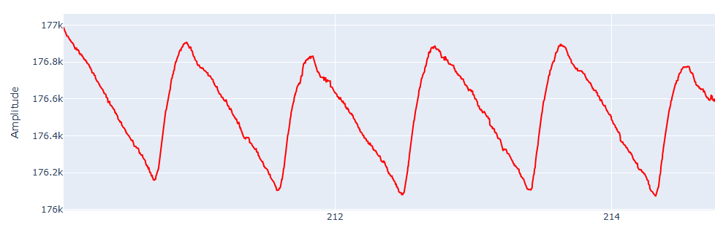
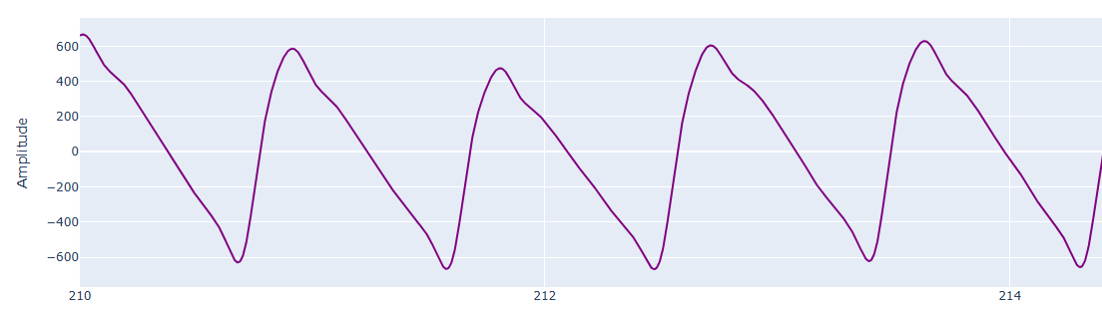
PPG preprocessing
Raw RED
Short internal gaps
≤ 100 samples
Linear interpolation
Filtered RED
Linear detrend
Butterworth 0.2–8 Hz
Prototype order 3
Zero phase
Thesis examples: raw and filtered RED signals, shown at their respective scales.
FILTERING
07
Notes:
Slide 7 | PPG preprocessing
34 seconds
The example shows how preprocessing reduces baseline variation and high-frequency fluctuations while retaining the pulse waveform.
PPG preprocessing repairs short internal gaps by linear interpolation, then treats red and infrared separately. A linear trend is removed before a third-order Butterworth band-pass from zero point two to eight hertz. Forward-backward filtering avoids phase displacement. Relative pulse amplitudes remain available, while a separate copy before detrending and filtering preserves the optical baseline for baseline-dependent measurements.
Sources
Thesis §3.3.1, Figure 15 and Table 5.

Slide 8
IMU preprocessing and gravity handling
Accelerometer
3 axes
Low-pass
20 Hz
Filtered acceleration
before gravity separation
Gyroscope
3 axes
Low-pass
40 Hz
Filtered angular velocity
Main profile: acceleration in g; angular velocity in degrees per second (°/s).
Profile A: low-pass filter (LPF) gravity separation
ĝ = LPF₀.₃Hz(a) a_dynamic = a − ĝ
Sensor low-pass filters: order 3. Profile A gravity estimate: 0.3 Hz, order 4.
PREPROCESSING
08
Notes:
Slide 8 | IMU preprocessing and gravity handling
37 seconds
The three-axis imu records acceleration and angular velocity. We apply a twenty-hertz low-pass filter to acceleration and a forty-hertz low-pass filter to angular velocity. Acceleration also includes the projection of gravity onto the sensor axes.
The pipeline evaluates two ways of separating this contribution.
Profile A estimates gravity with a zero-point-three-hertz low-pass filter and subtracts it from acceleration. The alternative extended Kalman filter, or EKF, estimates orientation before projecting gravity.
Sources
Thesis §3.3.2 and Tables 28–30, in particular B3.

Slide 9
Roll–pitch orientation and gravity separation
Profile B: calibrated extended Kalman filter (EKF) with unit conversion
Gyroscope
Predict roll and pitch
and gyro bias
EKF correction
roll φ, pitch θ
Project gravity
into sensor axes
Accelerometer
Observe roll, pitch
Adapt weight R
Dynamic acceleration
State x = [φ, θ, b₁, b₂, b₃]ᵀ
Subtract projected gravity
a
= a
− ĝ
b₁–b₃: residual gyro biases. Accelerometer weight decreases when ‖a‖ > g.
dyn
f
b
Profile B versus A: mean balanced accuracy was 7.0 (InceptionTime) and 6.6 (compact convolutional model) percentage points lower.
IMU PREPROCESSING
09
Notes:
Slide 9 | Roll–pitch orientation and gravity separation
35 seconds
This diagram shows the alternative extended Kalman filter route. Gyroscope angular velocities predict roll and pitch while an acceleration-based gravity estimate supplies a measurement update. The filter also estimates three gyroscope biases.
(During acceleration episodes, the acceleration measurement is given less weight.)
The resulting orientation defines the estimated gravitational acceleration, which is subtracted to obtain dynamic acceleration.
Thesis §3.3.2 and Tables 28–30 (B0 versus B3).

Slide 10
Workflow: motion detection and denoising
Waveform branch
Alternative inputs
PPG + IMU
recordings
Preprocessing
Windowing
+ resample
Models &
classification
Physiological
analysis branch
Motion detection
& denoising
Peak detection
Feature
engineering
Optional / identity
Shape / baseline use original optical data
Motion provides context for optional artefact processing in the physiological branch.
PIPELINE WORKFLOW
11
Notes:
Slide 11 | Workflow: motion detection and denoising
18 seconds
Motion artefacts can overlap the pulse bandwidth, so band-pass filtering alone cannot remove them.
A Motion detector is trained to identify motion segments; then an optional motion artifact denoiser attempts to recover useful pulse timing.
Sources
Thesis §3.3.5.

Slide 11
Quality requirements depend on the endpoint
PPG periodicity + RED/IR agreement
IMU motion information
Optional motion detector
LightCNN: 8 × 3200 samples
8 s windows, 2 s stride
3 convolution blocks
Motion probability
Rate quality
Q_rate
Shape quality
Q_morph
Poor segments can enter
artefact processing or be excluded
Pulse timing / PRV
Pulse morphology
SQI, the motion detector and denoising are all disabled in the final classification preset.
OPTIONAL SIGNAL ANALYSIS
11
Notes:
Slide 8 | 70 seconds
Cue:
Before extracting a measurement, the relevant question is whether the signal supports that particular measurement. A waveform may still provide reliable pulse timing even when its detailed shape is distorted. The pipeline therefore distinguishes a rate-quality assessment from a stricter morphology-quality assessment.
(The available checks include periodicity, cardiac-band concentration, plausible peak density, interval stability, agreement between wavelengths, and motion energy. Flatlines, clipping, and long gaps can invalidate a segment. )
An optional lightweight CNN provides a separate motion estimate from eight-second, eight-channel windows with a two-second hop. These mechanisms can route a segment directly to analysis, through artefact reduction, or to exclusion.
（In the selected final classification configuration, the quality gate, learned motion routing, and denoiser are disabled. Their role here is to explain the pipeline’s supported processing options.）
Sources
Thesis §3.3, Table6 and20; https://github.com/KaifengXuuu/PPG-Frailty-pipeline/blob/bc61262571725e4326fdefd2d722d007d629035d/final_v0/final_pipeline_v5/src/ppg_frailty/signal/sqi.py; https://github.com/KaifengXuuu/PPG-Frailty-pipeline/blob/bc61262571725e4326fdefd2d722d007d629035d/final_v0/final_pipeline_v5/src/ppg_frailty/artifacts/router.py
Thesis §3.3.5; src/ppg_frailty/signal/sqi.py; quality/routing.py; quality/motion.py; configs/presets/finalcase.yaml: quality, artifact.

Slide 12
Four approaches to motion artefacts
Adaptive cancellation
Use motion to estimate interference
Subtract the estimate
Spectral suppression
Reduce motion-dominant frequencies
Use a soft spectral mask
Aligned PPG + IMU
Decomposition
Reconstruct selected waveform
Keep pulse-like components
Source separation
Separate paired optical signals
Use red and infrared channels
Alternative artefact-reduction routes support physiological signal analysis. Classification uses the waveform branch.
MOTION PROCESSING
12
Notes:
Slide 12 | Four approaches to motion artefacts
33 seconds
The four routes of motion artifact denoisor use different representations:
the first adaptive cancellation predicts an additive artefact from the IMU reference and subtracts it from PPG.
the second spectral masking compares optical and motion spectra, attenuating frequency regions dominated by movement. ;
The third decomposes each optical waveform into components and reconstructs those concentrated in the cardiac band.
The fourth separates sources shared between red and infrared.
Sources
Thesis §3.3.5 and §3.3.5.2.

Slide 13
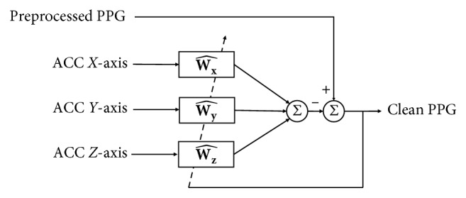
NLMS: IMU based motion artefact cancellation
Published adaptive cancellation structure
Pipeline: normalised least mean squares (NLMS)
Six IMU axes
Delayed samples
r[n]
RED / IR PPG
d[n]
Estimate artefact
â[n] = wᵀr[n]
Residual e[n] = d[n] − â[n]
IMU motion estimates the artefact
Subtract the estimate from PPG.
The residual updates the filter weights.
Use e[n] to update w at each sample
Shin & Cho, 2019, Fig. 2. Each wavelength uses synchronised PPG and IMU samples.
MOTION ARTEFACT REDUCTION
13
Notes:
Slide 13 | NLMS: IMU based motion artefact cancellation
51 seconds
the first method. Normalized least mean squares, or NLMS, uses an adaptive filter to predict motion contamination. The published structure on the left shows a motion reference entering the filter and the predicted artefact being subtracted from PPG.
In this pipeline, six processed IMU axes and their delayed samples form the reference. For each wavelength, a weighted sum predicts the artefact. Subtraction produces the residual, which also updates the filter weights sample by sample. This method requires the inertial reference to capture enough of the optical disturbance to separate it from the pulse.
Sources
Master thesis §3.3.5
Shin & Cho (2019), Fig. 2, https://doi.org/10.1155/2019/6283279
Widrow et al. (1975), https://doi.org/10.1109/PROC.1975.10036

Slide 14
Spectral masking: motion-dominant frequencies
4 s window
1 s hop
Process overlapping
frequency snapshots
Normalized PPG and motion spectra
Gain applied to the PPG spectrum
Teal: PPG Orange: motion
More motion relative to PPG = lower gain
Illustrative signal. In-band gain ≥0.2 avoids complete removal. PPG phase remains unchanged.
MOTION ARTEFACT REDUCTION
14
Notes:
Slide 14 | Spectral masking: motion-dominant frequencies
38 seconds
Spectral masking compares motion and optical energy by frequency. The plot above shows that The signal is divided into overlapping four-second window with a one-second step.Within each window, A short-time Fourier transform, produces spectra of PPG and imu signals.
In the lower-left example, the teal wave represents ppg while the orange one represents imu, the first peak is mainly optical, whereas the second peak has strong corresponding motion energy.
The gain curve on the right follows this relationship. Frequencies with a larger motion fraction receive stronger attenuation.
A lower gain bound in the cardiac band makes suppression gradual. The original optical phase is retained for reconstruction.
Sources
Thesis §3.3.5, Spectral suppression and temporal tracking
Zhang et al. 2015 TROIKA, doi:10.1109/TBME.2014.2359372

Slide 15
Spectral masking: parallel signal pathways
PPG channel
6 IMU axes
Hann STFT
X(f,t)
4 s frame
1 s hop
Hann STFT
U₁(f,t), …, U₆(f,t)
PPG magnitude
P = |X| / percentile₉₅
Motion fraction
M / (M + P)
RMS motion magnitude
M = RMS(|Uᵢ|) / percentile₇₅
G = clip(1 − 0.8M / (M + P), 0.2, 1)
Original complex spectrum
Bounded gain and masking
Y(f,t) = G(f,t) X(f,t)
Inverse STFT
Overlap-add reconstruction
STFT = short-time Fourier transform; RMS = root mean square. Thesis §3.3.5; cardiac band 0.5–3 Hz.
MOTION ARTEFACT REDUCTION
15
Notes:
Slide 15 | Spectral masking: parallel signal pathways
39 seconds
The workflow contains two parallel short-time Fourier transform, or STFT, spectral paths. One transforms an optical channel, and the other transforms the six IMU axes. The IMU magnitude spectra are combined by their root mean square, or RMS, value. Frame-wise normalisation makes the comparison less dependent on absolute optical and motion amplitudes. The normalised magnitudes then determine the motion fraction and the bounded gain. The long connection on the left carries the original complex PPG spectrum to the masking stage. This preserves the phase while changing spectral magnitude. Finally, the inverse transform and overlap-add reconstruction return the processed waveform to the original time grid.
Sources
Thesis §3.3.5

Slide 16
SSA: separating pulse and interference
SSA = singular spectrum analysis
Input PPG: components overlap in time
Pulse-rich components
Slow interference
Fast interference
Cardiac fraction ≈1.00
Retain for reconstruction
Cardiac fraction <0.02
Exclude from reconstruction
Cardiac fraction <0.02
Exclude from reconstruction
Illustrative signal. Decomposition separates patterns by structure, then cardiac-band concentration guides selection.
MOTION ARTEFACT REDUCTION
16
Notes:
Slide 16 | SSA: separating pulse and interference
35 seconds
Singular spectrum analysis, or SSA, represents the PPG as a sum of data-adaptive components. The upper trace combines a periodic pulse with slower and faster interference. A sliding embedding creates a matrix of neighbouring signal samples. Decomposition then separates patterns with different temporal structures. The lower traces show grouped components from this illustrative decomposition. Most energy in the teal group lies inside the cardiac band, while the orange and purple groups concentrate outside it. The selection criterion is the fraction of component power within the cardiac band. Retained components are summed to reconstruct the waveform.
Sources
Thesis §3.3.5, Non-stationary decomposition
Zhang et al. 2015 TROIKA, doi:10.1109/TBME.2014.2359372

Slide 17
SSA: component scoring and reconstruction
One PPG channel
x[1], …, x[N]
Hankel trajectory matrix
Hᵢⱼ = x[i+j−1], L ≤160
Singular value decomposition
H = UΣVᵀ
Rank-one component 1
Hⱼ = σⱼuⱼvⱼᵀ
Rank-one component 2
Hⱼ = σⱼuⱼvⱼᵀ
Rank-one component j ≤12
Hⱼ = σⱼuⱼvⱼᵀ
Diagonal average to xⱼ[n]
Cardiac-band power fraction Cⱼ
Diagonal average to xⱼ[n]
Cardiac-band power fraction Cⱼ
Diagonal average to xⱼ[n]
Cardiac-band power fraction Cⱼ
Cⱼ = Pⱼ(0.5–3.5 Hz)
/ Pⱼ(0.2–8 Hz)
Retain components with Cⱼ ≥0.45
y[n] = Σ retained xⱼ[n]
Reconstructed
PPG channel
Process RED and IR independently. Diagonal averaging restores each component to the original sample grid.
MOTION ARTEFACT REDUCTION
17
Notes:
Slide 17 | SSA: component scoring and reconstruction
65 seconds
For each optical channel, SSA first constructs a Hankel trajectory matrix from overlapping sequences of samples. Singular value decomposition, or SVD, expresses that matrix as rank-one components. Each component returns to a time series by diagonal averaging: entries representing the same original sample are averaged together. The next stage estimates the component spectrum and calculates cardiac concentration, using power from 0.5 to 3.5 hertz relative to power from 0.2 to 8 hertz. Components reaching the configured threshold contribute to the reconstructed PPG. This assessment occurs in parallel across the retained singular components. Red and infrared follow the same independent procedure.
Sources
Thesis §3.3.5

Slide 18
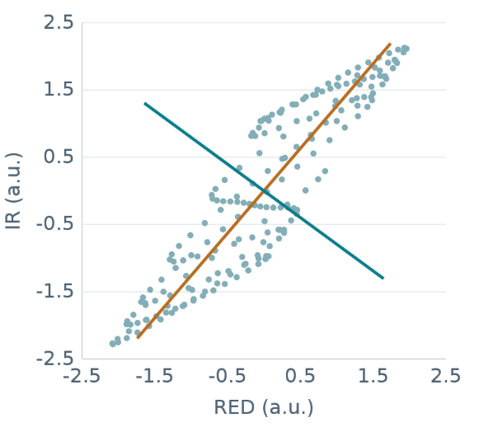
PCA: mixtures, projections and components
Synchronized RED and IR
PCA directions
Components
Paired optical samples
at the same instant.
Orange: first principal axis
Teal: second principal axis
PC1 score ≈0.19
PC2 score ≈0.71 → select
PCA = principal component analysis. The largest-variance component need not represent the pulse.
MOTION ARTEFACT REDUCTION
18
Notes:
Slide 18 | PCA: mixtures, projections and components
65 seconds
Principal component analysis, or PCA, is used here for blind source separation, or BSS. This PCA-BSS route treats red and infrared as different mixtures of underlying physiological and artefact components. The left traces show two synchronised optical observations. In the central plot, each point pairs their amplitudes at one instant. PCA finds orthogonal directions through this cloud and projects the observations onto them. The right panel shows the resulting component time series. The first principal component explains the most variance, but variance alone does not identify the pulse. Here, the second component receives the higher selection score because it has stronger cardiac concentration and less association with the motion reference.
Sources
Thesis §3.3.5, Dual-wavelength blind source separation

Slide 19
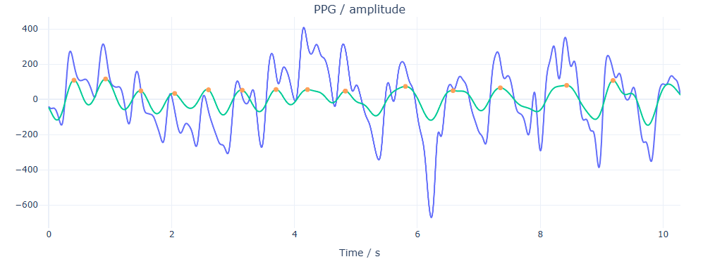
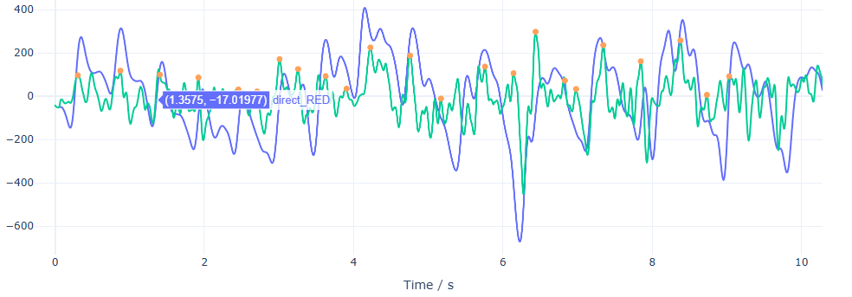
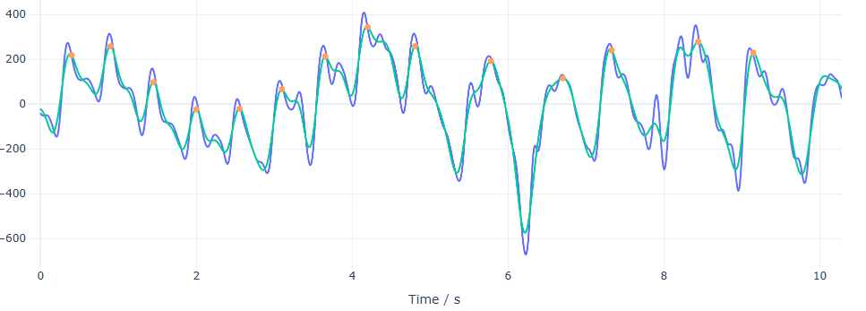
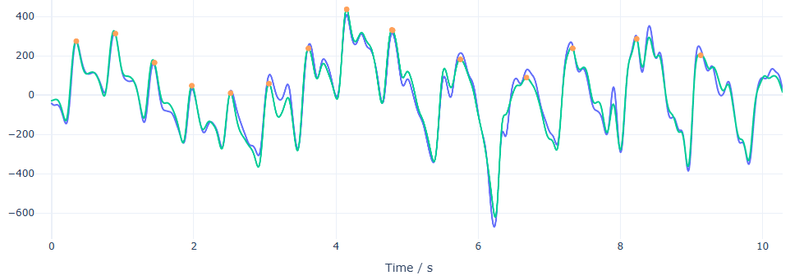
Four motion reducers on the same PPG segment
Spectral mask
Normalized least mean squares (NLMS)
Singular spectrum analysis (SSA)
Principal component analysis (PCA)
Blue: original PPG Teal: processed PPG Orange dots: detected peaks
MOTION ARTEFACT REDUCTION
19
Notes:
Slide 19 | Four motion reducers on the same PPG segment
30 seconds
These outputs use the same ten-second segment. Blue is the recorded signal, teal is the processed signal, and orange dots the detected peaks. The routes are spectral, NLMS, SSA and PCA.
Spectral masking gives a noticeably smoother trace in this example; the NLMS output remains irregular. The SSA and PCA outputs follow the main pulse shapes more closely. This comparison shows the form of the outputs. A smooth line alone cannot establish accurate beats or physiological fidelity.
Sources
Four user-supplied pipeline screenshots, uploaded 2026-09-23; order spectral, NLMS, SSA, PCA
Thesis §3.3.5 and §4.1.3, Table 22 (PCA algorithm name in source: pca_bss)

Slide 20
Identity control and four denoising methods
Dynamic IR: interval error relative to ECG
Route | Beat F1 (%)
Identity | 91.3 ± 8.0
NLMS | 80.4 ± 5.5
Spectral mask | 91.4 ± 8.1
SSA | 91.7 ± 8.0
PCA-BSS | 93.7 ± 5.3
Five-run mean ± SD
Spectral, SSA and PCA have similar mean error; NLMS roughly doubles it.
F1 = harmonic mean of precision and recall; SD = standard deviation; BSS = blind source separation. Thesis Table 22.
DENOISING EVIDENCE
20
Notes:
Slide 20 | Identity control and four denoising methods
52 seconds
The common benchmark test compares 4 denoiser argorithems with Identity, which applies no additional denoising. The benchmark uses an opensource dataset with labeled ECG peaks, as its reference.
On dynamic infrared recordings, both mean interval root mean square error, or RMSE, and Beat-matching F1,（ the harmonic mean of precision and recall,） show that Spectral, SSA and PCA have similar mean error; while NLMS roughly doubles it.
Thesis §4.1.3, Tables 22–23; spectral-mask dynamic IR RMSE p = 0.0656.

Slide 21
Workflow: peak detection
Waveform branch
Alternative inputs
PPG + IMU
recordings
Preprocessing
Windowing
+ resample
Models &
classification
Physiological
analysis branch
Motion detection
& denoising
Peak detection
Feature
engineering
Optional / identity
Shape / baseline use original optical data
Locate pulse events before measuring their intervals and morphology.
PIPELINE WORKFLOW
21
Notes:
Slide 21 | Workflow: peak detection
18 seconds
Peak detection assigns a time to each pulse. The project compared two candidate detectors： Aboy++ with multiscale peak and trough detection, MSPTDfast v2, Both were evaluated against ECG annotations from an external dataset.
Sources
Thesis §3.4.1.

Slide 22
Anatomy of a PPG pulse
Photoplethysmography (PPG): one complete pulse
sp
Waveform landmarks
on Pulse onset
dp
sp Systolic peak
dn Dicrotic notch
off
dp Diastolic peak
on
dn
off Pulse offset
In older adults, the notch and
secondary peak may be faint.
Detect systolic peaks. Adjacent valleys define each pulse.
Two candidates: Aboy++ inspired and MSPTDfast v.2 (fast multiscale peak and trough detection).
External stationary recordings: electrocardiogram (ECG) beat annotations. Schematic pulse; thesis §2.1.2 and §4.1.1.
PEAK DETECTION
22
Notes:
Slide 22 | Anatomy of a PPG pulse
39 seconds
The landmarks are pulse onset, on; systolic peak, sp; dicrotic notch, dn; diastolic peak, dp; and pulse offset, off. In older adults, the notch and diastolic peak can be weak or absent. The project therefore detects the prominent systolic peak. Its neighbouring valleys delimit a pulse for morphology measurements. Both candidate detectors were evaluated separately on red and infrared recordings.
Sources
Thesis §2.3.3, Figures 5–6 and §3.4.1; §4.1.1.

Slide 23
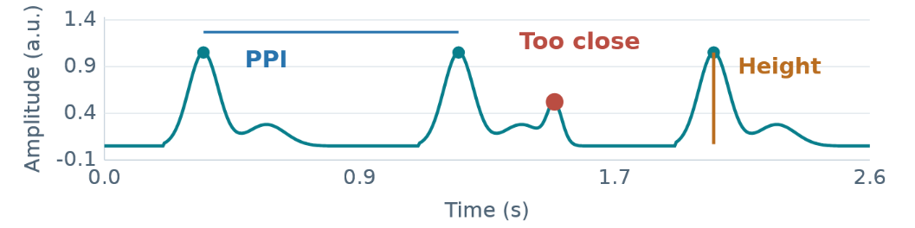
Aboy++: adaptive peak selection
1 Consecutive 10 s windows, without overlap
0–10 s: estimate HRi
10–20 s: update or reuse
20–30 s: repeat
2 Candidate peaks, interval and peak height
3 Reliable intervals update HRi.
Otherwise, retain the previous HRi.
4 Carry HRi into the next window.
PPI = pulse-to-pulse interval; HRi = heart-rate index (a variability measure, not beats per minute). Peak height above baseline is prominence.
PEAK DETECTION
23
Notes:
Slide 23 | Aboy++: adaptive peak selection
45 seconds
This page shows the workflow of aboy++ argorithums.
The upper signal plot shows that Aboy++ works through ten-second windows without overlap. Within each window, the detector first makes a permissive search for candidate peaks. and their pulse-to-pulse intervals, or PPI sequence. Reliable intervals update the heart-rate index, called HRi; otherwise, the previous value is retained.
（HRi measures interval variability, rather than beats per minute.）
The enlarged signal illustrates the final selection. A minimum spacing removes nearby false peaks, while the height above the surrounding baseline removes small fluctuations. This local peak height is called prominence. The resulting HRi passes to the next window, where the same sequence repeats.
Sources
Thesis §3.4.1; Goda, Charlton and Behar 2023, DOI 10.48550/arXiv.2307.10398.

Slide 24
Aboy++: peak selection in each 10 s block
PPG, both polarities
10 s blocks
High-pass, then
adaptive band-pass
Find candidate peaks
Spacing ≥ 60/210 s
Pulse-to-pulse intervals
Pd: values above P30
Update HRi
10 × SD(Pd) / mean(Pd)
Yes
Plausible
intervals?
No
Merge blocks
Check pulse intervals
Find final peaks
Spacing + peak height
HRi for this block
Reuse previous HRi
Heart-rate index (HRi): HRwin = Fs / [3(1 + HRi)] Minimum spacing ≥ 2HRwin
Peak height = height above surrounding valleys. Carry HRi into the next 10 s block.
PPIs are pulse-to-pulse intervals. Repeated independently for RED and IR. Thesis §3.4.1.1.
PEAK DETECTION
24
Notes:
Slide 24 | Aboy++: peak selection in each 10 s block
43 seconds
The flow begins with filtering and the carried heart-rate index. Preliminary peaks give candidate intervals; intervals above the thirtieth percentile form Pd. If enough remain and their mean is plausible relative to the preliminary median, HRi is updated. Otherwise, it stays unchanged. The final search applies adaptive spacing and peak-height requirements. Both signal polarities are tested; the more plausible sequence is selected, blocks are merged and intervals checked.
Master thesis §3.4.1.1
Goda, Charlton & Behar (2023), https://arxiv.org/abs/2307.10398

Slide 25
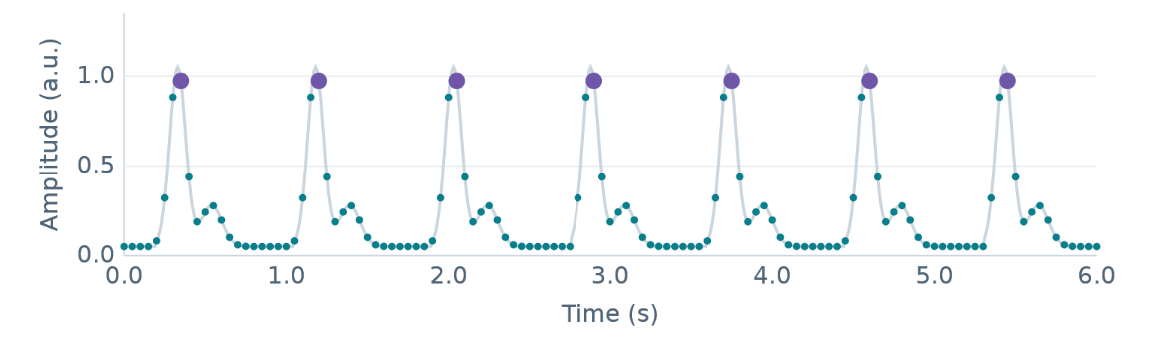
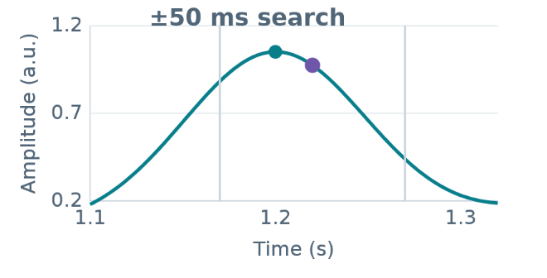
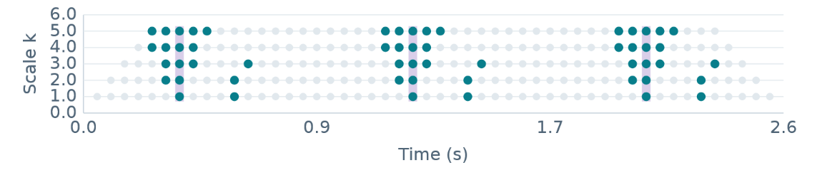
MSPTDfast v2: maxima across temporal scales
20 Hz detector samples within a 6 s window
Refine on the 400 Hz signal
Same sample must remain a maximum across scales
Teal: higher than both neighbours
at distance k samples.
Pulse peaks persist across scales.
Purple guides mark candidate columns.
Project peak-only MSPTDfast v2 port. Illustrative signal; six-second detector windows overlap by 20%.
PEAK DETECTION
25
Notes:
Slide 25 | MSPTDfast v2: maxima across temporal scales
41 seconds
The second detector, multi-scale peak and trough detection fast version two, called MSPTDfast v2 tests whether a sample remains a maximum as its comparison neighbourhood changes. The upper-left plot shows a six-second signal window on the reduced twenty-hertz detector grid. In the lower plot, each row uses a different distance to the left and right neighbours. A teal marker means that the central sample is higher than both neighbours at that scale. A candidate peak must satisfy this condition at every scale up to the selected characteristic scale. Small fluctuations tend to lose this consistency when the neighbourhood grows. Detection on the reduced grid saves computation, but the final pulse time is refined on the original four-hundred-hertz signal. The right-hand enlargement shows a search within fifty milliseconds of the coarse location. Overlapping windows provide additional coverage near their boundaries.
Sources
Thesis §3.4.1; Charlton et al. 2025, DOI 10.1088/1361-6579/adb89e.

Slide 26
MSPTDfast v2: parallel scales and peak refinement
Native PPG
400 Hz
6 s windows
20% overlap
400 / 20 = 20 Hz
Linear detrending
Restrict scales
Lower HR bound: 30 bpm
Parallel comparisons
Scale k = 1
x[i] > x[i−1], x[i+1]
Scale k = 2
x[i] > x[i−2], x[i+2]
Scale k = K
x[i] > x[i−k], x[i+k]
Binary scalogram
M(k, i) = 1 for a
local maximum
…
Overlapping windows protect
peaks near window boundaries.
Characteristic scale λ
λ = arg maxₖ Σᵢ M(k,i)
Candidate pulse peak
M(k,i) = 1 for all k ≤ λ
Refine at 400 Hz
Maximum within ±50 ms
Merge duplicate peaks
Project MSPTDfast v2 port outputs pulse peaks. Coarse detection reduces computation; native refinement preserves timing.
PEAK DETECTION
26
Notes:
Slide 26 | MSPTDfast v2: parallel scales and peak refinement
39 seconds
The detector uses six-second windows with twenty-percent overlap. After downsampling and detrending, parallel comparisons form a local-maxima scalogram. The characteristic scale has the greatest number of local maxima. Candidates must remain maxima across all preceding scales. They map back to the original signal for local refinement. Peaks from overlapping windows are then merged and duplicates removed, producing the final pulse times.
Sources
Thesis §3.4.1; Charlton et al. 2025, DOI 10.1088/1361-6579/adb89e.

Slide 27
Peak timing and execution speed
Timing error on IR
Execution time on IR
0.031%
0.006%
Beat F1: 97.8% → 99.7%
Approximately 5× faster
RMSE = root mean square error of pulse intervals against ECG. Static sample: 22 participants; runtime as % of duration.
EXTERNAL STATIC BENCHMARK
27
Notes:
Slide 27 | Peak timing and execution speed
47 seconds
Both detectors were evaluated against ECG timing on the external PPG dataset, called PTT, benchmark with twenty-two participants.
On infrared, MSPTDfast v2 achieved better score than Aboy++ on both median beat F1 and the RMSE between ECG inter-beat intervals,. Runtime was about one fifth as long. These results supported that MSPTDfast v2 is better.
Sources
Thesis §4.1.1, Tables 18–19.

Slide 28
Workflow: feature engineering
Waveform branch
Alternative inputs
PPG + IMU
recordings
Preprocessing
Windowing
+ resample
Models &
classification
Physiological
analysis branch
Motion detection
& denoising
Peak detection
Feature
engineering
Optional / identity
Shape / baseline use original optical data
Turn pulse timing, optical shape and movement into interpretable numerical descriptions.
PIPELINE WORKFLOW
28
Notes:
Slide 28 | Workflow: feature engineering
14 seconds
Feature engineering first measure pulse intervals and their variability, then pulse shape and optical descriptors.
These beat-level measurements are summarized together with spectral and movement descriptors to form the model inputs.
Sources
Thesis §3.4 and Tables 7–10.

Slide 29
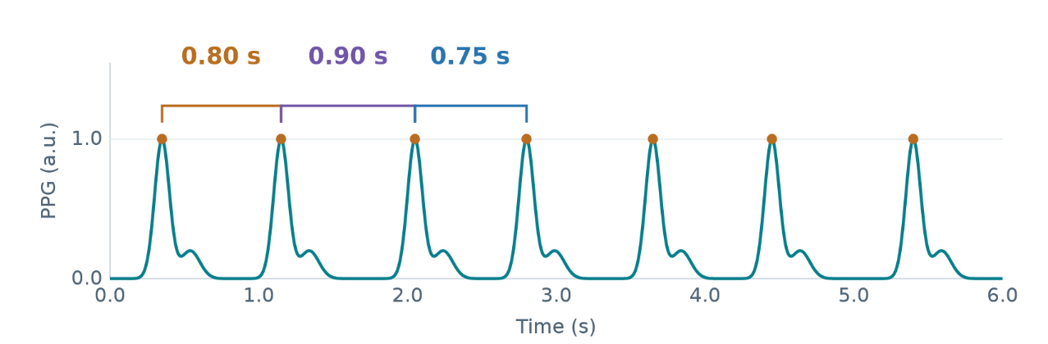
Pulse intervals and pulse rate variability
Peak spacing becomes
one interval value
PPIᵢ = tᵢ₊₁ − tᵢ
PRᵢ = 60 / PPIᵢ
PRV describes variation
SDNN: interval spread
RMSSD: successive changes
PPI = pulse-to-pulse interval; PR = pulse rate; PRV = pulse rate variability.
SDNN = standard deviation of intervals; RMSSD = root mean square of successive differences. Thesis §3.4.2.
FEATURE ENGINEERING
29
Notes:
Slide 29 | Pulse intervals and pulse rate variability
38 seconds
Consecutive peaks define the interval series. Mean spacing gives pulse rate; changing spacing describes PRV. The standard deviation of accepted intervals, or SDNN, measures overall dispersion. The root mean square of successive differences, or RMSSD, measures beat-to-beat changes.
(Invalid intervals break the sequence, so unrelated beats are not joined across gaps. Longer static recordings can also support spectral PRV.)
Sources
Thesis §3.4.2 and Table 8.

Slide 30
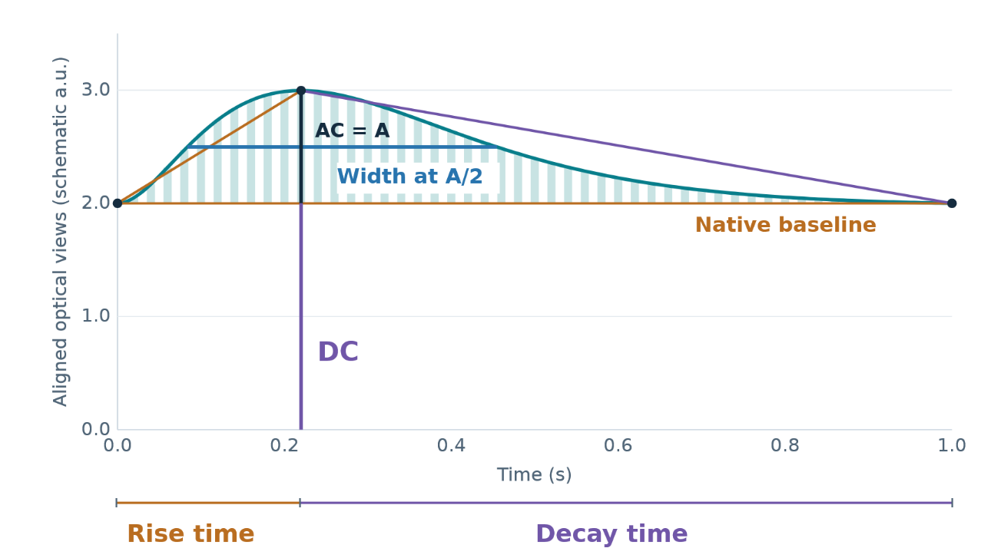
Pulse morphology, AC and DC
Seven shape descriptors
Amplitude and width
at half height
Rise slope = A /
rise time
Decay slope = −A /
decay time
Area above baseline
∫ max(y − DC, 0) dt
AC: alternating
(pulsatile) component
DC: direct
(slowly varying) component
AC is filtered pulse height; DC is the native local baseline. Both optical views are aligned in this schematic.
FEATURE ENGINEERING
30
Notes:
Slide 30 | Pulse morphology, AC and DC
40 seconds
Neighbouring valleys define the pulse baseline. The features are amplitude, half-amplitude width, rise and decay time, rising and falling slopes, and positive area. The alternating optical component, or AC, is pulse amplitude above that baseline. The direct optical component, or DC, comes from the aligned baseline-preserving signal. Their ratio expresses pulsatile amplitude relative to optical level; red and infrared supply wavelength-related ratios.
Sources
Thesis §3.4.3 and Table 9.

Slide 31
Pulse morphology, AC and DC
Seven shape descriptors
Amplitude and width
at half height
Rise slope = A /
rise time
Decay slope = −A /
decay time
Area above baseline
∫ max(y − DC, 0) dt
AC: alternating
(pulsatile) component
DC: direct
(slowly varying) component
AC is filtered pulse height; DC is the native local baseline. Both optical views are aligned in this schematic.
FEATURE ENGINEERING
30
Notes:
Slide 30 | Pulse morphology, AC and DC
40 seconds
Neighbouring valleys define the pulse baseline. The features are amplitude, half-amplitude width, rise and decay time, rising and falling slopes, and positive area. The alternating optical component, or AC, is pulse amplitude above that baseline. The direct optical component, or DC, comes from the aligned baseline-preserving signal. Their ratio expresses pulsatile amplitude relative to optical level; red and infrared supply wavelength-related ratios.
Sources
Thesis §3.4.3 and Table 9.

Slide 32
Recording features matrix
Group | Count
Rate and PRV | 17
Morphology | 14
Engineering mean / SD | 115
K × 146
chronological matrix
10 s windows, 2 s hop
K = number of complete windows
FEATURE REPRESENTATIONS
31
Notes:
Slide 31 | Recording features and the ordered matrix
32 seconds
The chronological feature matrix combines pulse rate and PRV, pulse morphology, dual-wavelength optical descriptors, signal statistics, spectral measures and IMU features.
It has one hundred and forty-six columns per local window (and one row per observation in time)
It uses ten-second windows with a two-second step
Thesis §3.4.5 and Tables 7–11; feature matrix configuration.

Slide 33
Workflow: windowing
Waveform branch
Alternative inputs
PPG + IMU
recordings
Preprocessing
Windowing
+ resample
Models &
classification
Physiological
analysis branch
Motion detection
& denoising
Peak detection
Feature
engineering
Optional / identity
Shape / baseline use original optical data
Duration, overlap, normalization and resampling define the waveform model’s input.
PIPELINE WORKFLOW
10
Notes:
Slide 10 | Workflow: windowing
14 seconds
For waveform branch. classification uses resampled and normalized ppg and imu signal in divided windows.
Sources
Thesis §§3.3.3–3.3.4 and Table 35.

Slide 34
Windowing, resampling and normalization
5 s windows
2.5 s hop
Robust scale
all 8 channels
Anti-alias resampling
64 Hz
8 × 320
samples
Interquartile range (IQR)
s = IQR / 1.349
z = (x − median) / s
Clip to [−8, 8]
Apply to all 8 model input channels
Keep feature views unnormalized
Window 1: 0–5 s
Window 2: 2.5–7.5 s
Schematic; complete windows only
PREPROCESSING
32
Notes:
Slide 32 | Windowing, resampling and normalization
34 seconds
The waveform branch uses five-second windows with a two-point-five-second step. Eight channels are resampled to sixty-four hertz. Each channel is centred by its median and scaled by its interquartile range, then clipped between minus eight and eight. Every window keeps its participant and recording-role identifiers.
Sources
Thesis §§3.3.3–3.3.4 and §3.5.2; Table 35.

Slide 35
Participant grouping and balanced aggregation
StratifiedGroupKFold: 5 grouped folds × 5 repeats
All files and windows from one participant remain in one fold
Window
probabilities
File mean
Role-family mean
B / R / S / W
Participant
probabilities
Baseline | Recovery | Sit-to-stand | Walking
25% | 25% | 25% | 25%
Internal out-of-fold evaluation. Repeated predictions do not create new independent participants.
MODELS AND CLASSIFICATION · EVALUATION
33
Notes:
Slide 33 | Participant grouping and balanced aggregation
43 seconds
Participants are the independent evaluation units. Stratified Group K-Fold, was implented to keeps each person's recordings together while approximately preserving class proportions. Five-fold validation is repeated five times. All learned preprocessing uses training participants only.
Predicted probabilities are averaged within each file, within each recording role, and across roles for each participant. With all roles present, each receives one-quarter weight. Balanced accuracy, or BA, averages class recalls; macro F1 averages the class F1 scores.
Sources
Thesis §3.6.1, §§3.6.2–3.7; StratifiedGroupKFold, participant-level aggregation.

Slide 36
Workflow: models and classification
Waveform branch
Alternative inputs
PPG + IMU
recordings
Preprocessing
Windowing
+ resample
Models &
classification
Physiological
analysis branch
Motion detection
& denoising
Peak detection
Feature
engineering
Optional / identity
Shape / baseline use original optical data
Link the selected representation to a model and aggregate predictions by participant.
PIPELINE WORKFLOW
34
Notes:
Slide 34 | Workflow: models and classification
11 seconds
The workflow has now reached classification. Classification compares the resampled waveform windows with feature engineered representations, using the same participant-grouped evaluation principle.
Sources
Thesis §§3.5–4.2.

Slide 37
Screening the input representations
Participant-level performance across five repeats
Representation and model | BA (%) | Macro-F1 (%) | F1 Holm p
Raw signals + 1-D CNN | 51.5 ± 3.9 | 50.4 ± 3.9 | Reference
Feature matrix + Small InceptionTime | 44.7 ± 4.3 | 35.8 ± 3.7 | 0.5635
The screening did not establish a significant difference between routes.
Raw-signal input was selected for deeper investigation within the thesis scope.
Feature-matrix input remained an exploratory comparison.
BA = balanced accuracy; CNN = convolutional neural network; 1-D = one-dimensional. Thesis Table 24.
MODELS AND CLASSIFICATION
35
Notes:
Slide 35 | Screening the input representations
29 seconds
Waveform windows and the chronological feature matrix reached mean balanced accuracy of fifty-one point five and forty-four point seven percent. Representation screening did not establish a significant difference. The observed ordering guided later work toward waveform input; it does not show that engineered features lack predictive value.
Sources
Thesis §4.2.1, Table 24; Holm-adjusted route comparisons.

Slide 38
Architectures make different assumptions
Model | Core architecture | Before 3-class output
Compact CNN | Conv9/32 → Pool4 → Conv9/64 → Pool4 → Conv7/128 → global average | 128 features → dropout → linear
Inception Small / Full | Parallel Conv39/19/9 + Pool3/Conv1 3/6 modules; 16/32 filters per branch | 64 / 128 features → global average → linear
ShapeFormer | Generic convolution + global attention Training-derived shapelets + attention | 48 + 128 = 176 → linear
Selected model: Small InceptionTime, 8 × 320 input at 64 Hz.
Convolution learns local patterns; attention links information across time.
Thesis §3.5.2 and Tables 12–14. Each model outputs probabilities for Pre-Frail, Robust and Young.
MODEL ARCHITECTURES
36
Notes:
Slide 36 | Architectures make different assumptions
30 seconds
For waveform classification, the thesis compares three time-series networks.
A one-dimensional convolutional neural network, 1D CNN, learns local temporal patterns. InceptionTime uses parallel convolutions of different lengths. ShapeFormer combines attention with learned shapelets.
The CNN and InceptionTime had comparable performance in the preliminary comparison; no significant advantage was established. InceptionTime ranked slightly higher descriptively and was carried into the subsequent grid search.
Sources
Thesis §§3.5.1–3.5.4 and §4.2.2.

Slide 39
Single-factor ablation
Change from the common baseline
Factor changed | InceptionTime
64 Hz to 400 Hz | −6.5 ± 3.5
Window / hop: 15 / 3 s to 5 / 2.5 s | −5.8 ± 4.7
Low-pass gravity separation to calibrated EKF | −7.0 ± 5.9
Window scaling to PPG-window / IMU-fold scaling | −13.8 ± 6.3
File-weighted to role-equal sampler | −4.4 ± 2.8
AdamW / batch 32 to Adam / batch 64 | −0.7 ± 5.0
Direct-window to file / role aggregation | +0.6 ± 1.9
Normalization
Window scaling showed the
largest consistent mean effect.
IMU processing
Calibrated EKF processing
lowered mean balanced accuracy in
both architectures.
More detailed IMU processing
did not guarantee better
classification in this cohort.
Δ balanced accuracy in percentage points, mean ± SD across repeats. Thesis Tables 28–30.
SELECTION OF THE FINAL CONFIGURATION
40
Notes:
Slide 40 | Single-factor ablation
70 seconds
The single-factor ablation varied sampling rate, windowing, IMU preprocessing, normalization, sampling, optimization and aggregation around a common baseline. The strongest consistent change concerned normalization. Replacing window-wise scaling of all channels with separate fold-level IMU scaling reduced balanced accuracy by thirteen point eight percentage points for InceptionTime and ten point five for the CNN.
Calibrated EKF gravity handling and increasing the model rate to four hundred hertz also produced lower mean scores in both architectures. More detailed physiological processing therefore did not necessarily improve classification in this cohort. Retained posture information and estimation transients are possible explanations for the IMU result. These paired changes describe sensitivity around the tested baseline, rather than independent effects that can simply be added together.
Sources
Thesis §4.2.4.1, Tables 28–30; §5.1.

Slide 40
Routing and hyperparameter searches
Comparison | Main observation | Decision for follow-up
Signal quality index (SQI) and motion gating | All-role ungated BA 61.9%; motion-only gating 50.9% | Retain all roles; disable gating
Batch size × learning rate 6 settings | Highest-ranked BA 59.5 ± 6.2%; next setting 56.1 ± 6.4% | Batch 16, learning rate 3 × 10⁻⁴
Regularization 9 settings | BA means ranged 55.0–58.9%; all ±1 SD intervals overlapped | No clear advantage within the tested grid
Additional exploratory tests | Epochs, window length / overlap, retained windows, CNN regularization | No further change to the final configuration
Small grid-search margins did not establish superiority.
Thesis Tables 27, 31–32 and §4.2.4.4. Mean ± SD describes variation between repeats.
SELECTION OF THE FINAL CONFIGURATION
41
Notes:
Slide 41 | Routing and hyperparameter searches
46 seconds
Routing was tested before fine tuning. Retaining all recording roles with both gates disabled gave the highest mean score. Motion-only gating reduced balanced accuracy from sixty-one point nine to fifty point nine percent, supporting the ungated route for subsequent experiments.
Grid searches examined batch size, learning rate and regularization. Differences across the regularization settings were small.
Sources
Thesis §§4.2.4.2–4.2.4.4; Tables 31–32 and Appendix D.

Slide 41
Final comparison of five configurations
Rank / configuration | BA (%) | Macro-F1 (%)
1 Small, all roles, Profile A | 71.9 ± 4.7 | 70.4 ± 4.4
2 Small, all roles, no gravity removal | 71.4 ± 4.9 | 69.3 ± 3.9
3 Full, all roles, Profile A | 70.6 ± 5.4 | 69.6 ± 5.2
4 Full, alternative training settings | 66.3 ± 4.9 | 67.6 ± 4.4
5 Full, static roles, Profile A | 58.1 ± 3.3 | 57.5 ± 4.1
Recording roles
Network capacity
Gravity removal
Ranks 3 vs 5: +12.5 pp BA
All roles versus static roles.
Holm p = 0.1255.
Ranks 1 vs 3: +1.3 pp BA.
Additional capacity showed
no clear benefit.
Ranks 1 vs 2: +0.5 pp BA.
The two leading settings were
indistinguishable on this evidence.
Thesis Tables 33–34. Rank 1 was selected by the pre-specified ranking; values are mean ± SD across repeats.
SELECTION OF THE FINAL CONFIGURATION
42
Notes:
Slide 42 | Final comparison of five configurations
40 seconds
The final comparison isolated three choices. Including walking and sit-to-stand alongside static recordings raised the full model's mean balanced accuracy from fifty-eight point one to seventy point six percent. This was the largest observed increase, but its Holm-adjusted p-value was zero point one two six.
Reducing network capacity gave a much smaller difference, and Profile A gravity separation versus no separation changed balanced accuracy by only half a percentage point. The selected compact configuration combined all recording roles, robust window scaling and Profile A. Dynamic recordings contributed only about four percent of signal duration but half of the role-averaged decision, so their observed contribution reflects both recorded information and aggregation weight.
Sources
Thesis §4.2.4.5, Tables 33–34; §5.1.

Slide 42
Final participant-level classification
Selected Small InceptionTime
Input
Endpoint | Mean ± SD (%)
Balanced accuracy | 71.9 ± 4.7
Macro-F1 | 70.4 ± 4.4
Macro ROC-AUC | 84.4 ± 3.1
Macro PR-AUC | 77.6 ± 4.2
8 channels at 64 Hz
5 s windows, 2.5 s hop
All four recording roles
Processing and evaluation
Window-wise robust scaling
Low-pass filter gravity separation
No SQI or motion gating
5 grouped folds × 5 repeats
Window probabilities are averaged by file, role and participant.
ROC-AUC = area under the receiver operating characteristic curve.
PR-AUC = area under the precision–recall curve. Thesis Tables 33–35.
CLASSIFICATION RESULTS
43
Notes:
Slide 43 | Final participant-level classification
45 seconds
Selected Small InceptionTime achieved participant-level balanced accuracy of seventy-one point nine percent, with a between-repeat standard deviation of four point seven points. Macro F1 was seventy point four percent. Macro receiver operating characteristic area under the curve, or ROC-AUC, was eighty-four point four percent; macro precision-recall area under the curve, or PR-AUC, was seventy-seven point six percent. These are held-out-participant estimates within this cohort, using all roles, window-wise scaling and Profile A.
Sources
Thesis Tables 33–35.

Slide 43
Classification across the three groups
Actual / predicted | Pre-Frail | Robust | Young
Pre-Frail | 36 80.0% | 9 20.0% | 0 0.0%
Robust | 25 41.7% | 28 46.7% | 7 11.7%
Young | 2 5.0% | 3 7.5% | 35 87.5%
Robust recall
46.7%
Young recall
87.5%
Worst-class F1: 62.1%
The Young group contributes an age-related contrast to the overall result.
Clinical focus: distinguishing Pre-Frail from Robust among older adults.
Thesis Table 34 and Chapter 6. Group counts are independent participants.
CLASSIFICATION RESULTS
44
Notes:
Slide 44 | Classification across the three groups
28 seconds
The confusion matrix shows where the aggregate result comes from.
The pooled recalls are eighty percent for Pre-Frail, forty-six point seven percent for Robust or Non-Frail, and eighty-seven point five percent for Young.
Robust was the hardest category to distinguish, despite being the largest group. Separating Robust from Pre-Frail older adults is the clinically relevant challenge here. The easier Young-versus-older contrast can raise the three-class summary, so the overall balanced accuracy should always be read alongside this class-level pattern.
Sources
Thesis Table 34 and Chapters 5–6.

Slide 44
Limitations
Scope of modelling | Feature-vector and feature-matrix routes were not pursued in depth, although screening did not establish their inferiority.
Cohort and validation | 29 participants and no independent frailty-labelled validation cohort. Young is an age-reference group.
Repeated model selection | All selection stages used the same cohort, introducing optimism into the selected performance.
Feature representation | Window summaries reduce the ordering of PPI and morphological changes across successive beats.
Short dynamic recordings | A few short windows can carry substantial weight in role-level aggregation.
Thesis §5.2. The results support feasibility within this cohort; clinical validity remains unestablished.
LIMITATIONS
45
Notes:
Slide 45 | Limitations
The most substantial limitation is the scope of modelling. Representation screening found no significant performance difference between the waveform, feature-vector and feature-matrix routes. Only the waveform route with a single InceptionTime network was then investigated in depth. The feature branches remained exploratory, so the thesis does not establish that another representation or ensemble could not perform as well or better.
All classification results are internal out-of-fold estimates from twenty-nine participants. Repeated selection on the same cohort introduces optimism, and there was no independent frailty-labelled test cohort. The dynamic recordings were short, yet their role-level aggregation gave them substantial weight. Window-level feature summaries also remove the order of beat-to-beat changes.
Sources
Thesis §5.2, especially scope restriction; internal evaluation; selection bias; feature aggregation and dynamic-task weighting.

Slide 45
Conclusions and future work
Conclusions
Next steps
A modular pipeline processes
synchronised PPG and IMU.
Larger cohorts and independent
participant-level validation
External ECG benchmarking supports
reliable pulse-interval extraction.
Beat-indexed feature sequences
and deeper feature-route evaluation
Internal classification identified
group-related information.
Wearable deployment: runtime,
memory, latency and energy
Thesis Chapters 5–6. Future evaluation should focus on the distinction between older frailty-related groups.
CONCLUSIONS
46
Notes:
Slide 46 | Conclusions and future work
33 seconds
The pipeline connects synchronized signals, physiological measurements and participant-level classification. External ECG evaluation supports the selected peak detector; grouped classification reached a highest mean balanced accuracy of seventy-one point nine percent. Future work should validate larger independent cohorts, investigate feature routes and preserve beat-level order, with emphasis on distinctions among older adults. Thank you.
Sources
Thesis Chapters 5–6.

Slide 46
Backup material
Optical representations
Motion as information and contamination
Signal-quality endpoints
Numerical scaling and missing values
Model representations and fusion
Separate native and filtered optical views
Additional detail for questions
DISCUSSION
47
Notes:
Slide 47 | Backup material
Backup: not included in timed presentation
The following material provides additional detail on signal representations, quality assessment and modelling routes.
Sources
Thesis Chapter 3.

Slide 47
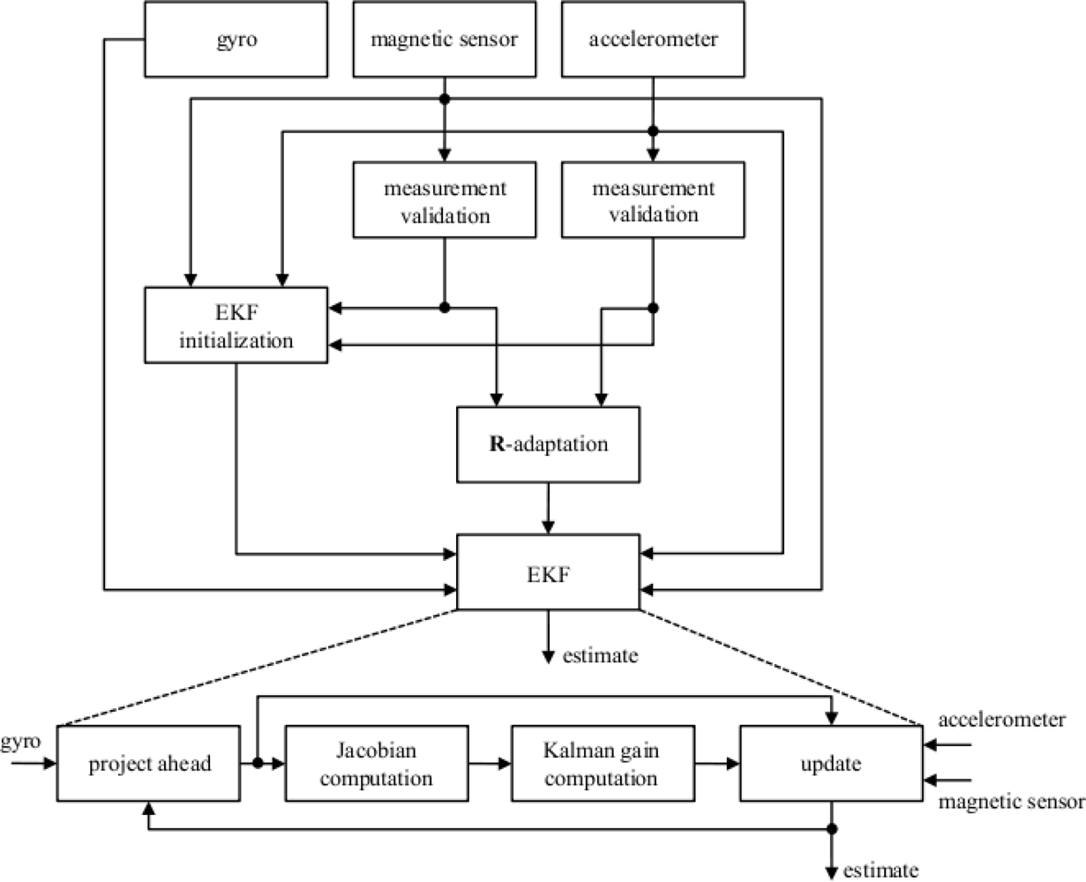
Published EKF: prediction and measurement update
Predict
Integrate gyro measurements
and propagate uncertainty.
Weight
Validate aiding sensors.
Adapt R and calculate the gain.
Correct
Update state and covariance,
then repeat at the next sample.
Sabatini, 2011, Fig. 6. Recursive orientation estimation: gyroscope prediction and aiding-sensor correction.
LITERATURE ALGORITHM
48
Notes:
Slide 48 | Published EKF: prediction and measurement update
Backup: not included in timed presentation
The prediction-and-correction cycle can also be followed through the covariance equations. The previous state predicts the next orientation and its uncertainty. Measurement validation then determines how strongly the new observations should influence that prediction.
The Kalman gain weights the innovation: the difference between the measured observation and the observation predicted by the current state. Applying this correction updates both the state and its covariance. Repeating the loop combines the short-term information from angular velocity with the longer-term orientation reference.
Sources
Thesis §3.3.2; Sabatini 2011, Figure 6, DOI 10.3390/s110201489.

Slide 48
PCA: component selection and reconstruction
RED + IR observations
X ∈ ℝᴺˣ²
Centre and decompose
X − mean(X) = SAᵀ
Candidate components
s₁[n], s₂[n]
Evaluate each component
using pulse periodicity
and motion association.
Cardiac concentration Cⱼ
Pⱼ(0.5–3.5) / Pⱼ(0.2–8)
Motion association Rⱼ
maxᵢ |corr(sⱼ, IMUᵢ)|
Aligned IMU axes
Select j* = argmax(Cⱼ −0.25Rⱼ)
Project back to RED / IR
X̂ = sⱼ* aⱼ*ᵀ + mean(X)
Other evaluated BSS methods
FastICA: independence Spectral NMF: nonnegative spectral factors
FastICA = fast independent component analysis; NMF = nonnegative matrix factorization. Thesis §3.3.5.
MOTION ARTEFACT REDUCTION
49
Notes:
Slide 49 | PCA: component selection and reconstruction
Backup: not included in timed presentation
The PCA route begins with the paired red and infrared samples, centres both channels, and decomposes them into candidate components. Each component undergoes two assessments. Cardiac concentration measures the proportion of power in the expected pulse band. Motion association measures the largest absolute correlation with any IMU reference axis. The selection score subtracts a weighted motion penalty from cardiac concentration. The component with the highest score is projected back into the two optical channels. The thesis also evaluates FastICA, which seeks statistical independence, and spectral NMF, which decomposes nonnegative magnitude spectra. These methods therefore use different separation criteria.
Sources
Thesis §3.3.5

Slide 49
Feature-matrix kernels move through time
Display: K windows × 146 features → Network: batch × 146 × K
Feature channel | Window 1 | Window 2 | Window 3 | …
PPI descriptor | x₁,₁ | x₁,₂ | x₁,₃ | …
Pulse-shape descriptor | x₂,₁ | x₂,₂ | x₂,₃ | …
IMU descriptor | x₃,₁ | x₃,₂ | x₃,₃ | …
… 146 channels | … | … | … | …
Window duration: 10 s
Window step: 2 s
For D ≥ 10 s:
K = ⌊(D − 10)/2⌋ + 1
60 s → 26 windows
300 s → 146 windows
Convolution slides along K →
Learned weights mix feature channels
Conv39: 10 + 38 × 2 = 86 s
Small maximum: 238 s, if K permits
Illustrative feature matrix. K varies with recording duration; padding is excluded by the sequence mask.
FEATURE MATRIX · DIMENSIONS AND SUPPORT
50
Notes:
Slide 50 | Feature-matrix kernels move through time
Backup: not included in timed presentation
For a closer look at the chronological matrix, denote the number of rows by K. The array then has shape K by one hundred and forty-six. A length-thirty-nine temporal kernel covers up to eighty-six seconds in the original recording, assuming the ten-second source window and two-second step. Three stacked modules have a nominal maximum span of one hundred and fifteen positions if the data are long enough. For shorter records, padding preserves array size without adding observations. Every feature column is standardized from training-participant statistics only.
Sources
Thesis §3.4.5; chronological feature-matrix configuration.

Slide 50
Three optical representations
Recorded RED / IR
Repaired native
optical signal
Retain acquisition-scale DC
Direct-route MSPTDfast input
Detrended + filtered
analysis signal
Scaled 5 s
model input
Pulse shape and amplitude
Engineering signal features
Learn waveform patterns
Scale each channel within each window
SIGNAL REPRESENTATION
51
Notes:
Slide 51 | Three optical representations
Backup: not included in timed presentation
The baseline-preserving optical view keeps the acquisition-level signal needed for DC-dependent measurements. The filtered view removes a linear trend and restricts the bandwidth, while preserving relative pulse amplitude. The deep-learning view then applies window-wise normalization. The three views remain aligned in time, and each supplies the measurements for which it was defined.
Sources
Thesis Table 5.

Slide 51
Motion has two roles in PPG analysis
IMU acceleration
and angular velocity
Potential group information
Task execution / movement
Participant
movement
Motion context / reference
Sensor–tissue coupling
and optical disturbance
PPG quality
and motion artefacts
Pulse analysis: assess or suppress contamination.
Classification: movement may also carry useful information.
Age, task execution and contact can contribute. A joint prediction does not isolate an independent IMU or PPG effect.
WHY ADD IMU?
52
Notes:
Slide 52 | Motion has two roles in PPG analysis
Backup: not included in timed presentation
Movement has two roles in this study. IMU signals describe physical activity and task execution, which can contribute to participant classification. The same activity can disturb optical contact and contaminate pulse measurements. Motion information therefore acts both as a model input and as a reference for interpreting and reducing PPG artefacts. The appropriate treatment depends on the endpoint being measured.
Sources
Thesis §3.3.5; §4.2.3 and §5.1.

Slide 52
Quality requirements depend on the endpoint
PPG periodicity + RED/IR agreement
IMU motion information
Optional motion detector
LightCNN: 8 × 3200 samples
8 s windows, 2 s stride
3 convolution blocks
Motion probability
Rate quality
Q_rate
Shape quality
Q_morph
Poor segments can enter
artefact processing or be excluded
Pulse timing / PRV
Pulse morphology
SQI, the motion detector and denoising are all disabled in the final classification preset.
OPTIONAL SIGNAL ANALYSIS
53
Notes:
Slide 53 | Quality requirements depend on the endpoint
Backup: not included in timed presentation
The quality module distinguishes pulse timing from pulse morphology. Rate quality evaluates periodicity, cardiac-band concentration, plausible peak density and interval stability. Morphology quality additionally requires repeatable pulse shape and agreement between wavelengths. Flatlines, clipping and long gaps provide exclusion checks.
Together with the motion detector, these measures can direct a segment to analysis, artefact reduction or exclusion. The selected waveform classifier leaves these optional gates disabled, following the routing comparison. The physiological feature branch retains endpoint-specific eligibility checks.
Sources
Thesis §3.3.5 and Table 6; §4.2.3.

Slide 53
Numerical handling depends on the representation
Input | Model-facing transformation | Value / validity constraint
Waveform input | Per-window median; IQR / 1.349 All 8 channels; clip before resampling | Clip ±8 before resampling Resampling may slightly overshoot
146-channel matrix | Per-feature training median; IQR / 1.349 Invalid cells → 0; time mask retained | No clipping; no universal range Per-cell validity is not appended
Fusion vector | Training median / IQR; MAD fallback 282 values + 282 validity indicators | 564 inputs; no clipping Missing: value 0 and indicator 0
Logistic / support vector machine (SVM) | Training median imputation StandardScaler | Feature-specific scaling ExtraTrees only imputes
Features include timing, bpm, optical amplitude, acceleration in g, angular velocity in °/s, powers and ratios.
MAD = median absolute deviation. Scaling parameters are fitted on training participants only.
FEATURE VALUES · SCALING AND MISSINGNESS
54
Notes:
Slide 54 | Numerical handling depends on the representation
Backup: not included in timed presentation
Feature columns represent different physical and statistical quantities, so their numerical ranges differ. Imputation and standardization are fitted on the training participants and then applied to held-out participants. Missing-value indicators record which measurements were available. In a chronological matrix, the time mask separately identifies valid sequence positions. These operations keep numerical preparation tied to the representation and the participant split.
Sources
Thesis §§3.3.4, 3.4.5 and 3.6.

Slide 54
Representations and models compared
Input representation | Model family | Role in the study
Engineered feature vector / matrix | Feature models / sequence encoder | Interpretable comparison
Waveform + engineered features | Signal encoder + multilayer perceptron (MLP) | Fusion comparison
8-channel waveform windows | 1D-CNN / InceptionTime / ShapeFormer | Time-series comparison
Selected input
8 × 320 waveform
Small InceptionTime
Single network
CLASSIFICATION CONTEXT
55
Notes:
Slide 55 | Representations and models compared
Backup: not included in timed presentation
The representation comparison used a waveform CNN, a logistic-regression feature vector and a Small InceptionTime feature matrix. No significant route differences were established. The architecture comparison then evaluated CNN, InceptionTime and ShapeFormer with matched waveform inputs. InceptionTime ranked highest descriptively, while ShapeFormer required substantially more computation. These comparisons guided the allocation of the subsequent experiments.
Sources
Thesis Tables 24–25.

Slide 55
Fusion joins two descriptions of one recording
W waveform windows
W × 8 × T
Shared encoder
Compact / Small Inception
Mean over valid windows
128 / 64 features
282 feature values
+ 282 validity indicators
Multilayer perceptron (MLP)
564 → 32 + ReLU
Concatenate once per file
160 / 96 features
Feature preprocessing is learned from training participants.
The same file vector is attached once per recording. ReLU = rectified linear unit.
Linear → 64 → ReLU → dropout 0.2
Linear → 3 scores → softmax probabilities
Fusion averages windows within each file. The selected Small InceptionTime model uses waveform input alone.
MODEL ARCHITECTURE · COMPARISON ROUTE
56
Notes:
Slide 56 | Fusion joins two descriptions of one recording
Backup: not included in timed presentation
The fusion architecture combines two descriptions of the same recording. A waveform encoder produces window embeddings, which are pooled into a recording-level signal representation. In parallel, the engineered features and their validity indicators pass through a small multilayer perceptron, or MLP. Concatenating the two embeddings supplies the final three-class head. This provides a defined extension for combining learned waveform patterns with physiological descriptors.
Sources
Thesis §§3.4.5 and 3.5.2.

Slide 56
AC and DC come from aligned optical views
Native view preserves
the optical level
DC
DC: native local baseline
at this beat’s peak
Filtered view:
pulsatile amplitude
AC
AC: filtered peak above
its local baseline
Optical descriptors here do not estimate peripheral oxygen saturation (SpO₂). Conceptual aligned views.
OPTICAL FEATURES
57
Notes:
Slide 57 | AC and DC come from aligned optical views
Backup: not included in timed presentation
The filtered waveform supplies pulse amplitude above a local valley-to-valley baseline. The aligned baseline-preserving signal supplies the native optical level at those beat locations. Their ratio expresses pulsatile modulation relative to the optical baseline. Comparing the ratios between red and infrared adds a dual-wavelength descriptor. Preserving both signal views allows these quantities to be calculated after the pulse locations have been identified.
Sources
Thesis §3.4.3 and Table 9.

Slide 57
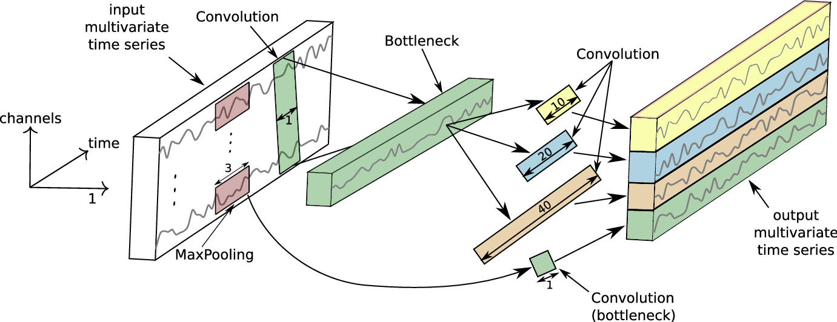
Small InceptionTime
8 channels
320 samples
3 modules
64 output channels
Global average
pooling
Dropout 0.5
Linear head
Softmax
3 probabilities
MODEL ARCHITECTURE
37
Notes:
Slide 37 | Small InceptionTime
50 seconds
Figure eleven shows an Inception module. A one-by-one bottleneck feeds three parallel convolutions; a fourth branch uses max pooling and a one-by-one convolution. Their outputs are concatenated, normalized and passed through the rectified linear unit, or ReLU.
Small InceptionTime uses kernel lengths thirty-nine, nineteen and nine, with sixteen filters per branch. Three modules and a residual connection process the eight-channel input. Global average pooling produces sixty-four values. Dropout and a linear head give three class scores, converted to probabilities by softmax.
Sources
Thesis Figure 11 and Table 13; Ismail Fawaz et al. 2020.

Slide 58
A receptive field is measured in samples
rnew = r + (k − 1) × d × j jnew = j × stride
r: receptive field k: kernel length d: dilation j: input-sample spacing
Local operation / model | Input samples R | At 64 Hz | At 400 Hz
One Conv39 branch | 39 | 0.609 s | 0.098 s
Small Inception · 3 modules | 115 = 1 + 3 × 38 | 1.797 s | 0.288 s
Full Inception · 6 modules | 229 = 1 + 6 × 38 | 3.578 s | 0.573 s
Compact CNN · including pooling | 152 | 2.375 s | 0.380 s
Global average pooling still aggregates the entire 5 s input window.
Longest local path before global pooling. Architectural support in seconds is expressed as R/fₛ.
LOCAL RECEPTIVE FIELD
38
Notes:
Slide 38 | A receptive field is measured in samples
40 seconds
A kernel's duration depends on sampling rate. Thirty-nine samples cover about zero point six seconds at sixty-four hertz, but less than one tenth of a second at four hundred hertz. Three stacked modules have a maximum local receptive field of one hundred and fifteen samples, about one point eight seconds at sixty-four hertz. Global average pooling combines information across the full five-second window.
Sources
Thesis §3.5.2 and §4.2.4.1.

Slide 59
Sampling rate also sets resolution and bandwidth
Grid | Sample interval
400 Hz · feature / refinement | 2.5 ms
64 Hz · selected model input | 15.625 ms
20 Hz · coarse peak search | 50 ms
Anti-aliasing is part of the representation
400 → 64 Hz gives a 32 Hz Nyquist limit. The 0.2–8 Hz PPG band is retained
in principle; gyroscope content above 32 Hz is removed during model resampling.
Conceptual sampling illustration. Coarse detector candidates are refined at 400 Hz; the classifier grid is a separate choice.
SAMPLING CONSTRAINTS
39
Notes:
Slide 39 | Sampling rate also sets resolution and bandwidth
31 seconds
Five seconds contains two thousand samples at four hundred hertz, but three hundred and twenty at sixty-four hertz. Higher-rate signals preserve pulse timing and morphology. The classifier rate still represents the filtered PPG band up to eight hertz and gives fixed-length kernels a longer time span. Anti-alias filtering precedes downsampling.
Sources
Thesis §3.3; §4.2.4.1; Table 35.

