Slide 1
UNIT-4

Slide 2
Introducing Linear Regression:
A regression is a statistical technique that relates a dependent variable to one or more independent (explanatory) variables.
Linear regression is one of the easiest and most popular Machine Learning algorithms. It is a statistical method that is used for predictive analysis. Linear regression makes predictions for continuous/real or numeric variables such as sales, salary, product price, etc.
Linear regression algorithm shows a linear relationship between a dependent (y) and one or more independent (y) variables, hence called as linear regression.
Since linear regression shows the linear relationship, which means it finds how the value of the dependent variable is changing according to the value of the independent variable.

Slide 3
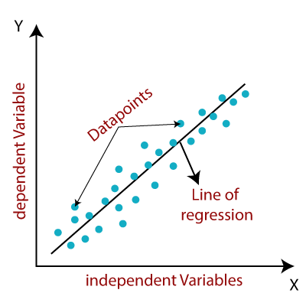
It is represented as: y= a₀+a₁x+ ε
Y= Dependent Variable (Target Variable) X= Independent Variable (predictor Variable) a0= intercept of the line (Gives an additional degree of freedom) a1 = Linear regression coefficient (scale factor to each input value). ε = random error
The values for x and y variables are training datasets for Linear Regression model representation.

Slide 4
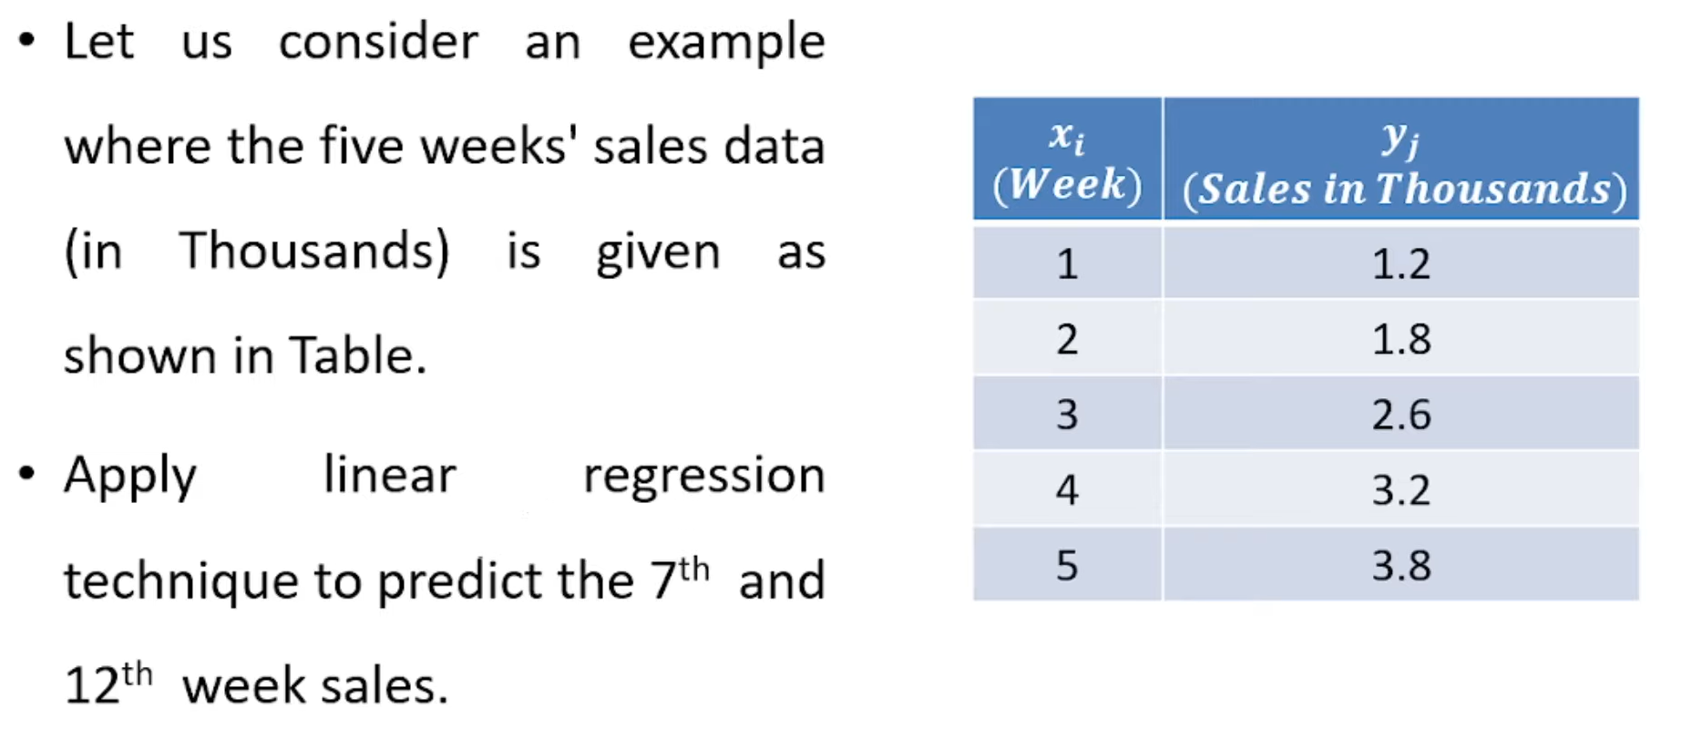
Example:

Slide 5
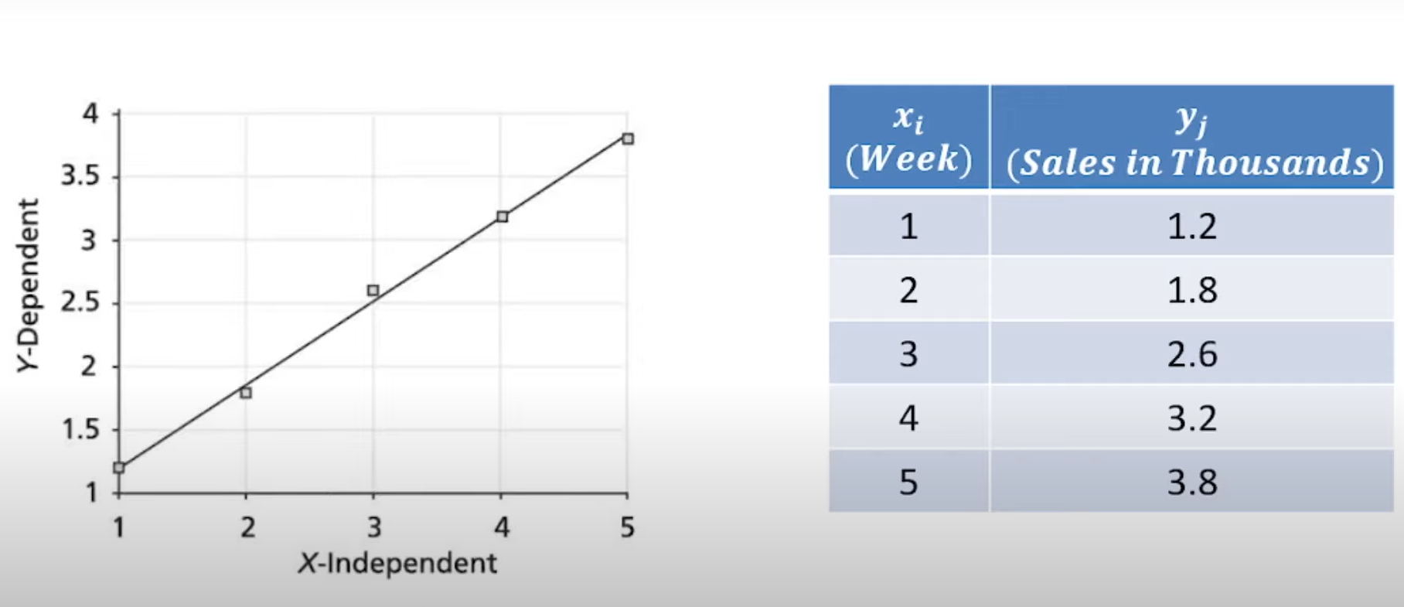

Slide 6
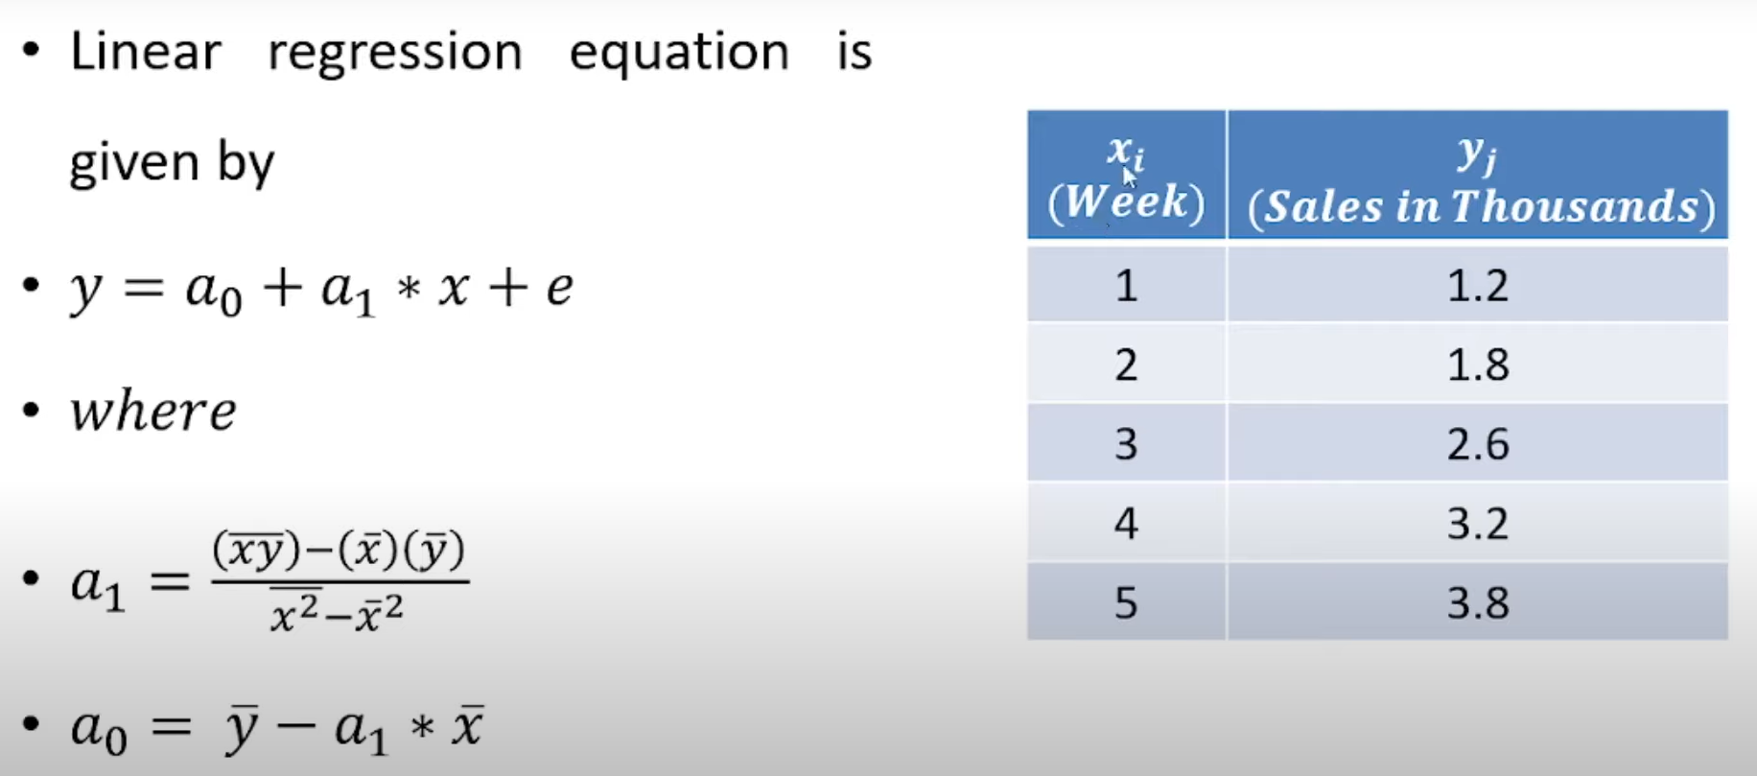

Slide 7
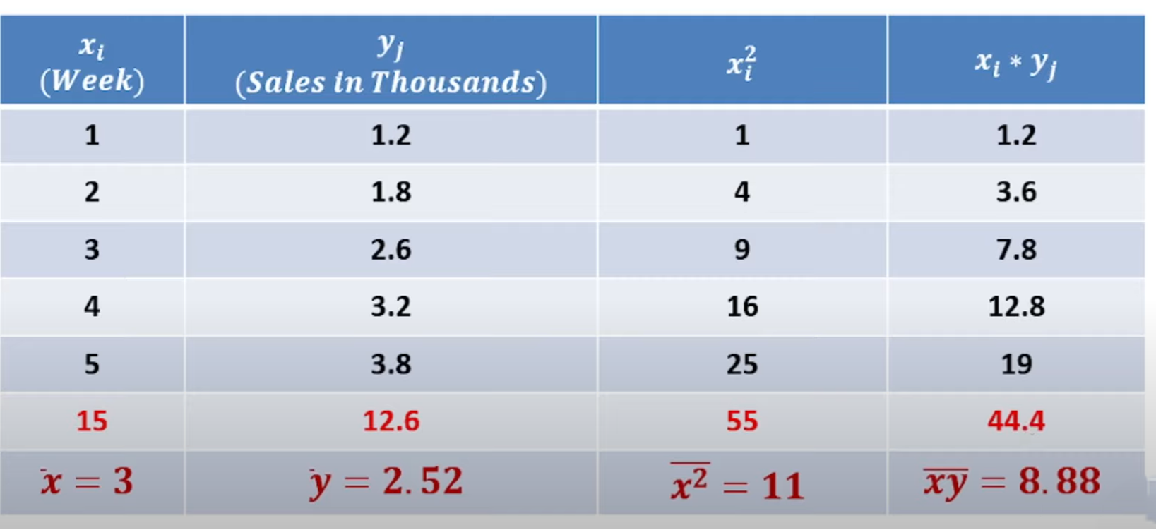
Here, there are 5 items, i.e., i=1,2,3,4,5

Slide 8
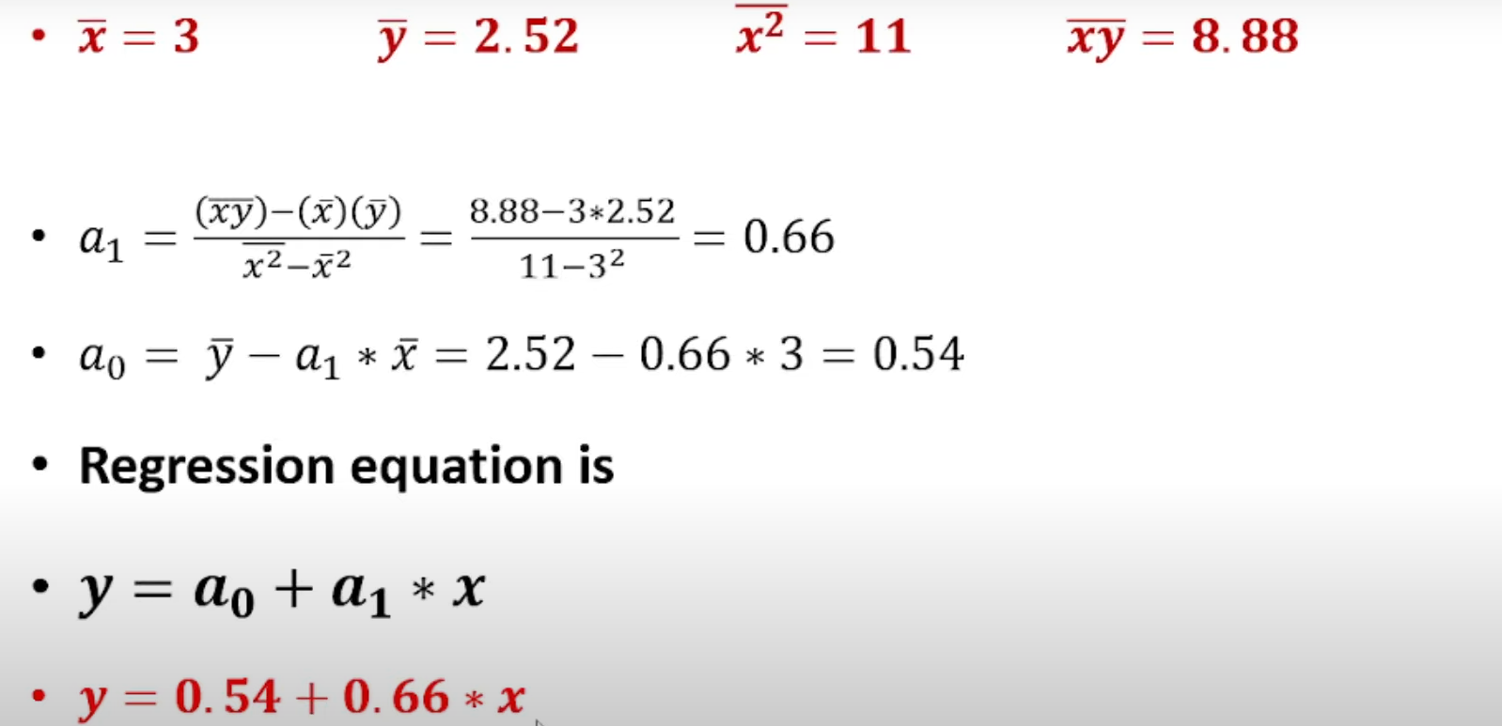

Slide 9
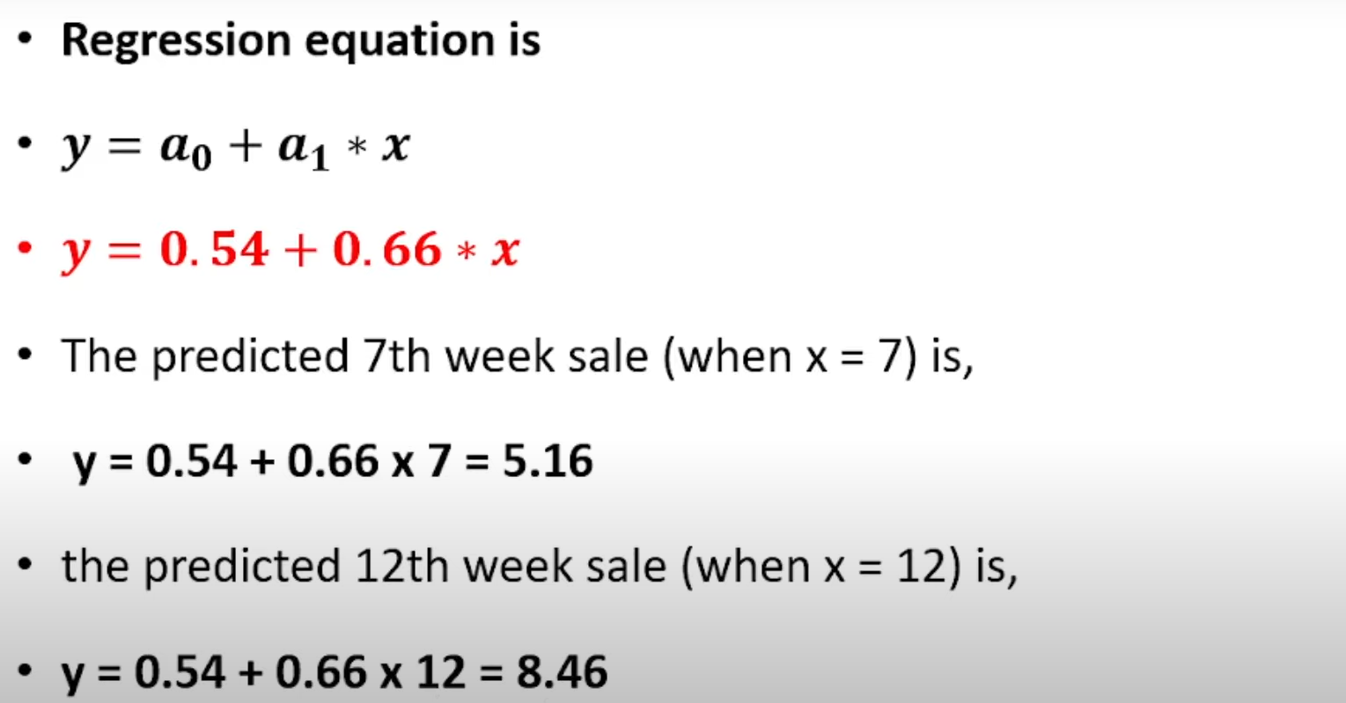

Slide 10
Types of Linear Regression:
Simple Linear Regression: If a single independent variable is used to predict the value of a numerical dependent variable, then such a Linear Regression algorithm is called Simple Linear Regression.
Multiple Linear regression: If more than one independent variable is used to predict the value of a numerical dependent variable, then such a Linear Regression algorithm is called Multiple Linear Regression.

Slide 11
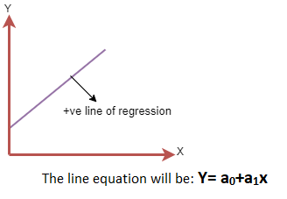
Linear Regression Line:
A linear line showing the relationship between the dependent and independent variables is called a regression line. A regression line can show two types of relationship:
Positive Linear Relationship: If the dependent variable increases on the Y-axis and independent variable increases on X-axis, then such a relationship is termed as a Positive linear relationship.

Slide 12
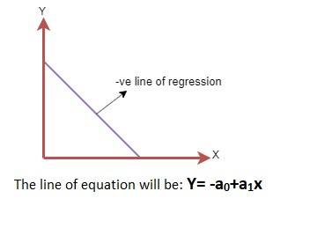
Negative Linear Relationship: If the dependent variable decreases on the Y-axis and independent variable increases on the X-axis, then such a relationship is called a negative linear relationship.

Slide 13
Finding the best fit line:
When working with linear regression, our main goal is to find the best fit line that means the error between predicted values and actual values should be minimized. The best fit line will have the least error.
The different values for weights or the coefficient of lines (a₀, a₁) gives a different line of regression, so we need to calculate the best values for a₀ and a₁ to find the best fit line, so to calculate this we use cost function.

Slide 14

Cost function-
The different values for weights or coefficient of lines (a₀, a₁) gives the different line of regression, and the cost function is used to estimate the values of the coefficient for the best fit line.
Cost function optimizes the regression coefficients or weights. It measures how a linear regression model is performing.
We can use the cost function to find the accuracy of the mapping function, which maps the input variable to the output variable. This mapping function is also known as Hypothesis function.
For Linear Regression, we use the Mean Squared Error (MSE) cost function, which is the average of squared error occurred between the predicted values and actual values. It can be written as:
Where,
N=Total number of observation Yi = Actual value (a1x_{i}+a₀)= Predicted value.

Slide 15
Residuals:
Residuals: The distance between the actual value and predicted values is called residual.
If the observed points are far from the regression line, then the residual will be high, and so cost function will high.
If the scatter points are close to the regression line, then the residual will be small and hence the cost function.

Slide 16
Gradient Descent:
Gradient descent is used to minimize the MSE by calculating the gradient of the cost function.
A regression model uses gradient descent to update the coefficients of the line by reducing the cost function.
It is done by a random selection of values of coefficient and then iteratively update the values to reach the minimum cost function.

Slide 17

Model Performance:
The Goodness of fit determines how the line of regression fits the set of observations. The process of finding the best model out of various models is called optimization. It can be achieved by below method:
R-squared method:
R-squared is a statistical method that determines the goodness of fit.
It measures the strength of the relationship between the dependent and independent variables on a scale of 0-100%.
The high value of R-square determines the less difference between the predicted values and actual values and hence represents a good model.
It is also called a coefficient of determination, or coefficient of multiple determination for multiple regression.
It can be calculated from the below formula:

Slide 18
Assumption of linear regression:
Linear relationship between the features and target: Linear regression assumes the linear relationship between the dependent and independent variables.
Small or no multicollinearity between the features: Multicollinearity means high-correlation between the independent variables. Due to multicollinearity, it may difficult to find the true relationship between the predictors and target variables. Or we can say, it is difficult to determine which predictor variable is affecting the target variable and which is not. So, the model assumes either little or no multicollinearity between the features or independent variables.
Homoscedasticity Assumption: Homoscedasticity is a situation when the error term is the same for all the values of independent variables. With homoscedasticity, there should be no clear pattern distribution of data in the scatter plot.

Slide 19
Normal distribution of error terms: Linear regression assumes that the error term should follow the normal distribution pattern. If error terms are not normally distributed, then confidence intervals will become either too wide or too narrow, which may cause difficulties in finding coefficients. It can be checked using the q-q plot. If the plot shows a straight line without any deviation, which means the error is normally distributed.
No autocorrelations: The linear regression model assumes no autocorrelation in error terms. If there will be any correlation in the error term, then it will drastically reduce the accuracy of the model. Autocorrelation usually occurs if there is a dependency between residual errors.

Slide 20
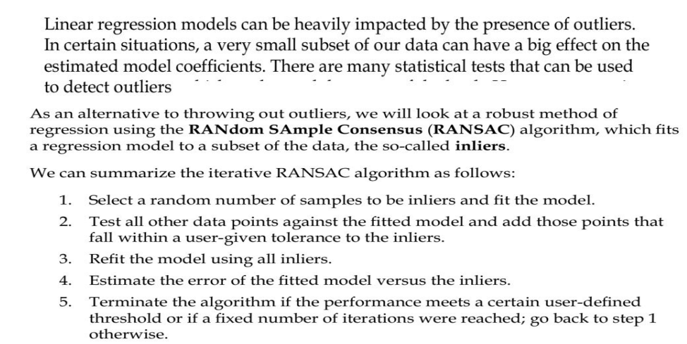
Fitting a Robust Regression Model using RANSAC:
The ordinary linear regressor is sensitive to outliers, and the fitted line can easily be skewed away from the true underlying relationship of data.
The RANSAC (RANdom SAmple Consensus) regressor automatically splits the data into inliers and outliers, and the fitted line is determined only by the identified inliers.
In simple words:

Slide 21
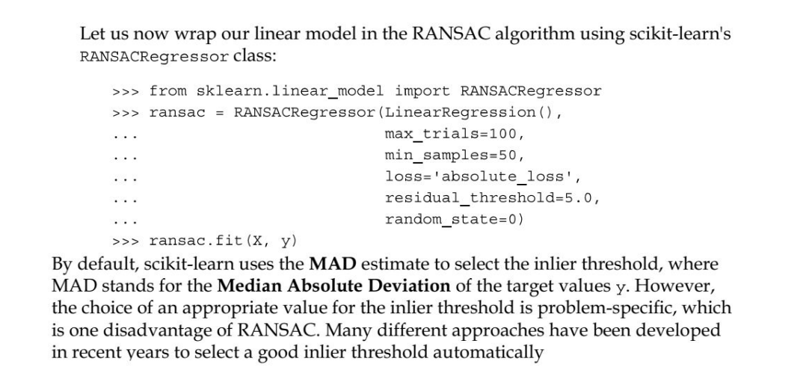

Slide 22
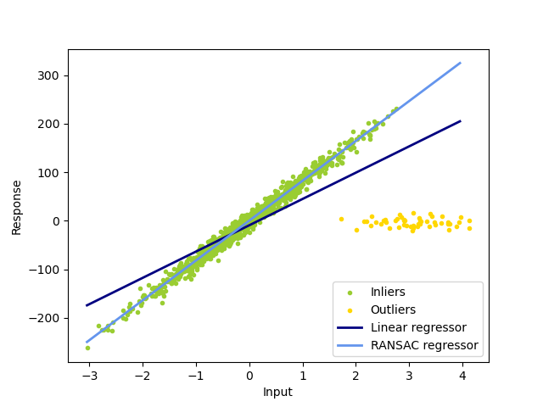

Slide 23
Correlation Matrix:
A correlation matrix is a statistical technique used to evaluate the relationship between two variables in a data set.
The matrix is a table in which every cell contains a correlation coefficient, where 1 is considered a strong relationship between variables, 0 a neutral relationship and -1 a not strong relationship.

Slide 24
When Do You Use the Correlation Matrix?
The correlation matrix gives you an idea about your data set.
For example, let’s say you want to predict the price of a car on the basis of fuel type, transmission type or age, etc. A correlation matrix would be very useful.

Slide 25
Using a correlation matrix, we can evaluate the relationship between two variables:
If the relationship is 1, then the relationship is strong.
If the relationship is 0, then it means the relationship is neutral.
If the relationship is -1, then it means the relationship is negative or not strong.
By using a correlation matrix, you can better understand your data set, analyze it and visualize the result.
Most data scientists consider this the main step before building any machine learning model because if you know which variables are correlated which, you can gain a better understanding about what’s most important for your model.
The correlation matrix is a statistical technique that gives you the values between -1 to 1 which you can determine the relationship between variables.

Slide 26
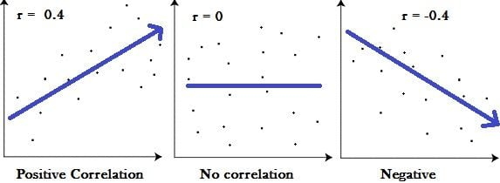

Slide 27
Exploratory Data Analysis:
Exploratory Data Analysis (EDA) refers to the method of studying and exploring record sets to apprehend their predominant traits, discover patterns, locate outliers, and identify relationships between variables. EDA is normally carried out as a preliminary step before undertaking extra formal statistical analyses or modeling.

Slide 28
The Foremost Goals of EDA:
1. Data Cleaning: EDA involves examining the information for errors, lacking values, and inconsistencies. It includes techniques including records imputation, managing missing statistics, and figuring out and getting rid of outliers.
2. Descriptive Statistics: EDA utilizes precise records to recognize the important tendency, variability, and distribution of variables. Measures like suggest, median, mode, preferred deviation, range, and percentiles are usually used.

Slide 29
3. Data Visualization: EDA employs visual techniques to represent the statistics graphically. Visualizations consisting of histograms, box plots, scatter plots, line plots, heatmaps, and bar charts assist in identifying styles, trends, and relationships within the facts.
4. Feature Engineering: EDA allows for the exploration of various variables and their adjustments to create new functions or derive meaningful insights. Feature engineering can contain scaling, normalization, binning, encoding express variables, and creating interplay or derived variables.
5. Correlation and Relationships: EDA allows discover relationships and dependencies between variables. Techniques such as correlation analysis, scatter plots, and pass-tabulations offer insights into the power and direction of relationships between variables.
6. Data Segmentation: EDA can contain dividing the information into significant segments based totally on sure standards or traits. This segmentation allows advantage insights into unique subgroups inside the information and might cause extra focused analysis.
7. Hypothesis Generation: EDA aids in generating hypotheses or studies questions based totally on the preliminary exploration of the data. It facilitates form the inspiration for in addition evaluation and model building.
8. Data Quality Assessment: EDA permits for assessing the nice and reliability of the information. It involves checking for records integrity, consistency, and accuracy to make certain the information is suitable for analysis.

Slide 30
Regularized Methods for Regression:
Before discussing regularized methods let us discuss what is Regularization.
Regularization: Regularization is a very important concept that is used to avoid overfitting of the data especially when the trained and tested data are much varying.
Regularization is implemented by adding a “penalty” term to the best fit derived from the trained data, in order to achieve a lesser variance with the tested data and also restricts the influence of predictor variables over the output variable by compressing their coefficients.

Slide 31
But, What are Overfitting and Underfitting?
Overfitting is a phenomenon that occurs when a Machine Learning model is constrained to the training set and not able to perform well on unseen data. That is when our model learns the noise in the training data as well. This is the case when our model memorizes the training data instead of learning the patterns in it.
Underfitting on the other hand is the case when our model is not able to learn even the basic patterns available in the dataset. In the case of the underfitting model is unable to perform well even on the training data hence we cannot expect it to perform well on the validation data. This is the case when we are supposed to increase the complexity of the model or add more features to the feature set.

Slide 32
And, What are Bias and Variance?
Bias refers to the errors which occur when we try to fit a statistical model on real-world data which does not fit perfectly well on some mathematical model.
If we use a way too simplistic a model to fit the data then we are more probably face the situation of High Bias which refers to the case when the model is unable to learn the patterns in the data at hand and hence performs poorly.
Variance implies the error value that occurs when we try to make predictions by using data that is not previously seen by the model. There is a situation known as high variance that occurs when the model learns noise that is present in the data.
Finding a proper balance between the two that is also known as the Bias-Variance Tradeoff can help us prune the model from getting overfitted to the training data.

Slide 33
So, Regularization in Machine Learning:
Regularization is a technique used to reduce errors by fitting the function appropriately on the given training set and avoiding overfitting. The commonly used regularization techniques are :
Lasso Regularization – L1 Regularization
Ridge Regularization – L2 Regularization
Elastic Net Regularization – L1 and L2 Regularization

Slide 34
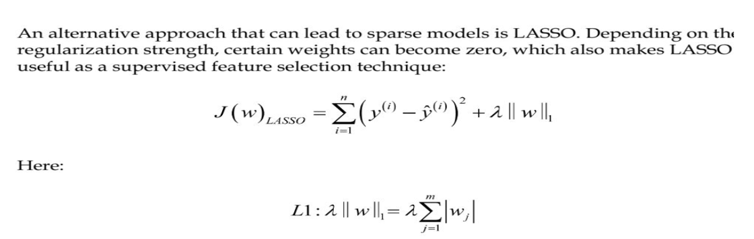
Lasso Regularization – L1 Regularization:
A regression model which uses the L1 Regularization technique is called LASSO(Least Absolute Shrinkage and Selection Operator) regression.
Where y cap is representing estimated value of the response variable in linear regression model/predicted value of y.

Slide 35
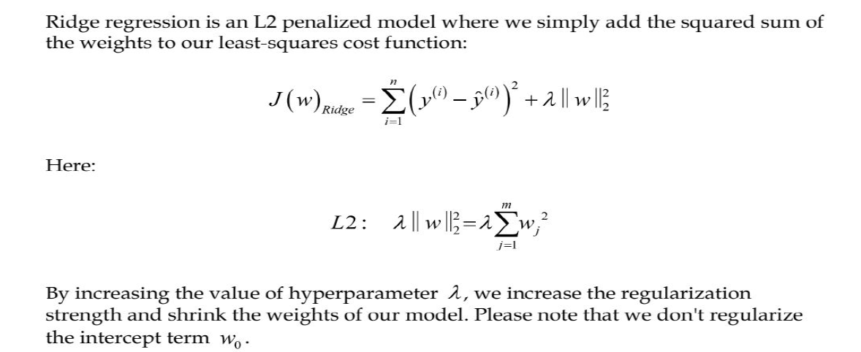
Ridge regression:
A regression model that uses the L2 regularization technique is called Ridge regression. Ridge regression adds the “squared magnitude” of the coefficient as a penalty term to the loss function(L).

Slide 36
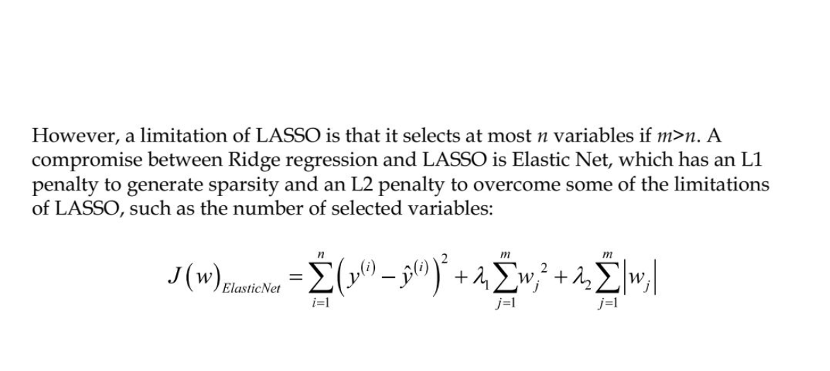
Elastic Net Regularization – L1 and L2 Regularization

Slide 37
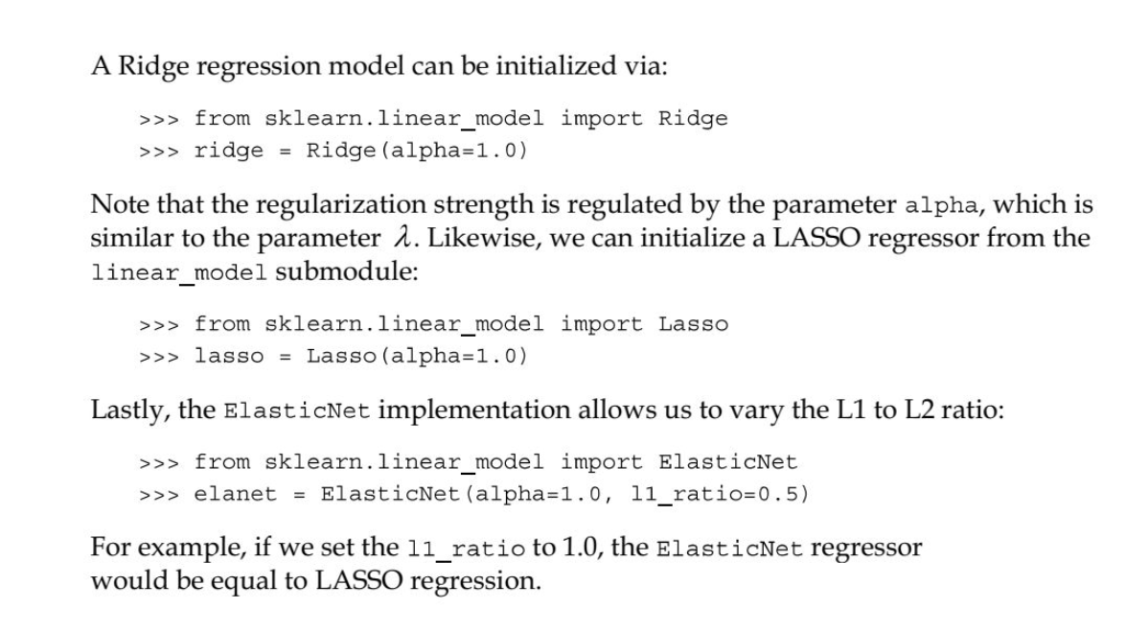

Slide 38
Polynomial Regression:
Polynomial regression is a type of regression analysis used in statistics and machine learning when the relationship between the independent variable (input) and the dependent variable (output) is not linear.
While simple linear regression models the relationship as a straight line, polynomial regression allows for more flexibility by fitting a polynomial equation to the data.
When the relationship between the variables is better represented by a curve rather than a straight line, polynomial regression can capture the non-linear patterns in the data.

Slide 39
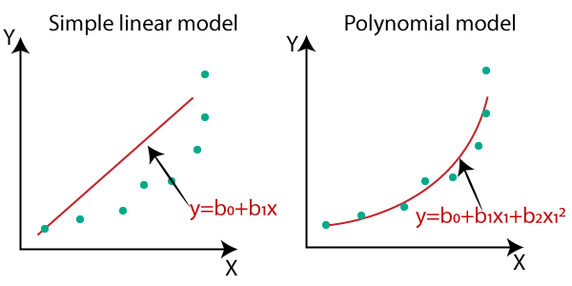
If the relationship between the independent and dependent variables is not linear, then the linear regression cannot be used as it will result in large errors.

Slide 40
Need of polynomial regression:
A good result is provided if a linear model is applied to a linear database, as is the case with simple linear regression.
However, a drastic output is produced if the same model is applied to a non-linear dataset with no modifications. These cause an increase in the loss function, high error rates, and a decrease in accuracy.
For cases where the data points are arranged in a non-linear fashion, there is a need for polynomial regression.
If a non-linear model is present and you try to cover it using a linear model, it will cover no data points.
Hence, a polynomial model is used to ensure that the data points are covered. That said, a curve will be suitable for covering most data points using polynomial models instead of a straight line.

Slide 41
Types of Polynomial Regression:
Since there is no limit to the degree in a polynomial equation, and it can go up to the nth value, numerous kinds of polynomial regression exist. For instance, a quadratic equation, when spoken, generally is used for the second degree of a polynomial equation. This degree, as stated, can up to nth value, and you can derive as many equations as you want to or need. Hence, polynomial regression is usually categorized as mentioned below.
Linear, when the degree is 1.
Quadratic, the degree of this equation is 2.
Cubic with a degree as three continues, based on the degree used.

Slide 42
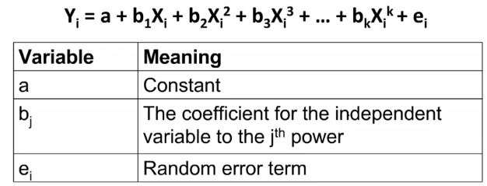
Equation of the Polynomial Regression Model
Any linear equation is a polynomial regression that has a degree of 1. The very common and usual equation used to define the regression is;
y = mx+b
In this equation, m is the slope, and b is the y-intercept. One can easily write this as
f(x) = c0 + c1 x where c1 is the slope and the c0 is the y-intercept.
It can be rewritten as:

Slide 43
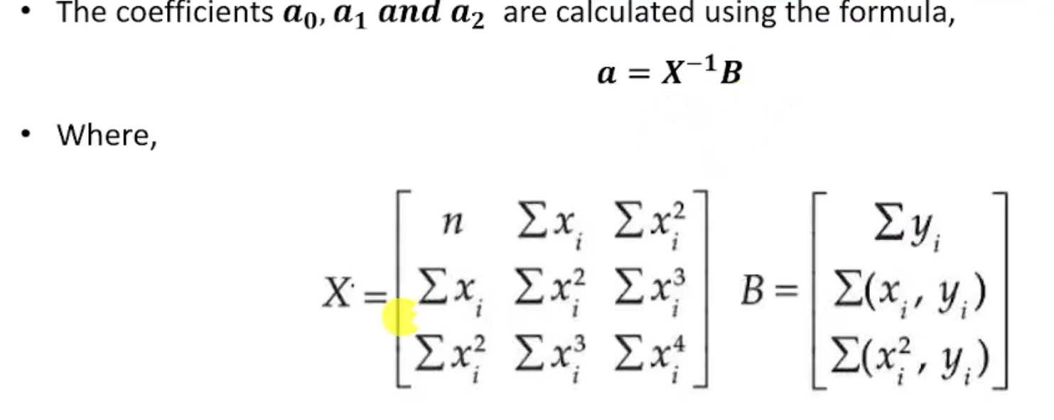
Consider the polynomial of 2nd degrees.
The polynomial equation is given by y=a0+a1x+a2x²

Slide 44
Example of polynomial regression:
Xi | yi
1 | 1
2 | 4
3 | 9
4 | 15

Slide 45
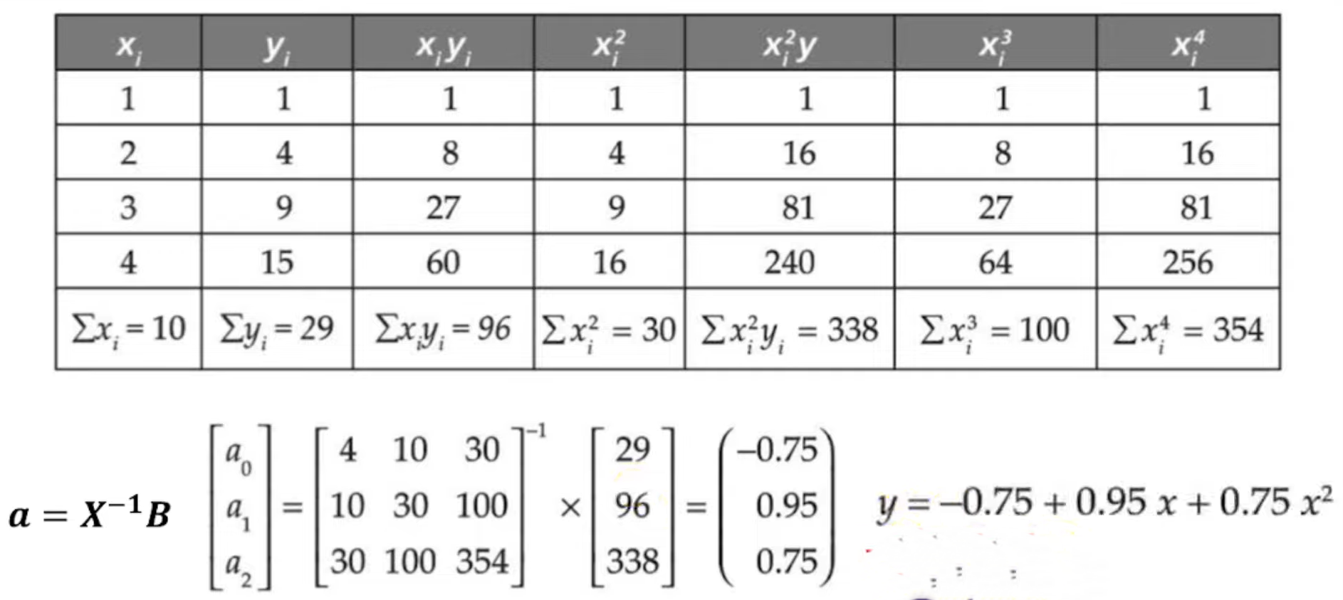

Slide 46
Advantage – Polynomial Regression
The polynomial regression is flexible enough to get fitted in a vast range of curvatures.
A broad range of functions can easily fit under it.
The polynomial regression offers the best approximation of the relationship between the two dependent and independent variables.
Disadvantage – Polynomial Regression
The presence of one or more outliers in the data can hurt the final results of the nonlinear analysis.
The polynomial regression is very sensitive to the outliers.
Very few model validation tools are available that help detect the outliers in nonlinear regression compared to the ones present for linear regression.

Slide 47
ARIMA:
ARIMA stands for Autoregressive Integrated Moving Average.
ARIMA models are a subset of linear regression models that attempt to use the past observations of the target variable to forecast its future values.
A key aspect of ARIMA models is that in their basic form, they do not consider exogenous variables. Rather, the forecast is made purely with past values of the target variable (or features crafted from those past values).
or
It is a class of models that uses a time series' own previous values—specifically, its own lags and lagged prediction errors—to explain the time series in order to predict future values.
If you were wondering what lags are, A lag is a fixed amount of passing time. Utilizing a distributed lag model, the ARIMA model makes predictions about the future based on lagged values.

Slide 48
Component of ARIMA:
AutoRegressive (AR) term: This refers to the use of past values in the regression equation for forecasting the future values. It assumes that the future value of the time series data can be predicted using a linear combination of its past values.
Integrated (I) term: This refers to differencing the time series data to make it stationary, which means removing trends or seasonality. It involves subtracting the previous value from the current value to make the series stationary.
Moving Average (MA) term: This involves modeling the error of the time series data as a combination of previous error terms. It helps in capturing the random shocks in the data.
ARIMA models are typically denoted by ARIMA(p, d, q), where:
p is the order of the AutoRegressive (AR) term.
d is the degree of differencing, or the Integrated (I) term.
q is the order of the Moving Average (MA) term.

Slide 49
Thank you!

