Slide 1
UNIT-5

Slide 2
Regression Metrics:
Regression metrics are quantitative measures used to evaluate the performance of regression models, which are statistical methods for predicting a continuous outcome variable based on one or more predictor variables. These metrics help assess how well the model's predictions match the actual values of the target variable.

Slide 3
Mean Absolute Error(MAE):
Mean Absolute Error calculates the average difference between the calculated values and actual values.
It is also known as scale-dependent accuracy as it calculates error in observations taken on the same scale.
It is used as evaluation metrics for regression models in machine learning.
It calculates errors between actual values and values predicted by the model.

Slide 4
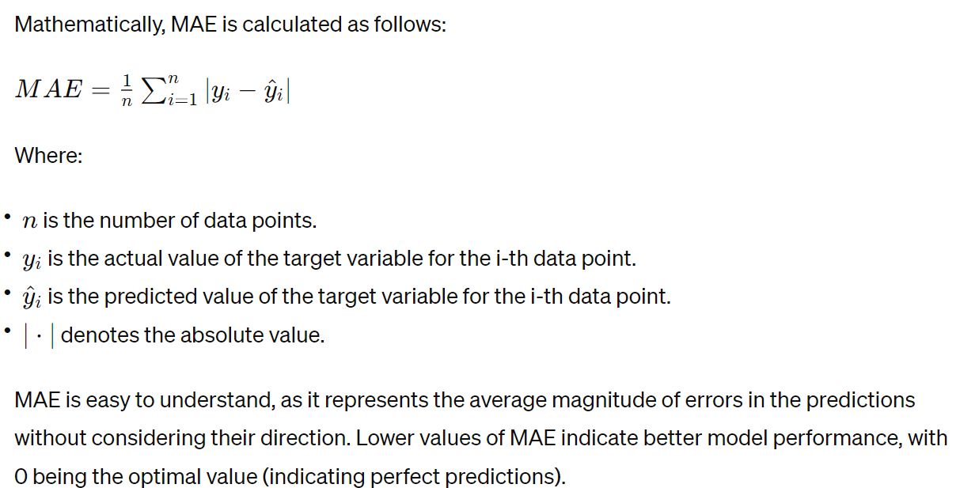

Slide 5
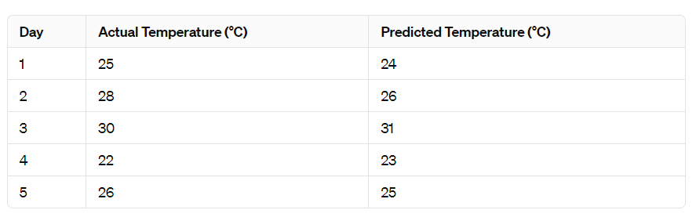
Example: Compute MAE

Slide 6
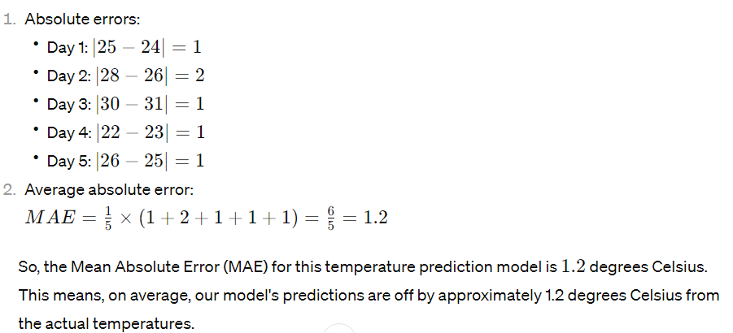
Let’s Compute:

Slide 7
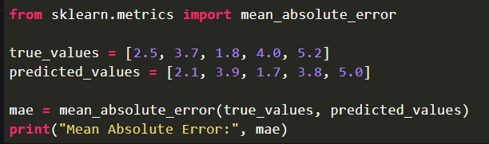
Syntax:

Slide 8
Mean Squared Error:
The Mean Squared Error (MSE) or Mean Squared Deviation (MSD) of an estimator measures the average of error squares i.e. the average squared difference between the estimated values and true value.
It is a risk function, corresponding to the expected value of the squared error loss.
It is always non – negative and values close to zero are better.
The MSE is the second moment of the error (about the origin) and thus incorporates both the variance of the estimator and its bias.

Slide 9
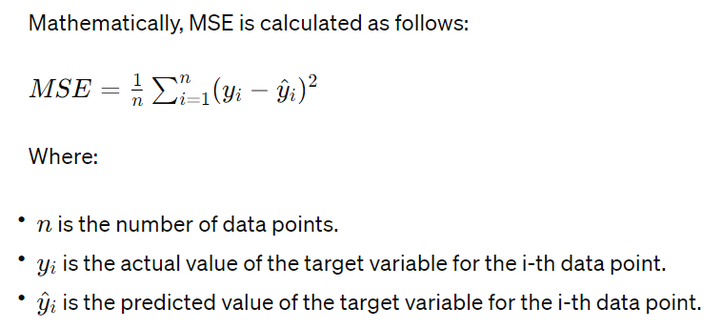

Slide 10
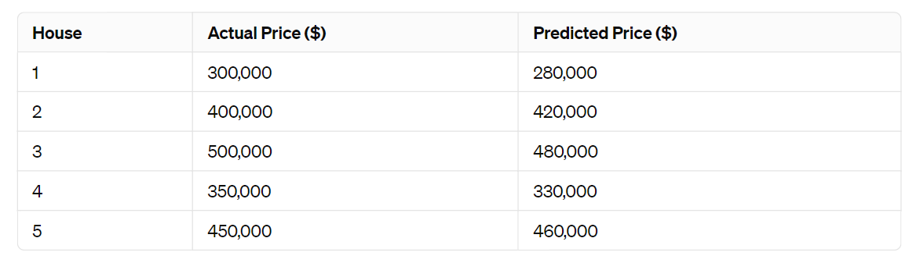
Example:
consider a real-world example involving predicting housing prices. Suppose we have a dataset containing actual housing prices and the prices predicted by a regression model for a set of houses. Here's a simplified version of the dataset:

Slide 11
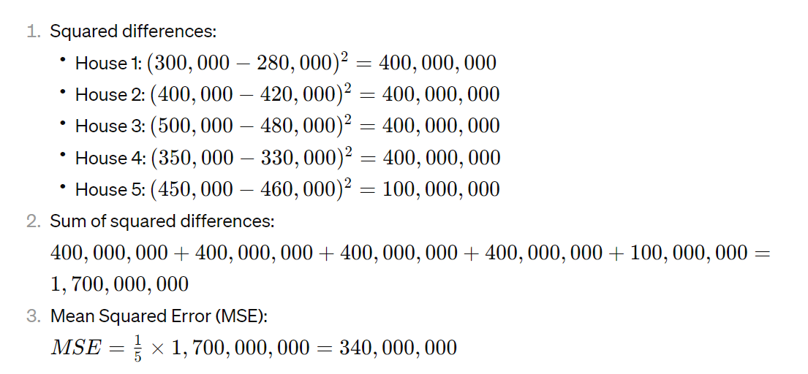

Slide 12
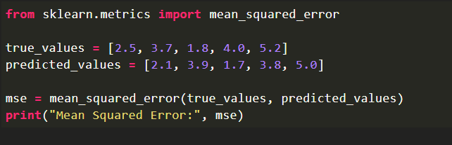
Syntax:

Slide 13
R-squared (R^{2):}
A statistical metric frequently used to assess the goodness of fit of a regression model is the R-squared (R²) score, also referred to as the coefficient of determination.
It quantifies the percentage of the dependent variable’s variation that the model’s independent variables contribute to.
R² is a useful statistic for evaluating the overall effectiveness and explanatory power of a regression model.
In simpler terms, R² tells us how well the independent variables explain the variability of the dependent variable.

Slide 14
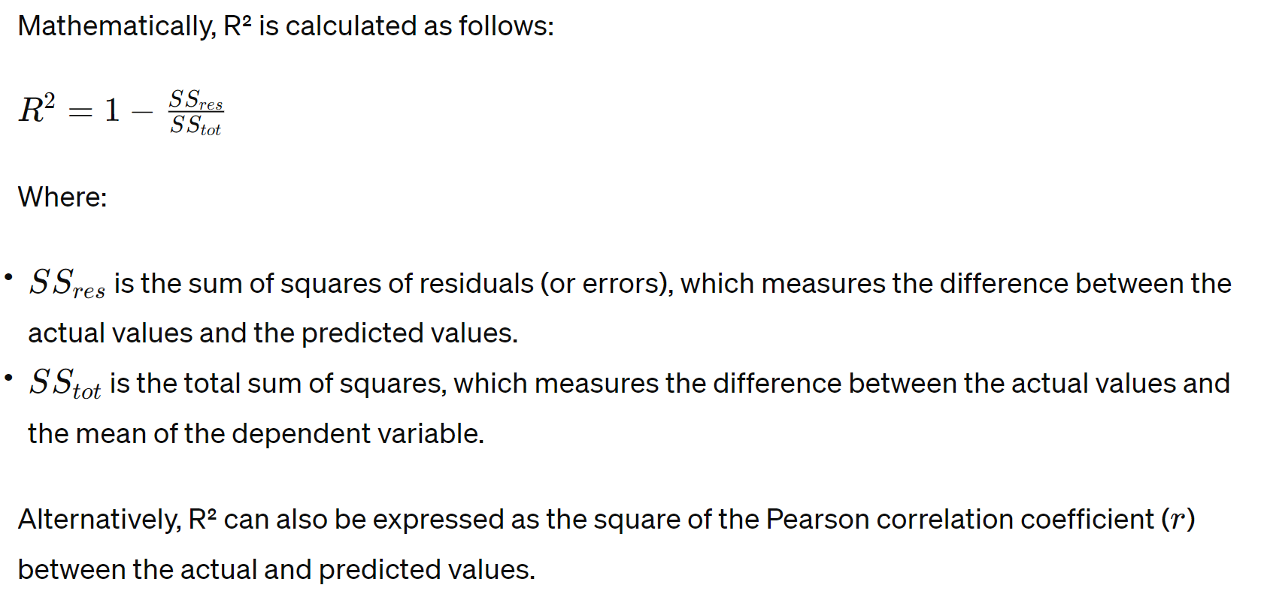

Slide 15
R² ranges from 0 to 1, where:
0 indicates that the model does not explain any of the variability of the dependent variable around its mean.
1 indicates that the model perfectly explains all the variability of the dependent variable around its mean.
An R² score closer to 1 indicates a better fit of the model to the data.
If the model performs worse than a horizontal line (i.e., the mean of the dependent variable), then R² can be negative.

Slide 16
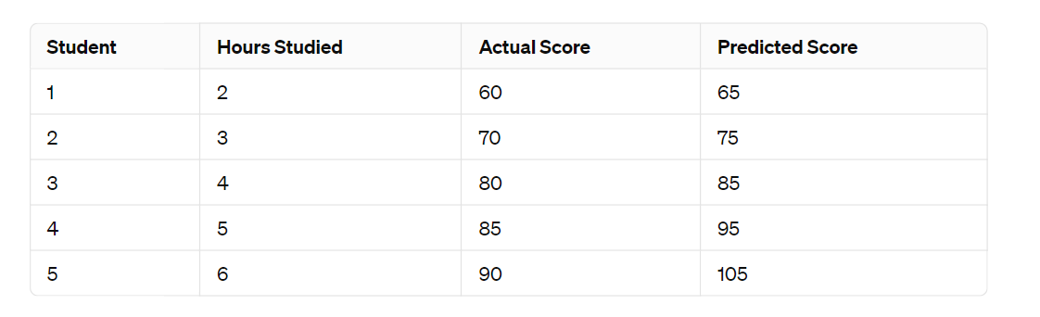
Consider a real-world example involving predicting student scores in an exam based on the number of hours they studied:

Slide 17
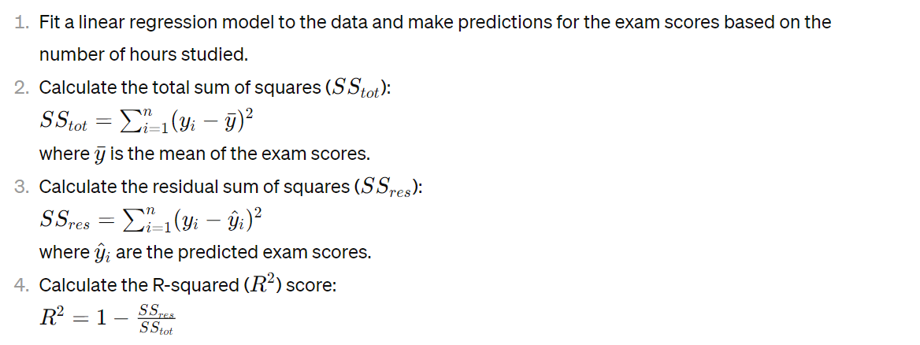

Slide 18
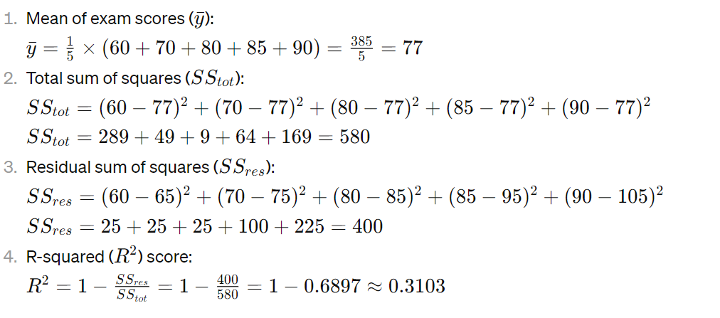

Slide 19
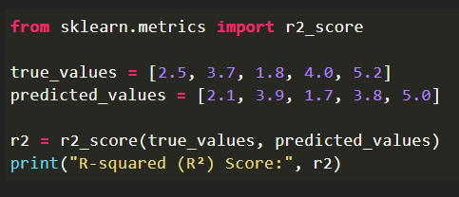
Syntax:

Slide 20
Root Mean Squared Error (RMSE):
It is a usually used metric in regression analysis and machine learning to measure the accuracy or goodness of fit of a predictive model, especially when the predictions are continuous numerical values.
The RMSE quantifies how well the predicted values from a model align with the actual observed values in the dataset. Here’s how it works:
Calculate the Squared Differences: For each data point, subtract the predicted value from the actual (observed) value, square the result, and sum up these squared differences.
Compute the Mean: Divide the sum of squared differences by the number of data points to get the mean squared error (MSE).
Take the Square Root: To obtain the RMSE, simply take the square root of the MSE.

Slide 21
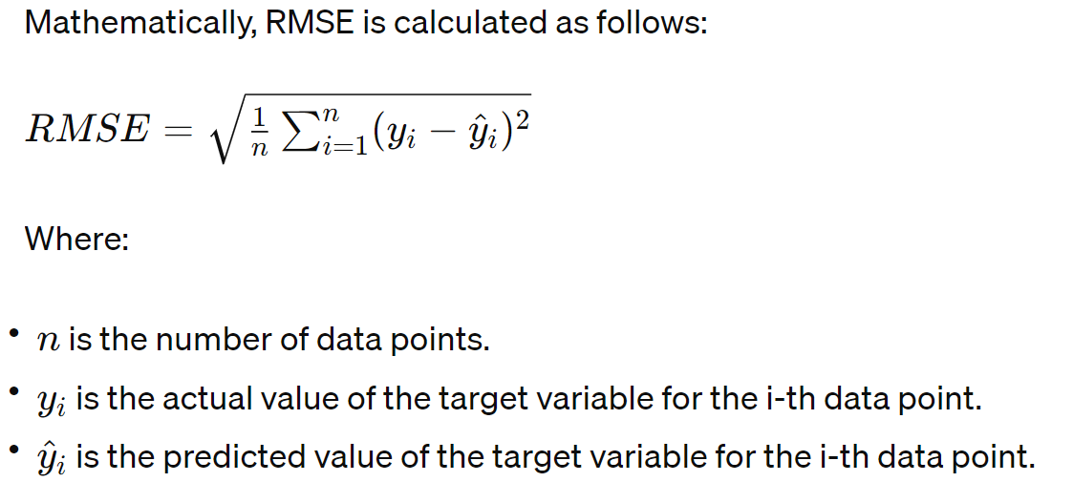

Slide 22
Fact’s about RMSE:
RMSE is preferred over Mean Squared Error (MSE) because it is in the same units as the original data, making it more interpretable. A lower RMSE value indicates better model performance, as it represents smaller differences between predicted and actual values.
RMSE is sensitive to outliers because it squares the errors before averaging them, and then takes the square root. Therefore, large errors have a disproportionately large effect on RMSE.

Slide 23
Example:
Suppose we have a dataset with actual values and predicted values as follows:
Actual values: [10, 20, 30, 40, 50] Predicted values: [12, 18, 28, 42, 48]

Slide 24
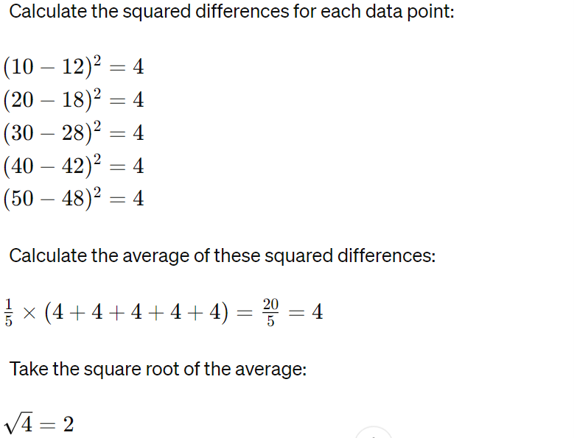

Slide 25
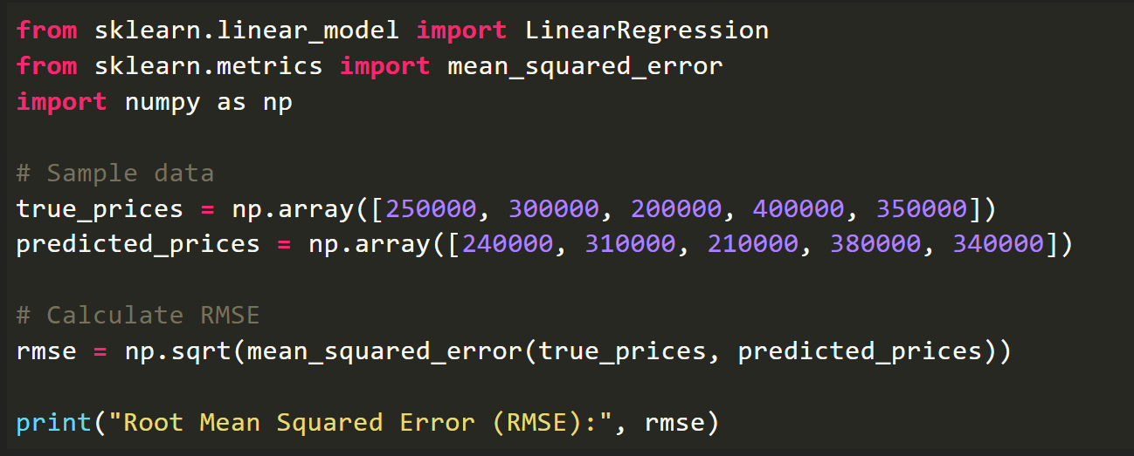
Syntax:

Slide 26
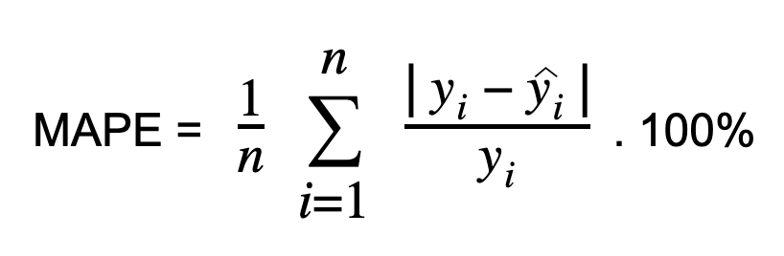
Mean Absolute Percentage Error (MAPE):
Calculate Mean Absolute Percentage Error (MAPE) by dividing the absolute difference between the actual and predicted values by the actual value.
This absolute percentage is averaged across the dataset. MAPE, also known as Mean Absolute Percentage Deviation (MAPD), increases linearly with error. Lower MAPE values indicate better model performance.

Slide 27
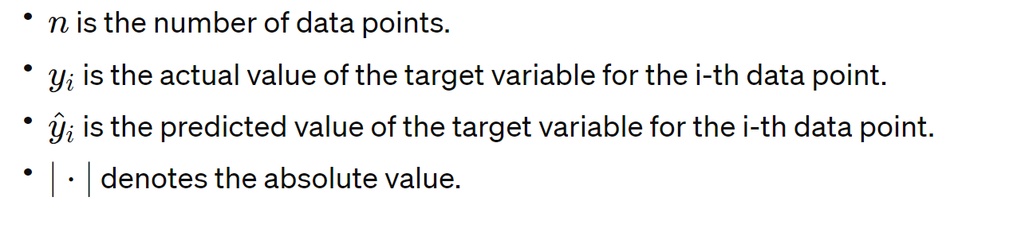
Where,
MAPE is expressed as a percentage, making it easy to interpret. A lower MAPE indicates better accuracy, with 0% indicating perfect predictions.
It's important to note that MAPE has limitations, especially when dealing with actual values that are close to zero. In such cases, MAPE can be undefined or can give misleading results. Additionally, MAPE is sensitive to outliers.

Slide 28
Example:
Suppose we have a dataset with actual values and predicted values as follows:
Actual values: [10, 20, 30, 40, 50] Predicted values: [12, 18, 28, 42, 48]

Slide 29
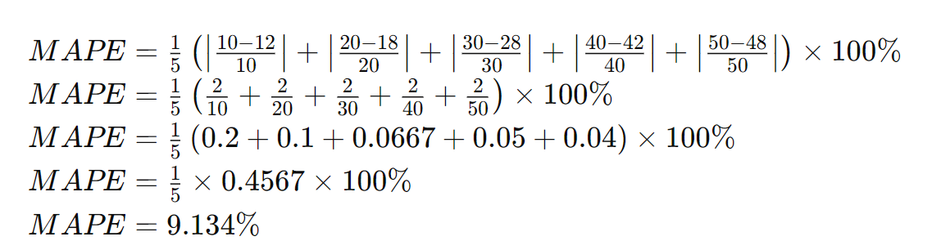

Slide 30
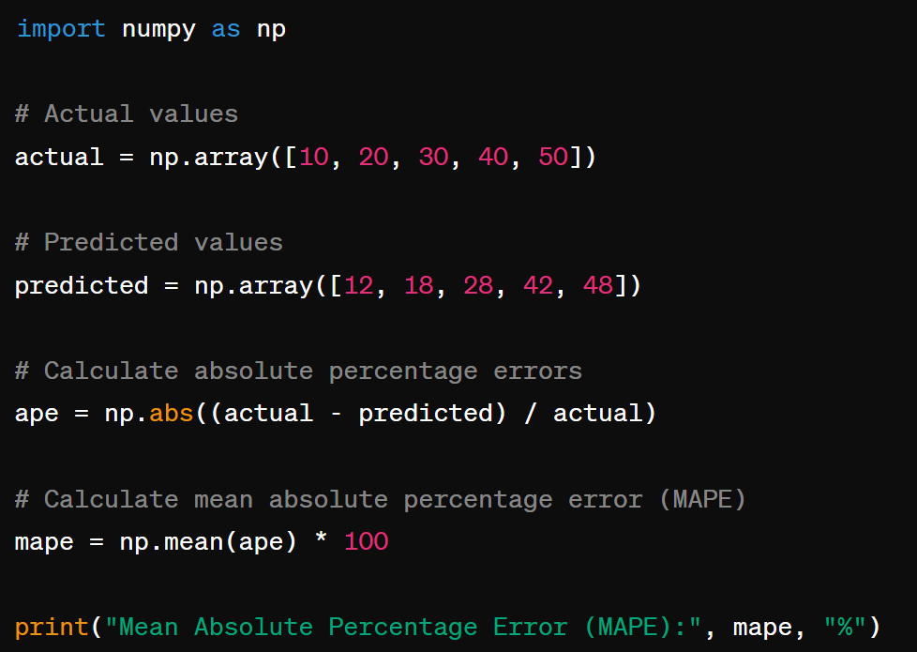
Syntax:

Slide 31
Root Mean Squared Logarithmic Error (RMSLE):
Root Mean Squared Logarithmic Error is calculated by applying log to the actual and the predicted values and then taking their differences.
RMSLE is robust to outliers where the small and the large errors are treated evenly.
It penalizes the model more if the predicted value is less than the actual value while the model is less penalized if the predicted value is more than the actual value.
It does not penalize high errors due to the log. Hence the model has a large penalty for underestimation than overestimation. This can be helpful in situations where we are not bothered by overestimation but underestimation is not acceptable.

Slide 32
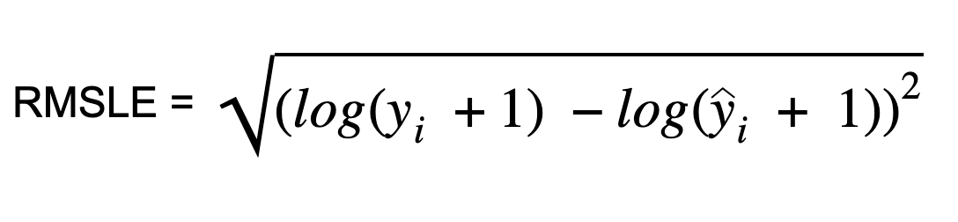
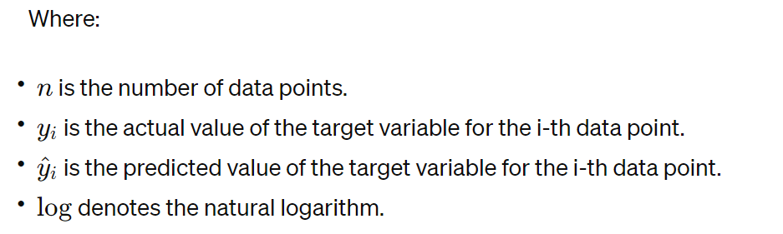
It is computed as:

Slide 33
Example:
Suppose we have the following actual and predicted values:
Actual values: [2, 5] Predicted values: [3, 6]

Slide 34
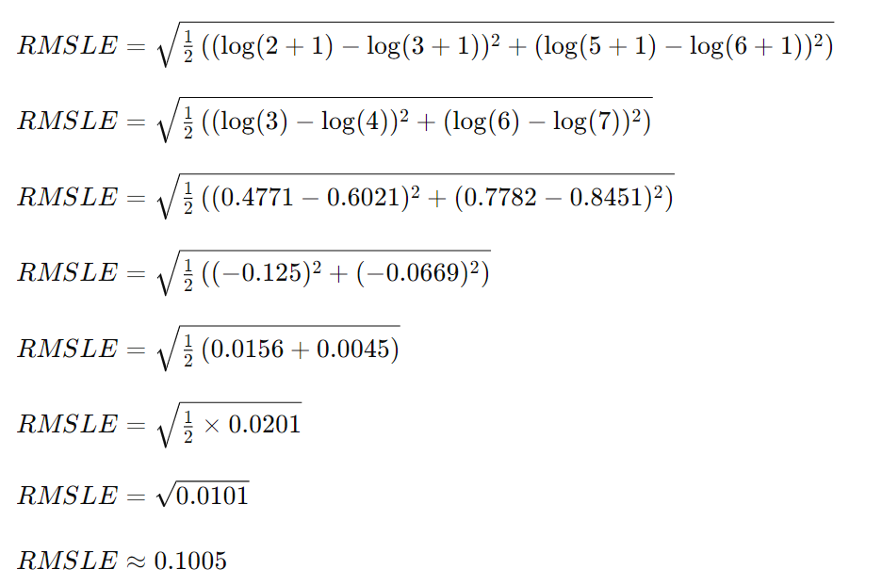

Slide 35
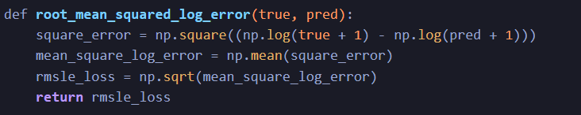
Code Example:

Slide 36
Explained Variance Score:
Explained Variance Score (EVS), also known as explained variance ratio or coefficient of determination, is a metric used to evaluate the performance of regression models.
It measures the proportion of variance in the dependent variable that is explained by the independent variables. In other words, it indicates how well the model captures the variability of the target variable.

Slide 37
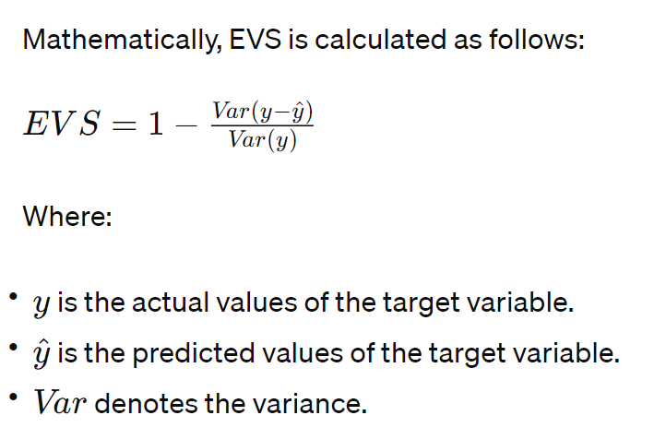

Slide 38
Fact’s above EVS:
EVS ranges from 0 to 1, where:
0 indicates that the model does not explain any of the variance in the dependent variable.
1 indicates that the model perfectly explains all the variance in the dependent variable.
EVS is similar to the R-squared (R²) score, but it is not normalized and can be negative. A negative EVS indicates that the model performs worse than a constant model predicting the mean of the target variable.

Slide 39
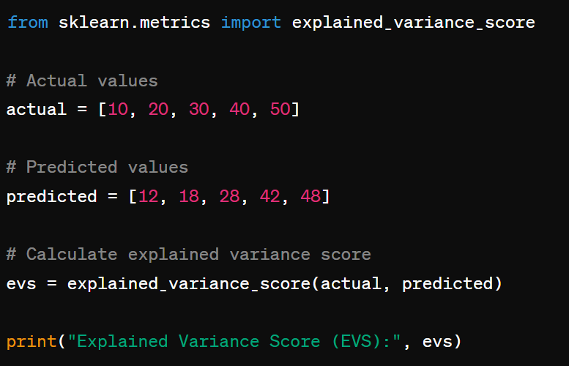
Syntax:

Slide 40
Example:
Given:
Actual values: [10, 20, 30, 40, 50]
Predicted values: [12, 18, 28, 42, 48]

Slide 41
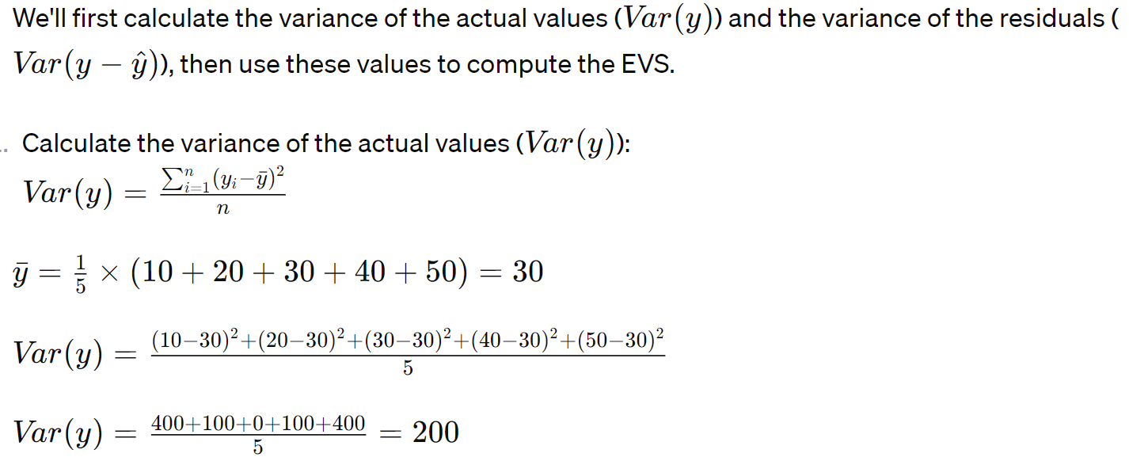

Slide 42
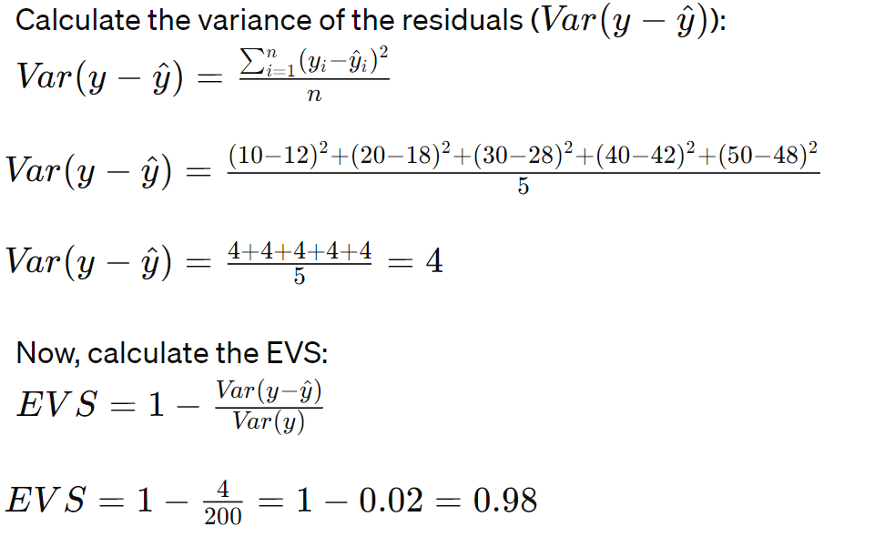

Slide 43
Other Regression Metrics:
https://www.analyticsvidhya.com/blog/2021/10/evaluation-metric-for-regression-models/

Slide 44
Thank You!

