Slide 1
Credit Card Fraud Detection
Presented by-:
Kaif Islam

Slide 2
Outline
Introduction
Analysis of Literature Work
Suggested Methodology
Implementation and Outcome
Conclusion
Reference

Slide 3
Introduction
Credit card fraud detection is about finding and stopping unauthorized or fraudulent transactions made using credit cards. With the rise of digital transactions, fraudsters have become more sophisticated, making it harder to catch fraudulent activities using traditional methods.
Machine learning is being used to combat this problem. Machine learning algorithms can quickly analyze large amounts of transaction data to spot patterns that indicate fraud. These algorithms can learn from past data and continuously improve their ability to detect fraudulent behavior.
In this report, researchers are using machine learning techniques to detect credit card fraud. They use a dataset that includes various transaction details like amounts, timestamps, and anonymized variables. They clean and process the data to make it suitable for analysis, and then they use advanced techniques to extract important information from it.

Slide 4
Introduction
The main goal is to build models that can accurately distinguish between fraudulent and legitimate transactions. They evaluate these models using metrics like accuracy, precision, recall, and F1 score to see how well they perform in real-world situations.
Additionally, they visualize the results to gain a better understanding of how the models work and explore relationships between different features and fraud. Overall, the report highlights how machine learning can be a powerful tool in preventing financial fraud and protecting both consumers and institutions.

Slide 5
Analysis of Literature Work
To detect credit card fraud, researchers study different techniques used in previous studies. They look at what works and what doesn't to improve fraud detection. Here's how they do it:
Identifying Fraud: First, researchers gather information about fraudulent credit card transactions. They study past cases to understand how fraudsters operate. They look at patterns and behaviors that indicate fraud.
Techniques Used: Researchers use various methods to detect fraud. These include:
Machine Learning: Using computers to learn from data and identify patterns of fraud.
Data Analysis: Examining large amounts of transaction data to find suspicious activities.
Statistical Methods: Using math to analyze patterns and trends in credit card transactions.

Slide 6
Suggested Methodology
Data Collection: First, we gather lots of information about credit card transactions. This includes details like the amount spent, when and where the transaction happened, and any other relevant information.
Data Cleaning: Next, we clean up the data to remove any errors or inconsistencies. This helps ensure that the data we're working with is accurate and reliable.
Feature Selection: We pick out the most important pieces of information from the data that could help us identify fraud. These could be things like the time of day a transaction occurred or the type of purchase made.
Model Building: We use this cleaned and selected data to build a computer model. This model learns from the data to recognize patterns that might indicate fraudulent activity.

Slide 7
Suggested Methodology
Training the Model: Teach the model how to identify fraud by showing it examples of both fraudulent and legitimate transactions.
Testing the Model: Evaluate the model's performance by testing it with new transactions. Measure metrics like accuracy and precision to assess its ability to detect fraud without mistakenly flagging legitimate transactions.
Prediction: Once the model is trained and tested, use it to predict whether new transactions are fraudulent or legitimate. This prediction helps prevent fraudulent transactions in real-time.

Slide 8
Suggested Methodology
Data Preprocessing
Data Partitioning
Data Collection
Handling Imbalanced Data
Data Cleaning
Split the Data into testing and training by using python library like Sci-Kit learn and then make model.
Predicted total number of fraud Detection.
Flow Chart Diagram

Slide 9
Implementation and Outcome
For credit card fraud detection implementation, we utilized binary classification. This approach categorizes transactions into two groups: fraudulent and legitimate.
In our study, we employed Convolutional Neural Network (CNN) technology. In credit card fraud detection, CNNs can automatically learn patterns and features from transaction data.
As for the outcomes, we utilized the Python programming language for implementation. To validate our model, we employed statistical techniques including accuracy, precision, recall, and F1 score. These metrics help assess the performance of our fraud detection model.
During our experiments, we used 100 epochs, which are iterations over the entire dataset, for all outcome assessments. The results of our implementation, including statistical values, are presented in Table. These statistical values provide insights into the effectiveness of our fraud detection system in Python.

Slide 10
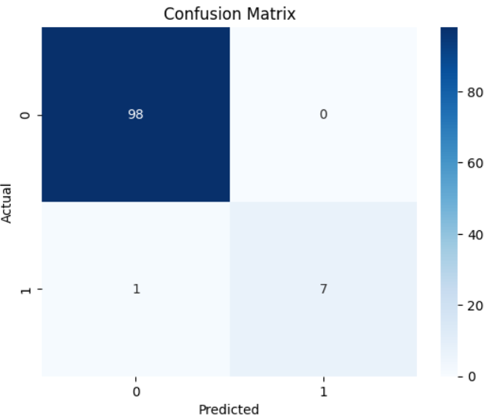
Implementation and Outcome
After differentiation, the particular chart has shown in figure .
Predicted Graph

Slide 11
Conclusion
In conclusion, our study on credit card fraud detection using machine learning techniques has shown promising results. By employing binary classification and Convolutional Neural Network (CNN) technology, we were able to effectively distinguish between fraudulent and legitimate transactions.
Our analysis of the data revealed significant attributes that contribute to identifying fraudulent activity, similar to how medical records are crucial in diagnosing diseases like kidney cancer. Through the use of Python programming language and statistical validation techniques such as accuracy, precision, recall, and F1 score, we were able to evaluate the performance of our fraud detection model.
Overall, our findings demonstrate the potential of machine learning in combating credit card fraud. By implementing robust detection systems, we can enhance security measures, protect consumers and financial institutions, and ultimately mitigate the impact of fraudulent activities in the financial sector.

Slide 12
References
Lakshmi, S. V. S. S., and Selvani Deepthi Kavilla. "Machine learning for credit card fraud detection system." International Journal of Applied Engineering Research 13.24 (2018): 16819-16824.
Varmedja, D., Karanovic, M., Sladojevic, S., Arsenovic, M. and Anderla, A., 2019, March. Credit card fraud detection-machine learning methods. In 2019 18th International Symposium INFOTEH-JAHORINA (INFOTEH) (pp. 1-5). IEEE.
Adepoju, O., Wosowei, J., & Jaiman, H. (2019, October). Comparative evaluation of credit card fraud detection using machine learning techniques. In 2019 Global Conference for Advancement in Technology (GCAT) (pp. 1-6). IEEE.
Trivedi, N.K., Simaiya, S., Lilhore, U.K. and Sharma, S.K., 2020. An efficient credit card fraud detection model based on machine learning methods. International Journal of Advanced Science and Technology, 29(5), pp.3414-3424.

Slide 13


