Slide 1
THE COFFEE CREW
Monisha M-727821TUEE054
Jeevashree J-727821TUEE032
Dinesh kumar -727821TUEE022
Mohammed Kaif-727821TUEE053
Dhanashree -727821TUEE014
Dhanasekaran-727822TUEE605

Slide 2


Slide 3
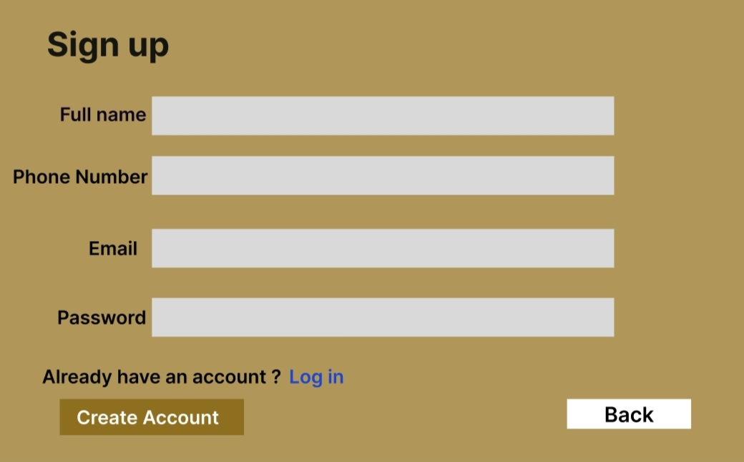

Slide 4
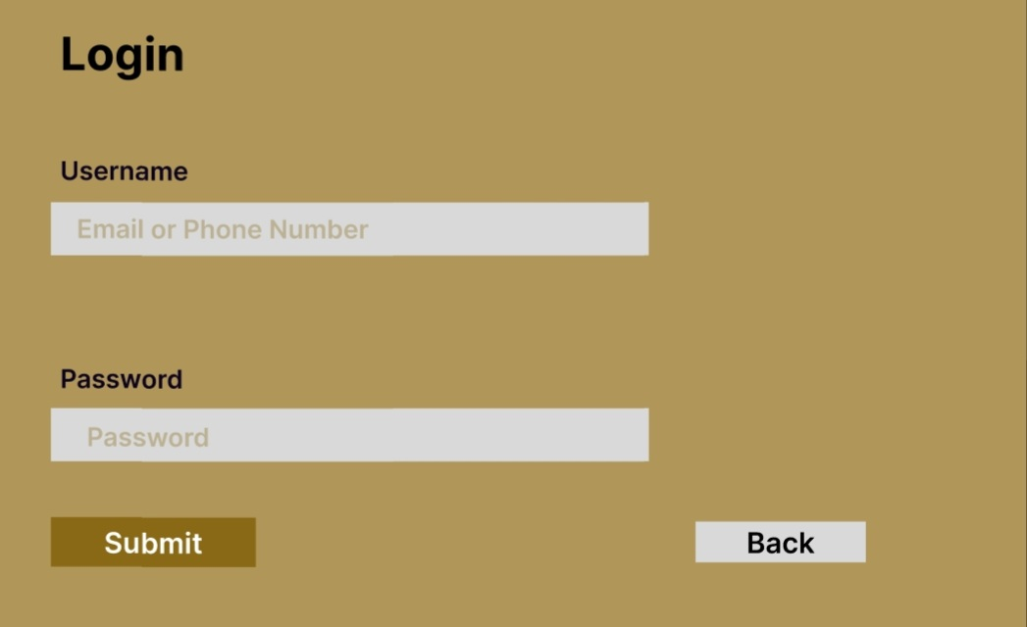

Slide 5
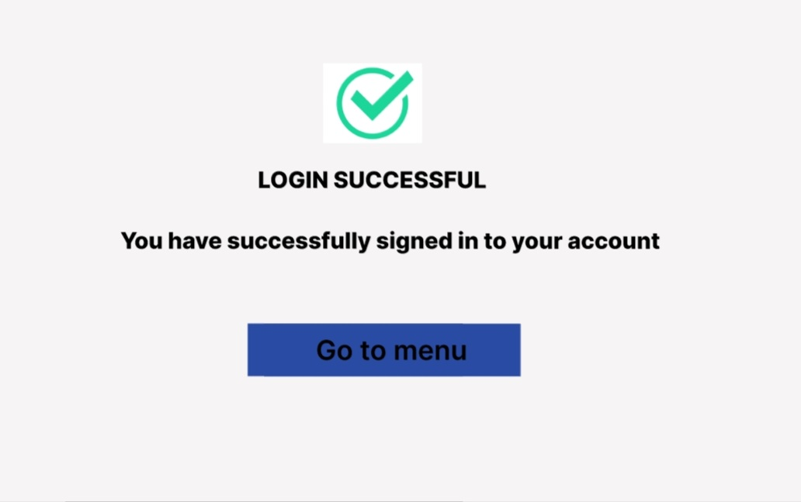

Slide 6
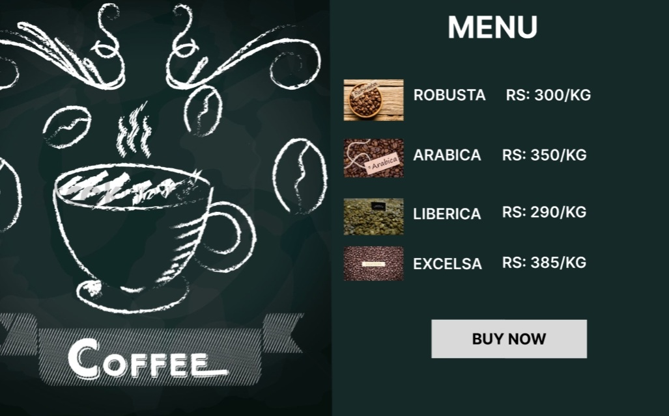

Slide 7
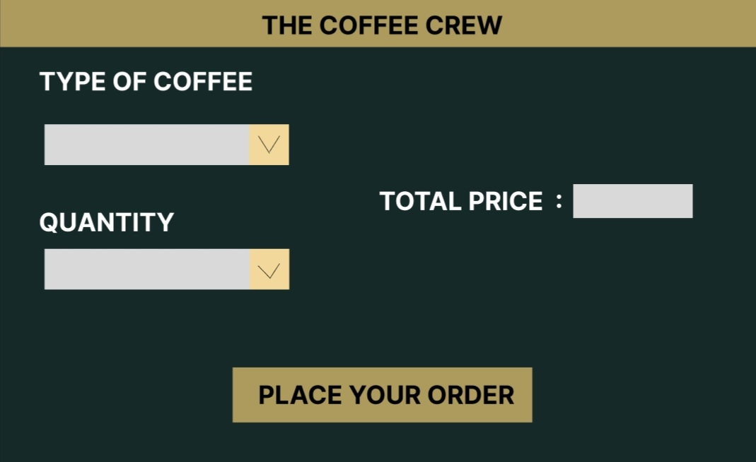

Slide 8
Reference Link Figma link https://www.figma.com/file/DxpH730ZThfQa2Ej8wDxtz/cofee1?node-id=0%3A1 Git Hub link https://github.com/Kaifx24

