Slide 1

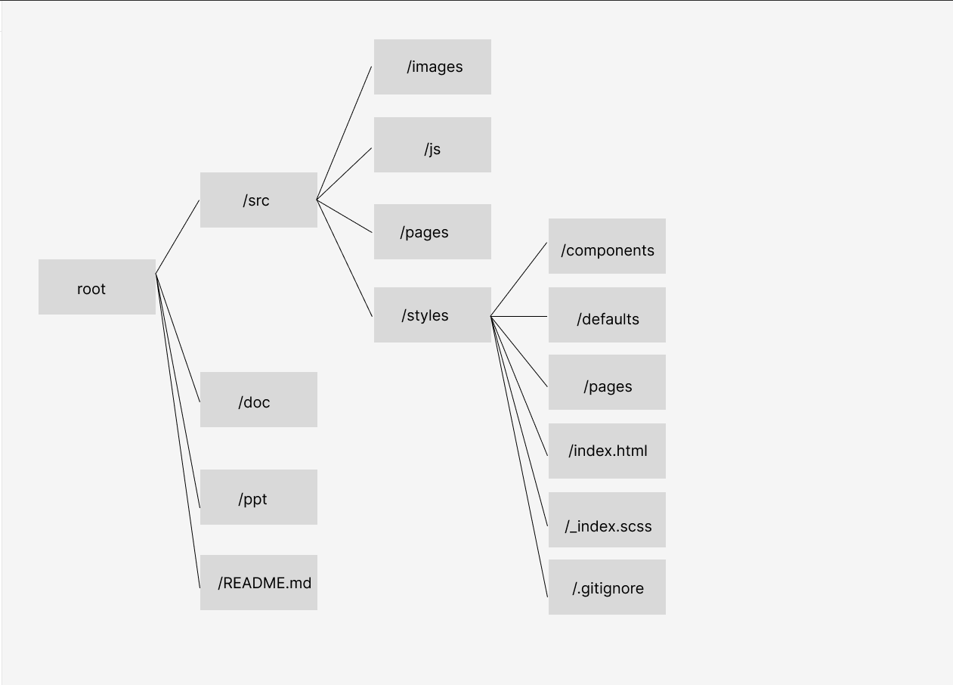

My Portfolio -Sitemap

Slide 2
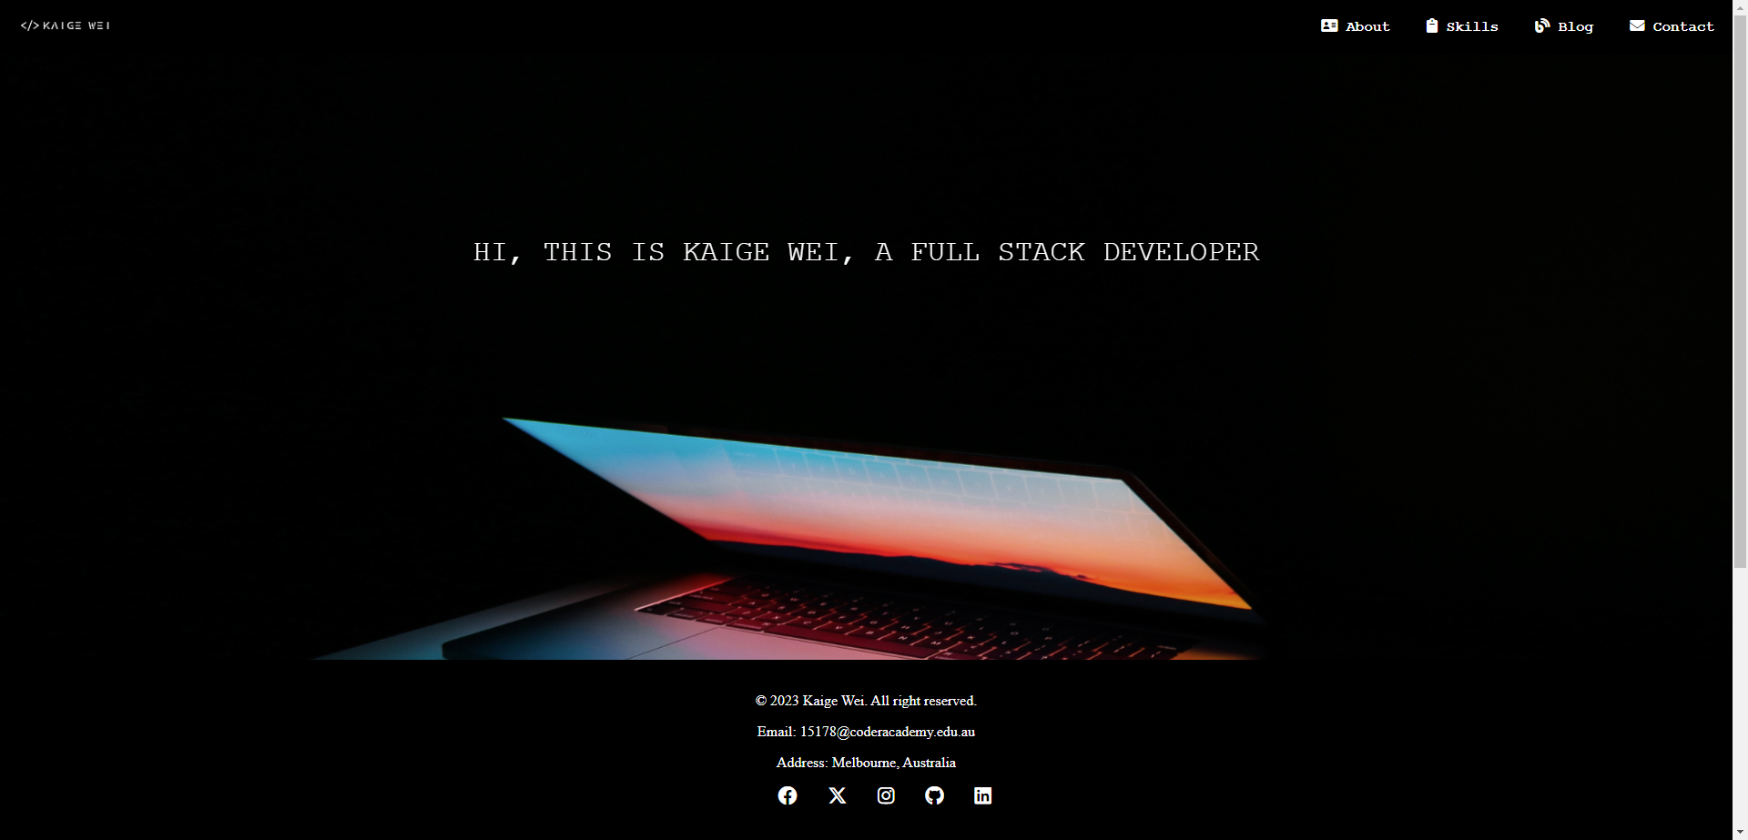

home

Slide 3
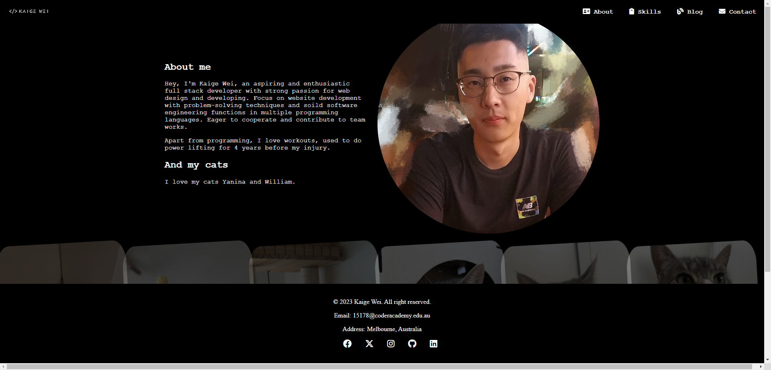
about

Slide 4
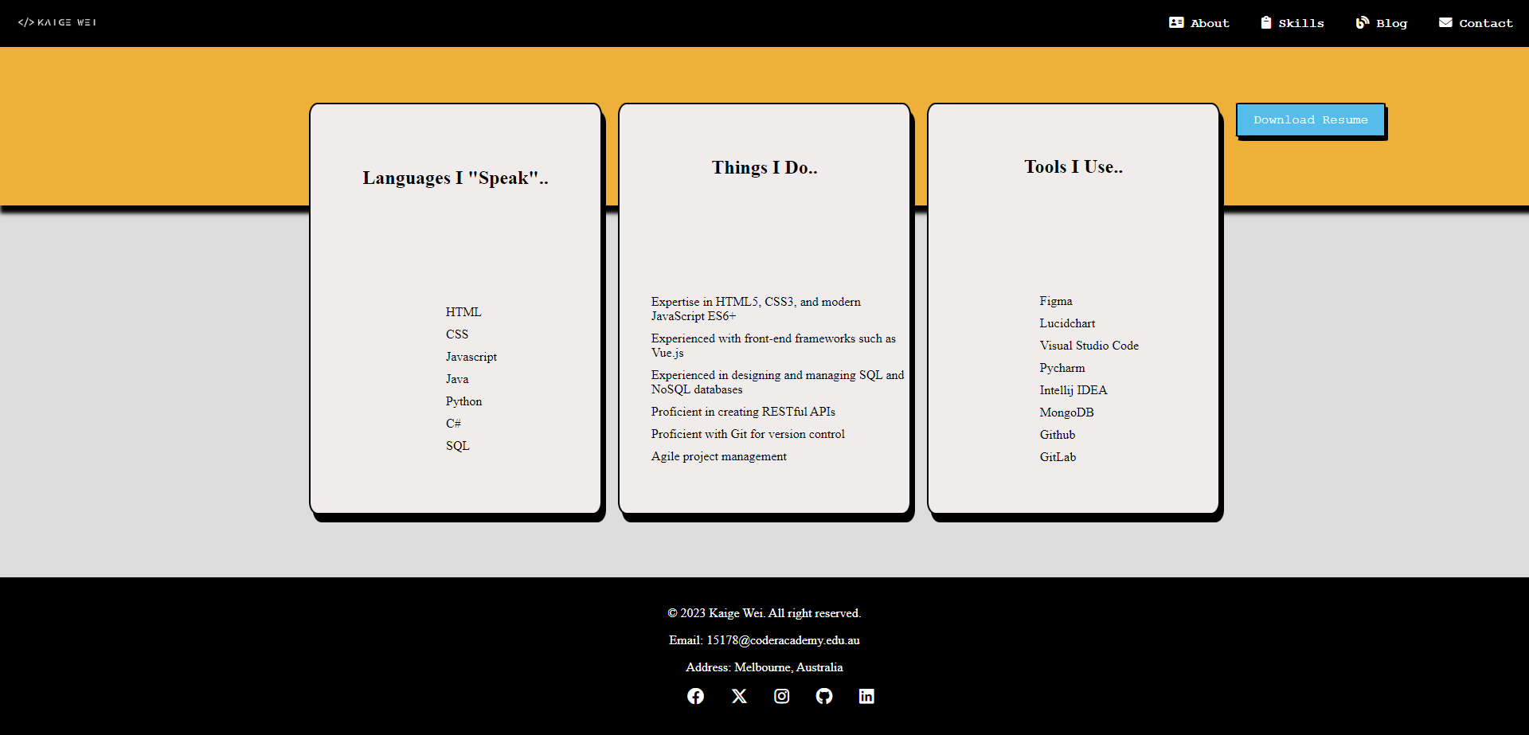
skills

Slide 5
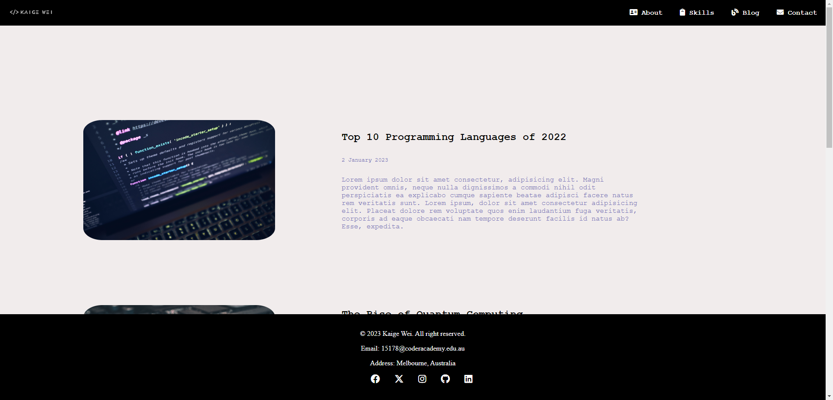
blog

Slide 6
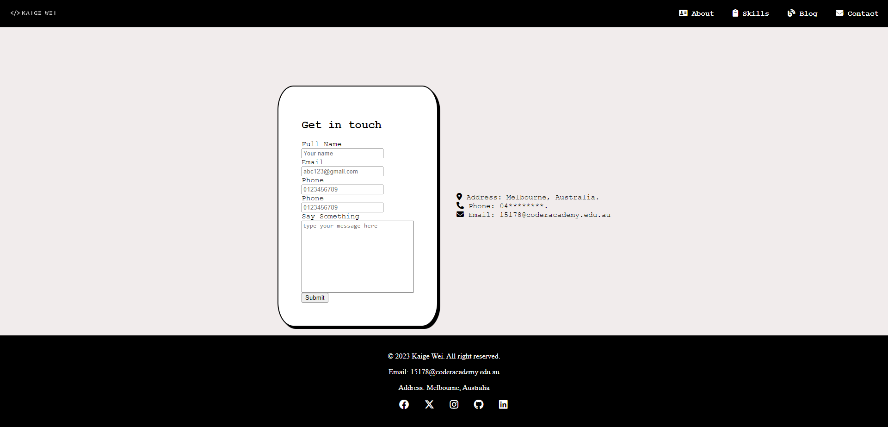
contact

Slide 7
List of components
Image Gallary
Responsive Design
Flex
Grid
Javascript
Animation
Download Resume
Contact Form

