Slide 1
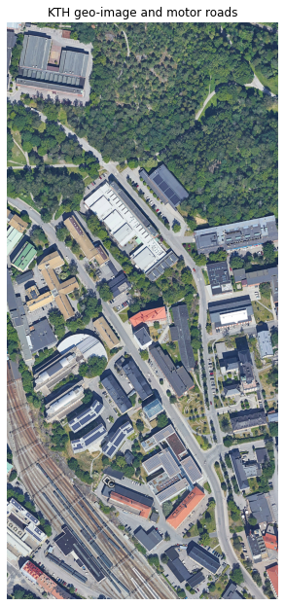
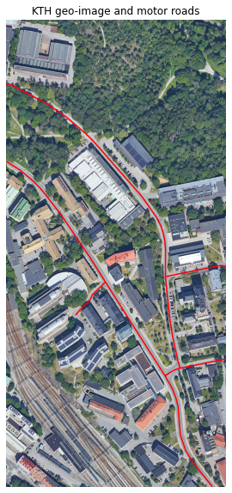
KTH geo-image
and motor road

Slide 2
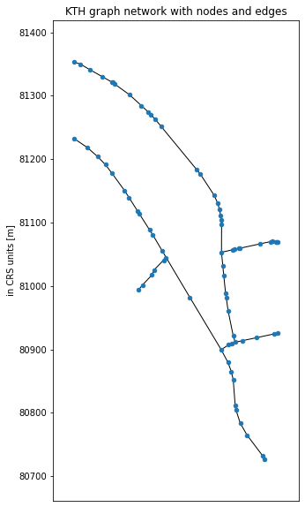
KTH graph network
with nodes and edges

Slide 3
Risk evaluation of two vehicles at Telco edge

