Slide 1
Writer-dependent off-line signature verification system
Kaihang Fu
Major professor: Yong Guan
Department of Electrical and Computer Engineering
Spring 2018

Slide 2
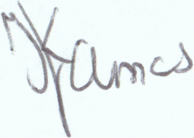
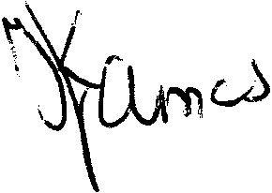
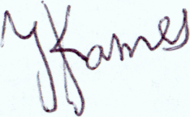
Verification System
a1
a2
…
…
a56
|a1-b1|
|a2-b2|
…
…
|a56-b56|
Same
or
different
signers
Signature 1
b1
b2
…
…
b56
Signature 2
Verification
Pre-processing
Pairing
Input
Feature extraction
Output
Signature Verification Module

Slide 3
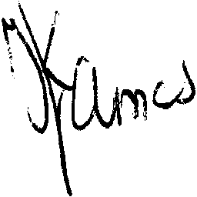
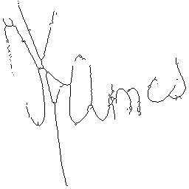

Feature Extraction
Pre-processing results:
Resized image (256╳256)
Thinned image
Cropped image
Binarized image
52 features
1 features
3 features
48 local features 4 global features
area
N
Intersection points
border points
16 pixel densities
16 pixel average angles
16 pixel average distances
aspect_ratio
Angle
H_var
V_var

Slide 4

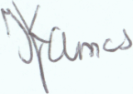
Verification Process
Others writers or computer program
M ╳ forged signature
pairing
Train set
writer
N ╳ Genuine signature
training
Same (1)
or
Different (0)
signers
Neural Network
╳ N = [1 1 0 1 … 1 1 1]
Questioned signature
N results
Signature Verification Module
If “1” > “0”, then
Genuine
If “1” < “0”, then
Forgery

Slide 5

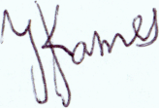
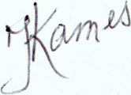

Dataset
International Conference on Document Analysis and Recognition (ICDAR) 2011 SigComp international signature verification competition
The Dutch training set:
Total of 361 images for 10 writers
About 24 genuine signatures and 12 forged signatures for each writer
12 forged signatures come from 3 others forgery-writers, each one
writes 4 forged signatures
Train signature
Train set
24 Genuines
22 Genuines
=231 genuine-genuine pairs
8 Forgeries
22╳8=176 genuine-forgery pairs
4 Forgeries1
10 writers╳
Test signature
Test set
4 Forgeries2
2 Genuines
22╳2=44 genuine-genuine pairs
4 Forgeries3
4 Forgeries
22╳4=88 genuine-forgeries pairs

Slide 6
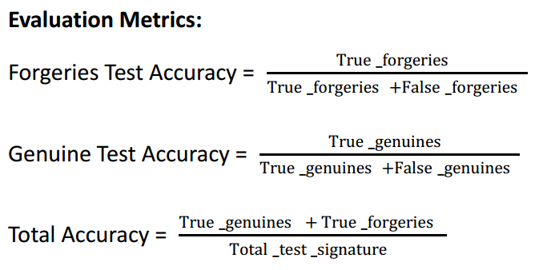
Experiment Result

Slide 7
Unseen forgery-writer signature test results
Train signature
24 Genuines
22 Genuines
4 Forgeries1
4 Forgeries1
4 Forgeries2
4 Forgeries2
Test signature
4 Forgeries3
2 Genuines
4 Forgeries3
 | F_random | F_worst | F_middle | F_best
FTA | 90% = 36/40 | 95% = 38/40 | 85% = 34/40 | 77.5% =31 /40
GTA | 100% = 20/20 | 100% = 20/20 | 100% = 20/20 | 100% = 20/20
TA | 93.3% = 56/60 | 96.7% = 58/60 | 90% = 54/60 | 85% = 51/60

Slide 8
All forgery-writers signature test results
Train signature
24 Genuines
22 Genuines
2 Forgeries1
4 Forgeries1
2 Forgeries2
 | F_all
FTA | 93.3% = 56/60
GTA | 100% = 20/20
TA | 95% = 76/80
4 Forgeries2
2 Forgeries3
4 Forgeries3
Test signature
2 Genuines
2 Forgeries1
2 Forgeries2
2 Forgeries3

Slide 9
Future works
Produce more genuine signatures and forged signatures as
train set
More train data, more accurate!
Design better feature
More representative features, more accurate!
Improve structure of Neural Network
Better classifier, more accurate!

Slide 10
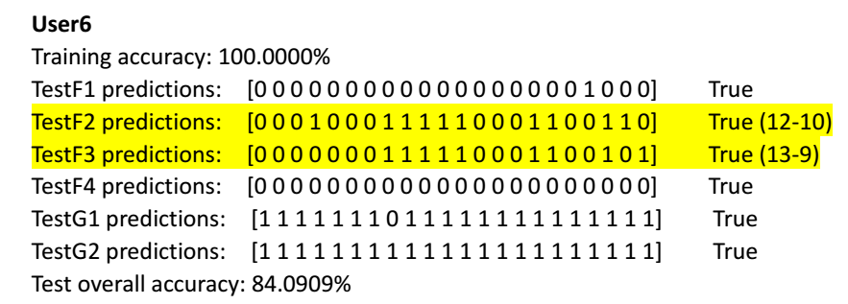
Open question
For second and third forged signature, after comparing with all 22 genuine signatures, produce more negative (0) results than positive (1) results, so system decide they are forged signature, that is true
But the number of negative (0) results and positive (1) results is very close
If for a questioned signature, the number of negative (0) results and positive (1) results is very close, how much can I trust the system’s decision ?

