Slide 1

15/03/2019
SMART BLIND STICK

Slide 2
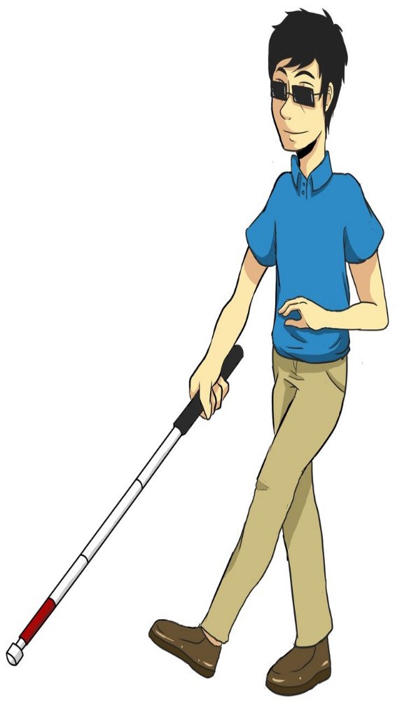
Introduction
According to the WHO statistics,
around 36 billion people are blind on
the earth.
This project proposes to design
and develop a portable stick for
them for easy usage and navigation
in public places.
The blind stick is integrated with
ultrasonic sensor along with GSM
and APR 33A3.

Slide 3
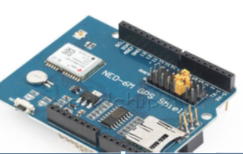
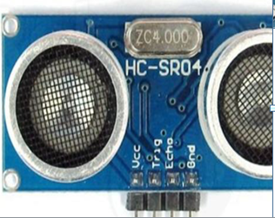
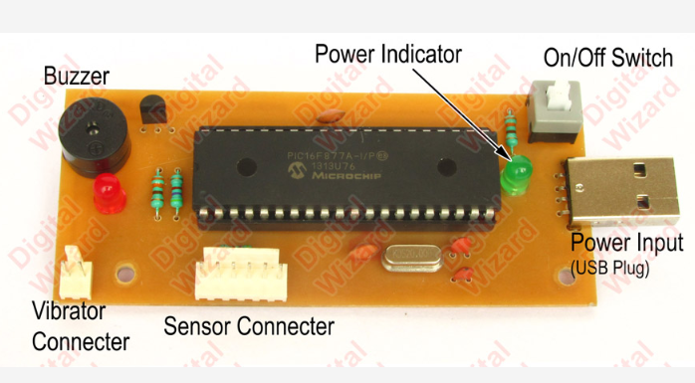
Raw Materials
Arduino UNO
Ultrasonic Sensors
GSM Module
GPS
SD card
Card Reader
Bluetooth/headphone
Buzzer/LED’s
Jumper cables
Battery
Breadboard
Push Buttons

Slide 4
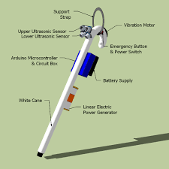
Prototype of Product
.

Slide 5
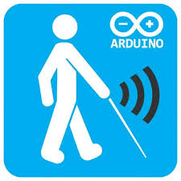
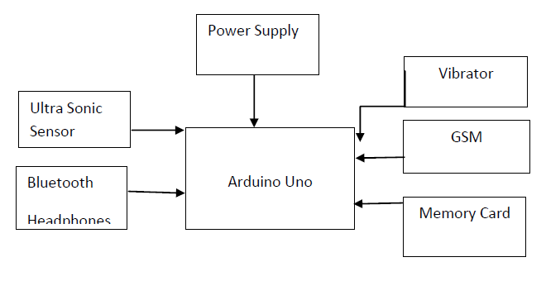
What is New
Detect Obstacle
Gives safe direction message through audio
Emergency Alert
Notes:
first uses ultrasonic sensors to detect obstacles using ultrasonic waves. On sensing obstacles the sensor passes this data to the Arduino Uno .
Obstacle can be occurred in Front side or left side or right side or may be on multiple side at a same time. So our stick will give safe side direction message through audio.
As well as we will have track of the route they travel with the help of GPS. If they are in any kind of problem of feel stuck/ lost, they only need to press the push button and with the help of GPS their close ones will get their latitude and longitude through which they can be found easily.

Slide 6
Total Cost
Parameters | Cost
Design | 4,500
Prototype development | 15,000
Bench Scale Production | 30,000
Professional Services | 2,000
Hiring Staff | 18,000
Trials | 7,000
Test Marketing | 15,000
Miscellaneous | 8,500
Total | 1,00,000

Slide 7
Advantages
Detects obstacles and alerts the blind person through speech output.
Blind person’s location can be tracked whenever needed which will ensure additional safety.
Easy to use and low cost.

Slide 8
Conclusion
Traditionally visually impaired people used a stick to find out if any obstacles are present in front of them. But the aim of our making walking stick smarter and more helpful.

Slide 9


