Slide 1


SMART INDIA HACKATHON 2024
TRAVEL AND TOURISM
Problem Statement ID - SIH1591
Problem Statement Title- Student Innovation
Theme - Travel and Toursim
PS Category - Software
Team ID - 356
Team Name - RGCET-CODESPRINT

Slide 2
COMPREHENSIVE TRAVEL WEB APPLICATION
RGCET CODESPRINT
IDEA / SOLUTION :
The web application will serve as a comprehensive travel destination recommendation platform.
Users can browse and search for detailed information about top tourist destinations.
Logged in users can track the places which they have visited and manage their travel posts.
Users can share posts about places they have visited.
They can also leave feedback which helps other users make informed decisions.
Based on the user’s travel history, the web application suggests new places to visit.
web application will also have 3D-Map for users to virtually experience the place.
IMPACT :
Enhanced User Experience
Increased Tourism
Informed Decision-Making
Environmental Awareness
Cultural Exchange and Understanding
BENEFITS:
User Engagement and Loyalty
Revenue Generation
Brand Recognition and Market Positioning
Data Insights and Analytic
Global Reach

Slide 3
COMPREHENSIVE TRAVEL WEB APPLICATION
RGCET CODESPRINT
CHALLENGES:
The web application can easily become cluttered due to vast amount of information, which can confuse visitors.
Sometimes, device responsiveness may be low, and it will drive customers away.
Performance issues may arise as the web application grows and attracts more users, like slow page loading.
Integrating third-party services can be complex and prone to errors.
There are many travel web applications, which will provide tough competition to the web application.
SOLUTION:
Conducting regular user testing to gather feedback on usability and continually improve the interface.
Compress images, and minimize code to ensure quick loading times.
using SSL certificates (HTTPS) to secure data transmissions.
To overtake competition, offering unique services like personalized itineraries, AI-powered travel recommendations, and social features.
Encourage positive feedback by actively engaging with users, responding to reviews, and offering incentives for leaving feedback.

Slide 4
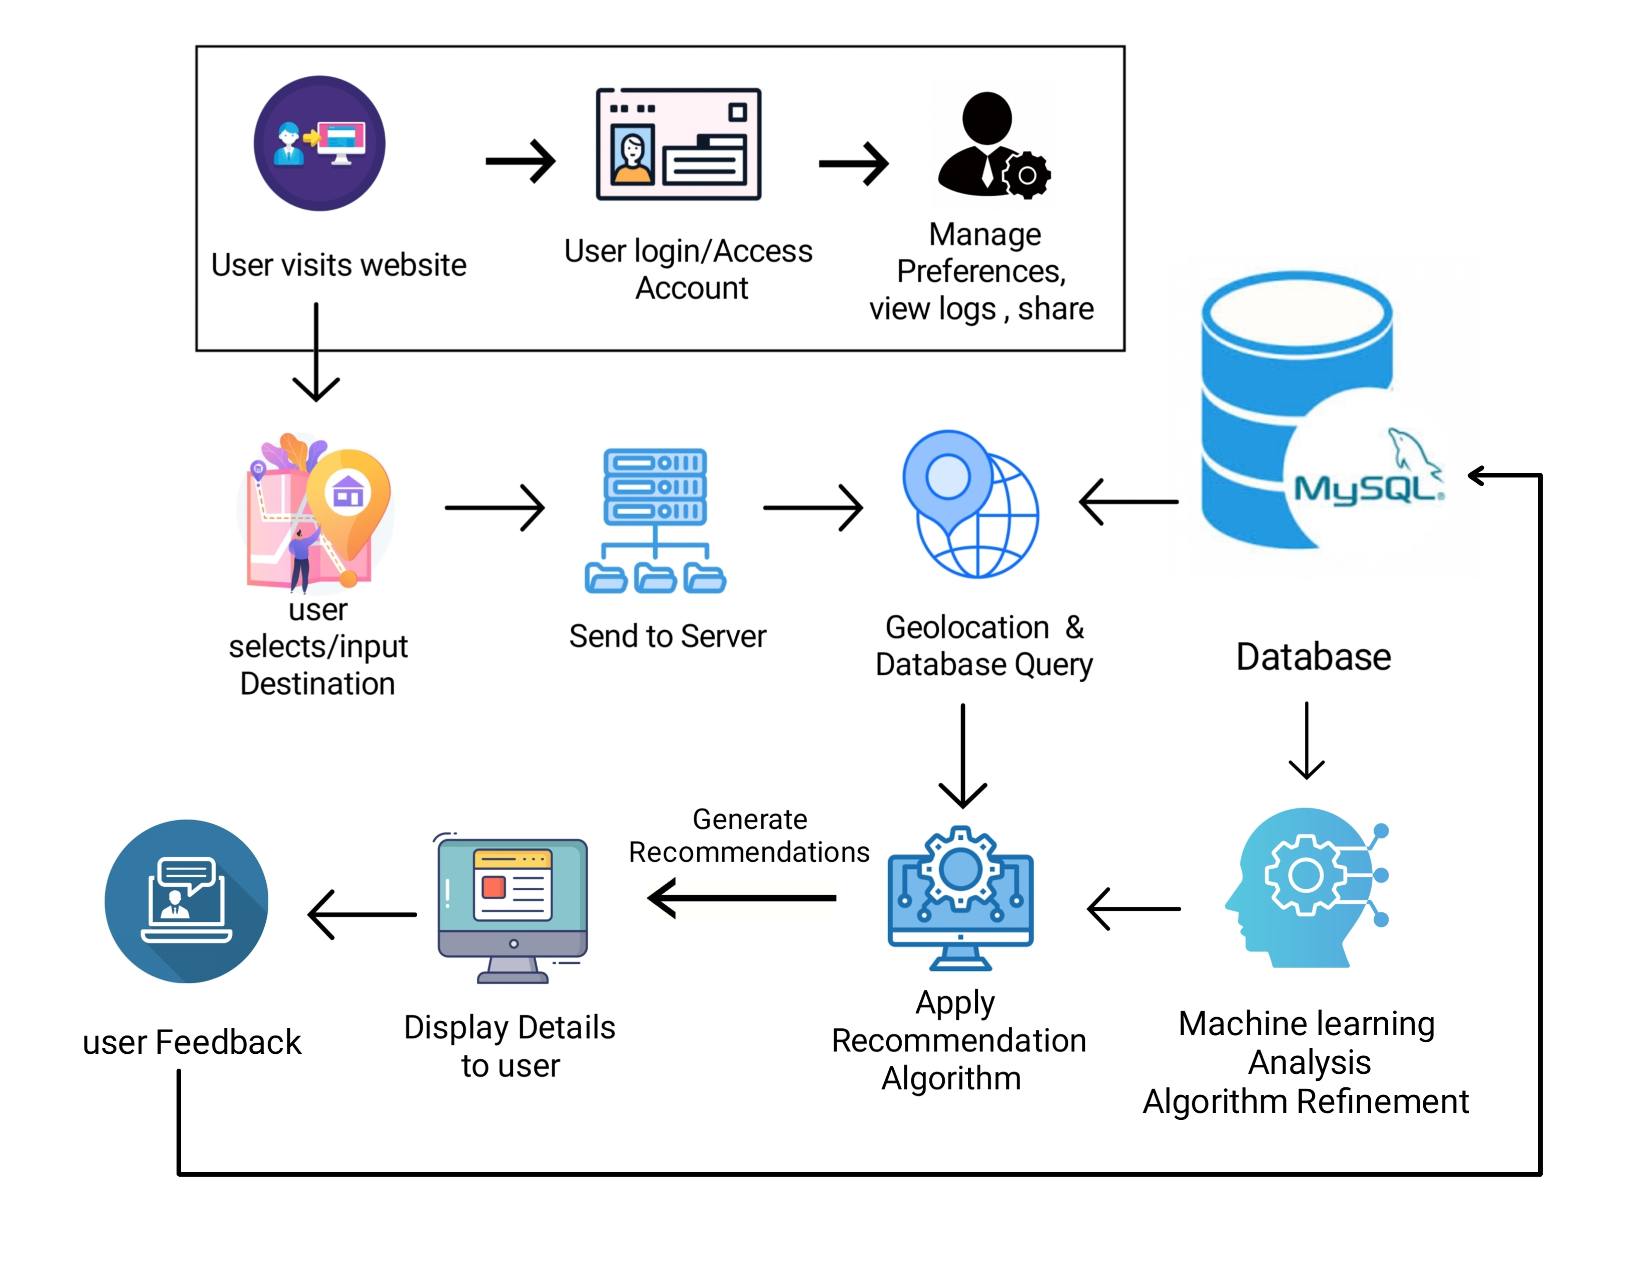
TECHNICAL APPROACH
RGCET CODESPRINT
TECHNOLOGY STACK
Frontend: HTML5, CSS3, React.js
Backend: Node.js, Python + Flask
APIs: Google Maps, API for geolocation and mapping, custom APIs for user interaction and feedback handling.
Security: Implement HTTPS, user authentication, and data encryption to ensure a secure environment for user data
PROCESS FLOW ARCHITECTURE

Slide 5
RESEARCH AND REFERENCES
RGCET CODESPRINT
Google Maps API Documentation: https://developers.google.com/maps/documentation/javascript/overview
HTML5 Geolocation API:
https://developer.mozilla.org/en-US/docs/Web/API/Geolocation_API
Machine Learning and Recommendation System Resources:
https://scikit-learn.org/stable/
Stack Overflow:
https://stackoverflow.com/

