Slide 1

GPRS Architecture
Presented by:
Ishwori Shreemal
Jeegyasha Niraula
Kailash Dhungana

Slide 2

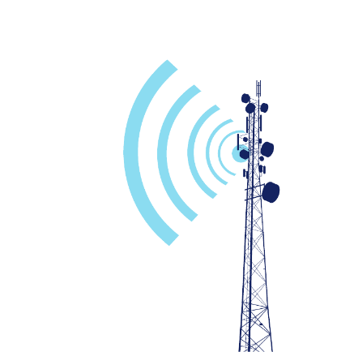
General Packet Radio Service
MSC
PSTN/
Voice Network
BSC
HLR
SGSN
MS-Mobile Station
BTS- Base Trasceiver System
BSC- Base System Controller
MSC- Mobile Switching Center
HLR- Home Location Register
SGSN- Serving GPRS Support Node
GGSN- Gateway GPRS Support Node
GGSN
Data Network

Slide 3
Work Flow of GPRS
If request is internet service
If request is voice service
BSC
MSC
PSTN/
Voice Network
MS
BSC
HLR
SGSN
HLR
BTS
GGSN
Data (PDN) Network

Slide 4
Some Key Points
Addition of two components i.e SGSN and GGSN
Packet Switched System
Supports Voice call as well as internet
Software and hardware updates to GSN architecture

Slide 5
Thank you …

