Slide 1


InsurAI – AI Powered Insurance Management System
KAILASH GOWTHAM U

Slide 2
InsurAI – AI Powered Insurance Management System
InsurAI is an AI-powered platform that helps users and agents manage policies, process claims, and access expert consultations in one place. It also provides personalized recommendations to identify coverage gaps and reduce financial risk.

Slide 3

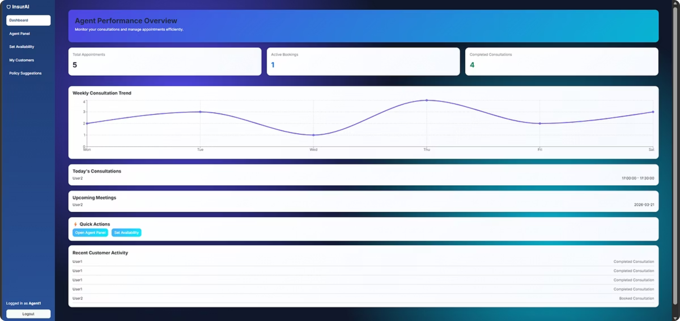
Agent Dashboard
Overview & Performance Tracking
The Agent Dashboard gives a clear view of performance and daily activity, including appointments, bookings, and consultations.
Weekly charts, today's consultations, and upcoming schedules are highlighted for quick action and easier workload management.

Slide 4
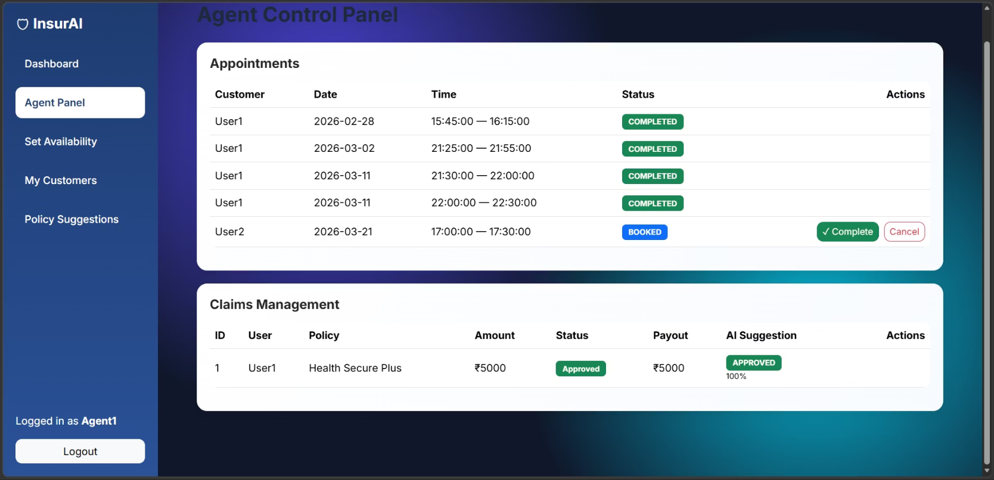
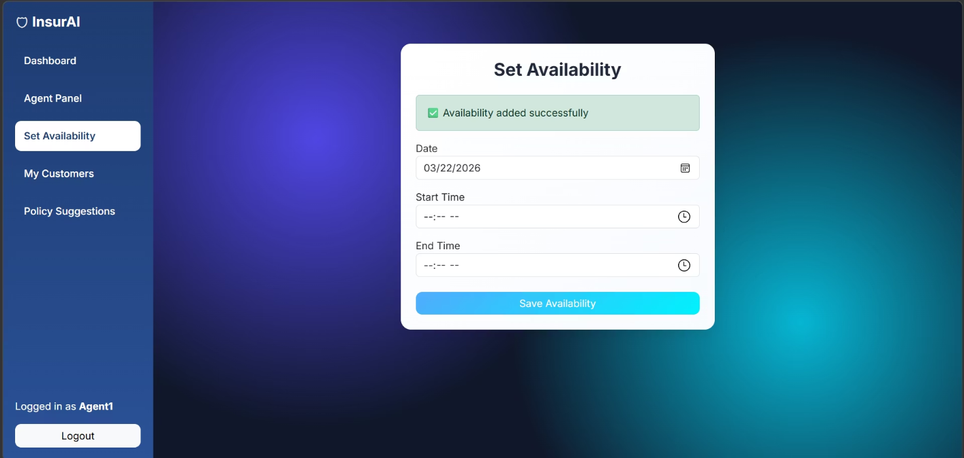
Agent Panel & Set Availability
Central Control Panel
Complete Appointments
Set Availability
Structured View
Define consultation windows for smoother scheduling and better time management
See scheduled activities and customer appointments in chronological order
Manage customer interactions from one interface with visibility into scheduled activities
Mark consultations complete or cancel appointments with one-click actions

Slide 5
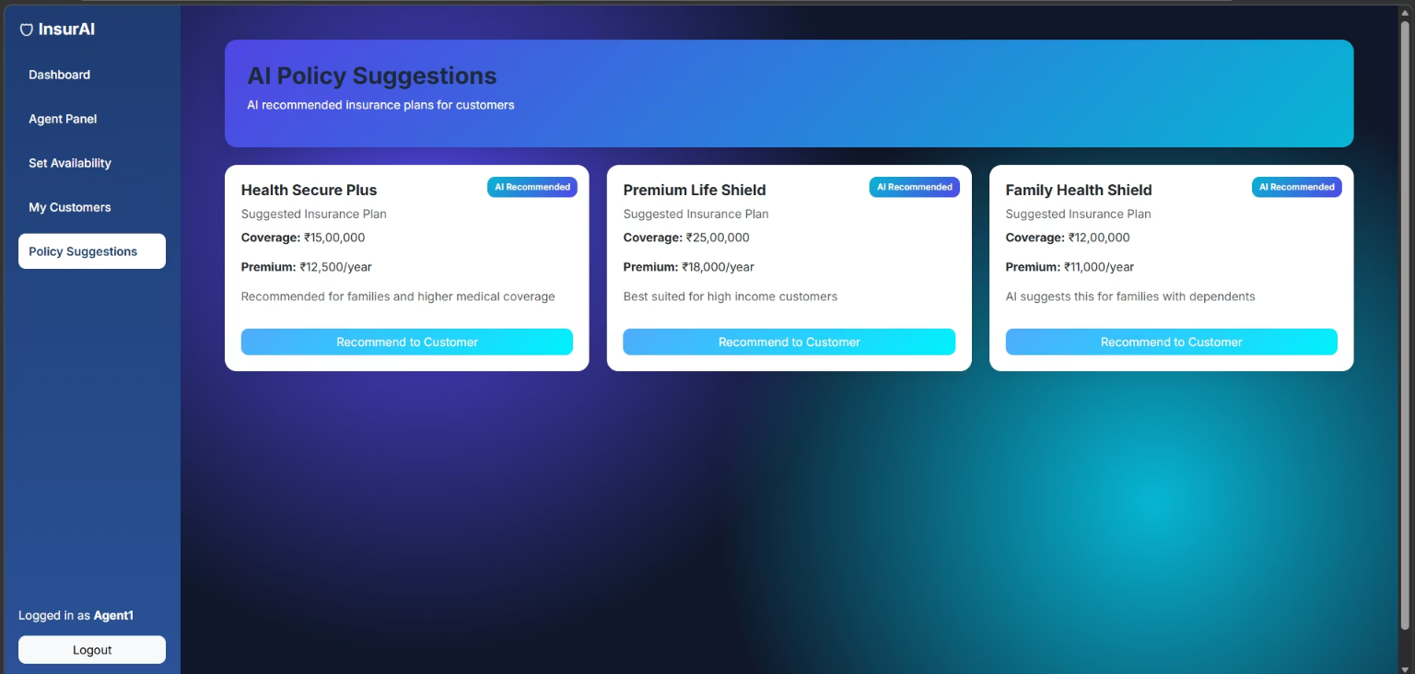
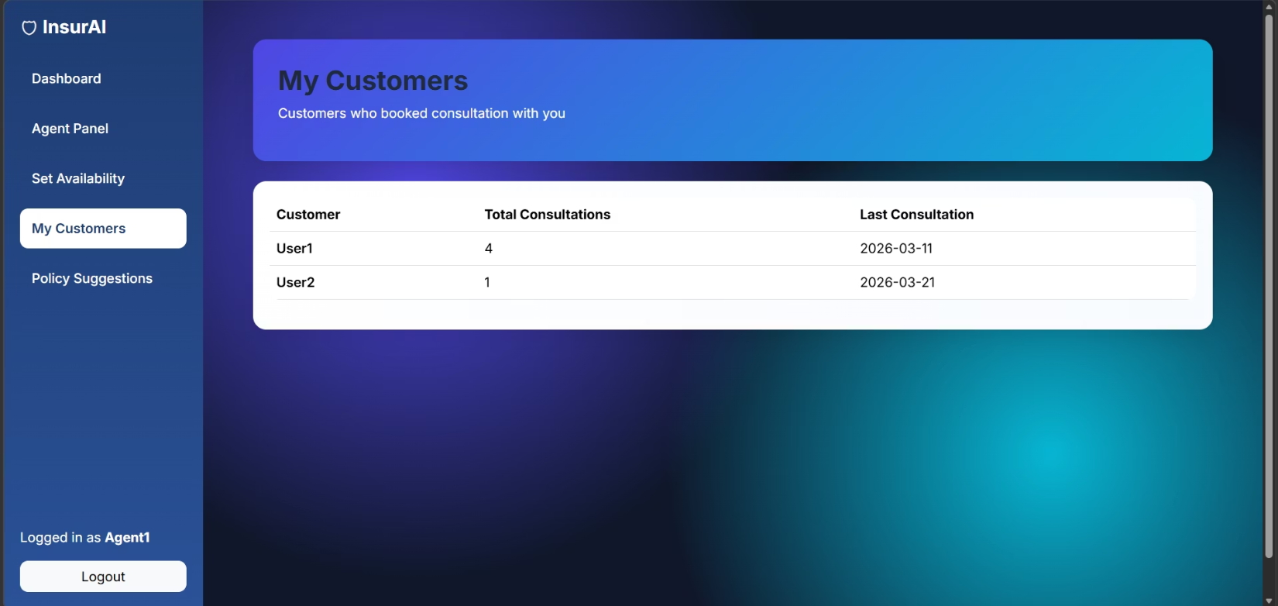
My Customers & Policy Suggestion
Customer Details
Interaction Tracking
AI Policy Matching
Personalized Recommendations
View profiles, policy history, and contact info.
Get policy suggestions tailored to customer needs.
Track consultation history for better context.
Share relevant coverage options that build trust.

Slide 6
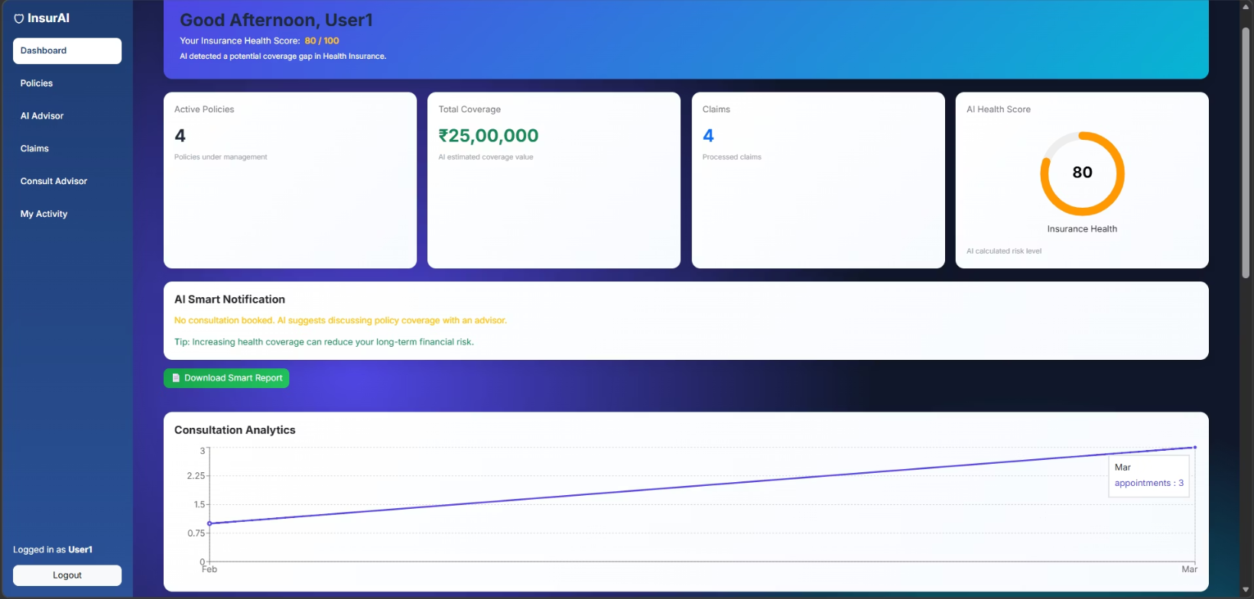
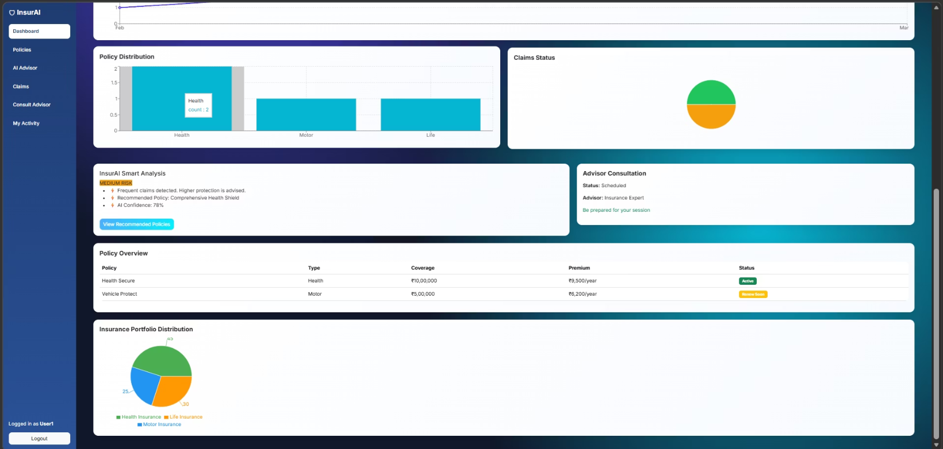
User Dashboard
Shows Insurance Health Score for the user
Displays total coverage, active policies, and claims summary
Provides AI-based smart notifications and tips
Includes consultation analytics for better tracking

Slide 7

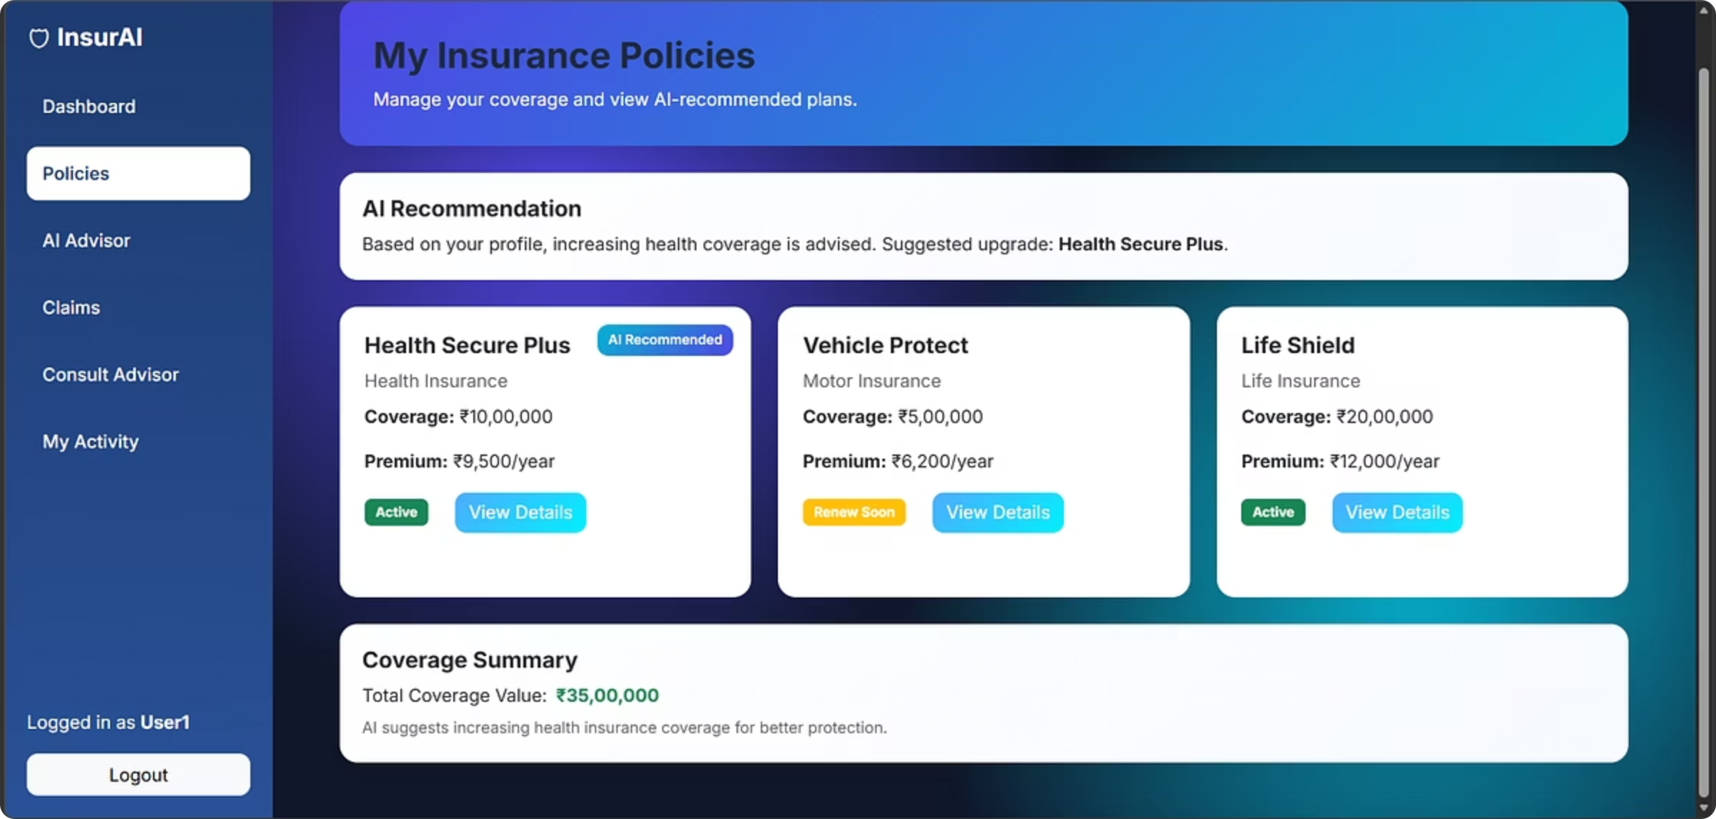
Policies & AI Advisor
Policy Display
AI Recommendations
View policies with coverage, premiums, and benefits at a glance.
See policies recommended for your profile and protection needs.
Profile Analysis
Risk Assessment
AI Advisor reviews age, income, dependents, and lifestyle factors.
Get personalized risk scores and identify coverage gaps.

Slide 8
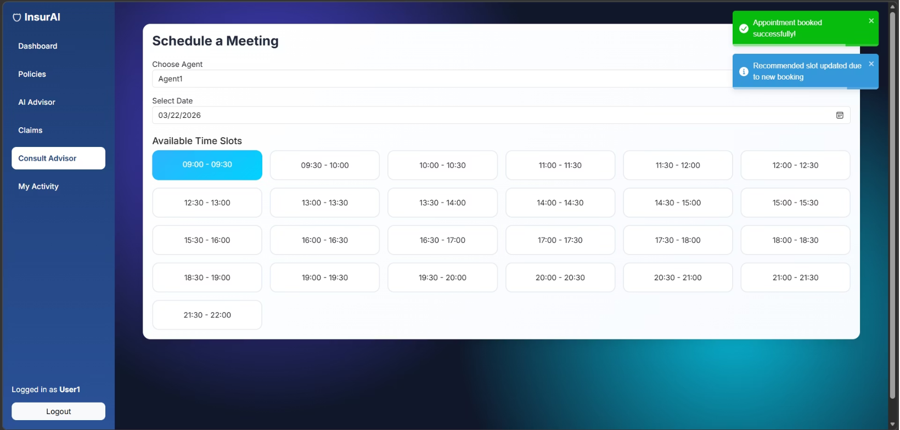
Claims & Consult Advisor
Streamlined Claims Processing
Submit and track claims with real-time updates
View claim history and status at a glance
AI Fraud Detection flags risky claims
AI Claim Decision suggests approval or review
Advisor connects users with qualified agents
Faster claims processing with automated fraud analysis.

Slide 9

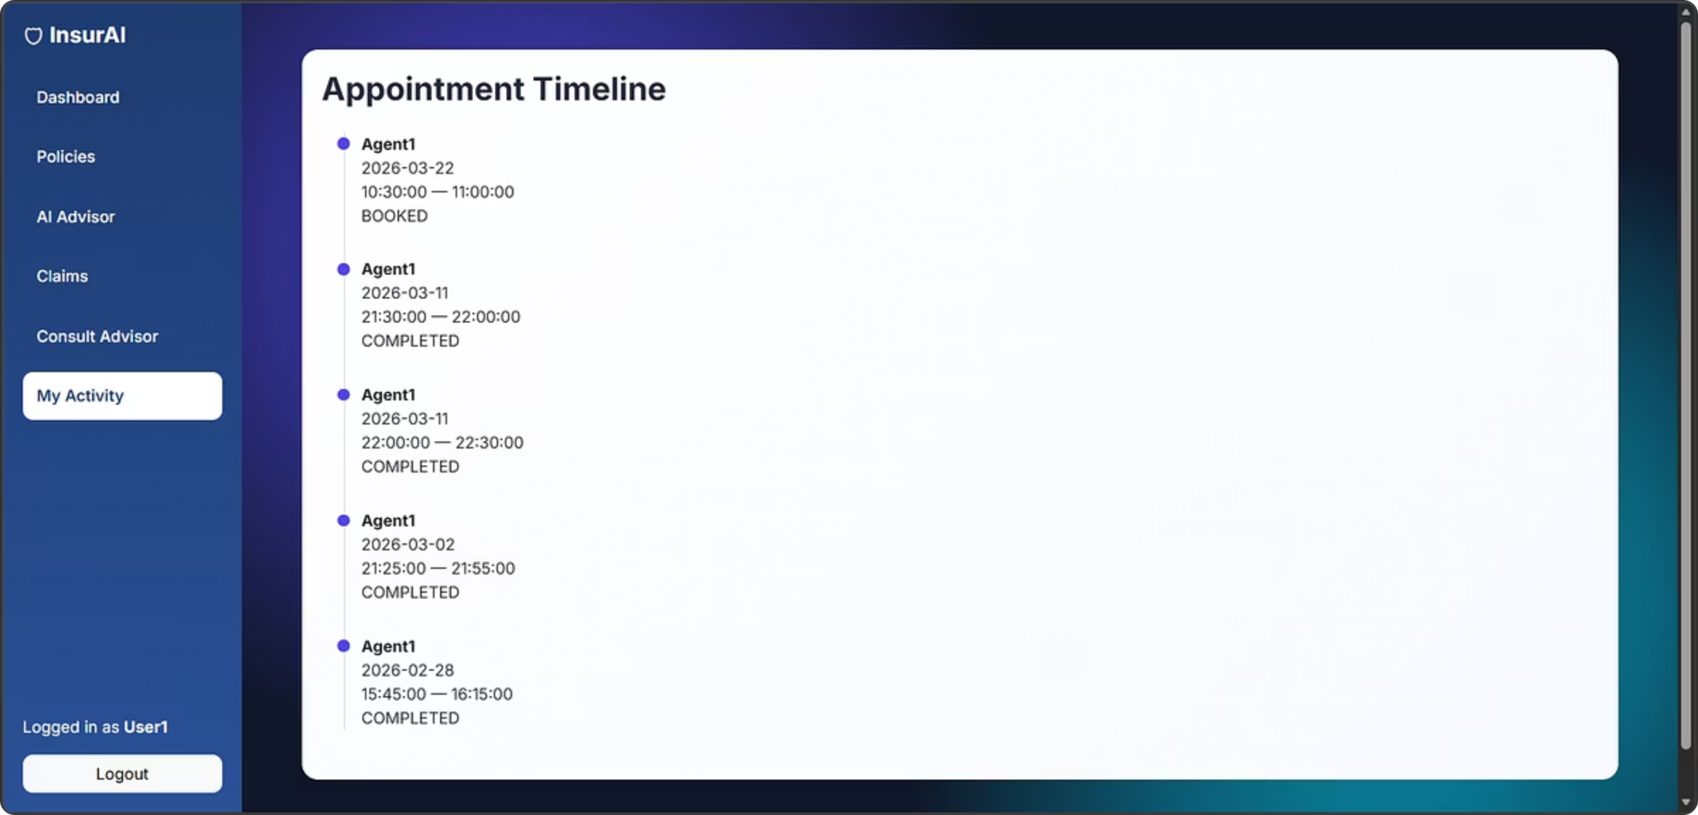
My Activity
1
Appointment History
View past and upcoming consultations.
2
Interaction Timeline
Track communications, policy changes, and claims.
3
Status Updates
See booked, completed, or cancelled appointments.
4
Transparency
Get full visibility into all activities.

Slide 10





Transforming Insurance with AI
Unified Platform
Combines AI and insurance management in one intuitive system.
Enhanced Decision-Making
Delivers intelligent insights, recommendations, and guidance.
Fraud Reduction
Automates risk analysis and cuts fraud and manual work.
Improved Experience
Speeds processing and personalizes service.
Smart AI System
InsurAI turns traditional insurance into a smart, AI-driven system for policyholders and agents alike.

