Slide 1
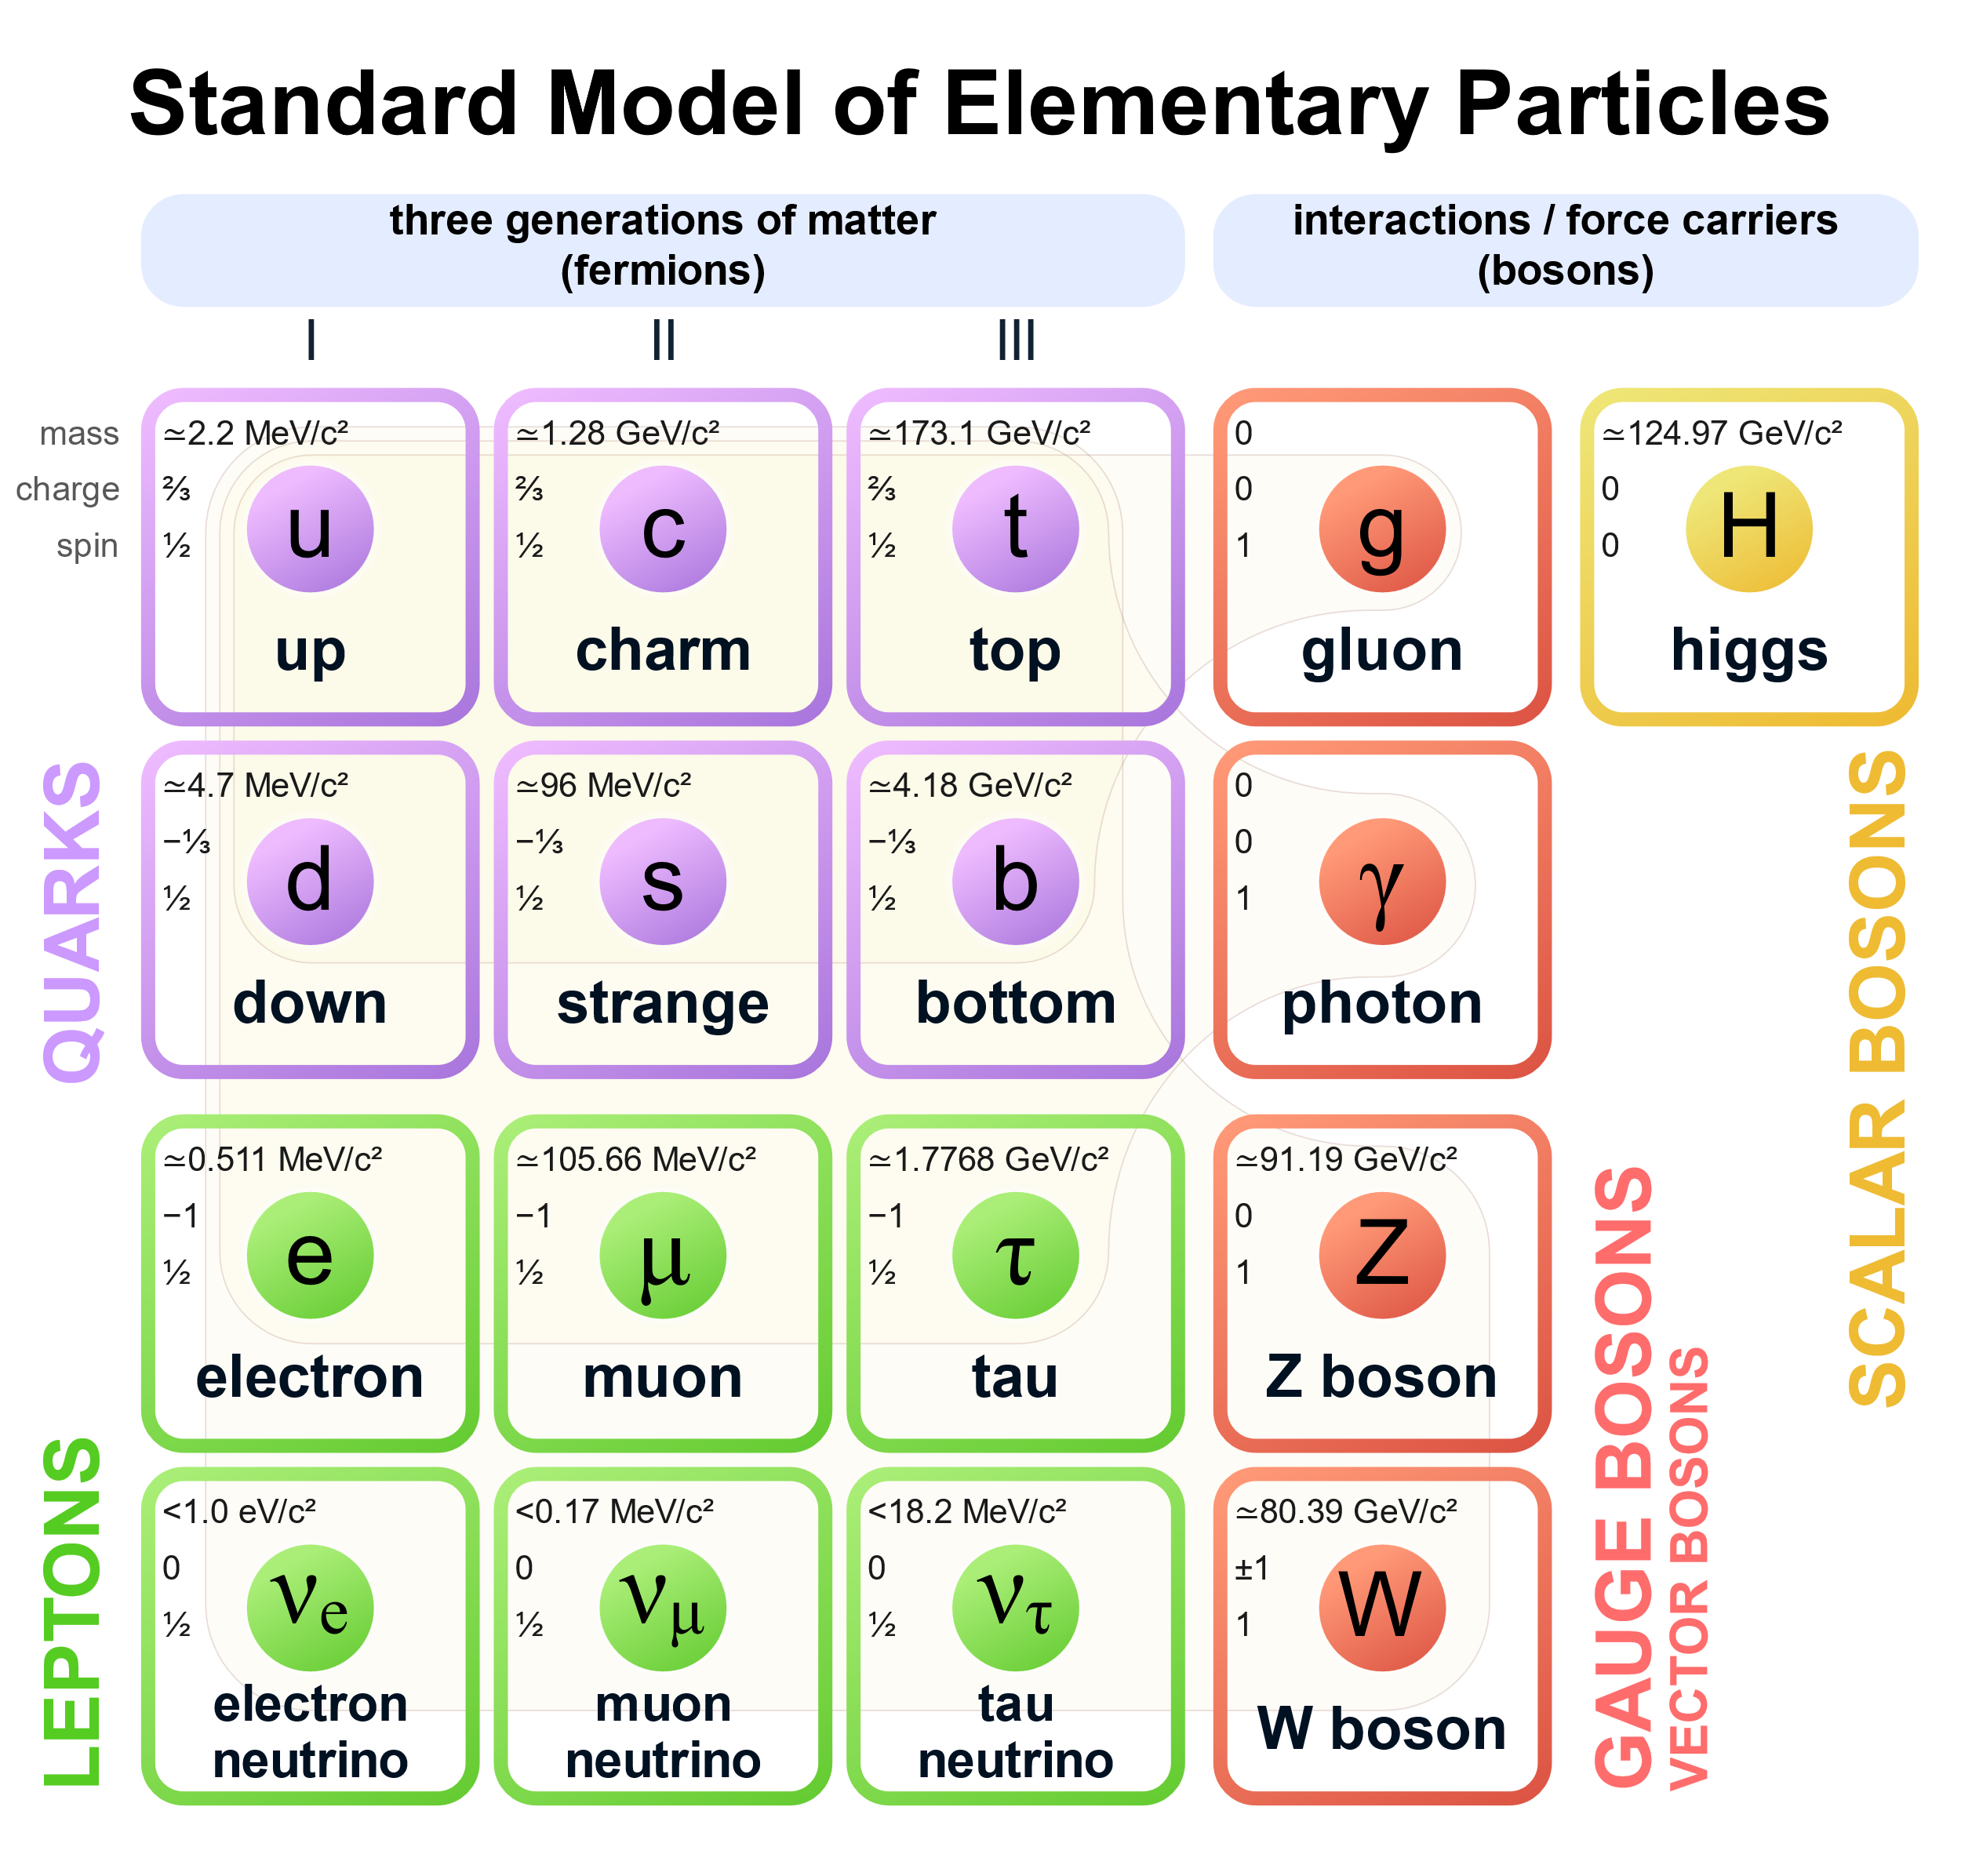
2. Metallurgy, 3. Environmental Chemistry, 4. Chemistry in Everyday life
1. Surface Chemistry
Inorganic Chemistry:
a) Block chemistry,
b) Coordination Chemistry
Organic Chemistry:
a) GOC: Stereochemistry,
Electronic effects
b) Functional Groups
c) Biomolecules, Polymers
Chemical Kinetics
p
Proton
n
neutron
1. Electrochemistry
Properties of Compounds
Chemical Reactions
Redox Reactions
Energy
States
Molecules
Atom
States of Matter: Gas, Solid, Liquid
Thermodynamics
Equilibrium
Chemical Bonding
Intermolecular Forces
Structure of Atom
Periodicity

