Slide 1
Ads-Summer 2019 CNN(Convolutional Neural Networks) Project Presentation
Kailash Nadkar - 001387392

Slide 2
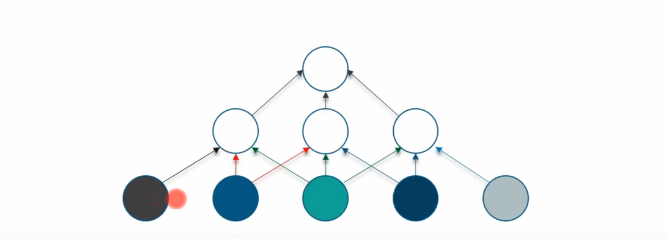
what IS Convolutional Neural Networks (CNN)
A Convolutional Neural Network (ConvNet/CNN) is a Deep Learning algorithm which can take in an input image, assign importance (learnable weights and biases) to various aspects/objects in the image and be able to differentiate one from the other.
in a convolutional layer each neuron is only connected to a few nearby (aka local) neurons in the previous layer, and the same set of weights (and local connection layout) is used for every neuron.

Slide 3
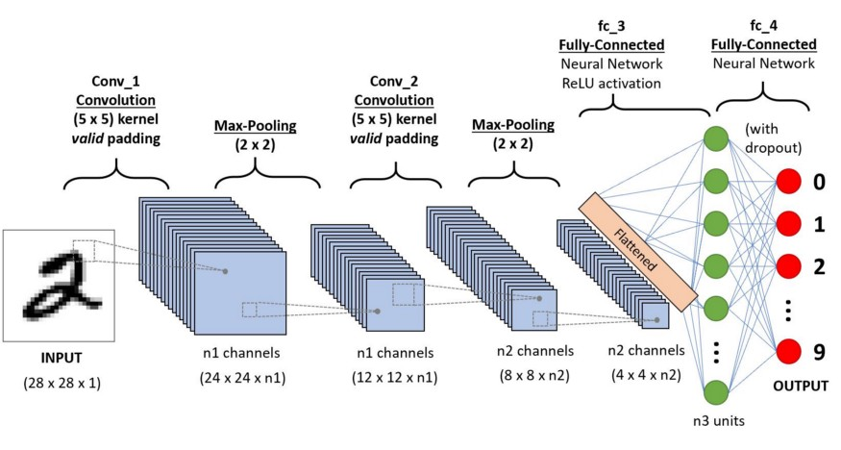
HOw CNN works??

Slide 4
Convolutional neural Network Has Following Layers:
Convolutional Layer: The objective of the Convolution Operation is to extract the high-level features such as edges, from the input image.

Slide 5
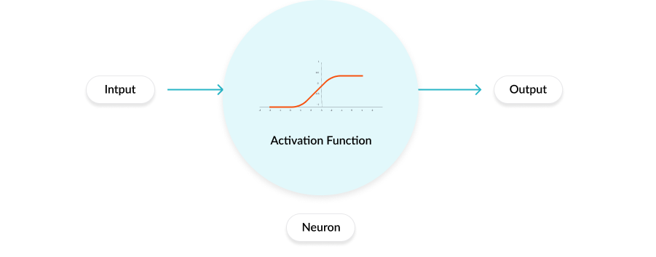
Activation Function: The activation function is a mathematical “gate” in between the input feeding the current neuron and its output going to the next layer. It can be as simple as a step function that turns the neuron output on and off, depending on a rule or threshold. Or it can be a transformation that maps the input signals into output signals that are needed for the neural network to function.

Slide 6
Pooling Layer: Similar to the Convolutional Layer, the Pooling layer is responsible for reducing the spatial size of the Convolved Feature. This is to decrease the computational power required to process the data through dimensionality reduction. Furthermore, it is useful for extracting dominant features which are rotational and positional invariant, thus maintaining the process of effectively training of the model.
There are two types of Pooling: Max Pooling and Average Pooling. Max Pooling returns the maximum value from the portion of the image covered by the Kernel. On the other hand, Average Pooling returns the average of all the values from the portion of the image covered by the Kernel.

Slide 7
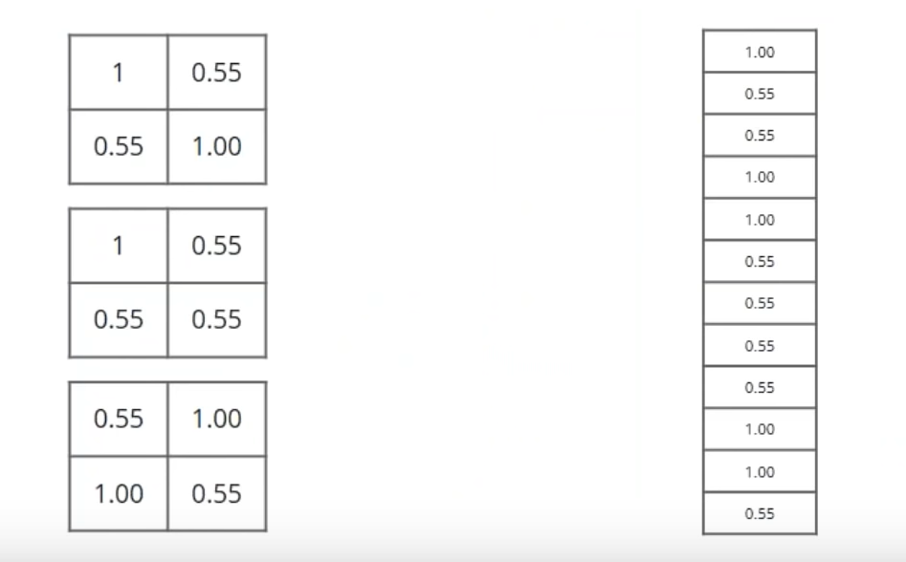
Fully Connected Layer: Adding a Fully-Connected layer is a (usually) cheap way of learning non-linear combinations of the high-level features as represented by the output of the convolutional layer. The Fully-Connected layer is learning a possibly non-linear function in that space.
Here we take our filtered and shrinked image and put them into single list/vector.

Slide 8
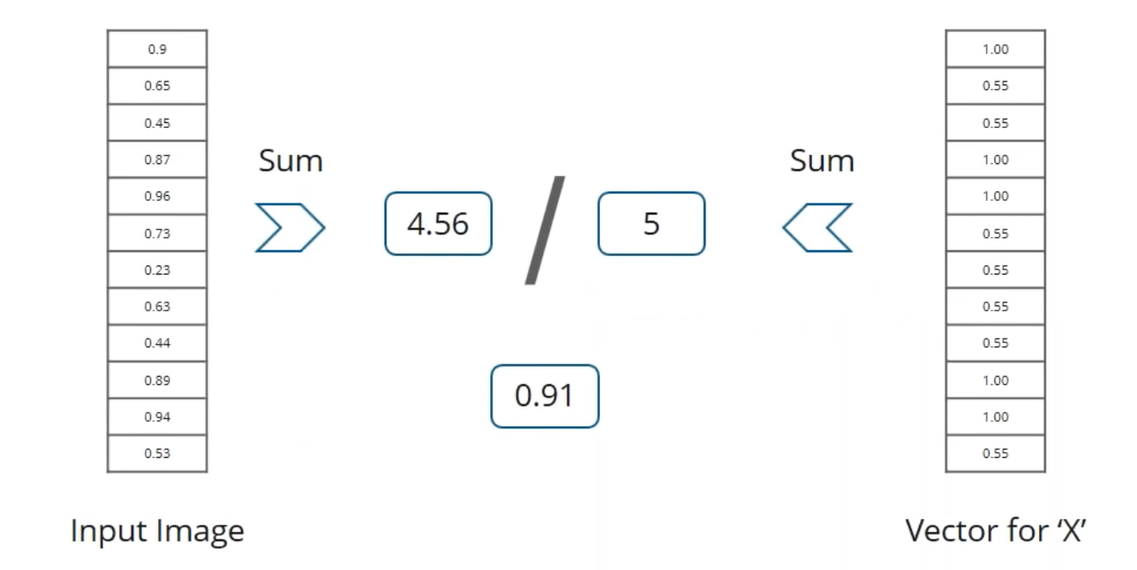

Slide 9
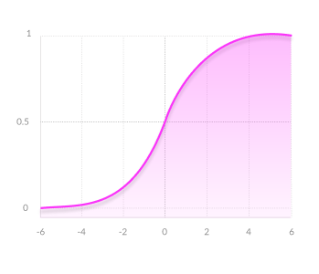
Implementation Ideas(CNN)
In this project I will be experimenting with different Activation Functions. Analyzing there effects, comparing there accuracy, evaluating there advantage an try to come up with our own activation function.
I will be working on following Activation functions :
SIGMOID / LOGISTIC:
ADVANTAGES
Smooth gradient, preventing “jumps” in output values.
Output values bound between 0 and 1, normalizing
the output of each neuron.
Clear predictions- For X above 2 or below -2, tends to bring
the Y value (the prediction) to the edge of the curve,
very close to 1 or 0. This enables clear predictions.
DISADVANTAGES
Vanishing gradient- for very high or very low values of X,
there is almost no change to the prediction, causing a vanishing gradient problem.
This can result in the network refusing to learn further, or being too slow to reach an accurate prediction.
Outputs not zero centered.
Computationally expensive

Slide 10
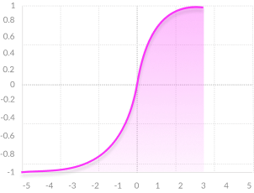
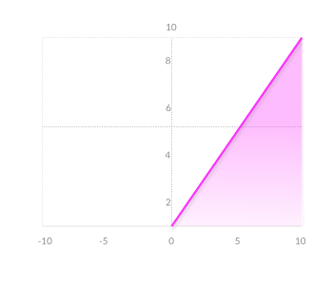
TANH / HYPERBOLIC TANGENT:
ADVANTAGES
Zero centered- making it easier to model inputs that
have strongly negative, neutral, and strongly positive values.
Otherwise like the Sigmoid function.
DISADVANTAGES
Like the Sigmoid function
RELU (RECTIFIED LINEAR UNIT):
ADVANTAGES
Computationally efficient—allows the network to
converge very quickly
Non-linear—although it looks like a linear function,
ReLU has a derivative function and allows for backpropagation
DISADVANTAGES
The Dying ReLU problem- when inputs approach zero,
or are negative, the gradient of the function becomes zero,
the network cannot perform backpropagation and cannot learn.

Slide 11
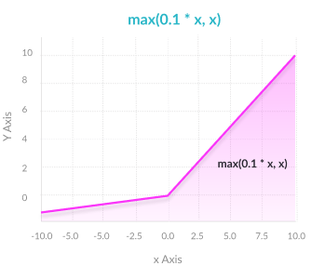
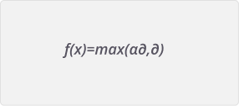
LEAKY RELU:
ADVANTAGES
Prevents dying ReLU problem- this variation of ReLU
has a small positive slope in the negative area,
so it does enable backpropagation, even for negative input values.
Otherwise Like a ReLU.
DISADVANTAGES
Results not consistent- leaky ReLU does not provide consistent
predictions for negative input values.
Parametric RELU :
ADVANTAGES
Allows the negative slope to be learned—unlike leaky ReLU,
this function provides the slope of the negative part of the function
as an argument. It is, therefore, possible to perform
backpropagation and learn the most appropriate value of α.
Otherwise like ReLU
DISADVANTAGES
May perform differently for different problems.

Slide 12
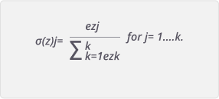
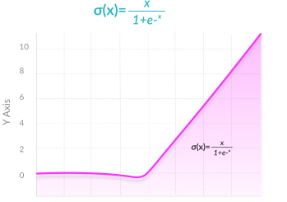
softmax:
ADVANTAGES
Able to handle multiple classes only one class in other activation
functions- normalizes the outputs for each class between 0 and 1,
and divides by their sum, giving the probability of the input
value being in a specific class.
Useful for output neurons- typically Softmax is used
only for the output layer, for neural networks that need to
classify inputs into multiple categories.
SWISH:
ADVANTAGES
Swish is a new, self-gated activation function discovered by researchers
at Google. According to their paper, it performs better than ReLU with
a similar level of computational efficiency. In experiments on ImageNet
with identical models running ReLU and Swish, the new function
achieved top -1 classification accuracy 0.6-0.9% higher.

Slide 13
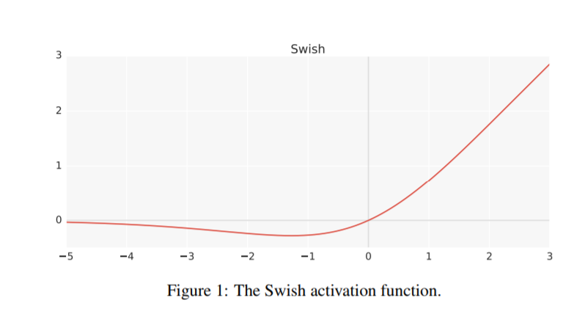
c

Slide 14
Getting Data
For this project I will be using Intel Image Classification dataset from Kaggle.
This is image data of Natural Scenes around the world.
This Data contains around 25k images of size 150x150 distributed under 6 categories.
{'buildings' -> 0, 'forest' -> 1, 'glacier' -> 2, 'mountain' -> 3, 'sea' -> 4, 'street' -> 5 }
There are around 14k images in Train,
3k in Test and
7k in Prediction.

Slide 15
Algorithms
I will be implementing Convolutional Neural Network
Using Keras and TensorFlow library
Implementing various activation functions and evaluating their accuracy, drawbacks and a dataset where which activation function can be more suited.
Additionally I aim to implement research paper based on activation function SWISH which is discovered by researchers at google

Slide 16
ReferenceS and citationS:
https://www.youtube.com/watch?v=H-HVZJ7kGI0
https://towardsdatascience.com/a-comprehensive-guide-to-convolutional-neural-networks-the-eli5-way-3bd2b1164a53
https://www.youtube.com/watch?v=umGJ30-15_A&t=881s
https://missinglink.ai/guides/neural-network-concepts/7-types-neural-network-activation-functions-right/
https://www.analyticsvidhya.com/blog/2018/12/guide-convolutional-neural-network-cnn/
https://www.kaggle.com/puneet6060/intel-image-classification
https://arxiv.org/pdf/1710.05941v1.pdf

