Slide 1
MARKSMITH
A Handcrafted Markdown Studio
CS23531 – Web Programming | Mini Project
KAILASH BALASUNDARATHURAI – 241001101
Rajalakshmi Engineering College, Thandalam

Slide 2
Introduction
Markdown is the standard format for READMEs, notes and documentation
Many online previewers are cluttered, need accounts or upload your text
Marksmith is a fast, private editor with a live preview, running fully in the browser
MARKDOWN
PREVIEW
# Hello
**Bold** text
- list item
Hello
Bold text
• list item
Live, on every keystroke

Slide 3
Objectives
1
Live preview
2
Smart editing
Instant rendering on every keystroke, no page reloads
Auto-indent, list continuation, auto-pairing and a toolbar
3
Flexible workspace
4
Save and export
Split, Write and Read modes with a draggable divider
Auto-save, file import, export as .md, HTML or PDF

Slide 4
Key Features
GFM rendering
Syntax highlighting
Math support
Tables, task lists and alert callouts
Highlight.js with a Copy Code button
Inline and display LaTeX via KaTeX
Themes
Task checklists
Live statistics
Several colour themes and preview fonts
Tick in the preview, editor updates
Words, characters, lines, read time

Slide 5
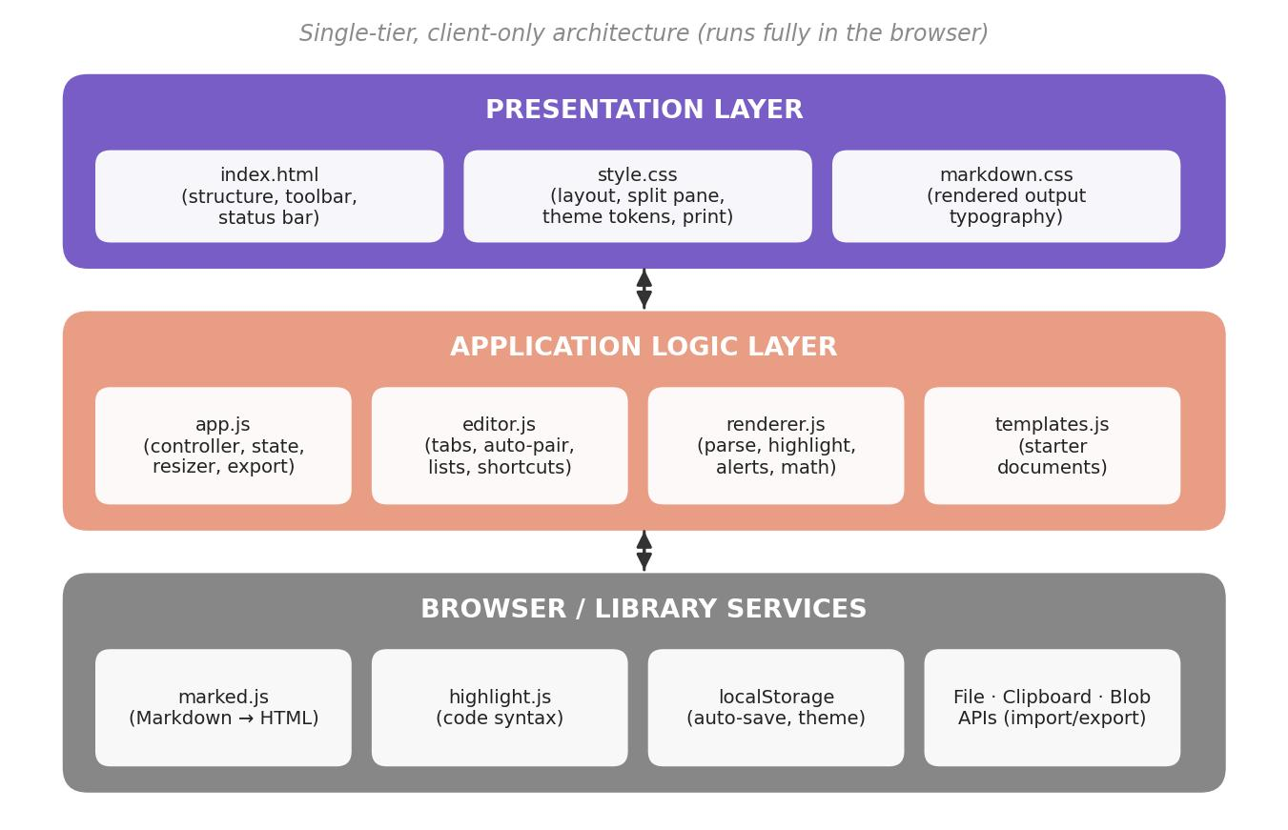
System Architecture
Client-only
No backend or database
Three layers
Presentation, logic and browser services
Private
Your text stays on your device

Slide 6
Technology Stack
HTML5
Structure of editor, preview and toolbar
CSS3
Split-pane layout, themes and print styles
JavaScript ES6+
Editor logic, state, scroll sync and export
marked.js
Parses Markdown into HTML
Highlight.js · KaTeX
Code highlighting and maths
localStorage
Auto-save and theme persistence

Slide 7
How It Works
1
2
3
4
Type
Parse
Render
Save
Write Markdown in the editor
marked.js converts it to HTML
Code, alerts and maths styled
Auto-save, then export
Keyboard shortcuts
Ctrl+B Bold · Ctrl+I Italic · Ctrl+K Link · Ctrl+S Download · Ctrl+/ Help

Slide 8
Conclusion and Future Scope
Conclusion
Future Scope
A full Markdown studio with only HTML, CSS and JavaScript
No frameworks, build tools or backend
Fast, private and comfortable for long writing
Multiple documents with tabs
Find and replace
Mermaid diagram support
PWA offline mode
Thank you

