Slide 1
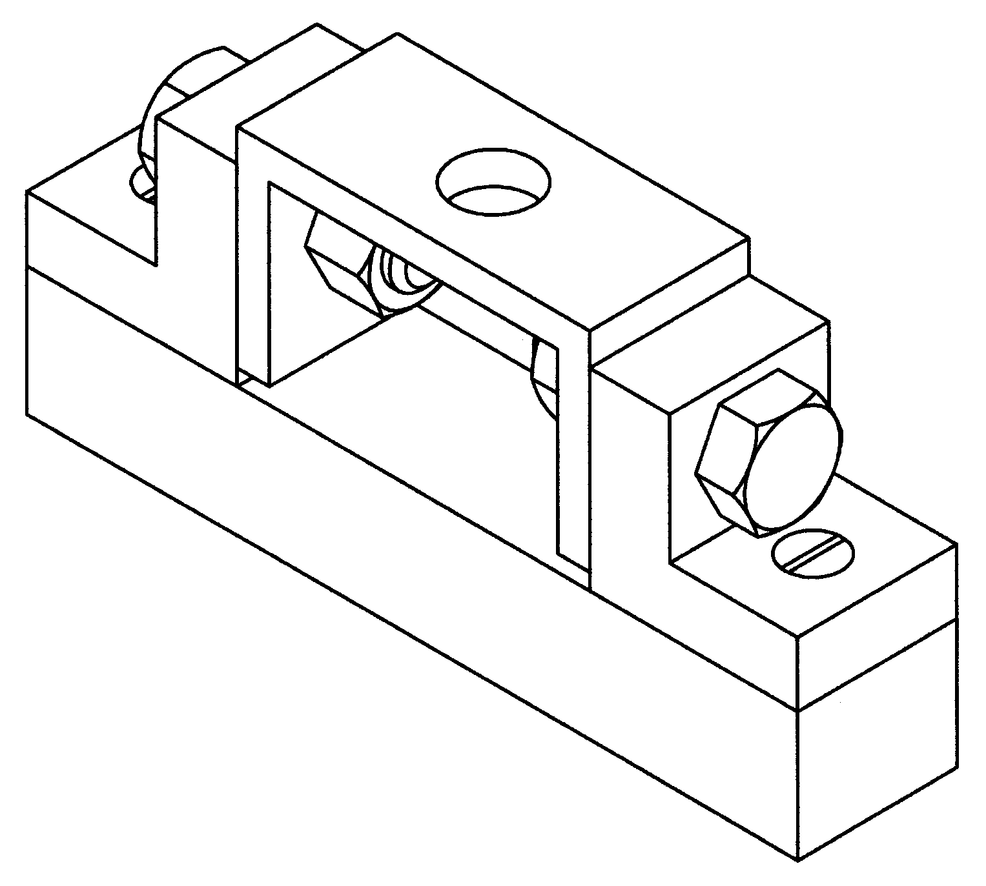

Assume necessary dimensions………………………………………….

Slide 2
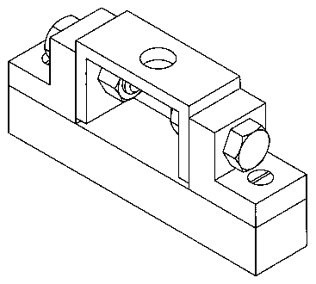
When sectioned nut &bolt will seen
The complete figure is

Slide 3
