Slide 1
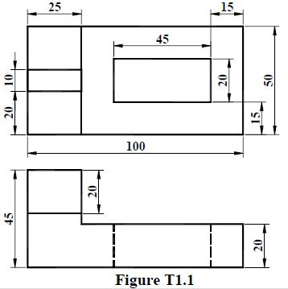

midpoint
5
20
45
75
25
100
20
30°
30°
50

