Slide 1
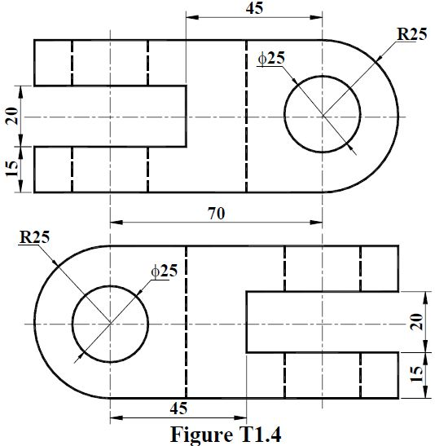

10
10
15
95
30
30
For making ellipse click here

