Slide 1
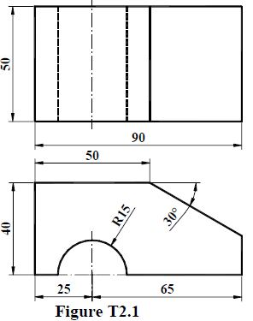


T2.1
30˚

