Slide 1
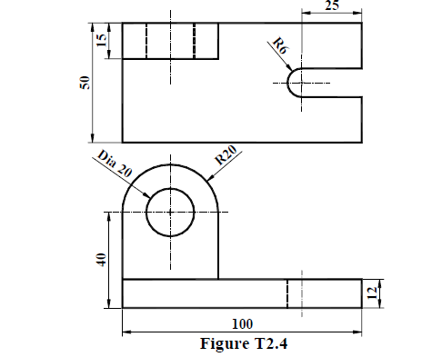
For making ellipse, click here

