Slide 1
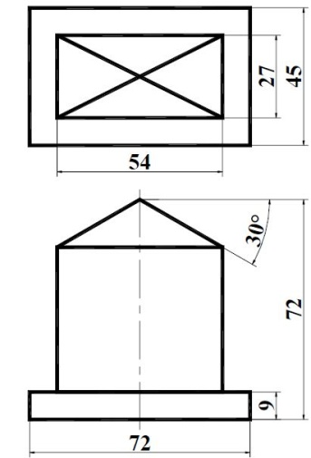

Parallel lines
Parallel lines

Slide 2
VP:Vanishing Point
PP:Paper/Projection Plane
SP:Station Point
TV:Top View
GP:Ground Plane
Click here for studying a little about perspective drawings ☺

