Slide 1
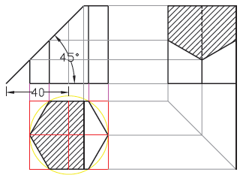

T5.6

Slide 2
To learn about sectioning click here………….

