Slide 1
EPISTEMIC INTELLIGENCE & CONTRADICTION ENGINE
NullSpace
"See What the Sources Don't Say."
AI-Assisted Counterfactual Schema Alignment & Contradiction Detection Engine
SYSTEM ARCHITECT & LEAD ENGINEER:
POCHIRAJU KAILASH RAM MARKANDEYA SHARMA
Principal Software Architect & Lead Full-Stack AI Engineer | Full-Stack Architecture, Epistemic Graph Models & Security
Hackathon Submission Edition | 100% Automated Testing & Offline Deterministic Verification
NullSpace | Epistemic Audit Platform | Architect: POCHIRAJU KAILASH RAM MARKANDEYA SHARMA | Slide 1

Slide 2
PROBLEM ANALYSIS
The Blind Spot Crisis in Retrieval-Augmented AI
1. Confirmation Bias
• Standard RAG engines query: 'What do these pages say?'
• They silently omit critical criteria that no source mentions.
• If a scholarship notice neglects renewal policy, RAG presents an incomplete decision as verified.
• Users accept grants only to be disqualified in subsequent years.
2. Unchecked Contradictions
• Web sources disagree frequently on high-stakes numeric limits.
• Blog A claims ceiling is Rs. 4 Lakh; Notice says Rs. 3 Lakh; Blog B claims Rs. 2 Lakh.
• LLMs hallucinate a synthetic blend or arbitrarily pick the most recent text.
• No verbatim grounding or side-by-side span diffing.
3. Temporal Decay & Omission
• Web scrapers confuse retrieval timestamp with policy applicability.
• A 2024 blog scraped today is mistaken for current 2026-27 guidance.
• Critical application cycle differences (e.g. AY 2025-26 vs AY 2026-27) go undetected.
• No mathematical uncertainty metric to prioritize verification.
NullSpace | Epistemic Audit Platform | Architect: POCHIRAJU KAILASH RAM MARKANDEYA SHARMA | Slide 2

Slide 3
CORE INNOVATION
The Counterfactual Solution: Schema-First Epistemics
Traditional Retrieval Workflow (Flawed)
• Step 1: Scrape/Fetch arbitrary user-provided URLs.
• Step 2: Generate summaries based strictly on retrieved texts.
• Fatal Vulnerability: Severe blind spots. If all sources omit a required document or renewal rule, the user is never alerted.
• Confirmation bias is baked into the discovery architecture.
• Quotes are often synthetic paraphrases invented by the model.
NullSpace Counterfactual Workflow (Schema-First)
• Step 1: Synthesize mandatory Decision Requirement Graph G = (V, E) BEFORE scraping any source.
• Step 2: Ingest sources with SSRF protection and compute SHA-256 snapshots.
• Step 3: Extract atomic claims with verified character offsets [start:end].
• Step 4: Execute bipartite alignment mapping claims to requirement nodes.
• Step 5: Mathematical InDegree(v) = 0 Dark Spot flag for ungrounded mandatory criteria.
NullSpace | Epistemic Audit Platform | Architect: POCHIRAJU KAILASH RAM MARKANDEYA SHARMA | Slide 3

Slide 4
ALGORITHMIC RIGOR
Mathematical Formulations & Epistemic Metrics
A. Digital Dark Spot Condition
• For any mandatory decision requirement node v in V_mandatory:
• IsDarkSpot(v) <=> InDegree(v) = 0
• InDegree(v) = |{ c in Claims : mapped(c, v) }|
• Guarantees that unaddressed decision facets are mathematically surfaced.
B. Exact Character Offset Grounding
• Snapshot immutability: ContentHash = SHA256(RawText)
• Offset mathematical invariant: RawText[start : end] == exact_quote
• If a model hallucinates a paraphrase, offset search fails -> claim is rejected from Grounded Evidence Vault.
C. Normalized Shannon Evidence Entropy
• For requirement v with claims distributed across k=4 epistemic states:
• H(X_v) = - sum(p_i * log2(p_i))
• H_norm(X_v) = H(X_v) / log2(k)
• When InDegree = 0 (Dark Spot): U_missing = 1.0 (maximum uncertainty).
D. Priority Risk Scoring (0 - 100)
• Score = min(100, 0.35*(Imp/5)*35 + 0.30*U_missing*30 + 0.20*I_conflict*20 + 0.15*I_stale*15 + 0.10*H_norm*10)
• Critical Risk: Score >= 75 | High Risk: Score >= 55
• Medium Risk: Score >= 35 | Low Risk: Score < 35
NullSpace | Epistemic Audit Platform | Architect: POCHIRAJU KAILASH RAM MARKANDEYA SHARMA | Slide 4

Slide 5
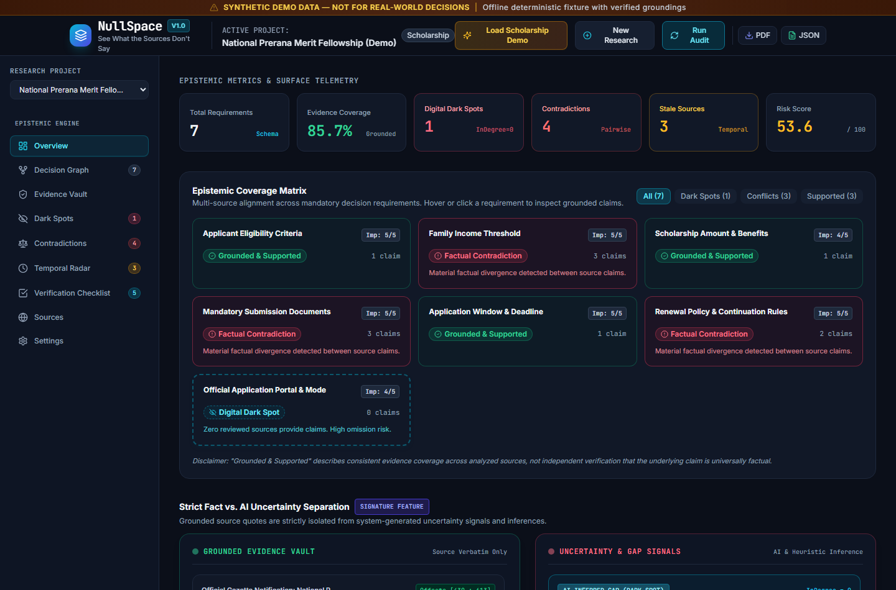
USER INTERFACE
Executive Dashboard & Live Epistemic Telemetry
Dashboard Innovations
• Epistemic Coverage Matrix: Green (Supported), Red (Conflict), Amber (Stale), Hollow (Dark Spot).
• Calculated KPIs: Real-time coverage %, conflict count, dark spot count, and risk score.
• Strict Fact vs. AI Separation: Grounded Evidence Vault (verbatim only) segregated from Uncertainty & Gap Signals.
• One-Click Scholarship Demo: 100% deterministic offline fixture with zero API keys required.
• Direct PDF & JSON report exports.
NullSpace | Epistemic Audit Platform | Architect: POCHIRAJU KAILASH RAM MARKANDEYA SHARMA | Slide 5

Slide 6
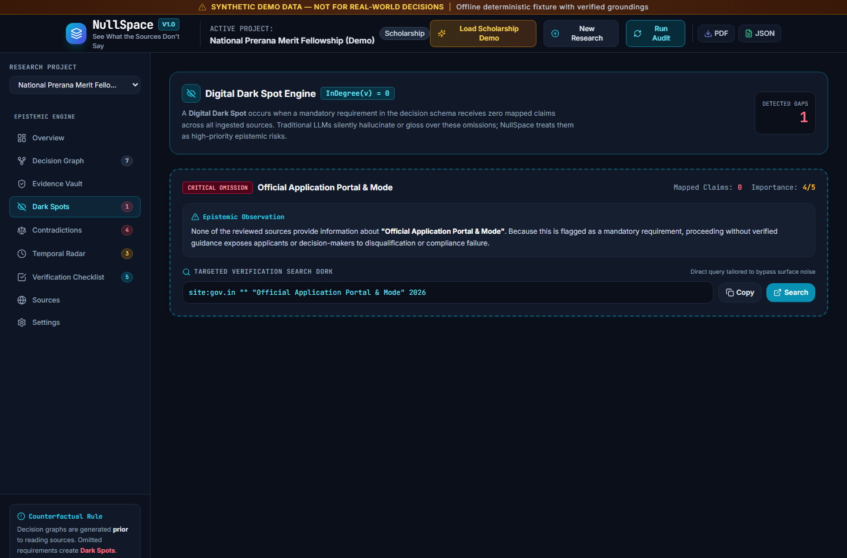
SIGNATURE FEATURE
Digital Dark Spot Engine & Search Dork Generation
Dark Spot Engine
• Zero-in-degree detection flags missing mandatory criteria.
• Exposes that neither the official gazette nor blogs provided submission mode.
• Targeted Search Dork Generator: creates high-intent queries (site:gov.in, filetype:pdf).
• One-click clipboard copy with visual confirmation.
• One-click browser execution directly opening Google search tab.
NullSpace | Epistemic Audit Platform | Architect: POCHIRAJU KAILASH RAM MARKANDEYA SHARMA | Slide 6

Slide 7
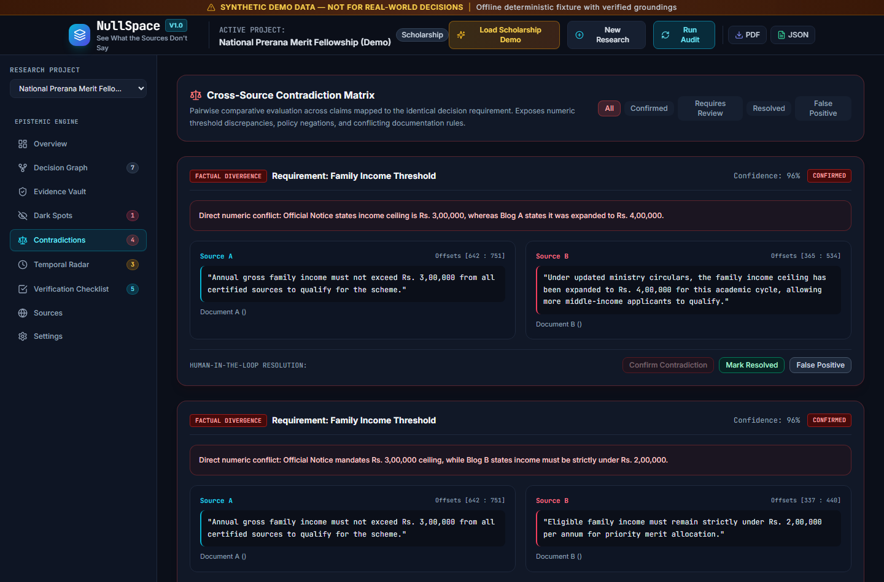
EPISTEMIC ARBITRATION
Pairwise Cross-Source Contradiction Matrix
Contradiction Engine
• Only compares claims mapped to the identical requirement node.
• Tri-source numeric conflict detection: Rs. 3 Lakh vs Rs. 4 Lakh vs Rs. 2 Lakh.
• Policy negation conflict: Mandatory renewal vs Renewal not required.
• Documentation divergence: Secondary school marksheet vs 6-month bank statement.
• Human-in-the-Loop review actions: Confirmed, Resolved, False Positive.
NullSpace | Epistemic Audit Platform | Architect: POCHIRAJU KAILASH RAM MARKANDEYA SHARMA | Slide 7

Slide 8
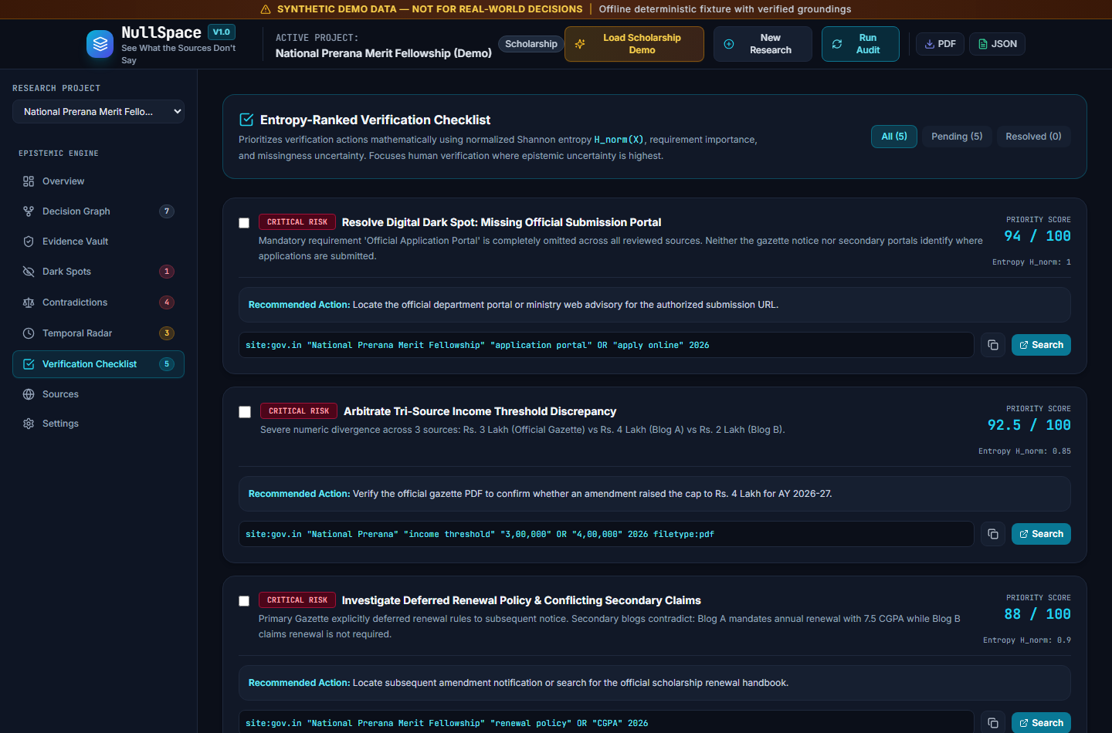
ACTIONABLE OUTPUT
Entropy-Ranked Verification Checklist
Checklist Mechanics
• Intelligent sorting by Priority Score (0 - 100) based on Shannon entropy.
• Risk Categorization: Critical, High, Medium, Low badges.
• Plain-English rationales explaining why verification is prioritized.
• Actionable next steps tailored to resolve specific discrepancies.
• Interactive resolution state persisted in SQLite database.
NullSpace | Epistemic Audit Platform | Architect: POCHIRAJU KAILASH RAM MARKANDEYA SHARMA | Slide 8

Slide 9
ENGINEERING DESIGN
Full-Stack Technology Stack & Architecture
Backend Engine (Python 3.13)
• FastAPI asynchronous REST API server with OpenAPI docs (/docs, /redoc).
• Pydantic v2 strict request & response schema validation.
• SQLAlchemy 2.0 ORM with SQLite database (WAL mode).
• BeautifulSoup4 HTML sanitizer & main content extractor.
• HTTPX asynchronous client with strict timeout controls.
• ReportLab publication-quality PDF export generator.
Frontend Client (React 18 + TS)
• Vite bundler producing optimized production assets.
• TypeScript strict typing for all API models and views.
• Tailwind CSS custom dark research design system.
• Lucide React iconography with epistemic status colors.
• TanStack Query (React Query) for server-state caching.
• Embedded directly inside FastAPI root route for single-port delivery.
Security & Isolation Layer
• Comprehensive SSRF Protection Engine blocking private/internal IPs.
• Blocks 127.0.0.1, 10.0.0.0/8, 172.16.0.0/12, 192.168.0.0/16, 169.254.169.254.
• Revalidates resolved DNS addresses post-redirect.
• Immutable source text snapshots hashed via SHA-256.
• Zero API keys required for offline demo fixtures.
NullSpace | Epistemic Audit Platform | Architect: POCHIRAJU KAILASH RAM MARKANDEYA SHARMA | Slide 9

Slide 10
QUALITY ASSURANCE
Automated Verification & Testing Telemetry
Pytest Test Suite (16/16 Passed - 100%)
• test_01_requirement_generation: PASSED
• test_02_requirement_graph_validation: PASSED
• test_03_ssrf_url_validation: PASSED
• test_04_html_text_extraction: PASSED
• test_05_claim_grounding_and_exact_offsets: PASSED
• test_06_claim_grounding_mismatch_rejection: PASSED
• test_07_requirement_to_claim_semantic_mapping: PASSED
• test_08_contradiction_detection_numeric: PASSED
• test_09_contradiction_detection_policy_negation: PASSED
• test_10_neutral_claim_handling: PASSED
• test_11_temporal_auditing: PASSED
• test_12_entropy_and_dark_spot_calculation: PASSED
• test_13_dork_generation: PASSED
• test_api_health: PASSED
• test_load_scholarship_demo_deterministic: PASSED
• test_custom_research_workflow: PASSED
Frontend & E2E Verification
• npm run typecheck: PASSED (0 TypeScript errors).
• npm run build: PASSED (1,555 modules transformed in 9.35s).
• Puppeteer E2E Browser Automation: PASSED.
• Interactive navigation tested across all 9 tabs.
• Instant demo loading verified on port 8080.
• ReportLab PDF report generation verified (HTTP 200).
• Structured JSON audit serialization verified (HTTP 200).
NullSpace | Epistemic Audit Platform | Architect: POCHIRAJU KAILASH RAM MARKANDEYA SHARMA | Slide 10

Slide 11
PRACTICAL IMPACT
High-Stakes Real-World Use Cases
1. Government Schemes & Fellowships
• Students navigate confusing scholarship portals with conflicting blog summaries.
• Surfaces unmentioned renewal conditions before accepting loans or stipends.
• Exposes income threshold divergence across regional advisories.
2. Visa & Consular Compliance
• Immigration applicants face complex requirements across embassy pages and blogs.
• Identifies omitted financial solvency proofs or mandatory medical attestations.
• Flags outdated application windows or superseded fee structures.
3. Public Procurement & Tenders
• Vendors bidding on public contracts must comply with strict eligibility thresholds.
• Detects missing EMD exemption guidelines and conflicting turnover minimums.
• Generates targeted dorks to retrieve gazetted amendment corrigenda.
NullSpace | Epistemic Audit Platform | Architect: POCHIRAJU KAILASH RAM MARKANDEYA SHARMA | Slide 11

Slide 12
NULLSPACE — SEE WHAT THE SOURCES DON'T SAY
The Future of Epistemic AI Verification
PROJECT ARCHITECT & LEAD ENGINEER:
POCHIRAJU KAILASH RAM MARKANDEYA SHARMA
Principal Software Architect & Lead Full-Stack AI Engineer | End-to-End System Delivery
Key Project Takeaway:
NullSpace transforms AI from a gullible summarizer into an adversarial epistemic auditor. By generating counterfactual schemas before reading sources, grounding exact offsets, identifying Digital Dark Spots, and ranking uncertainty with Shannon entropy, NullSpace reveals the critical gaps that conventional systems miss.
NullSpace | Epistemic Audit Platform | Architect: POCHIRAJU KAILASH RAM MARKANDEYA SHARMA | Slide 12

