Slide 1


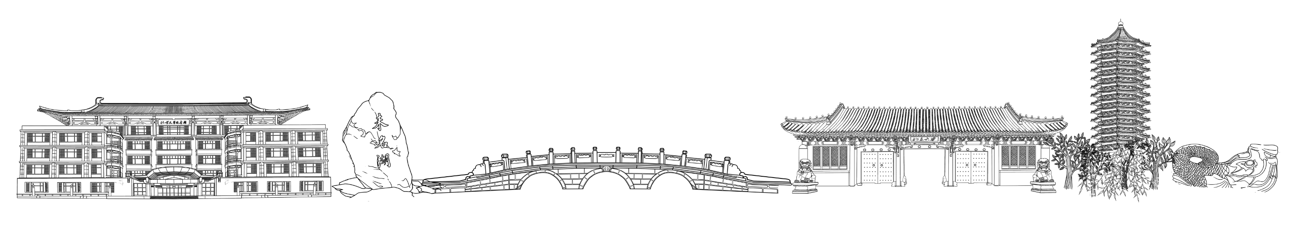
Time Minimization and Online Synchronization for Multi-agent Systems under
Collaborative Temporal Logic Tasks
Reporter: Zhao Qisheng
2023.10.23

Slide 2


CONTENTS
01
Motivations & Challenges
02
Main Contributions
03
Thoughts
Peking University

Slide 3
CONTENTS
01
Motivations & Challenges
02
Main Contributions
03
Thoughts
Peking University

Slide 4
Motivations & Challenges
Multi-agent systems can be more efficient and can accomplish complex tasks.
Coordination of robots to accomplish the desired task can result in great complexity, the current solutions include optimal planning algorithms such as mixed integer linear programming (MILP) and search algorithms over state or solution space.
The problems of the existing solutions: Offline
not real-time, need to take unpredictable time to compute
robots execute independently without any synchronization
lack online adaptation, cannot handle changes in the workspace or in the team (agent failure)

Slide 5
CONTENTS
01
Motivations & Challenges
02
Main Contributions
03
Thoughts
Peking University

Slide 6
Main Contributions
Real-time requirement
It proposes an anytime algorithm that combines the partial ordering analysis of the underlying task automaton for task decomposition, and the branch and bound (BnB) search method for task assignment. (objective: minimize task completion time)
Online synchronization under uncertain execution time
It proposes a synchronization protocol that relied on online synchronization and distributed communication.
Plan adaptation under agent failures
It proposes an adaptation algorithm (modified BnB algorithm) to re-assign unfinished subtasks.
Optimal Plan Synthesis
Online Adaptation

Slide 7
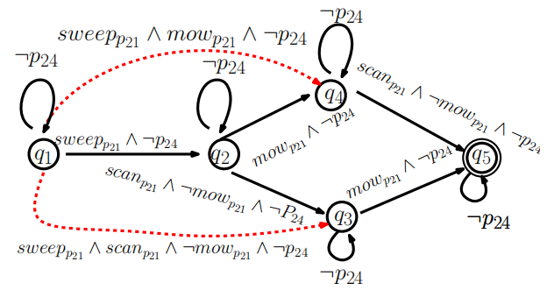
Main Contributions
Optimal Plan Synthesis
the pruning of the NBA associated with the global task
Task decomposition
Task assignment
1. Pruning of NBA
remove infeasible transitions - q_{j}∈δ(q_{i}, σ), no subgroup of agents in N can generate σ
remove invalid states - q 不能从任何初始状态到达或者它不能到达任何可自循环重复到达的可接收状态
remove decomposable transitions - 不能同时执行多个子任务
Result: this step can reduce up to 60% states and edges for typical
multi-agent tasks.

Slide 8

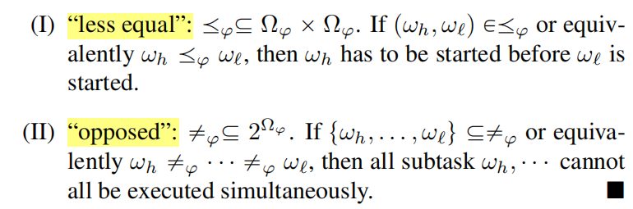
Main Contributions
2. Task Decomposition
Definition: how the subtasks and their partial orderings are abstracted from the pruned automaton
Decomposition(a set of 3-tuples) and Subtasks(3-tuple):
Remark: the decomposition Ωφ imposes directly a strict and complete ordering of the subtasks within.
index of subtasks
a set of self-loop requirement labels
a set of position or action propositions
Partial relations:
ordering constraints
concurrent constraints

Slide 9



Main Contributions
R-poset of Subtasks(relaxed and partially ordered set):
Decompositon + set of ‘≤’ + set of ‘≠’
Remark: more elements in ‘≤’ and ‘≠’ -> more temporal constraints -> less concurrent execution -> lower efficiency thus we desire to find one decomposition and the associated R-poset that has few partial relations.
Language of R-poset:
Definition: the set of all finite words that can be generated by the subtasks in Ωφ while satisfying the partial constraints.
It is given by ，where
Remark: A R-poset Pφ is called accepting if its language satisfies the original task specification.
starting time of subtask
subtask in Ωφ
focus on finding accepting R-poset

Slide 10
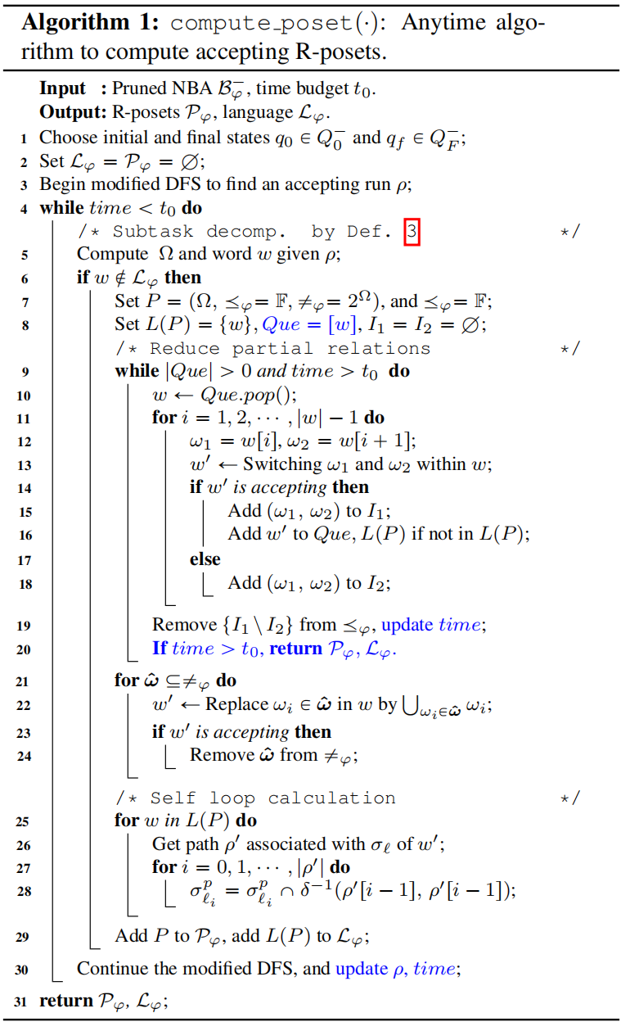

Main Contributions
It proposes an anytime algorithm that can generate the first valid R-poset quickly, while adding more R-posets as time allows.
1. 根据 Pruned NBA及选定的初始和最终状态，通过修改的 DFS 算法生成 an accepting run；
2. 根据 accepting run 计算得到 Decomposition 和 word;
3. 构建全序的 Poset 并初始化一些集合；
4. 不断交换 Que 推栈出的 word 中相邻的两个 edge (subtask)的顺序，看交换之后新生成的 word 是否 accepting，若是，则在 Poset 中的 "≤" 部分删除该约束，并把新的 word 存入 Que 和 L(P) 中；
5. 遍历 ''≠'' ，依次让每个 opposed relation 相关子任务可以同步进行，然后看新生成的 word 是否 accepting，若是，则在 Poset 中的 "≠" 部分删除该约束;
6. 由于改变了偏序关系，Ω中的 self-loop 部分需要重新生成，因此遍历每个 word，并将 word (是边的序列) 转换成 path (是状态节点的序列)，记录每一个节点的自循环标签;
7. 若时间允许，DFS 继续寻找新的 accepting run 并重复以上过程。
Remark:
DFS 生成的每个 accepting run 并由此计算得到的一个 word 经过算法只生成一个 Poset 及其对应的 Language
给足够时间能得到 the complete set of R-posets

Slide 11
Main Contributions
3. Task Assignment
Definition: How to use the set of R-posets to compute the optimal assignment of all subtasks such that
all partial ordering requirements are respected;
the completion time of all subtasks is minimized.
Typical solution: formulate a Mixed Integer Linear Program (MILP)
Drawbacks of MILP:
computation complexity grows exponentially with the probelm size;
there is no intermediate solution before the optimal solution is generated, not real-time.
This paper proposes an anytime assignment algorithm based on the Branch and Bound (BnB) search method.

Slide 12

Main Contributions
Components of BnB
Node expansion
node:
在分配过程中满足 partial order: (avoid infeasible node)
对当前 node的任务分配：若 (w₁, w₂)∈≤_{φ}，则分配完任务 w₁ 之后才会对 w₂ 进行分配；
对 v 下一个扩展节点的任务分配：要求任务 w 的 parenting subtasks 在 v 中都分配完了。
Branching method
It determines the order in which these child nodes are visited.
Propose to use A* search, as the heuristic function matches well with the lower bounds.
The set of child nodes is expanded in the order of estimated completion time of the whole plan given its current assignment.
τ_{n} is the ordered sequence of tasks assigned to agent n∈N

Slide 13

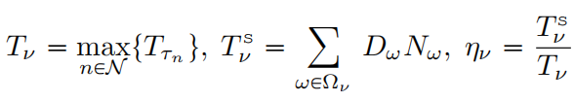
Main Contributions
Components of BnB
Upper bound
It is tried for each chosen node to update the current best solution.
Upper bound of all solutions rooted from node v:
Concurrency level η_{ν} of node ν:
the beginning time of all subtasks
the execution time of all subtasks in τ_{n}
the upper bound
(makespan of completing all subtasks)
the total execution time of all subtasks ω given its duration Dω and the number of participants Nω.
the max current makespan
the associated complete assignment with the same structure of ν (all subtasks have been assigned)
Remark: the child node with the highest η_{ν} is chosen as the next node to expand.

Slide 14
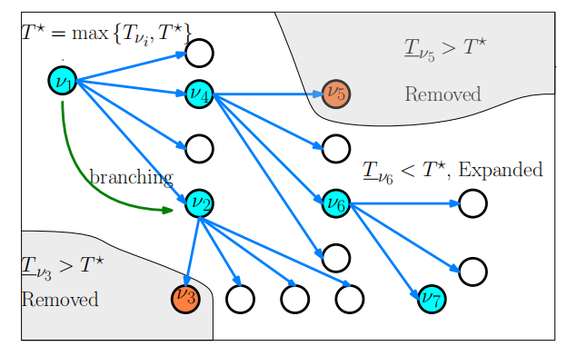
Main Contributions
Components of BnB
Lower bound
It is designed to check whether a node fetched by branching has the potential to produce a better solution.
The lower bound of the makespan of all solutions rooted from this node is estimated via two separate relaxations of the original problem: one is to consider only the partial ordering constraints while ignoring the agent capacities; another is vice versa.

Slide 15
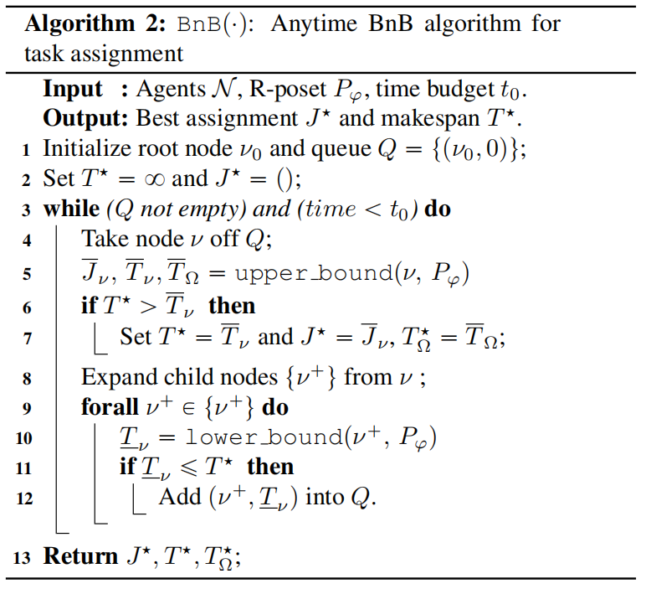
Main Contributions
算法逻辑：
1. 初始化 root node v_{0 、} Q (用于储存还未访问的 nodes 且以lower bound 作为 index)以及最优值 T*, J*;
2. 在时间预算内从 Q 中挑出 lower bound 值最小的 node;
3. 计算该 node 的 upper bound 并更新最优值 T*, J*, T_{Ω}*；
4. 生成 node v 的 set of child nodes;
5. 遍历计算每个 child node 的 lower bound 值，如果该值小于等于 T*（说明该节点有可能生成一个更优的解），则将该 node 存入 Q中；
6. 若时间允许，则 repeat。

Slide 16
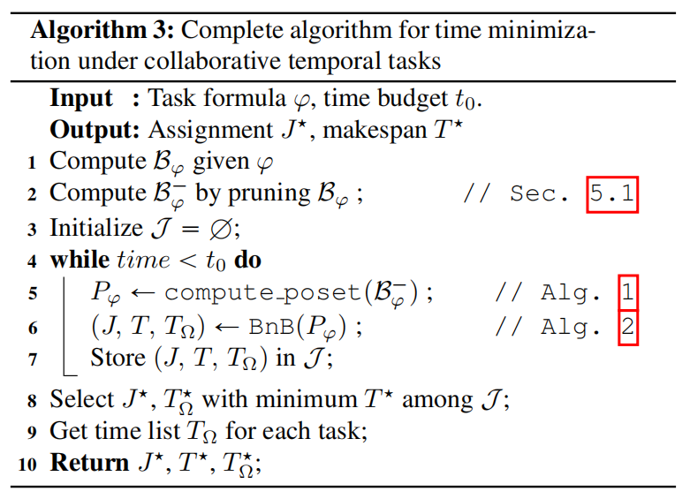
Main Contributions
Overall Algorithm
算法逻辑：
1. 根据任务的 LTL 公式计算得到 NBA;
2. 对 NBA 进行 prune;
3. 在预算时间 t₀ 内，用 Alg.1 计算得到 R-posets，将得到的R-poset 输入到 Alg.2 中去计算任务分配，并将每个 R-poset任务分配的最优结果记录在 J 中，这个过程不断 repeat 直到时间用完了；
4. 在 J 中选择 T*(makespan) 最小的方案，return 它的分配结果 J*, makespan T*以及记录了每个任务开始时间的 T_{Ω}*。
Remark:
Alg.1 and Alg.2 can be implemented and run in parallel.

Slide 17
Main Contributions
Online Adaptation
Online synchronization under uncertain execution time
Plan adaptation under agent failures
1. Online synchronization under uncertain execution time
This paper proposes a synchronization protocol that relied on online synchronization and distributed communication. (event-based, only subtasks within the partial relations are required to synchronize)
Each subtask has a temporary leader agent. (local: the agent; collaborative: agent with the largest ID)
Before execution:
(w_{i}, w_{j})∈≤ ：leader agent of task w_{i} send a “start” synchronization message to leader agent of w_{j}.
{w_{i}, w_{j},...}∈≠：leader agent of task w_{i} will check the “start” or “stop” message from leader agent of w_{j}, ... to ensure that not all subtasks in {w_{i}, w_{j},...} are executing.

Slide 18
Main Contributions
self loop: each subset of agents that are executing w_{i} publishes the labels of self loop associated with the subsequent subtask w_{j}. Other agents would satisfy the requirements before w_{i} is finished.
During execution:
collaborative subtask: collaborators send synchronization message to the leader agent to start executing. The leader coordinates with all collaborators to start simultaneously after relevant constraints within the R-posets are satisfied and the synchronization messages of all collaborators are received.
local subtask: the agent start the execution directly.
After execution:
{w_{i}, w_{j},...}∈≠：After the execution of w_{i} is finished, leader agent of w_{i} will send a “stop” synchronization message to leader agent of w_{j},... .

Slide 19



Main Contributions
2. Plan adaptation under agent failures
This paper proposes a modified BnB algorithm to re-assign unfinished subtasks.
Modified places:
The initial root node now consists of the subtasks that are already accomplished, and the broken agent N_{d} is excluded.
The node expansion now re-assgins all unfinished tasks.
Then an adapted plan can be obtained.

Slide 20
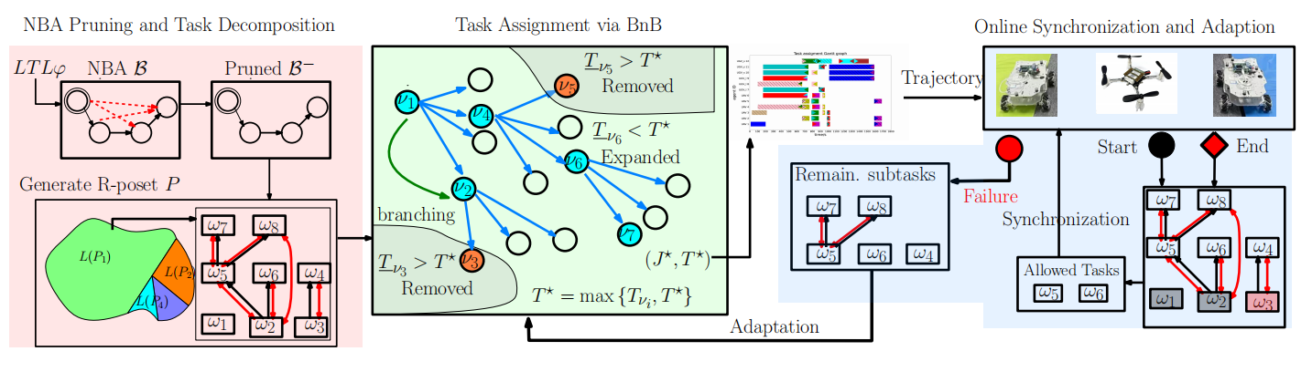
Main Contributions
Algorithmic Summary
The proposed planning algorithm Alg.3 can be used offline to synthesize the complete plan that minimizes the time for accomplishing tasks;
During execution, the proposed online synchronization sheme can be applied to overcome uncertainties in the duration of certain transition or actions;
Whenever one or several agents have failures, the proposed adaptation algorithm can re-assign the unfinished tasks.

Slide 21
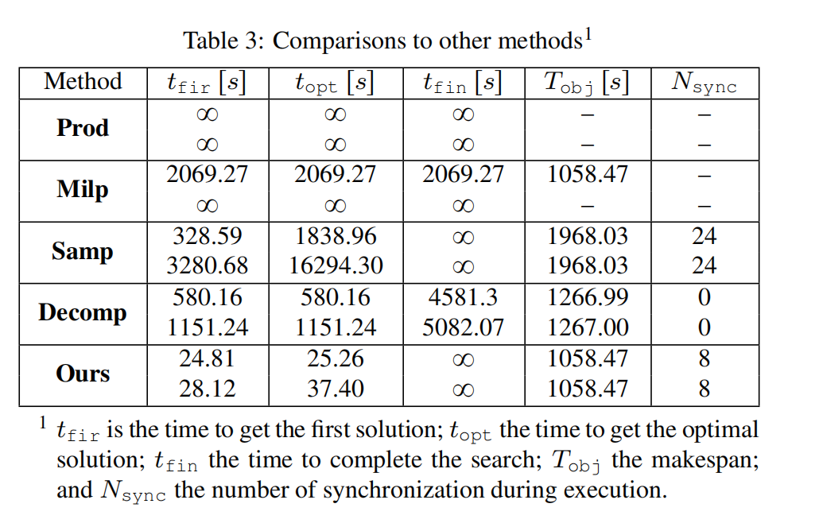
Main Contributions
Simulation results compared against several state-of-art methods:
12 agents
24 agents

Slide 22
CONTENTS
01
Motivations & Challenges
02
Main Contributions
03
Thoughts
Peking University

Slide 23
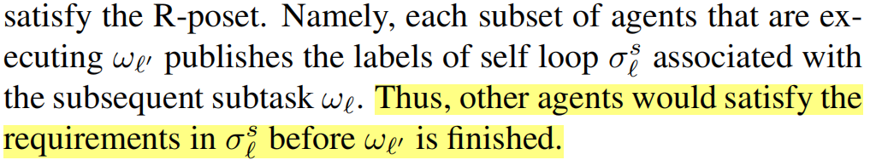
Thoughts
1. 用分布式方法计算 local 和 global R-posets 的 product
这有可能可以缓解将一个很长的 LTL 公式转换为其相关的 NBA 时的复杂性瓶颈问题。
2. Online synchronization protocol (before execution) 自循环部分
问题：自循环条件是一个全局性的要求，如果有两个 subtask 在同时进行，对应的两个后续任务的自循环条件如果有冲突无法同时满足怎么办？后续任务自循环条件与当前并行的任务有冲突怎么办？
可能的解决方法：在 Compute_poset (Alg.1) 中添加不同 subtask 之间的自循环条件/自循环条件与 set of position or action AP 对比部分，判定它们之间有无冲突，如果有的话，把这两个subtask 添加到偏序关系 “≠” 中，让它们不同时执行。

Slide 24


Peking University
谢谢！

