Slide 1

Machine Learning
By Kailey Owens

Slide 2
ChatGPT in Healthcare
Expanding Artificial Intelligence reach over time
Education access
Potential dangers
Influential subject

Slide 3
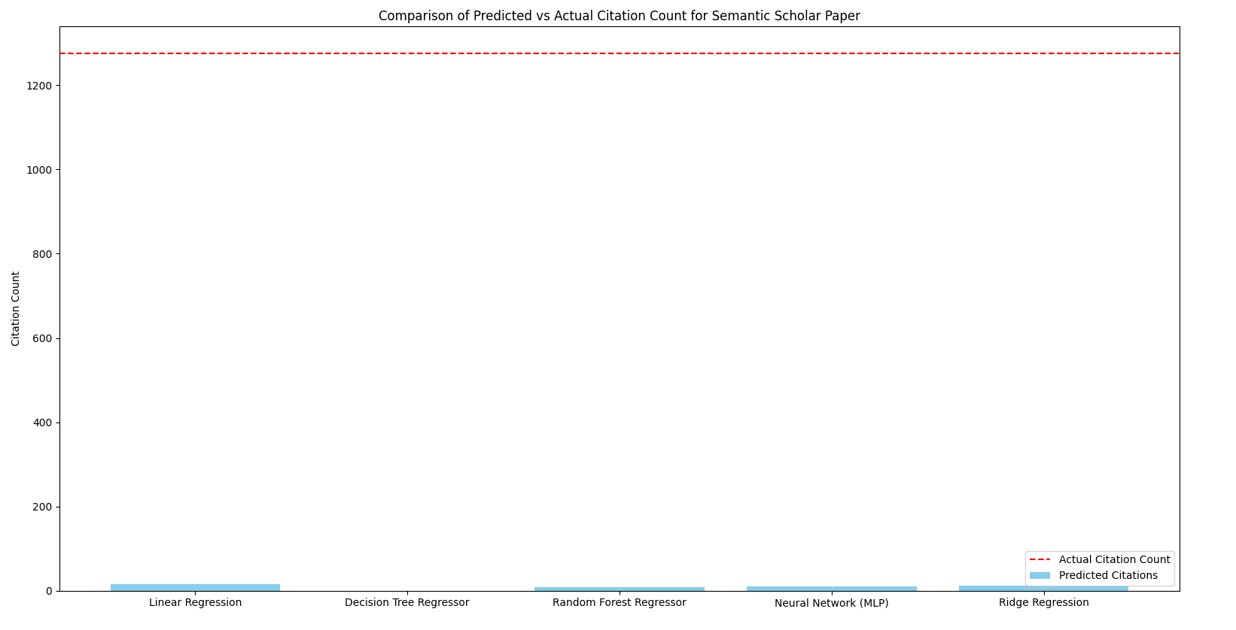
Individual predictions vs actual count

Slide 4
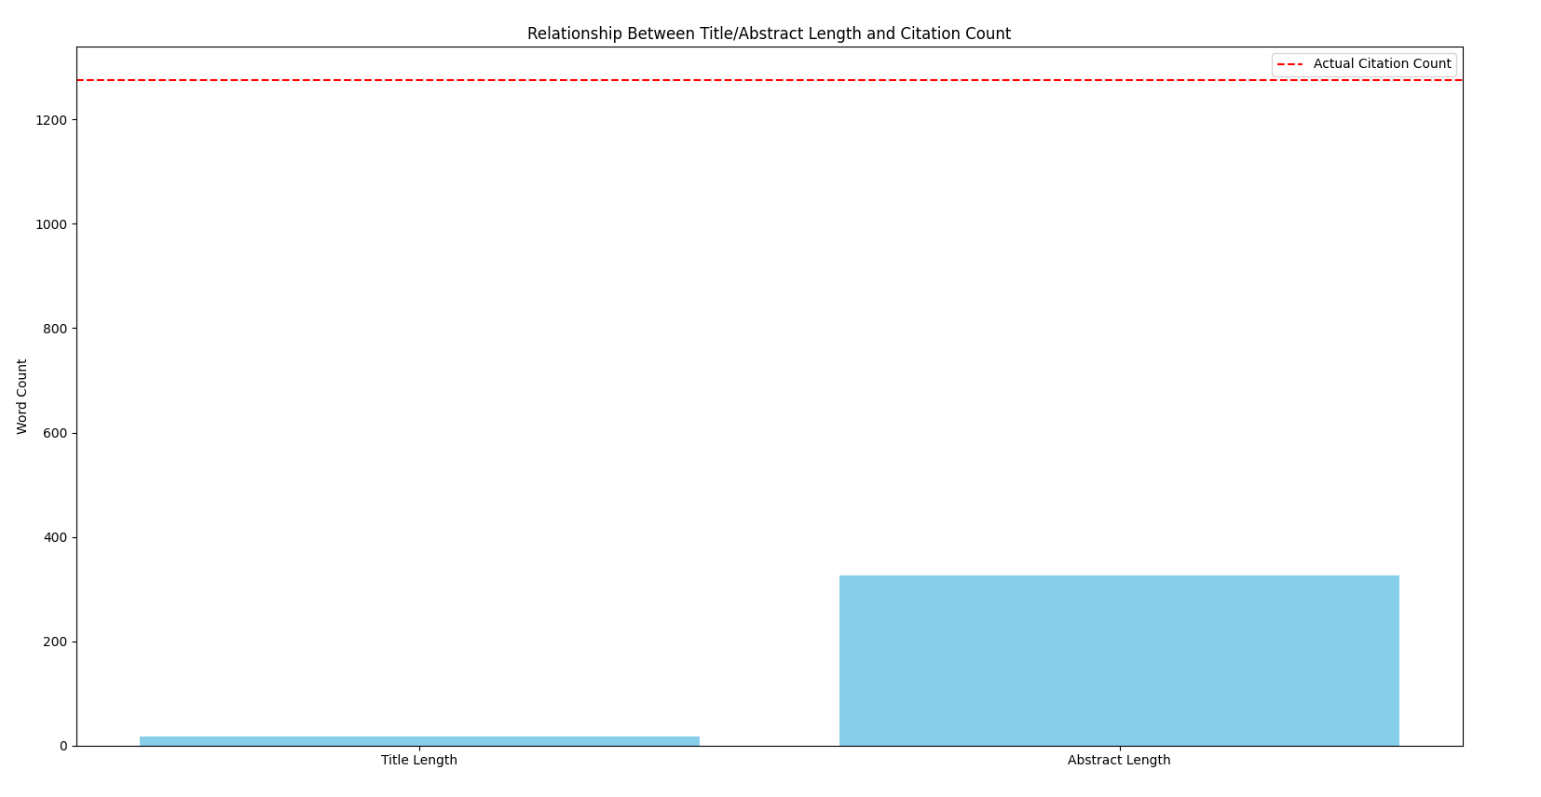
Analyzes title, abstract, and citation for single paper

Slide 5
Multiple papers
Compares numerous studies
Accessible trends
Bulk analysis

Slide 6
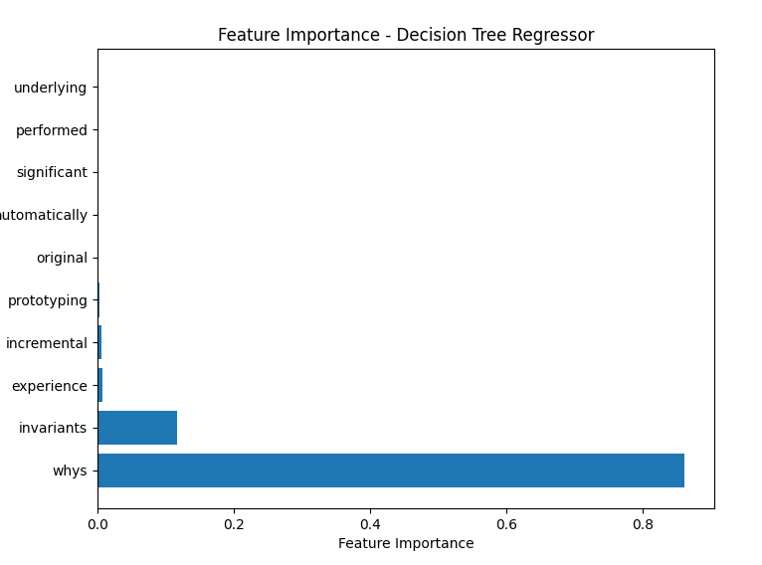
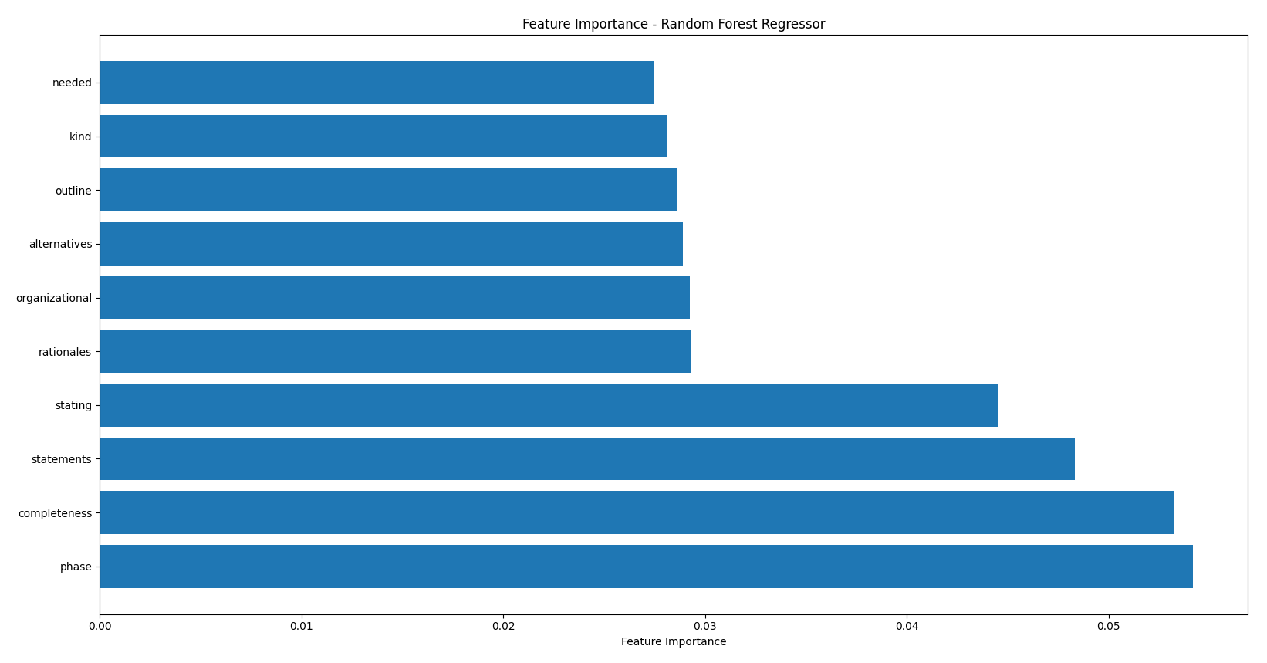
Evaluate features leading to more citations

Slide 7
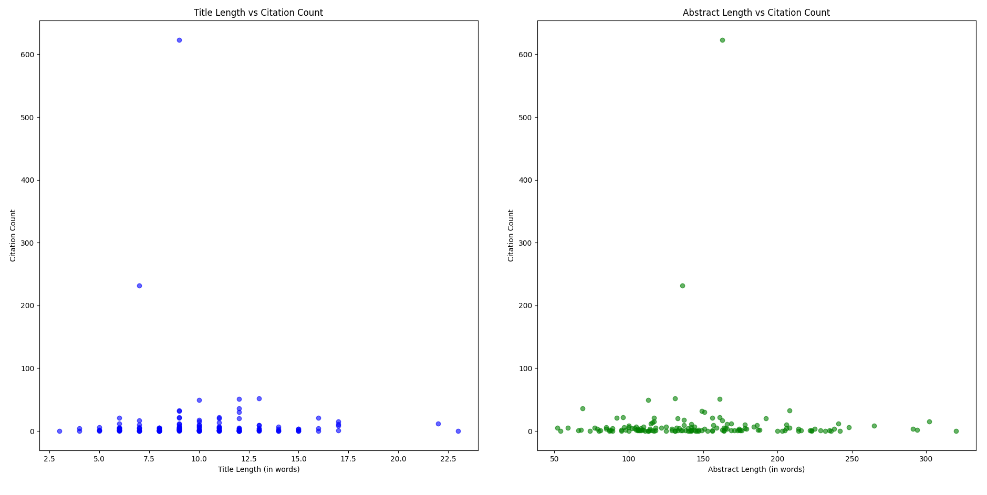
Compares lengths of multiple papers

Slide 8
Works Cited
[PDF] ChatGPT Utility in Healthcare Education, Research, and Practice: Systematic Review on the Promising Perspectives and Valid Concerns | Semantic Scholar

