Slide 1

Personal Management Application
By Kailey Owens

Slide 2
Purpose
The modern world is a very busy place; it is difficult to keep track of every responsibility
One of the most valuable things a person has is time, which is easily wasted while overwhelmed about everything that must get done
I propose an application that helps relieve busy schedules. It will lay out the user's responsibilities in a digestible manner so the user can prepare for and deal with them more easily

Slide 3
Research and Background
I did not have much experience working on websites, but it was fitting for this project
Worked briefly on html for an internship
Application is a web-server because:
Convenience of access. Its general usability implies that users would be more likely to find a web version useful for quick and uncommitted look up
Its flexible design is fitting for using an existing environment rather than creating a full app space by hand; no complexity is lost on the web
Researched web design and common languages, biggest choice was python

Slide 4
Project Tools
Languages used: HTML, CSS, Python, JavaScript
Python is especially useful with its Calendar library
Software/assistance: python environment, Jinja, Flask, SQLite
Hardware: Computer with access to GitHub

Slide 5
Requirements
Access to necessary tools (refer previous slide)
User must generate the database by running a python file
Ability for program to run on a server and open in browser
Application must display all frontend design and be able to use backend logic correctly

Slide 6
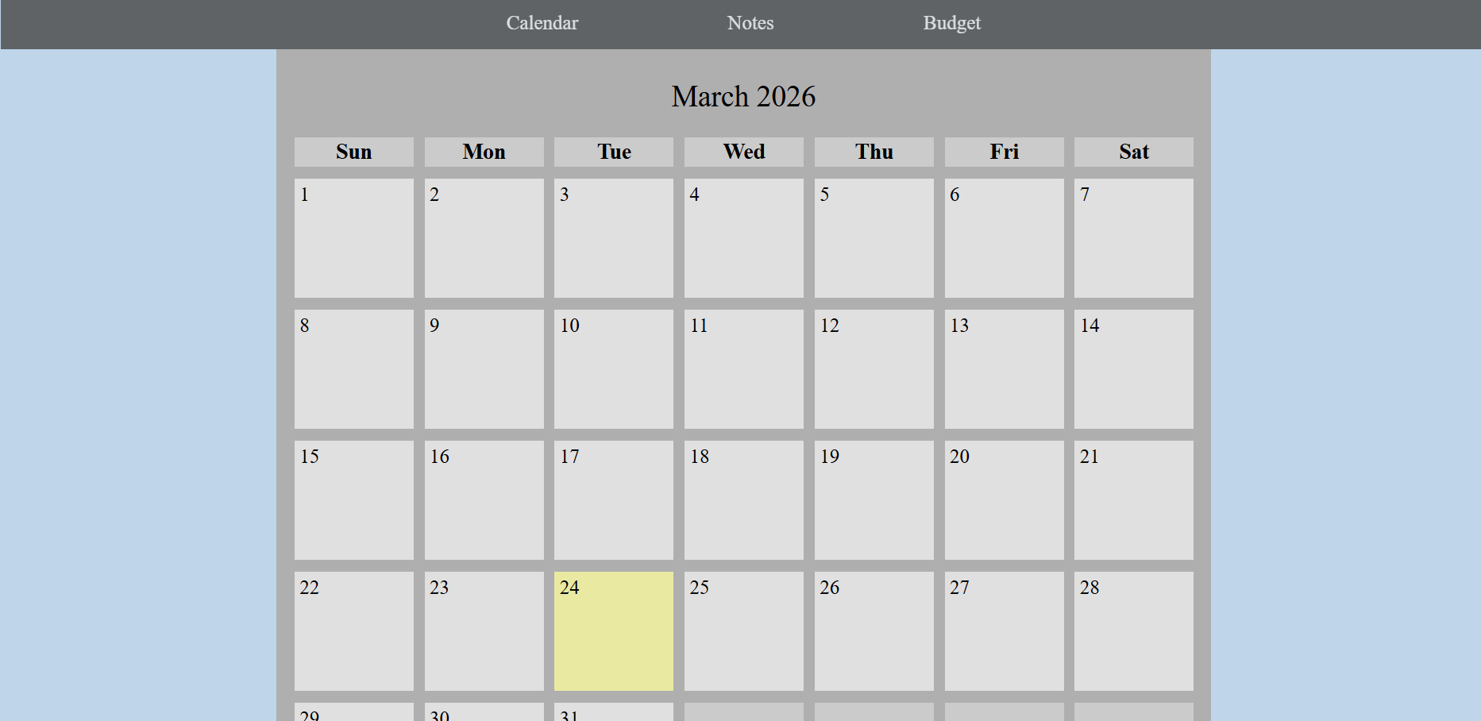
Implementation
The Application opens up on the current month and year
You will see the month, days of the week, and the days with event(s)
A circle implies there is an event
Up to three circles will appear depending on how many events there are
Click the number of a day to get to that day's page

Slide 7
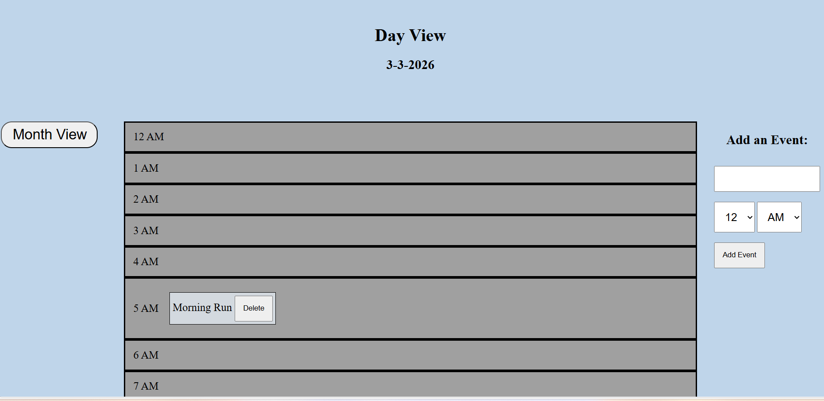
Day View
After clicking a day, you get to the day view. It has the date, ability to add an event, every hour of the day, and a button to get back to the months
Adding an event lets you enter the title and time
Events will appear in the correct hour of the event; 12 AM is the default time

Slide 8
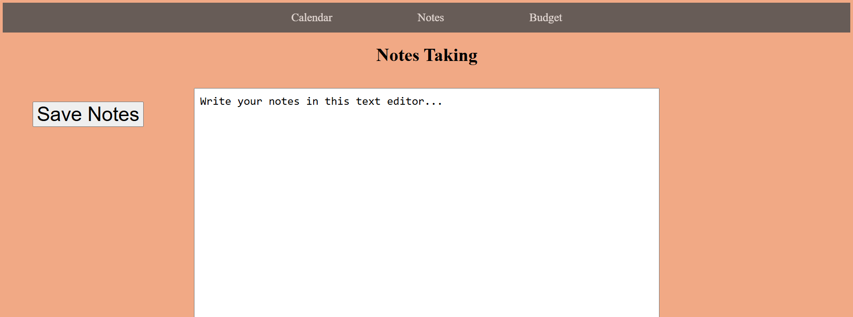
Notes Section
The header allows you to go to Calendar, Notes, and Budget pages
Notes brings you to this text editor page
You can write down anything and save your writing by clicking the "Save" button

Slide 9
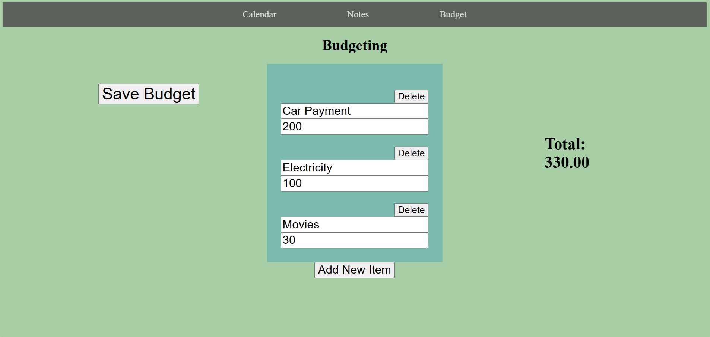
Budget Section
Budget section gives a list of text/number inputs
Allows users to keep track of finances and see what goes to what
Budget items can be deleted or appended
Once file is saved, the total is calculated

Slide 10
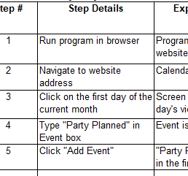
Testing
Testing method: several test cases were created and distributed among multiple testers
A seven-question survey was conducted for each tester
Results were diverse
Notes was the most commonly named least useful section, but it was also named the most useful
No definitive winner of what section was most widely beloved
Shows that the most and least useful parts vary by person, a good trait for the design goal of helping with various problems

Slide 11
Challenges Overcome
Working fully in a web application, including front to back end, was new territory for me
Coming up with solutions or methods and not being sure which tool would work best with what idea (Jinja vs JS vs POST)
Keeping track of branching actions (how one execution affects the whole website) was easy to get lost in
Web design was tedious
Overcame challenges by researching and learning more about web construction

Slide 12
Future Enhancements
Application has many opportunities for new features
Let user swap budget items around
Let user change text information in notes
Be able to go through multiple years instead of just the current one
Let the sections interact more physically
This is a very scalable project when given enough time and ability

Slide 13
Link to GitHub Repository
https://github.com/KaileyMO/Time-Management-Project

