Slide 1
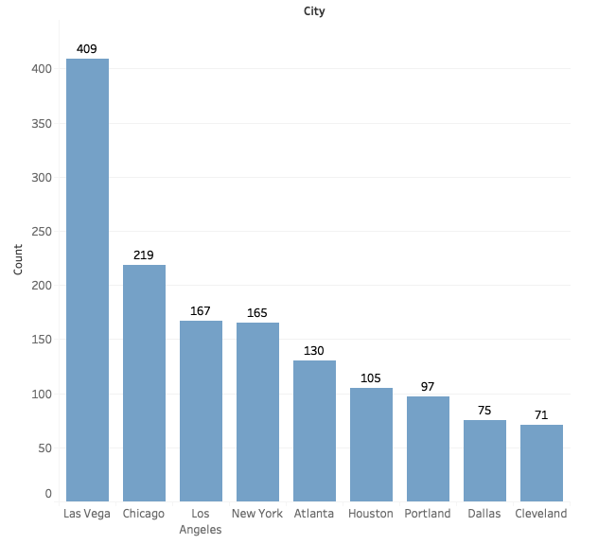
OVERVIEW – ALL REVIEWS
Review Count by City
Count of Total Review: 1525
Count of City: 9
About 27% of the review comes from Las Vegas
For Houston, Portland, Dallas, and Cleveland we may need more reviews to understand business problems

Slide 2
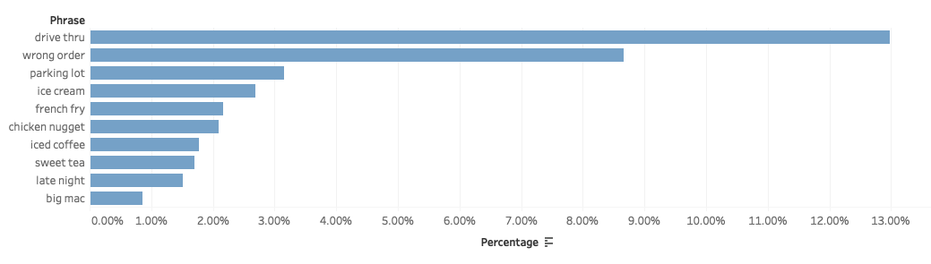
OVERVIEW – Potential Problems Across All Areas
Problem Identification:
Notice that Drive Through is the biggest problem across all areas followed by Wrong Order, then Parking Lot.
Customers complaint about French Fries, Chicken Nugget, Big Mac, some of the bestsellers at McDonald. This May result from order frequency of these products or others quality control issues.
Customers mention Late Night frequently, which may imply some management problems with late night shift.
Ice products like Ice Cream, Iced Tea, or Sweet Tea appear frequently. Should handle these products more carefully.
% Mentioned in All Reviews
Notes:
bestselling McDonald's menu
https://spoonuniversity.com/lifestyle/mcdonalds-most-popular-items
https://www.businessinsider.com/the-bestselling-mcdonalds-menu-items-of-all-time-2018-2

Slide 3
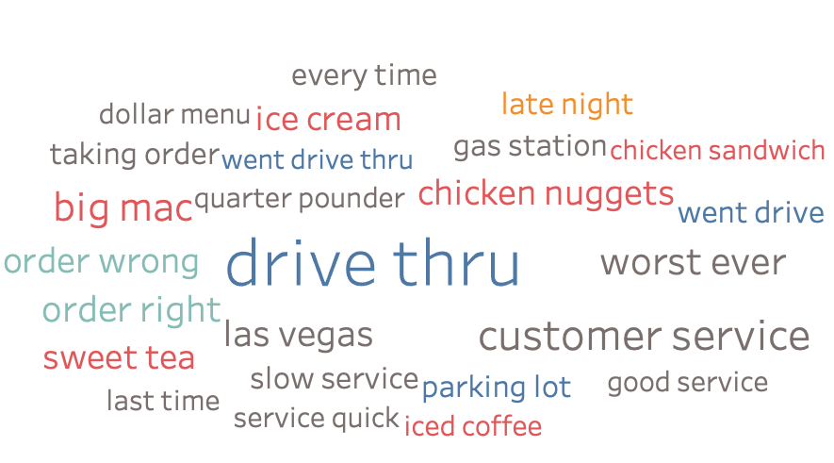
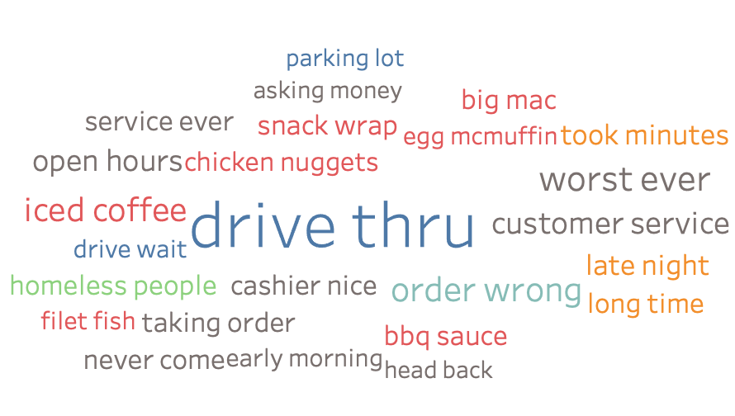
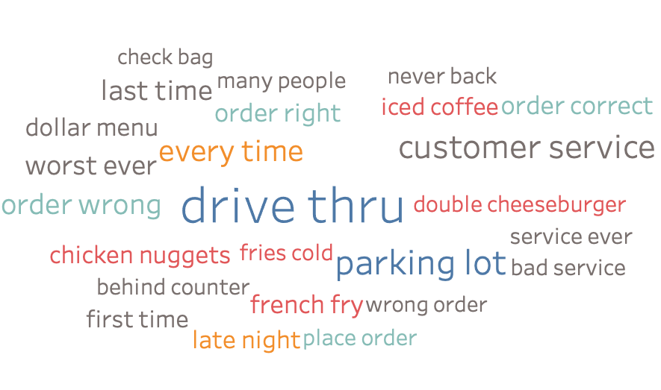
Las Vegas / Los Angeles / Chicago
Las Vegas
Conclusion
The biggest problem for these three cities is “Drive Through”. Another concern may be the quality of some popular products. Notice that in LA, homeless people and waiting time could be problems.
Los Angeles
Chicago

Slide 4
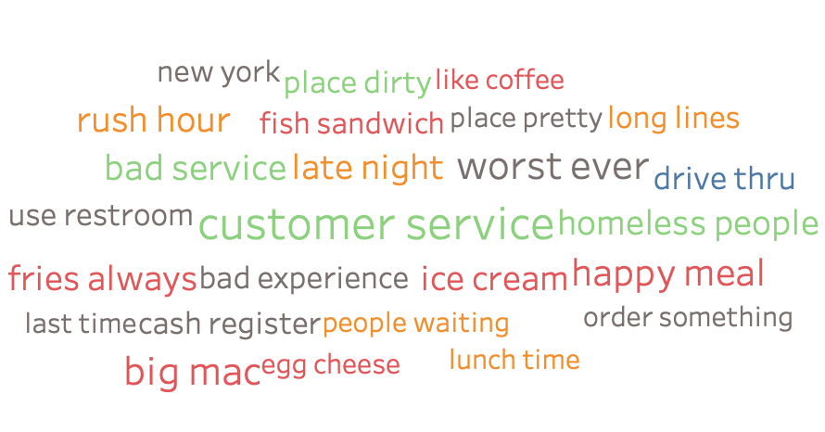
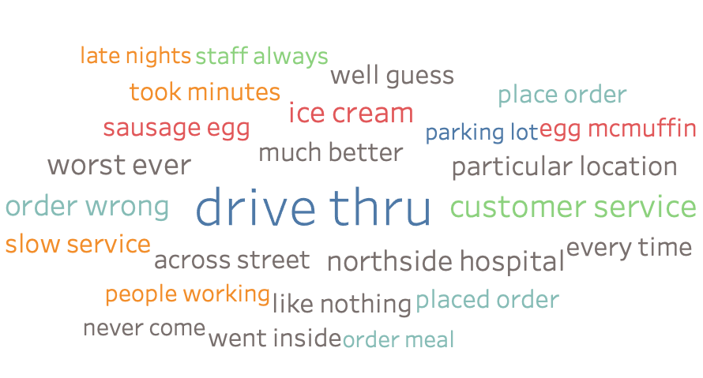
New York / Atlanta
New York
Conclusion
NY is the special case among the 9 cities. The biggest problems for NY are dining environment, and customer service not drive through. Though the main problem for Atlanta is drive through, it could have quality control issue on some items like egg McMuffin, and sausage egg (not best sellers). Also, waiting time is a concern for both cities.
Atlanta

Slide 5
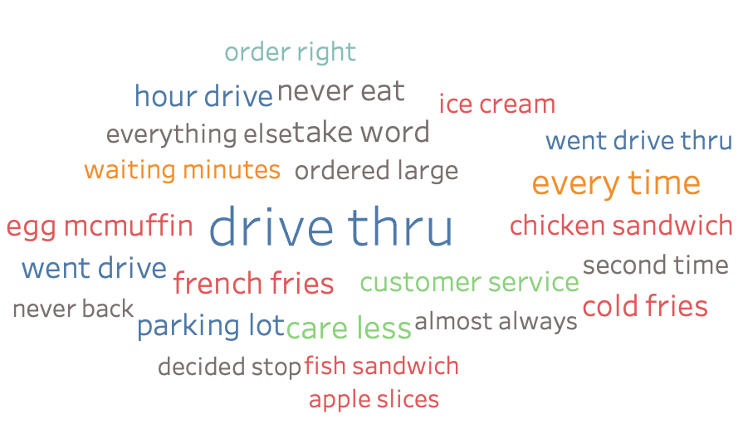
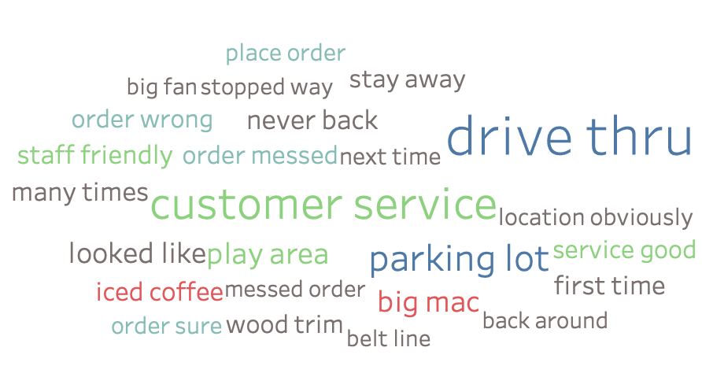
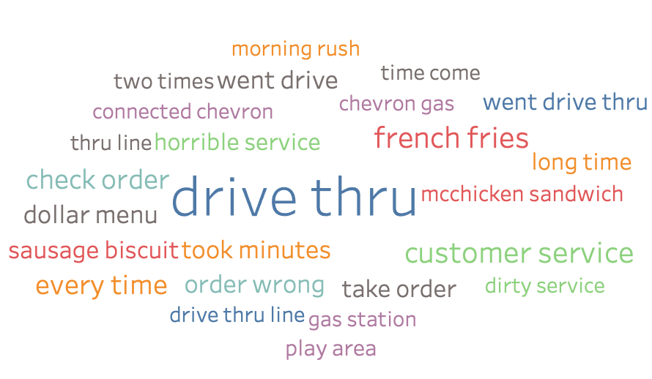
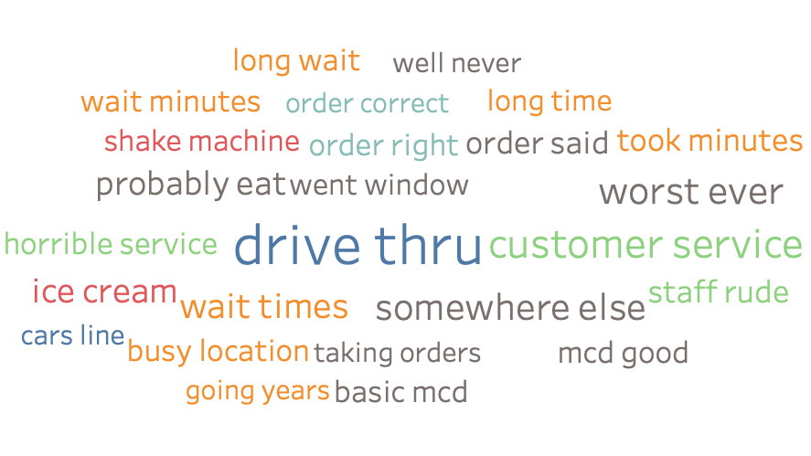
Houston/ Dallas / Portland / Cleveland
Portland
Dallas
We can already see some problems through the data. However, we may need more reviews to verify. Especially in Dallas, it may suffer from some issues that other cities don’t have, such as play area.
Cleveland
Houston

