Slide 1
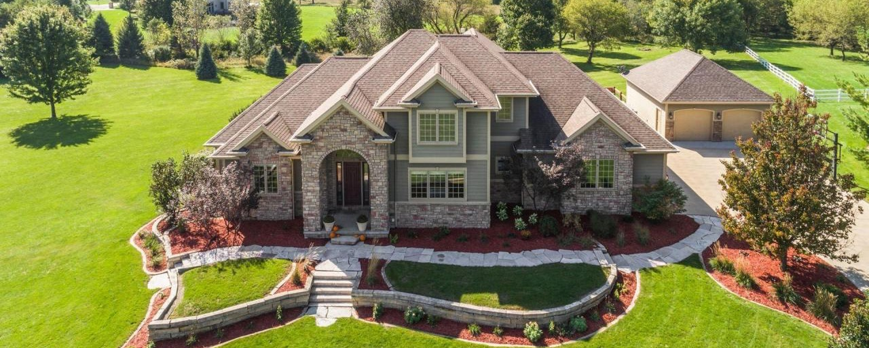
This Old House: Renovations Guided by Machine Learning
Kailun Cheng
Richard Kim
Jon Harris

Slide 2

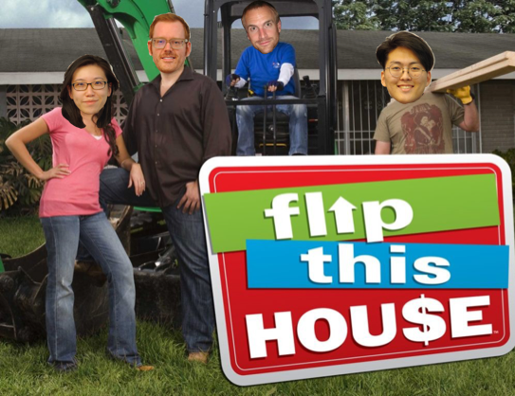
Background
Ames, Iowa needs a facelift
Flipping houses makes for great tv (allegedly)
Requires lots of time and resources
Important to turn a profit
Housing data available
Unsure what features to upgrade
Machine learning may provide insight

Slide 3
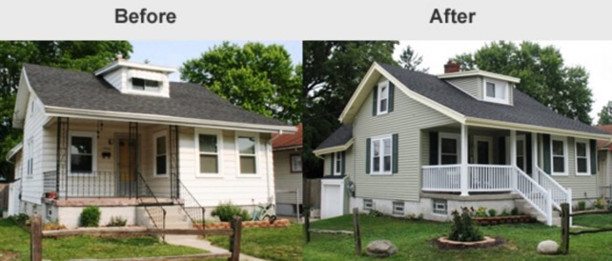
Purpose
Main Objective:
Use machine learning algorithms to predict house prices based on available predicting variables
Secondary Objective:
Use analysis to identify key upgrades that contribute the most towards the price of the house

Slide 4
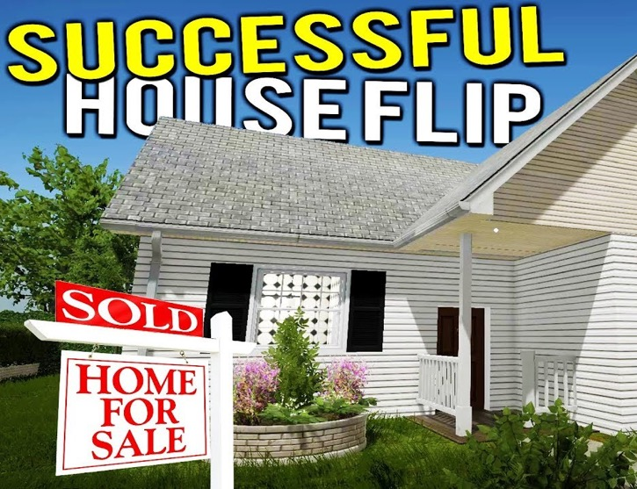
Presentation Outline
Exploratory Data Analysis
Trends and visualizations
Model Building
aka ‘the weeds’
Application of ML
Key findings

Slide 5
Exploratory Data Analysis

Slide 6
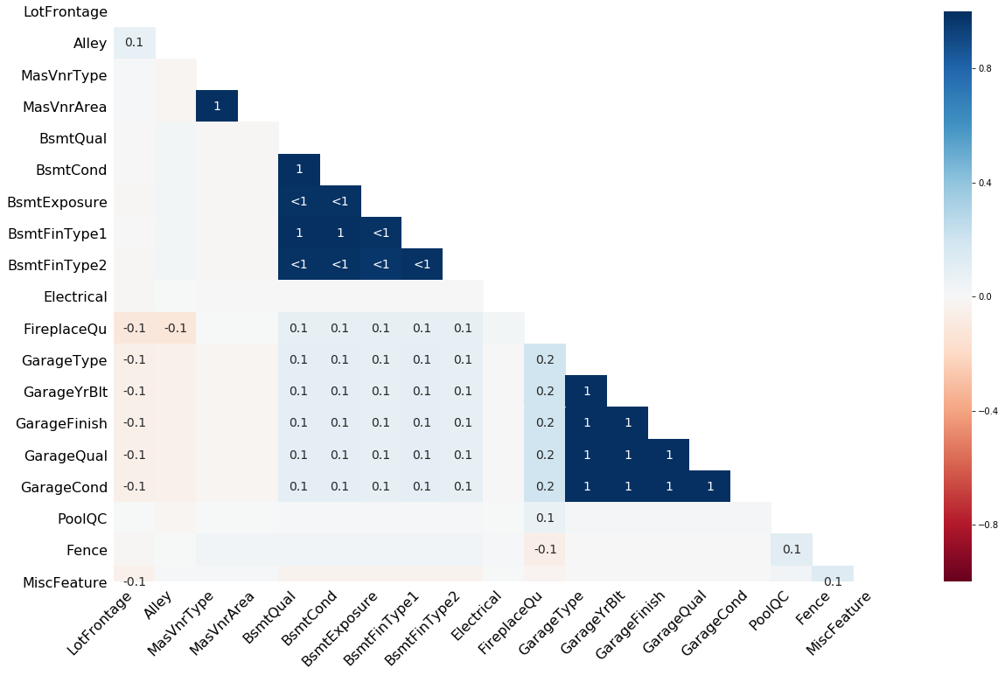
Missing-Data Mechanisms
Correlation of Missing Values
Missingness Completely at Random
Missing at Random
Missing Not-At Random

Slide 7
Handling Missing Data
Variables w/ 95% missing → Drop the entire column
Basement-related variables
w/Null → Impute with ‘None’ given by data description .txt file
Incorrect ‘none’ → corroborate with other basement variables
Garage-related variables
Incorrect ‘none’ → corroborate with other basement variables

Slide 8
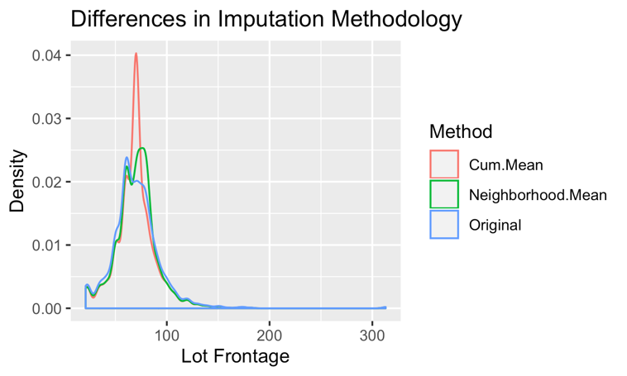
Imputation: Lot Frontage
~17% missing
Imputation by mean:
Easy
Distorted distribution of data due to number of datapoints missing
Neighborhood Mean:
Maintains distribution of original data

Slide 9
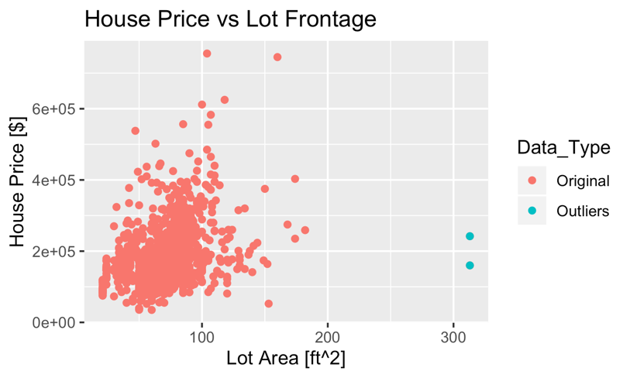
Outlier Removal
10 observations removed
Outliers identified as >6SD
Lot Frontage
Lot Area
Total Basement ft²
Same houses outliers for metrics quantifying floor area

Slide 10
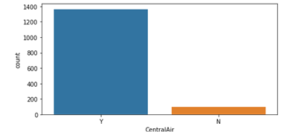
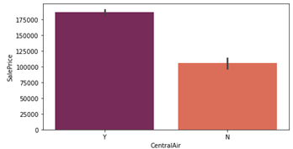
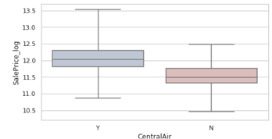
EDA Plots
Countplot: Category vs Count of instances within each subcategory
Barplot: Category vs Mean Sale Price within each subcategory
Boxplot: Category vs Distribution of Log_Price within each subcategory

Slide 11
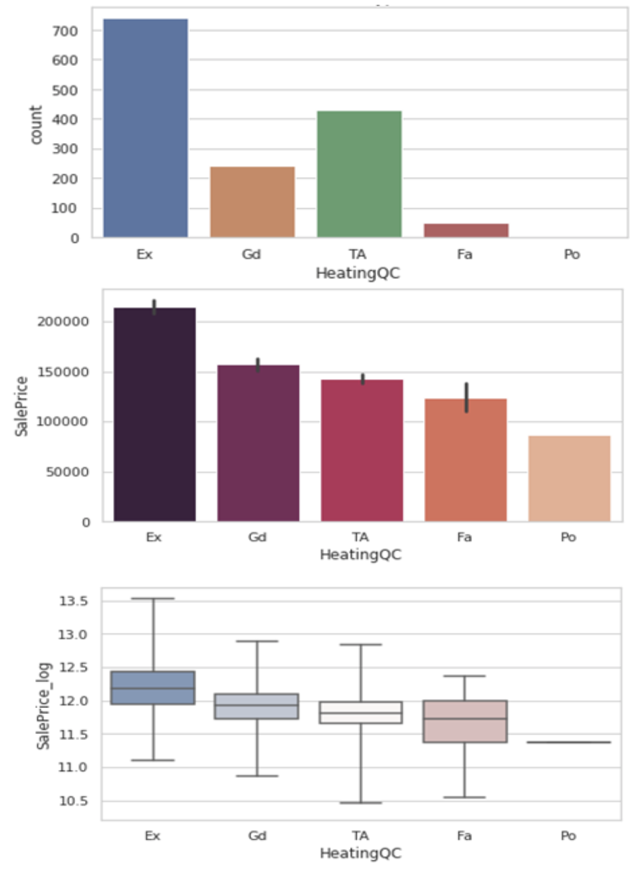
Ideal Categorical Variable: HeatingQC
Dominant no more than 50% of data
Subcategories are represented
Need to examine the proportions in test set
Ordinal categorical variable subcategories exhibit sequential behavior w.r.t. Mean of SalePrice
Distributions of subcategories seem normal
Medians of subcategories descend sequentially

Slide 12
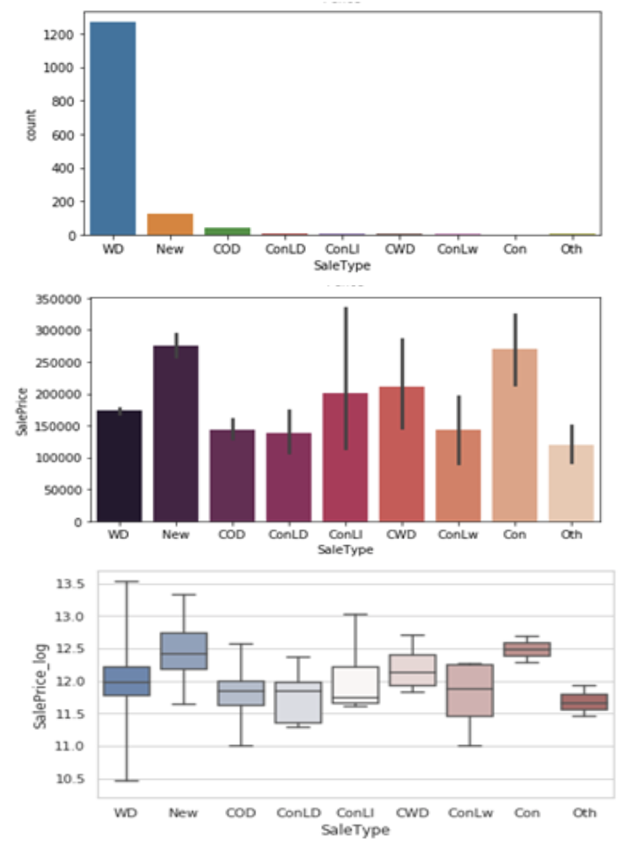
Categorical Variable that needs to be Feature Engineered: SaleType
Dominant group cover well over 50% of date
Collapse subcategories that are underrepresented
Need to examine the proportions in test set
Mean of subcategories vary with no distinct grouping
May need domain knowledge to supplement regrouping
Distributions of subcategories are not normal
Median Log of Sale Price of subcategories vary with no distinct grouping

Slide 13
Model Talk

Slide 14
General Models Used
Linear regression
Tree-Based Regression
Assumptions:
Linear relationships
Homoscedasticity of residuals
Independence of errors
Normality of residuals
Lack of multicollinearity
Assumptions:
No formal distributional assumptions

Slide 15
Linear Regression Models Tested
Multiple Linear Regression
Forward- and Backward-Feature Selection
Variable Inflation Factor for Multicollinearity
Lasso Regularized Regression
Used for feature selection of penalized regression
Ridge Regularized Regression
Features previously selected with Lasso

Slide 16
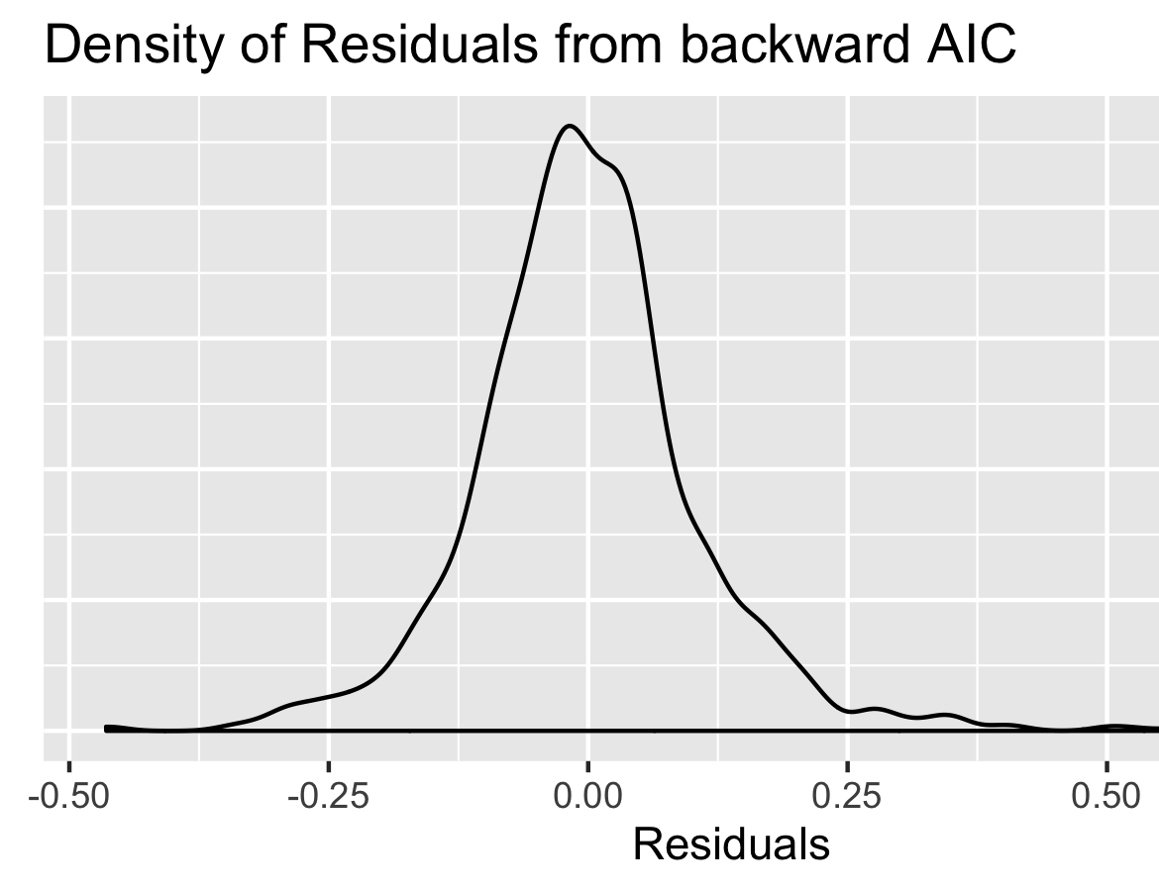
MLR Feature Selection
Forward-Selection:
RMSE = 0.1160
55 coefficients
R²: 0.9116
Backward-Selection:
RMSE = 0.1159
56 coefficients
R²: 0.9117

Slide 17
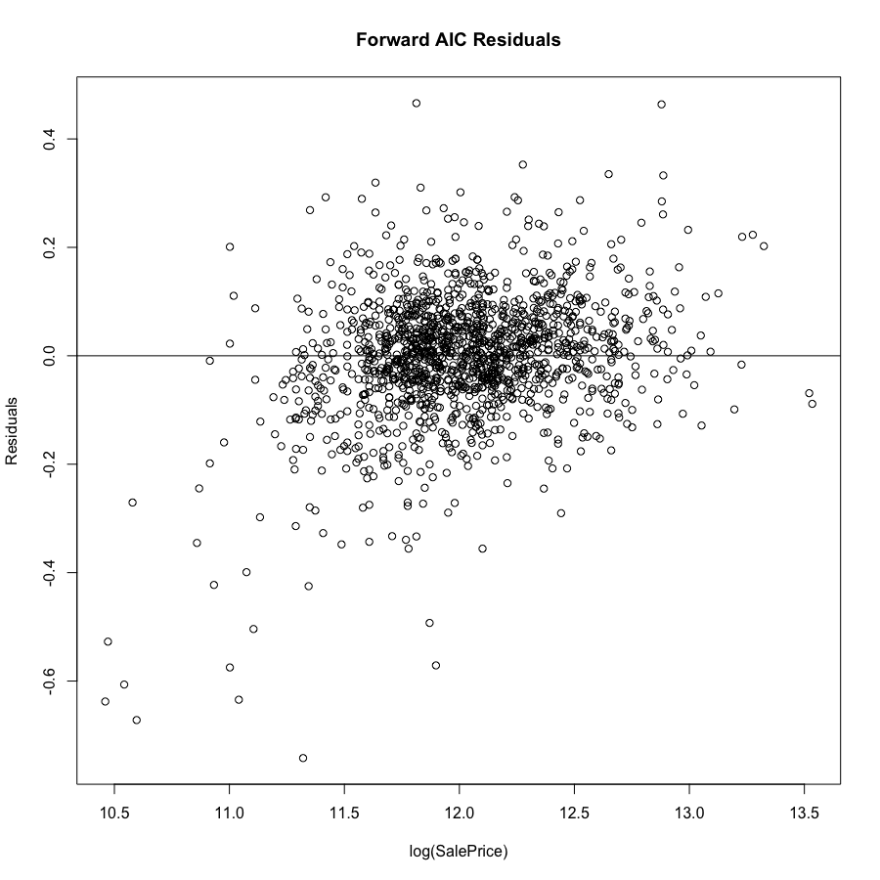
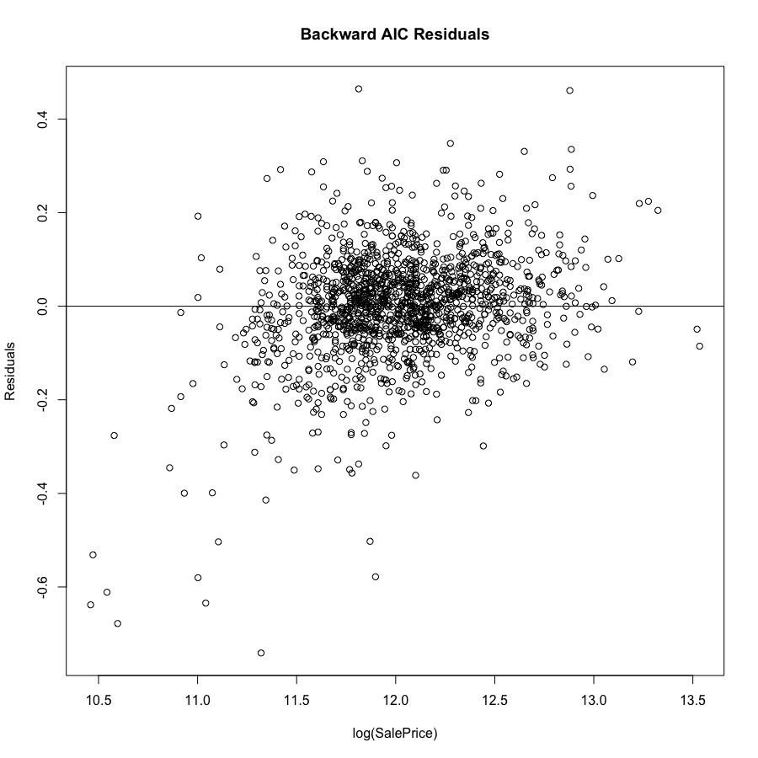
MLR Feature Selection

Slide 18
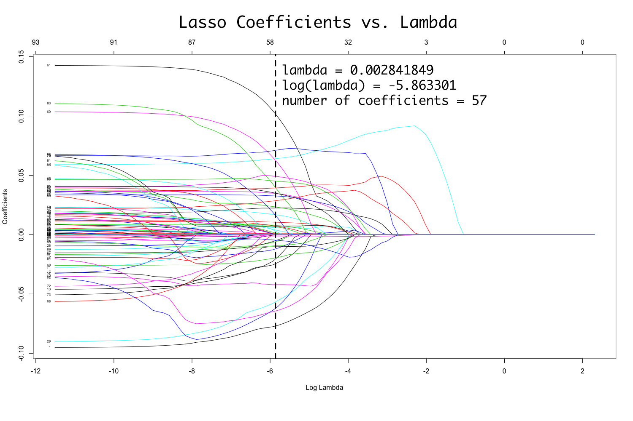
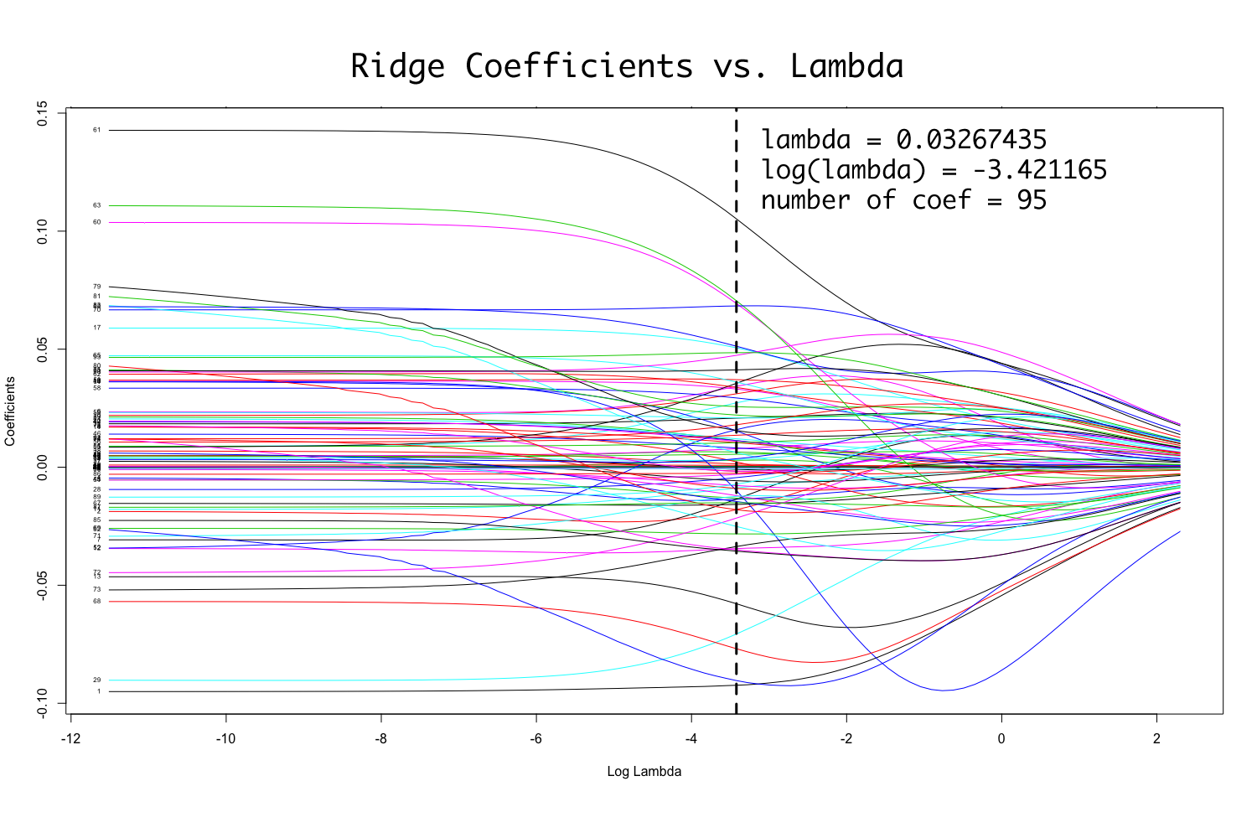
Feature Selection
lasso
ridge

Slide 19
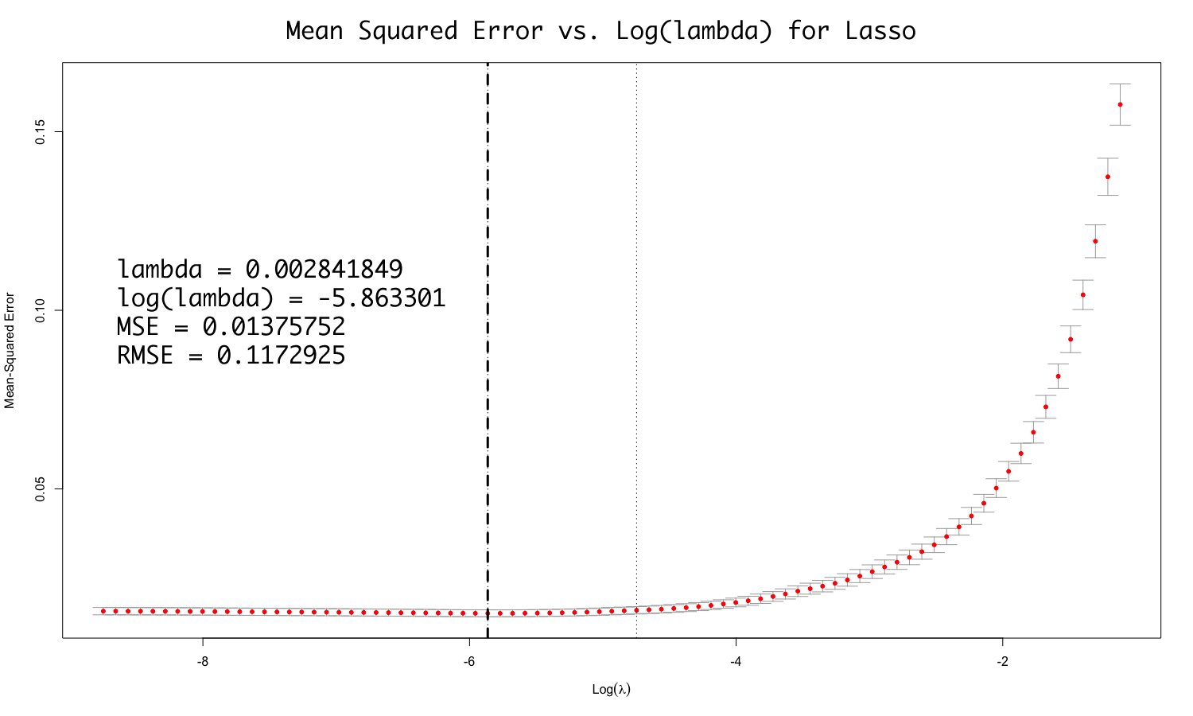
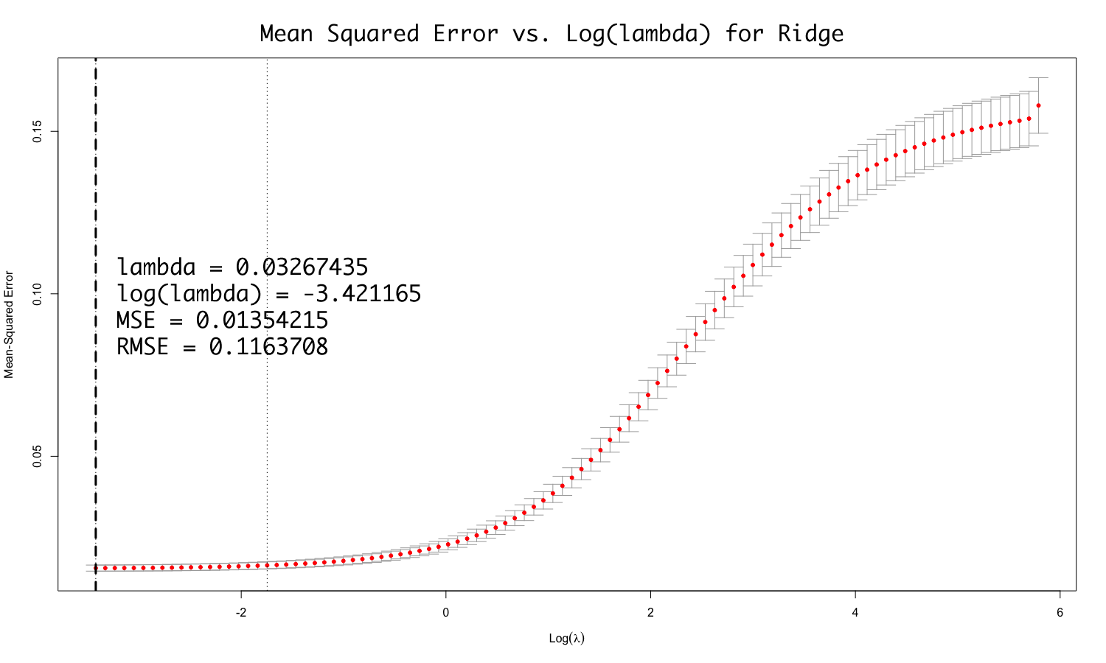
Hyperparameter Tuning
lasso
ridge

Slide 20
Tree-Based Model: XGBoost
Tuning Parameters
Optimized gradient-boosting decision-tree-based algorithm
Eta: learning rate
Gamma: restricts splits between leaves
Max Depth: depth of decision tree
Min Child Weight: limits further partition
ColSample: number of features supplied to tree
Alpha: L1 Lasso penalization
Lambda: L2 Ridge penalization
N Trees: number of trees

Slide 21
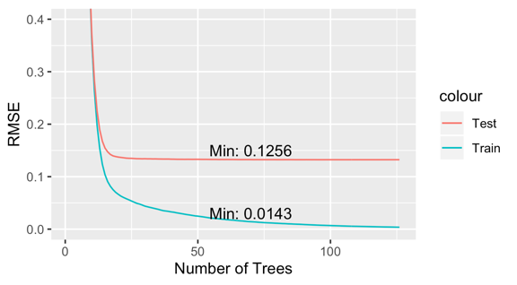
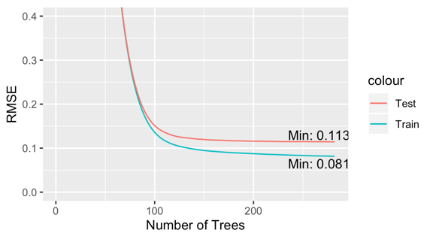
Parameter Tuning
Without Tuning
With Tuning

Slide 22
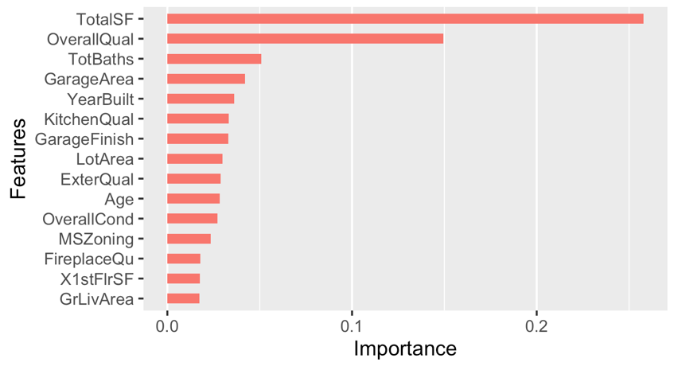
Feature Importance

Slide 23
Flipping Houses
What are the Features that homeowners can control to make their homes more valuable?
Key features
Unfinished basement
Overall quality
Central Air
Gas heating
Number of rooms
Base price dependent
Neighborhood
Age
Zoning

Slide 24
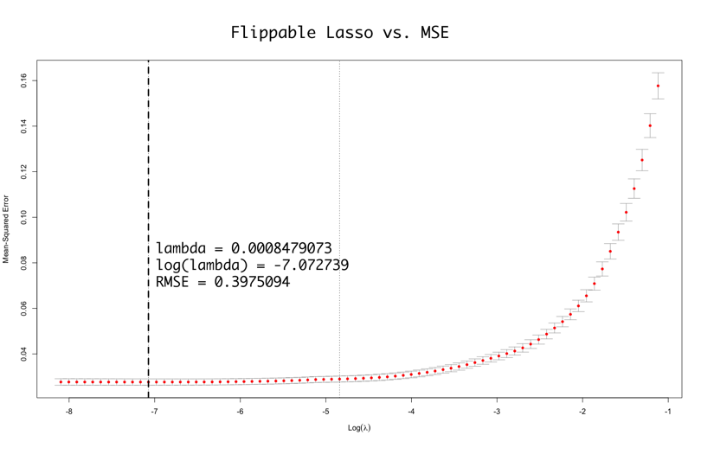
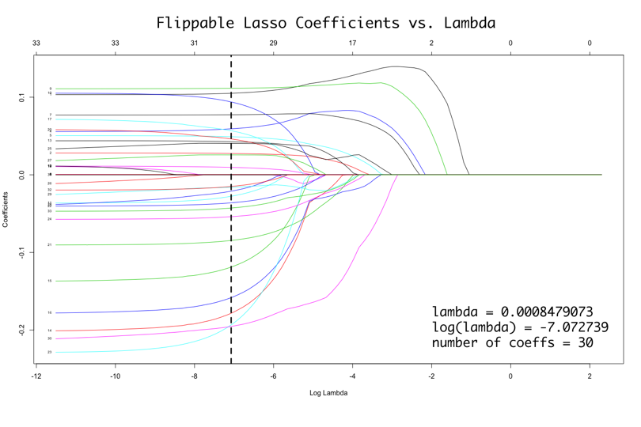
Lasso: Only Upgradable Features
Of the 17 variables included, only one (# of kitchens) was dropped: most of the variables that homeowners can improve are proven to be significant in improving sale price.

Slide 25
Insights

Slide 26
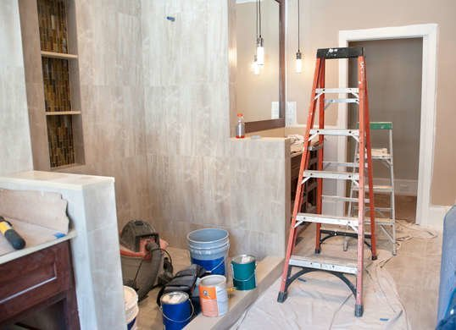
Upgradable Features
Many features found to contribute to sales price can be upgraded
Number of bathrooms
Garage Finish
Square footage of house
Overall quality metrics
Fireplace
Exterior

Slide 27

Upgradable Features
Cost of upgrades unknown
Unable to weight cost of upgrades

