Slide 1

Review of Cybersecurity Breaches Worldwide
Kailyn Philpot
Notes:
Good afternoon, I'm Kailyn Philpot, and today I’ll be presenting my data analysis project exploring cybersecurity threats over the last decade.
Before diving into the data, it’s important to understand why cybersecurity is a major global issue.Cyberattacks today don't just target individuals — they impact governments, banks, hospitals, and entire countries.
A real-world example is the hacking group Anonymous. Over the last decade, they launched cyberattacks against government websites, corporations, and financial institutions around the world to make political statements.
Their actions showed how a few people with technical skills could disrupt major systems — exposing vulnerabilities we often take for granted.

Slide 2

Dataset: Global Cybersecurity Threats (2015-2025)
What?
Why?
This dataset tracks cybersecurity incidents from 2015 to 2024, including attack types, industries affected, financial losses, user impact, and resolution times.
T
The goal of this project was to explore patterns in global cybersecurity incidents, focusing on attack types, financial losses, and trends over time.
When?
Studying incidents from 2015 to 2024 shows how cybersecurity threats have evolved recently and helps predict future risks as technology and attack methods continue to change.
Notes:
The goal of this project is to study cybersecurity attacks that happened around the world between 2015 and 2024. I will look at what types of attacks happened most often, which industries were targeted, and how much money was lost. This will help show trends in cybersecurity risks and give a better idea of how these attacks have affected businesses and users over time.

Slide 3
Data Cleaning and Preparation
Handling Missing Values & Removing Duplicates
01
I checked for null values and duplicates, however there were none within this dataset, which made it very easy to work with.
Converted 'Year' column to categorical type
02
I converted the 'Year' column into a categorical type because 'Year' is better treated as a label for grouping events, not as a number we perform calculations on like addition or averaging.
Created new columns: Loss per User, Year Interval
03
It helped spot trends across eras, not just single years. It gave a more precise picture of attack severity.
Notes:
"The 'Year Interval' column helped simplify the timeline by grouping incidents into periods.
It made it easier to spot broader patterns in cybersecurity attacks over multiple years, not just year-by-year changes."
"The 'Loss per User' column allowed me to see which attacks were most damaging on a per-person basis.
It showed not just how big an attack was overall, but how severe it was for each individual affected."

Slide 4
Exploratory Data Analysis
Findings:
Top countries: UK, Germany, Brazil
Top industries: Finance, Healthcare
Common attacks: Phishing, Ransomware

Slide 5
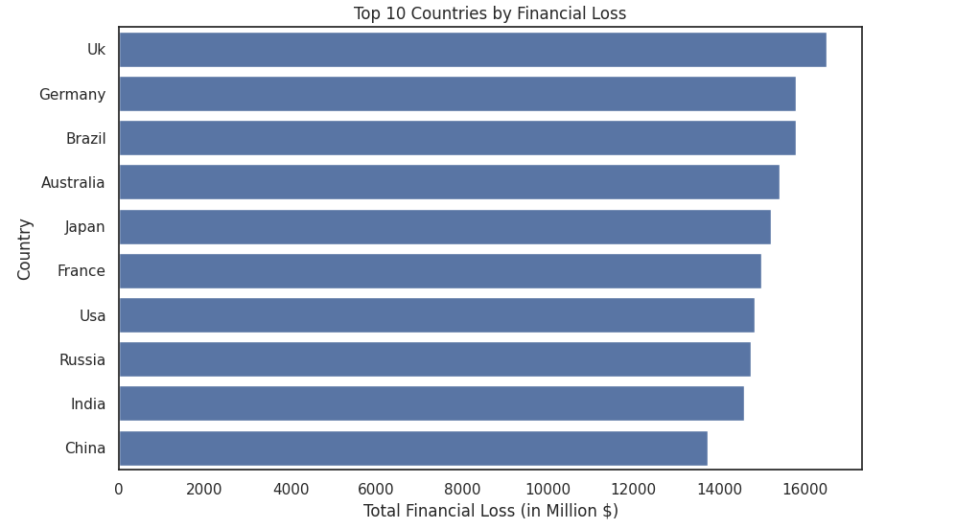
Exploratory Data Analysis:
Top 10 Countries by Financial Loss
Notes:
his chart shows the ten countries that experienced the highest total financial losses from cybersecurity incidents between 2015 and 2024.
The United Kingdom ranks first, followed by Germany and Brazil, which is somewhat surprising given the expectation that the United States or China would typically dominate.
This suggests that cybercriminals are increasingly targeting a broader range of countries, not just the largest global economies.
It also highlights how developed digital infrastructures — like those in Europe and South America — are vulnerable to costly attacks if defenses are not strong enough.

Slide 6
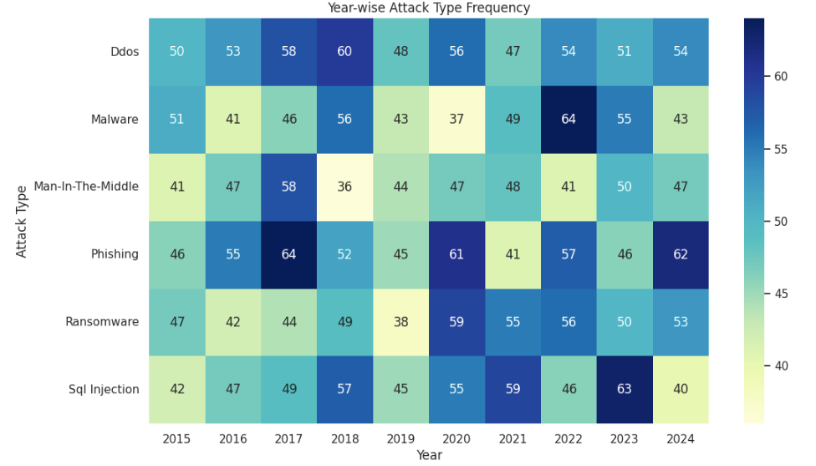
Exploratory Data Analysis:
Attack Type Frequency Over Time
Notes:
This heatmap shows the number of cybersecurity incidents by attack type across each year from 2015 to 2024.
The darker colors represent a higher number of incidents, while lighter colors represent fewer incidents.
As we can see, phishing consistently had the highest frequency every year, making it the most common attack type across the entire period.
However, starting around 2019, ransomware attacks began to rise significantly, indicating a shift in attacker strategy toward more financially motivated and damaging attacks.
Other attack types like malware and insider threats remained relatively stable in frequency without major spikes.
Overall, this view helps highlight both the persistence of traditional threats and the emergence of newer, more aggressive ones in recent years."

Slide 7
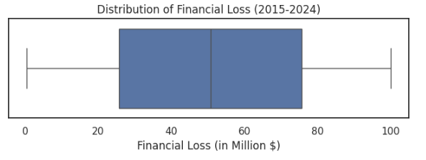
Exploratory Data Analysis:
Distribution of Financial Loss
Notes:
This boxplot shows the distribution of financial losses from cybersecurity incidents between 2015 and 2024.
In a boxplot, the middle box represents the range between the 25th and 75th percentiles, with the line inside showing the median financial loss.
The lines extending out, or whiskers, represent the general spread of the data.
As we can see, most financial losses fall within a moderate range, and there are no extreme outliers shown beyond the whiskers.
This suggests that while losses vary, most incidents stayed within a relatively predictable band without unusually massive loss events skewing the data.

Slide 8
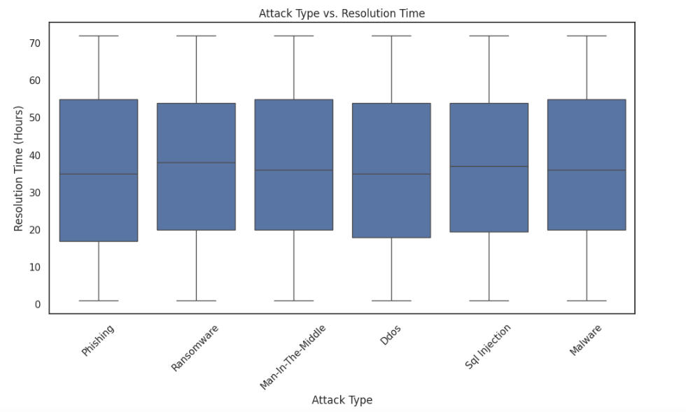
Exploratory Data Analysis:
Attack Type vs. Resolution Time
Notes:
This boxplot compares how long different types of cybersecurity attacks took to resolve, measured in hours.
Each box shows the distribution of resolution times for each attack type, and the median line inside each box represents the typical resolution time.
What’s noticeable is that the median resolution times across all attack types are very similar, and the interquartile ranges are also fairly consistent.
This means that regardless of the attack type — whether phishing, ransomware, insider threats, or malware — most incidents were resolved within roughly the same time frame.
The data suggests that organizational response processes may be standardized, handling different types of attacks with similar efficiency.

Slide 9
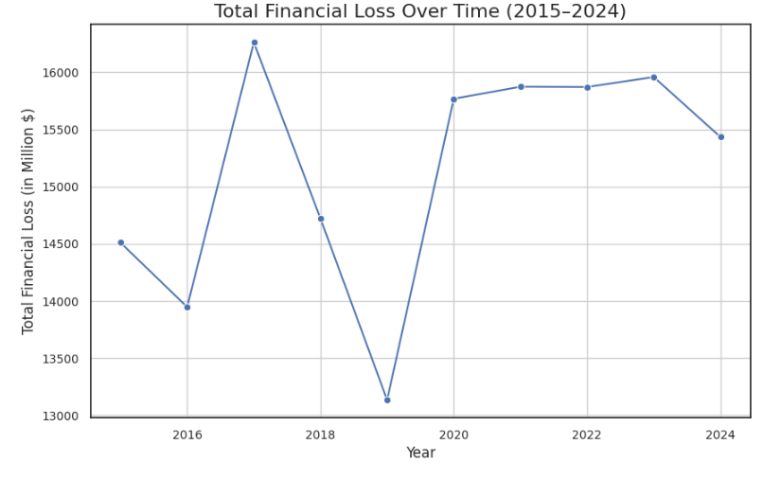
Exploratory Data Analysis:
Yearly Financial Loss Trend
Notes:
This line graph shows the total financial loss from cybersecurity incidents each year between 2015 and 2024.
Each point represents the combined financial loss recorded for that year, and the line helps visualize the trend over time.
We can see that financial losses were relatively stable early on but started to increase sharply after 2018, peaking around 2022.
This trend suggests that the financial impact of cybersecurity attacks has been growing, possibly due to the rise of more complex and costly attack methods like ransomware.
It highlights how cybersecurity risks are becoming not just more common, but also much more expensive for organizations globally.

Slide 10
Insights & Limitations
Findings:
Finance and Healthcare industries most targeted
Ransomware financial damage increasing
Dataset Limitations:
Possible underreporting
Variations in reporting standards

Slide 11
Thank you!
Notes:
Good afternoon, I'm Kailyn Philpot, and today I’ll be presenting my data analysis project exploring cybersecurity threats over the last decade.

