Slide 1



Arachne: Orchestrating Cascades for Efficient Text-to-Video Model Training
Peng Yu, Yuankai Fan*, Yang Qiu, Tian Li, Bihuan Chen, Yin Chen, Qizhen Weng*
Fudan University · Institute of Artificial Intelligence (TeleAI), China Telecom
SC26 · Chicago, November 2026 | * Corresponding authors
Notes:
Hi everyone, I'm Yuankai Fan from the Institute of Artificial Intelligence (TeleAI), China Telecom. Today I'll present Arachne, joint work led by Peng Yu from Fudan University. Arachne is a distributed training framework for text-to-video models. Today's T2V training leaves a large fraction of GPU time idle, because heterogeneous video data meets static parallelism. Arachne breaks each training step into fine-grained units we call cascades and schedules them in both time and space, giving up to 1.65x faster iterations than Megatron-LM.

Slide 2
Are We Fully Utilizing Our GPUs?
Unfortunately, No!
One training step of HunyuanVideo-13B on 16 GPUs (DP = 4 × SP = 4):
DP group 1 · 37 frames
38.9 s idle
DP group 2 · 105 frames
13.4 s
DP group 3 · 113 frames
58.6 s, the slowest
DP group 4 · 13 frames
52.6 s idle ≈ 90% of the step
Computing
Idle, waiting at the gradient-sync barrier
• Why do GPUs sit idle in T2V training?
• How can we put that idle time to work?
2
Notes:
Let me start with a simple question: are we fully utilizing our GPUs when training text-to-video models? [Click] Unfortunately, no. This is one real training step of HunyuanVideo, 13 billion parameters, on 16 GPUs: four data-parallel groups, each using sequence parallelism of four. Each group gets a batch of clips with a different length, 37, 105, 113 and 13 frames. The group with 113-frame clips takes 58.6 seconds. Everyone else finishes early and waits at the gradient synchronization barrier; the group with the shortest clips sits idle for 52.6 seconds, about 90 percent of the step. [Click] So this talk answers two questions: why are GPUs idle in T2V training, and how can we put that idle time to work?

Slide 3
Outline
1. Background: T2V Training Today
2. Motivation: Why GPUs Sit Idle
3. Arachne Design
4. Evaluation
3
Notes:
Here's the plan: a short background on how T2V models are trained today; then the motivation, which is the core of this talk, explaining why GPUs sit idle; then Arachne's design; and finally the evaluation.

Slide 4



Background: Text-to-Video Generation
Rapidly growing applications
Content creation
Interactive games
World simulation
One shared blueprint: latent diffusion + Diffusion Transformer (DiT)
Sora · Movie Gen · HunyuanVideo · Wan2.1 · CogVideoX
13B
7–20M
3 stages
parameters (HunyuanVideo)
video clips per training stage
360p → 720p → 1080p
4
Notes:
Text-to-video generation is growing fast, for content creation, interactive games and world simulation. The leading models, Sora, Movie Gen, HunyuanVideo, Wan and CogVideoX, share one blueprint: latent diffusion with a Diffusion Transformer backbone. Training them is expensive: billions of parameters, millions of clips per stage (WebVid about 7 million, Koala about 20 million, our Lynx about 10 million), and a three-stage curriculum from 360p to 1080p.

Slide 5
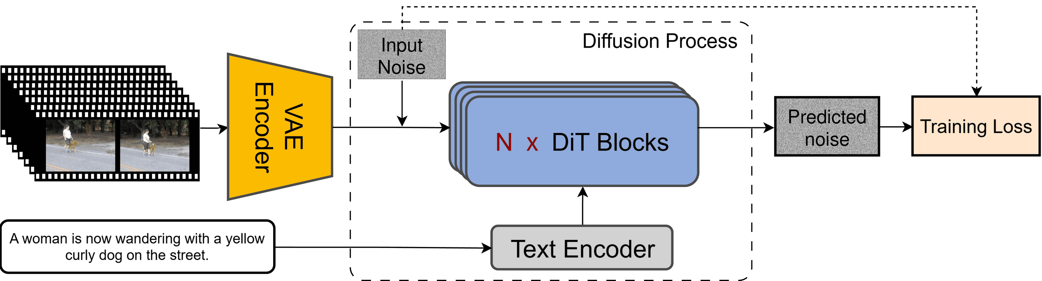
Background: Anatomy of a T2V Model
Text encoder
VAE
DiT × N
short prompts, cheap
3D conv, large activations
O(L²) attention, dominant cost
5
Notes:
A typical T2V model has three modules. The VAE compresses each clip into a spatio-temporal latent. Noise is added, and a stack of DiT blocks, conditioned on the text encoder, learns to predict that noise. Their costs are very different. The text encoder sees short prompts, under 256 tokens, and is cheap. The VAE uses 3D convolutions and has large activations at high resolution. The DiT runs full self-attention over every 3D patch, quadratic in sequence length, and dominates training time. These three modules become the units Arachne schedules.

Slide 6

Background: Data Bucketing
① Clips of mixed length
② Group into buckets
③ One bucket per DP group
105 f
13-frame bucket
13 f × Bs 6
13 f
37 f × Bs 3
37-frame bucket
113 f
105 f × Bs 1
37 f
105-frame bucket
113 f × Bs 1
13 f
bar = tokens per group (Bs × frames): roughly equal
113-frame bucket
37 f
key = (resolution, frame count)
Why buckets? Zero-padding wastes compute and packing 3D video is complex; buckets keep every batch uniform
6
Notes:
How do people batch videos of different lengths? Zero-padding them to the same length wastes a lot of compute, and sequence packing, which is common for LLMs, is very complex for 3D video tensors and makes attention masking inefficient. So T2V frameworks such as Open-Sora and HunyuanVideo use bucketing. Step one: the dataset contains clips of very different lengths. Step two: clips are grouped into buckets keyed by resolution and frame count, here 13, 37, 105 and 113 frames, which are exactly the buckets in our running example. Step three: in each iteration every data-parallel group samples its whole batch from a single bucket, and the batch size adapts so that each group sees roughly the same number of tokens: six 13-frame clips, three 37-frame clips, but only one 105- or 113-frame clip. This keeps each local batch uniform. Keep this picture in mind: equal tokens per group will turn out not to mean equal work.

Slide 7

Background: DP × SP Parallelism
13 f × 6
GPU
GPU
GPU
GPU
SP / CP: within a row
Video sequences are long, so split one video's tokens over 4 GPUs (Ulysses All-to-All or Ring attention)
37 f × 3
GPU
GPU
GPU
GPU
105 f × 1
GPU
GPU
GPU
GPU
DP: across rows
Each group trains on its own bucket, then gradients are synchronized
113 f × 1
GPU
GPU
GPU
GPU
Common practice: static DP = 4 × SP = 4. To avoid OOM, every DP rank uses the longest sequence's large SP degree
All-Reduce gradients across DP groups: everyone waits here
7
Notes:
Now how are these buckets mapped to GPUs? T2V training uses data-centric parallelism. Each row here is one data-parallel group of four GPUs, and each group gets the batch from one bucket. Because video sequences are long, a single video does not fit on one GPU, so inside a group, sequence or context parallelism splits its tokens across the four GPUs, using Ulysses-style All-to-All or ring attention. Across groups, it is plain data parallelism: each group computes gradients on its own bucket, and then all groups All-Reduce their gradients, so every group has to wait for the others at this barrier. And the common practice is one static layout, here DP 4 by SP 4: to make sure the longest sequence does not run out of memory, every DP rank uses the large SP degree that sequence needs, even when its own bucket is short. This is exactly the setup from the opening slide, so let's see why it leaves so many GPUs idle.

Slide 8
Outline
1. Background: T2V Training Today
2. Motivation: Why GPUs Sit Idle
3. Arachne Design
4. Evaluation
8
Notes:
Now the core of the talk: why do GPUs sit idle in T2V training?

Slide 9
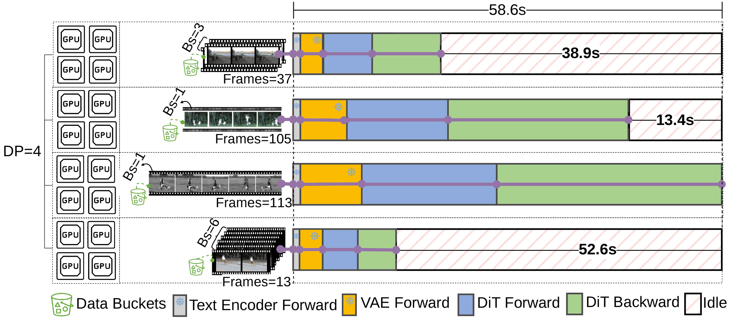

Problem: GPUs Idle Despite Bucketing
52.6 s
idle in a 58.6 s step (≈90%)
Observation:
Every rank waits at the gradient-sync barrier for the longest bucket
Bs = batch size. Buckets with shorter sequences are assigned larger batch sizes to equalize the total tokens (i.e., batch size × sequence length) processed per rank, subject to GPU memory constraints.
HunyuanVideo, DP = 4 × SP = 4. Adaptive batch sizing cannot close the gap: it is capped by GPU memory and the static layout.
9
Notes:
Here is the step from the opening slide in full detail. Four data-parallel groups, each with SP of four, draw batches from four different buckets. Bucketing makes each local batch uniform, but the groups are badly unbalanced. The group with the 113-frame clip takes 58.6 seconds; the group with 13-frame clips finishes almost at once and waits 52.6 seconds, about 90 percent of the step, at the gradient synchronization barrier after the DiT backward pass. Adaptive batch sizing tries to compensate, but it is limited by GPU memory and by the fixed layout. The natural question: can we simply change the parallelism per bucket, as recent LLM systems do? To answer that we need to look at what makes video different.

Slide 10
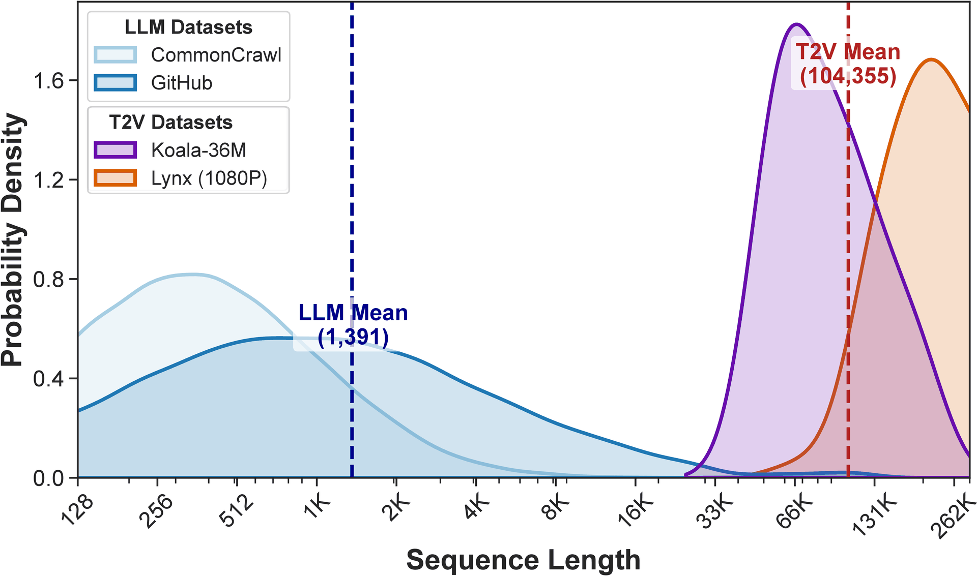
Observation 1: Long, Clustered, Discrete
Right-shifted
Mean 104K tokens vs. 1.4K for LLMs (≈75×)
Concentrated
33K–262K tokens: only an ≈8× range
Discrete
Length jumps with frame count: big compute gaps between buckets
Implication: every sample is heavy, and buckets differ in large but predictable steps
10
Notes:
Our first observation is about sequence lengths. This plot compares two LLM corpora with two video datasets, Koala and our internal 1080p dataset Lynx; the x-axis is log scale. Video sequences are right-shifted: after VAE encoding the mean is over 100 thousand tokens, about 75 times the LLM mean, so even the shortest video sample is heavier than 99.5 percent of LLM sequences. They are concentrated: the range is only about 8x, versus three orders of magnitude for LLMs. And they are discrete: length grows in steps set by the frame count, so neighboring buckets differ a lot in compute. The implication: every sample is expensive, and the imbalance between buckets is large but predictable, which is exactly what a planner can exploit.

Slide 11
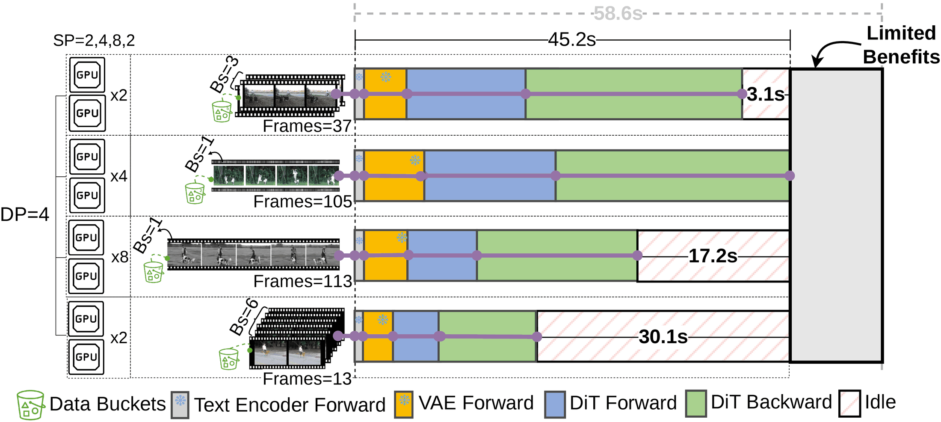

Observation 2: Computation Is the Bottleneck
DiT attention is O(L²) on ~100K-token sequences. LLM-style dynamic SP (e.g. FlexSP) targets communication; applied to our step (SP = 8 for 113 frames, SP = 2 for 13 / 37 frames):
58.6 s → 45.2 s
only 23% shorter
Bottleneck shifts
to the 105-frame bucket
3.1 / 17.2 / 30.1 s
still idle on the other groups
Bs = batch size. Buckets with shorter sequences are assigned larger batch sizes to equalize the total tokens (i.e., batch size × sequence length) processed per rank, subject to GPU memory constraints.
11
Notes:
The second observation: T2V training is compute-bound. The DiT runs full self-attention, quadratic in sequence length, over sequences of about a hundred thousand tokens. Recent LLM systems such as parallelism hot-switching and FlexSP do adapt parallelism per iteration, but they were designed for text, where sequences are short and highly variable and communication is the main overhead. Let's apply that idea to our step: give the 113-frame bucket SP of 8 and the short buckets SP of 2. The step drops from 58.6 to 45.2 seconds, only 23 percent, because the bottleneck simply moves to the 105-frame bucket, and the other groups are still idle for 3, 17 and 30 seconds. Re-sizing groups per bucket is not enough.

Slide 12
Prior Work: Why It Falls Short
Approach | Adapts to imbalance | Built for compute-bound T2V | Flexible in time and space
Static DP + SP / CP (Megatron-LM, DeepSpeed) | No | No | No
LLM dynamic parallelism (FlexSP, hot-switching) | Per iteration | No: targets comm. | No
Heterogeneous-cluster training (Metis, Whale) | Hardware only | No | Static plan
Arachne | Per cascade | Yes | Yes
Complementary: sparse / ring attention speed up the attention kernel itself and can run inside Arachne's cascades; recomputation and offloading also combine with it.
12
Notes:
How does prior work fare? Static systems like Megatron-LM and DeepSpeed use one data- and sequence-parallel layout for everything, so they do not adapt to imbalance at all. Dynamic-parallelism systems from the LLM world, such as FlexSP and parallelism hot-switching, re-size SP groups per iteration, but they were designed around the communication cost of short text sequences, and as we just saw, re-sizing only moves the bottleneck for compute-bound video. Heterogeneous-cluster systems like Metis and Whale adapt to different GPU types, not to different workloads, and still produce a static plan. None of them can place each module of each sample independently in time and space. Long-sequence attention techniques such as sparse or ring attention are complementary: they make each attention kernel faster and can run inside Arachne's cascades.

Slide 13


Root Cause: Two Rigidities
Static in space
Synchronized in time
Each sample is bound to one GPU group for all of its modules
All samples launch together, then wait for the slowest one
Key idea
Decompose each module's execution on each sample into a cascade, then schedule every cascade in time (when to launch, on how many GPUs) and space (on which GPUs)
13
Notes:
So why do all these approaches leave GPUs idle? We trace it to two rigidities they share. In space: each sample is pinned to one group of GPUs for its entire lifecycle, so its text encoder, VAE and DiT all use the same layout. In time: all samples in an iteration start together and must finish together, so short samples wait for the longest. [Click] Our key idea removes both: treat each module's execution on each sample, its text encoder, VAE or DiT pass, as a fine-grained unit we call a cascade, and for each cascade choose when it starts, how many GPUs it uses, and exactly which GPUs. Heterogeneity then becomes scheduling freedom instead of idle time.

Slide 14
Outline
1. Background: T2V Training Today
2. Motivation: Why GPUs Sit Idle
3. Arachne Design
4. Evaluation
14
Notes:
With that motivation, let me walk through Arachne's design.

Slide 15
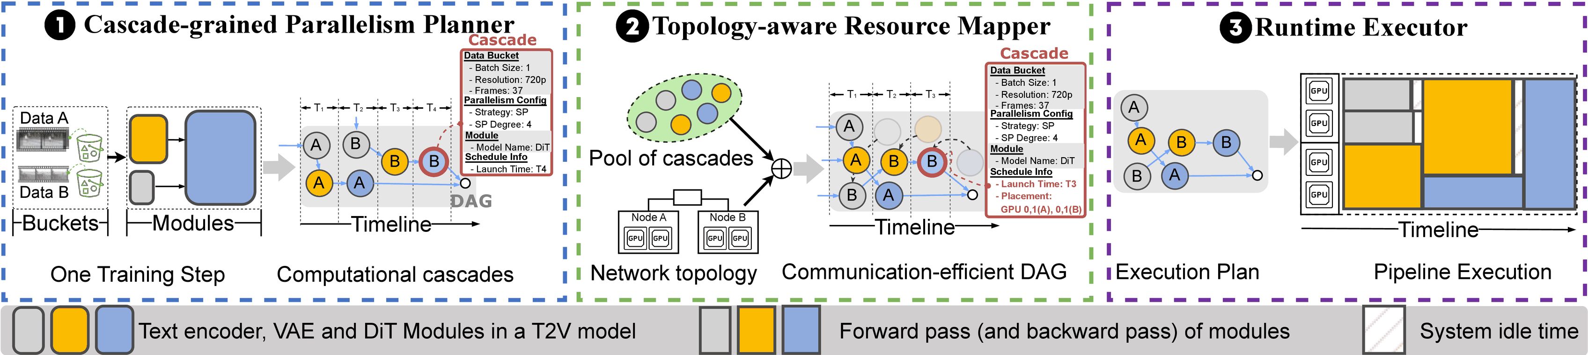
Arachne: Overview
Time
Space
Execution
When each cascade runs, and on how many GPUs
Which physical GPUs, chosen by network topology
Data handoff and exact gradient accumulation
15
Notes:
This is Arachne at a glance, with three components. The cascade-level parallelism planner handles time: it turns a training step into a DAG of cascades and decides when each launches and with what parallel degree, minimizing the makespan on an abstract pool of GPUs. The topology-aware resource mapper handles space: it maps each cascade onto concrete GPUs so communication stays cheap. The runtime executor runs the plan: it moves intermediate data between dependent cascades and makes sure each gradient is accumulated exactly once. Let's go through them one by one.

Slide 16
Arachne: Overview
① Cascade-level Parallelism Planner
Decide when each cascade runs and on how many GPUs, to minimize the step's makespan
16
Notes:
First, the planner. It decides the temporal side: when each cascade starts and how many GPUs it uses.

Slide 17

Planner: Decompose a Step into Cascades
Cascade = one module on one input, runnable by an existing framework
One step → a DAG of cascades
Sample A
Example cascade
Text enc.
VAE
DiT (fw+bw)
Data 1 clip, 720p, 37 frames
Module DiT
Sample B
Parallelism SP = 4
Text enc.
VAE
DiT (fw+bw)
Placement GPU 0–1 on node A, B
2 samples × 3 modules = 6 cascades
Launch T3
Static parallelism fixes these per iteration; Arachne chooses them per cascade
17
Notes:
A cascade is the smallest self-contained computation an existing distributed training framework can run directly: one module applied to one input, together with its own parallel strategy, GPU placement and launch time. For example, a DiT cascade on one 37-frame 720p clip with SP degree four, placed on GPUs 0 and 1 of nodes A and B, launched at slot T3. A step with two samples becomes a DAG of six cascades: for each sample, the text encoder and VAE feed the DiT. The difference from static parallelism: all these fields are chosen per cascade rather than once per iteration.

Slide 18





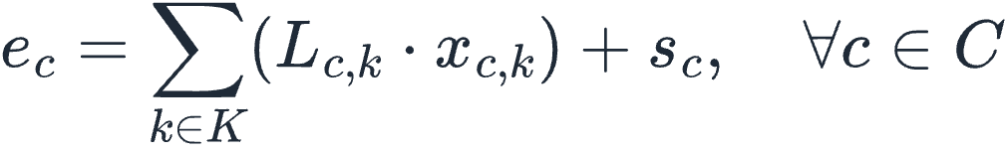

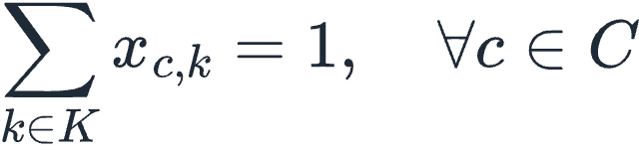
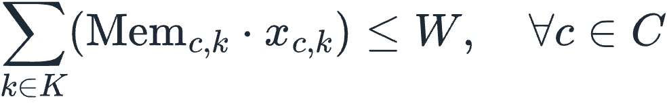
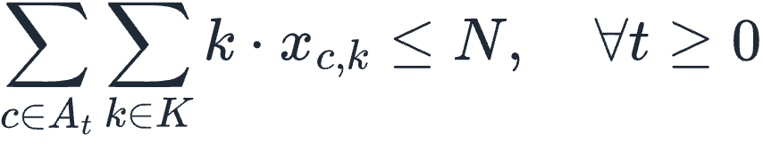
Planner: Makespan-Minimizing Schedule
MILP on a homogeneous GPU pool
NP-hard → anytime GA
launch time
degree k chosen (0/1)
makespan
Chromosome: a degree per cascade
(1) objective
(2) end time
Fitness: critical-path list scheduler → makespan
(3) makespan bound
(4) dependencies
(5) one degree each
Evolve: elitism, crossover, mutation
(6) GPU memory
Anytime: keep the best plan so far
(7) GPU budget
More details: §IV-B, Table I and Algorithm 1 in the paper
18
Notes:
We formulate cascade scheduling as a mixed-integer linear program. For each cascade we pick a launch time and exactly one parallel degree, and minimize the makespan of the step. A cascade cannot start before its predecessors finish, its peak memory must fit in one GPU, and at any time the running cascades cannot use more GPUs than we have. GPUs are treated as a homogeneous pool here; placement comes later. Solving this exactly is NP-hard, so in practice we use a genetic algorithm. A chromosome assigns a degree to every cascade; a fast critical-path list scheduler turns that into launch times and a makespan; and the population evolves with elitism, crossover and mutation. It is an anytime algorithm: we can stop whenever the budget runs out and keep the best plan so far.

Slide 19

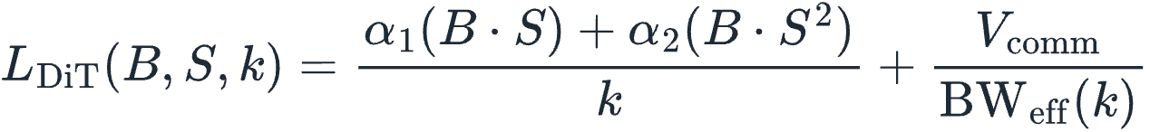
Planner: Cost Models & Profiling
VAE
DiT
Profiling
Tile-parallel to avoid OOM
Batch B, length S, degree k
≈15 min
1,302 profiles cover HunyuanVideo's 3 stages, once offline
Simulate base tiles round-robin on k GPUs; latency = slowest GPU
Cheap thanks to discrete bucket points (Obs. 1)
Per tile: linear model + XGBoost residual
Attention grows with B·S²; bandwidth depends on intra- vs. inter-node
More details: Eqs. (8)–(9) in the paper
19
Notes:
The planner needs to know, before running anything, how long each cascade takes and how much memory it needs at each degree. For the VAE, high-resolution videos are split into tiles across GPUs to avoid running out of memory, which makes latency irregular; we simulate a round-robin distribution of base tiles, and predict each tile's latency with a linear model refined by XGBoost on the tile shape. For the DiT, memory is model state plus activations that scale with tokens over k; latency has a linear term and a quadratic attention term divided by k, plus communication that depends on intra- or inter-node bandwidth. The text encoder is ignored since prompts are under 256 tokens. Profiling is cheap thanks to Observation 1: lengths fall on discrete bucket points, so for HunyuanVideo's full curriculum we collect 1,302 profiles, 1,002 DiT and 300 VAE, in about 15 minutes, once.

Slide 20
Arachne: Overview
② Topology-aware Resource Mapper
Decide which physical GPUs run each cascade, keeping communication on fast links
20
Notes:
The planner's schedule is logical: it knows how many GPUs a cascade uses, not which ones. The topology-aware resource mapper fills that in.

Slide 21
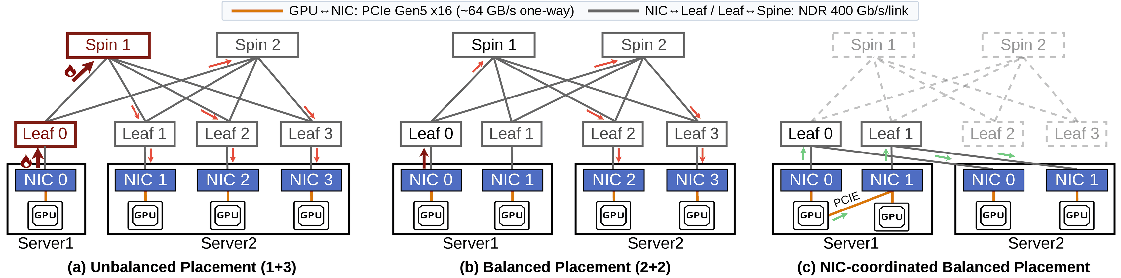
Mapper: Topology-aware Placement
P1 · One node
P2 · Balanced
P3 · NIC-aligned
P4 · Short paths
Keep collectives on NVLink
2 + 2, not 1 + 3: no NIC hotspot
Same-index NICs share a leaf: skip the spine
Minimize PCIe / NUMA distance to NICs
21
Notes:
Inside a cascade, the mapper follows four priorities. First, keep the whole cascade inside one node whenever possible so its collectives stay on NVLink. Second, if it must span nodes, split it evenly: in panel (a), a 1 plus 3 split of an SP-4 cascade funnels all cross-node traffic through one NIC and one leaf uplink; panel (b), a 2 plus 2 split, spreads it out. Third, align NIC indices across nodes: in multi-rail clusters, same-numbered NICs hang off the same leaf switch, so in panel (c) traffic never touches the spine. Fourth, among equivalent choices, pick GPUs closest to their NICs in the PCIe and NUMA hierarchy.

Slide 22
Arachne: Overview
③ Runtime Executor
Run the plan: hand data between dependent cascades and keep gradients exact
22
Notes:
Finally, the runtime executor turns the plan into execution. Two things are non-trivial: moving data between cascades of the same sample that now run on different GPUs, and keeping gradient accumulation correct.

Slide 23

Executor: Inter-cascade Data Handoff
e.g. a VAE cascade produces a latent that a DiT cascade on other GPUs consumes
Overlapping GPU groups → in-place handoff
Shared GPUs act as a distributed cache; a local broadcast fills in any new peers
Disjoint GPU groups → asynchronous fire-and-forget
Pack on a side CUDA stream
Offload to host memory
Route via Gloo brokers, parallel to NCCL
Consumer prefetches ahead
The mapper maximizes producer–consumer overlap → near-zero handoff overhead
23
Notes:
Once cascades of the same sample can run on different GPUs, intermediate data has to move, for example the latent from a VAE cascade to a DiT cascade. The mapper and executor are co-designed for this. The mapper tries to maximize the overlap between producer and consumer GPUs. When they overlap, the executor hands off in place: the shared GPUs already hold the tensor and act as a distributed cache, and a local broadcast updates any new peers. When the groups are disjoint, the producer fires and forgets: the tensor is packed on a side CUDA stream, offloaded to host memory, and routed through broker nodes over a CPU-side Gloo channel that runs in parallel with NCCL collectives. Consumers prefetch upcoming transfers. In practice this keeps the handoff off the critical path.

Slide 24
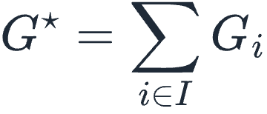


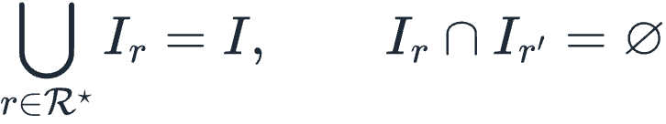


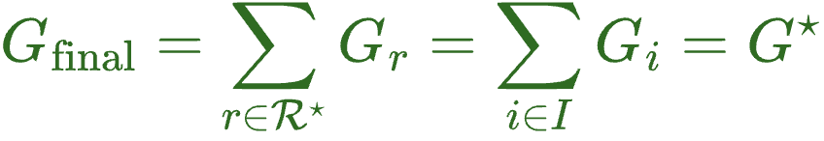
Executor: Exact Gradient Accumulation
Problem: mixed partial sums
Fix: two-phase sync
Target
Pick a minimum exact cover: disjoint groups covering every sample (Groups 1, 2)
Phase 1: All-Reduce among the cover groups
Phase 2: broadcast to the rest (Group 3)
Group 1
Group 2
Group 3
Global All-Reduce counts sample A twice: wrong
Same update as static training
More details: Eqs. (10)–(12) in the paper
24
Notes:
Dynamic dispatch creates a correctness problem. In static data parallelism, each GPU holds its own sample's gradient and an All-Reduce sums them. With cascades, different GPU groups hold different pre-summed gradients. With four samples A to D: one group holds G_A plus G_B, another G_C plus G_D, and a third just G_A. A global All-Reduce would count G_A twice. The executor uses a two-phase, representative-based synchronization: it selects a minimum exact cover of groups whose samples are disjoint and together cover all samples, here groups one and two. Those representatives All-Reduce to get exactly the sum of all sample gradients, and the result is broadcast to the remaining GPUs. The update is identical to static training, and both phases reuse groups that already exist.

Slide 25
Outline
1. Background: T2V Training Today
2. Motivation: Why GPUs Sit Idle
3. Arachne Design
4. Evaluation
25
Notes:
Now let's see how well it works.

Slide 26
Evaluation: Setup
Item | Configuration
Platform | 64 × H100-80GB; 8 GPUs per node (NVLink), 8 × 400 Gbps InfiniBand per node
Models | Wan2.1-1.3B · CogVideoX-5B · HunyuanVideo-13B
Workloads | Open-Sora curriculum: WebVid 360p (~7M) → Koala 720p (~20M) → Lynx 1080p (~10M)
Baselines | Megatron-LM (DP + ZeRO-1 + CP) · DeepSpeed (ZeRO + Ulysses SP) · FlexSP (adaptive SP)
Protocol | 16 GPUs end-to-end, up to 64 for scaling; same buckets and batching for all; mean of 50 iterations
26
Notes:
For the evaluation we use a 64-GPU H100 cluster, eight GPUs per node with NVLink and eight 400-gigabit InfiniBand NICs per node, running PyTorch 2.7.1 and CUDA 12.6. We train three models from 1.3 to 13 billion parameters: Wan 2.1, CogVideoX and HunyuanVideo, following the Open-Sora three-stage curriculum: WebVid at 360p, Koala at 720p and our internal Lynx dataset at 1080p. Baselines are Megatron-LM and DeepSpeed with hand-tuned static layouts, and FlexSP, which adapts its SP degree every iteration. All systems share the same buckets, adaptive batching and activation checkpointing; max length is capped at 129 frames, and we report the mean of 50 iterations after 10 warm-up iterations.

Slide 27
Evaluation: End-to-end Performance
HunyuanVideo-13B, 16 GPUs
Megatron-LM
DeepSpeed
FlexSP
Arachne
Arachne's speedup over each baseline
Average GPU idle ratio (%)
Iteration time; axis starts at 1.0× (= baseline)
Baselines idle more at higher resolution
1.65×
47.0
45.8
1.59×
38.8
37.6
34.6
32.8
33.6
1.43×
1.42×
1.35×
26.8
23.5
1.27×
1.18×
12.1
1.13×
1.09×
9.0
8.1
Stage 1 · 360p
Arachne 22.07 s
Stage 2 · 720p
Arachne 32.96 s
Stage 3 · 1080p
Arachne 26.80 s
Stage 1 · 360p
Stage 2 · 720p
Stage 3 · 1080p
27
Notes:
End-to-end results on HunyuanVideo with 16 GPUs across the three curriculum stages. On the left, Arachne's speedup in iteration time over each baseline. Arachne is fastest in every stage and its advantage grows with resolution: at 1080p it is 1.65 times faster than Megatron-LM, 1.59 times faster than DeepSpeed and 1.35 times faster than FlexSP. Stage 3's absolute iteration time is lower than Stage 2's because memory limits at 1080p cap clips at 57 frames, but the compute gap between buckets is larger, so imbalance is worse. The right chart explains the speedup: baseline idle ratios climb from Stage 1 to Stage 3, up to 47 percent for Megatron-LM, and FlexSP still idles a third of the time. Arachne goes the other way, down to about 8 percent, because more heterogeneity gives its scheduler more room to fill gaps.

Slide 28
Evaluation: Scalability
Model size
Data heterogeneity
Cluster size
1.35× → 1.43×
1.21× → 1.35×
1.37–1.43×
over Megatron-LM, 1.3B → 13B
over Megatron-LM, wider frame window
over Megatron-LM, 16 → 64 GPUs
Model | MLM | DS | FlexSP
Wan2.1 1.3B | 1.35× | 1.33× | 1.11×
CogVideoX 5B | 1.40× | 1.39× | 1.21×
Hunyuan 13B | 1.43× | 1.40× | 1.26×
Max frames | MLM | DS | FlexSP
53 | 1.21× | 1.19× | 1.13×
81 | 1.25× | 1.24× | 1.18×
105 | 1.35× | 1.34× | 1.21×
GPUs | MLM | DS | FlexSP
16 | 1.43× | 1.40× | 1.26×
32 | 1.40× | 1.40× | 1.23×
64 | 1.37× | 1.40× | 1.22×
More imbalance (bigger models, more diverse data) → more room for Arachne
Stage 2 throughput speedup vs. Megatron-LM (MLM), DeepSpeed (DS), FlexSP. The 53 / 81 / 105-frame windows cover 10.8% / 46.9% / 70.4% of the data.
28
Notes:
How does the benefit scale? These are Stage 2 throughput speedups. Model size: from the 1.3B Wan model to the 13B HunyuanVideo, the speedup over Megatron-LM grows from 1.35 to 1.43 times, because larger models make every second of imbalance more expensive. Data heterogeneity: widening the maximum frame window from 53 to 105 frames, covering 11 to 70 percent of the dataset, grows the speedup from 1.21 to 1.35 times; Arachne turns extra imbalance into scheduling room. Cluster size: from 16 to 64 GPUs the advantage stays at roughly 1.4 times over the static baselines and above 1.2 times over FlexSP, even though more GPUs means a much larger scheduling problem.

Slide 29
Evaluation: Mapper Ablation
Configuration | Stage 1 | Stage 2 | Stage 3
Arachne (full) | 22.07 s | 32.96 s | 26.80 s
w/o inter-cascade | +4.13% | +4.04% | +3.64%
w/o intra-cascade | +7.68% | +8.48% | +13.67%
w/o mapper | +8.26% | +12.53% | +19.26%
+19.26%
slower without the mapper at 1080p
Observation:
Intra-cascade placement matters most (13.67% vs. 3.64%)
HunyuanVideo-13B, mean iteration time; Stages 1 / 2 / 3 = 360p / 720p / 1080p. Other rows: slowdown vs. full Arachne.
29
Notes:
To isolate the spatial side, we ablate the topology-aware resource mapper. Removing it entirely slows every stage, most at 1080p, where iteration time goes up by more than 19 percent. Breaking it down, intra-cascade placement, choosing the right GPUs and NICs for a single cascade, matters most: disabling it costs 13.7 percent in Stage 3, versus 3.6 percent for inter-cascade placement. The lesson: an optimized temporal schedule only pays off when paired with topology-aware placement, which is why Arachne treats time and space together.

Slide 30
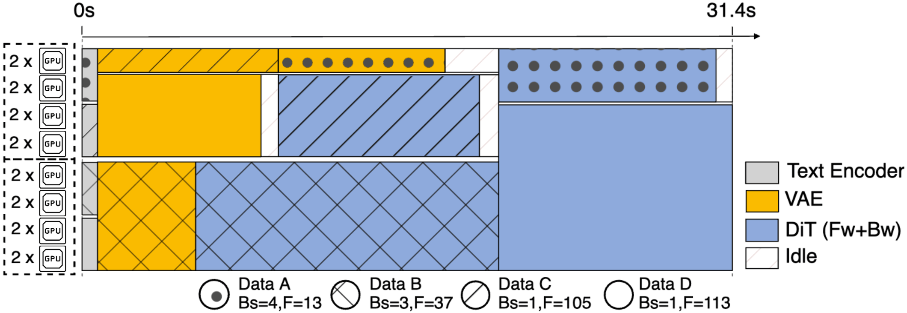
Evaluation: Case Study
Same step as the opening example, with Arachne:
Step makespan
Static, DP = 4 × SP = 4
58.6 s
FlexSP-style re-sizing
45.2 s
Arachne
31.4 s (−30.5%)
Bs = batch size. Buckets with shorter sequences are assigned larger batch sizes to equalize the total tokens (i.e., batch size × sequence length) processed per rank, subject to GPU memory constraints.
Time
Space
Same four samples
Short cascades (A, B) fill gaps around long ones
Data D: text enc. / VAE / DiT on 4 / 6 / 12 GPUs
A / B / C / D = 13 / 37 / 105 / 113 frames
30
Notes:
Back to the opening example: the same four samples on 16 GPUs, now scheduled by Arachne. Two things happen. In time, the short cascades from data A and B no longer wait for long ones; they are staggered into gaps. In space, cascades of one sample run on different GPU sets: for data D, the text encoder uses 4 GPUs (12 to 15), the VAE 6 (8 to 13), and the DiT 12 (0 to 11). The step finishes in 31.4 seconds, versus 45.2 for the FlexSP-style re-sizing and 58.6 for the static layout, a 30.5 percent reduction over FlexSP. Per-rank compute is far more balanced: the ratio between the busiest and least busy rank drops from 2.75 for Megatron-LM, to 1.52 for FlexSP, to 1.09 for Arachne, and the coefficient of variation stays around 0.1 over 50 consecutive iterations.

Slide 31
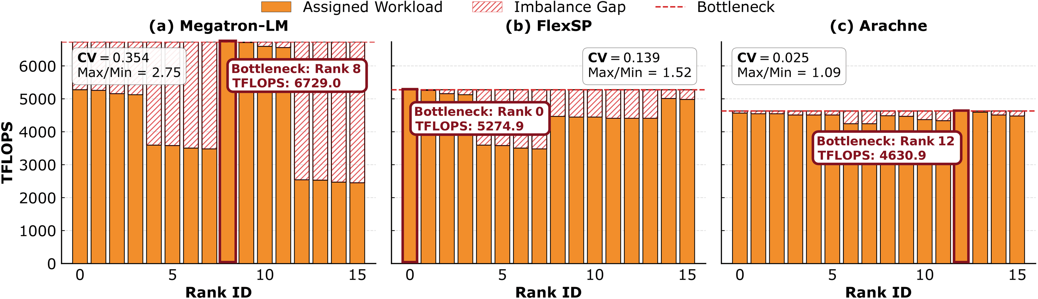
Evaluation: Workload Balance
Per-rank TFLOPS in one iteration; hatched = gap to the bottleneck rank
2.75 → 1.52 → 1.09
CV ≈ 0.10, every iteration
max/min per-rank TFLOPS: Megatron-LM → FlexSP → Arachne
over 50 iterations; Megatron-LM spikes to ~0.8 (Fig. 11)
31
Notes:
Where does the speedup come from? This figure shows how much compute each of the 16 ranks does in one iteration; the hatched part is the gap to the slowest, bottleneck rank. Megatron-LM is very uneven: the busiest rank does 2.75 times the work of the least busy one. FlexSP narrows this to 1.52. Arachne is almost flat, 1.09, with a coefficient of variation of 0.025 in this iteration. And it is not a lucky iteration: across 50 consecutive iterations Arachne's CV stays around 0.1, while Megatron-LM's swings up to about 0.8. Balanced ranks mean almost no time wasted waiting at synchronization points.

Slide 32
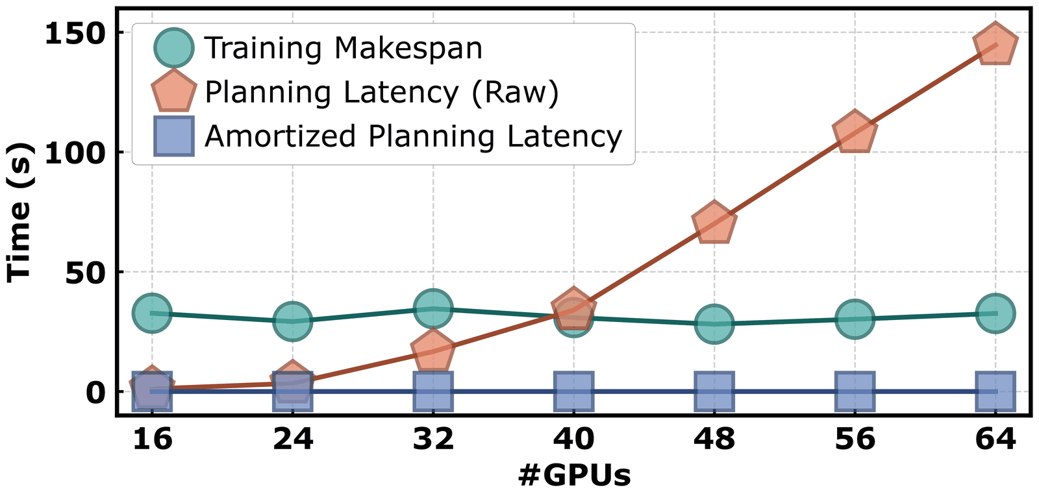
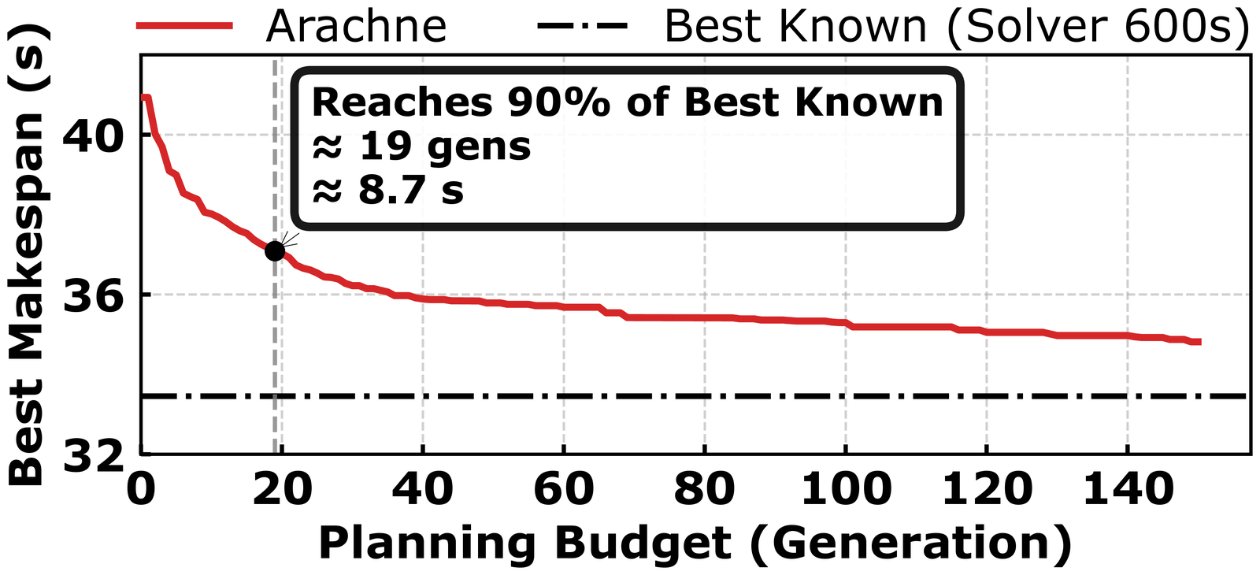
Evaluation: Planner Overhead
Look-ahead planning hides the cost
Anytime GA converges fast
Raw latency grows with #GPUs, but host CPUs plan ahead of training: amortized latency stays negligible
Within 10% of a 600-s MILP after ≈8.7 s (19 generations); under 5% gap vs. optimum on 8 GPUs
32
Notes:
A natural concern is planning cost. On the left: raw planning latency, in orange, grows with cluster size and at 64 GPUs it exceeds an iteration. But it never sits on the training critical path: planning runs on host CPUs and is pipelined ahead, so while GPUs run one iteration the CPUs plan later ones, and larger clusters bring more CPU cores for a deeper prefetch window. The amortized latency, in green, stays negligible. On the right, plan quality: on a 32-GPU, 16-cascade instance the genetic algorithm gets within 10 percent of the best result a 600-second MILP run finds after only 19 generations, about 8.7 seconds, and gains taper after about 50 generations. On 8 GPUs, where we can compute the true optimum, the gap stays under 5 percent, about 3 percent on average.

Slide 33
Summary
T2V characteristic | Why GPUs sit idle | Arachne
Long, clustered, discrete lengths | Large, predictable imbalance across buckets | Cascade DAG, makespan-minimizing planner
Compute-bound DiT | Re-sizing SP only moves the bottleneck | Launch time and degree per cascade
Static GPU binding | Idle GPUs cannot be re-tasked | Topology-aware placement per cascade
1.65×
faster than Megatron-LM (1.59× DeepSpeed, 1.35× FlexSP); GPU idle ratio at 1080p down from 47.0% to 8.1%
Code and T2V workloads: github.com/woshipapa/Arachne_artifact
33
Notes:
To summarize. T2V training differs from LLM training in three ways: sequence lengths are long, clustered and discrete; the DiT is compute-bound; and today's systems bind each sample to a fixed GPU group. Together these leave GPUs idle: the imbalance across buckets is large, re-sizing SP per bucket only moves the bottleneck, and idle GPUs cannot be re-tasked. Arachne answers each one: it plans a DAG of cascades to minimize the makespan, chooses launch time and degree per cascade, and places each cascade with topology awareness. The result is up to 1.65 times faster iterations than Megatron-LM and 1.35 times over FlexSP, with GPU idle time at 1080p down to about 8 percent. We release the code and workloads.

Slide 34
Thank You!
Questions?
Yuankai Fan · fanyk1@chinatelecom.cn
Corresponding authors: Yuankai Fan (fanyk1@chinatelecom.cn), Qizhen Weng (wengqzh@chinatelecom.cn)
First author: Peng Yu (pyu25@m.fudan.edu.cn)
Code and workloads: github.com/woshipapa/Arachne_artifact
Notes:
Thank you. I'm happy to take questions. Likely questions and short answers: Why not just use sequence packing? Packing 3D video tensors is complex and attention masking becomes inefficient. Does dynamic dispatch change convergence? No; the two-phase representative sync produces exactly the same gradient as static training. How much does planning cost? It runs asynchronously on host CPUs and is pipelined ahead of training, so its amortized latency is negligible. Does it work on heterogeneous GPUs? Our evaluation focuses on data heterogeneity, but Arachne extends naturally: each cascade gets device-specific compute and memory cost profiles for the planner, and the mapper uses the heterogeneous interconnect bandwidths for placement.

