Slide 1
Simple Review
Merge Sort
  MERGE(A,p,q,r)
Analysis of Merge Sort－Θ(nlgn), by
  Picture of Recursion Tree
  Telescoping
  Mathematical Induction
Asymptotic Growth
  O-notation
  Ω-notation
  Θ-notation
Software School of XiDian University

Slide 2
Θ-notation
Note:
--We often think of f(n) = O(g(n)) as corresponding to f(n)≤g(n).
--Similarly, f(n) = Θ(g(n)) corresponds to f(n) = g(n)
--Similarly, f(n) = Ω(g(n)) corresponds to f(n) ≥ g(n)
Software School of XiDian University

Slide 3
Asymptotic Notation in Equations
Used to replace functions of lower-order terms to simplify equations/expressions.
For example,
4n³ + 3n² + 2n + 1 = 4n³ + 3n² + Θ(n)
= 4n³ + Θ(n²) = Θ(n³)
Or we can do the following: 4n³ + 3n² + 2n + 1 = 4n³ + f(n²)
Where f(n²) simplifies the equation
Software School of XiDian University

Slide 4
Simple Review
Merge Sort
  MERGE(A,p,q,r)
Analysis of Merge Sort－Θ(nlgn), by
  Picture of Recursion Tree
  Telescoping
  Mathematical Induction
Asymptotic Growth
  O-notation
  Ω-notation
  Θ-notation
Software School of XiDian University

Slide 5
Design and Analysis of Algorithms
Recurrences(Ch4)
Software School of XiDian University

Slide 6
Design and Analysis of Algorithms
Recurrences
Topics:
Substitution method
Recursion-tree method
Master method
Software School of XiDian University

Slide 7
Solving recurrences
The analysis of Mergesort from Lecture 2 required us to solve a recurrence.
Recurrences are a major tool for analysis of algorithms
--Today: Learn a few methods.
>> Substitution method
>> Recursion - tree method
>> Master method
Divide and Conquer algorithms which are analyzable by recurrences.
Software School of XiDian University
Notes:
Substitution：代替, 取代作用, 代入法, 置换

Slide 8
Substitution method
The most general method:
-- Guess the form of the solution
-- Verify by induction
-- Solve for constants
Ex. T(n) = 4T(n/2) + 100n
-- Assume that T(1) = Θ(1)
-- Guess O(n³). (Prove O and Ω separately for Θ.)
-- Assume that T(k) ≤ck³ for k < n
-- Prove T(n) ≤cn³ by induction
Software School of XiDian University

Slide 9
Example of substitution
T(n) = 4T(n/2) + 100n
≤4c(n/2)³ + 100n
= (c/2)n³ + 100n
= cn³ – ((c/2)n³ – 100n)
≤cn³
desired-residual
desired
Whenever (c/2)n³ – 100n ≥ 0, for example, if c ≥ 200 and n ≥ 1
residual
Make a good guess
Software School of XiDian University
Notes:
Residual：剩余的, 残留的
其实这个T(n)是O(n^2)的
现证：T(n) <= cn^2 – 100n
假设对于所有k<n，T(k) <= ck^2 – 100k
则：
T(n) = 4T(n/2) + 100n
<= 4( c(n/2)^2 – 100(n/2) ) + 100n
= 4( cn^2/4 – 50n) + 100n
= cn^2 – 100n

Slide 10

Avoiding Pitfalls
Be careful not to misuse asymptotic notation. For example:
-- We can falsely prove T(n) = O(n) by guessing T(n) ≤cn for T(n) = 2T( ) + n
T(n) ≤ 2c + n
≤ cn + n
= O(n)
Wrong
-- The error is that we haven’t proved the exact form of the inductive hypothesis T(n) ≤ cn.
Software School of XiDian University
Notes:
Pitfall：缺陷
Hypothesis：假设

Slide 11

Changing Variables
Use algebraic manipulation to make an unknown recurrence similar to what you have seen before.
-- Consider T(n) = 2T( ) + lgn,
-- Rename m = lgn and we have
T(2^{m}) = 2T(2^{m/2}) + m.
-- Set S(m) = T(2^{m}) and we have
S(m) = 2S(m/2) + m → S(m) = O(mlgm)
-- Changing back from S(m) to T(n), we have
T(n) = T(2^{m}) = S(m) = O(mlgm) = O(lgnlglgn)
Software School of XiDian University
Notes:
Algebraic：代数的

Slide 12
Recursion - tree method
A recursion tree models the costs (time) of a recursive execution of an algorithm.
The recursion tree method is good for generating guesses for the substitution method.
the recursion-tree method can be unreliable, just like any method that uses ellipsis (…).
The recursion-tree method promotes intuition, however.
Software School of XiDian University

Slide 13

The Construction of a Recursion Tree
Solve T(n) = 3T(n/4) + Θ(n²), we have
Software School of XiDian University

Slide 14
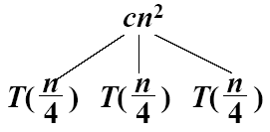
The Construction of a Recursion Tree
Solve T(n) = 3T(n/4) + Θ(n²), we have
Software School of XiDian University

Slide 15
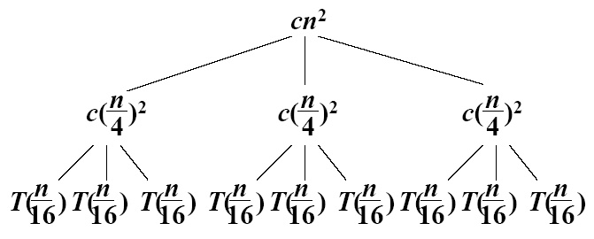
The Construction of a Recursion Tree
Solve T(n) = 3T(n/4) + Θ(n²), we have
Software School of XiDian University

Slide 16
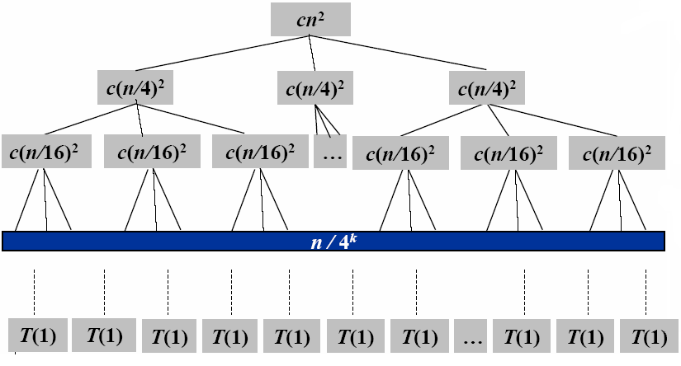
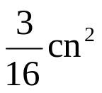
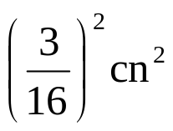


Construction of Recursion Tree
cn²
log₄n+1
Geometric series
Total: O(n²)
The fully expanded tree has lg₄n+1 levels, i.e., it has height lg₄n
Software School of XiDian University
Notes:
Geometric：几何的
Series：级数
Geometric Series：等比级数 q0+q1+q2+… = 1/(1-q)

Slide 17
Master Method
It provides a “cookbook” method for solving recurrences of the form:
T(n) = a T(n/b) + f(n)
Where a ≥ 1 and b > 1 are constants and f(n) is an asymptotically positive function.
Software School of XiDian University

Slide 18
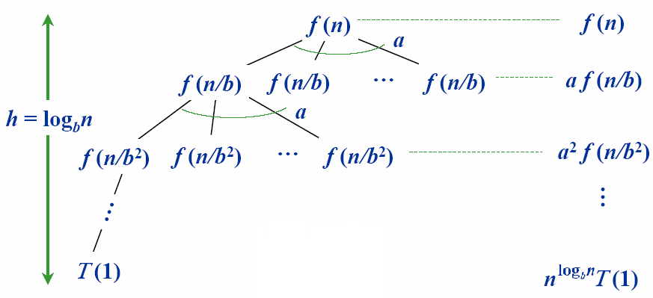
Idea of master theorem
Recursion tree
#leaves = a^{h}
= a^{logbn}
= n^{logba}
a
Software School of XiDian University

Slide 19
Three common cases
Compare f(n) with n^{logba} :
-- 1. f(n) = O(n^{logba-ε}) for some constantε> 0
>> f(n) grows polynomially slower than n^{logba} (by an n^{ε} factor),
-- Solution: T(n) = Θ(n^{logba})
Software School of XiDian University

Slide 20
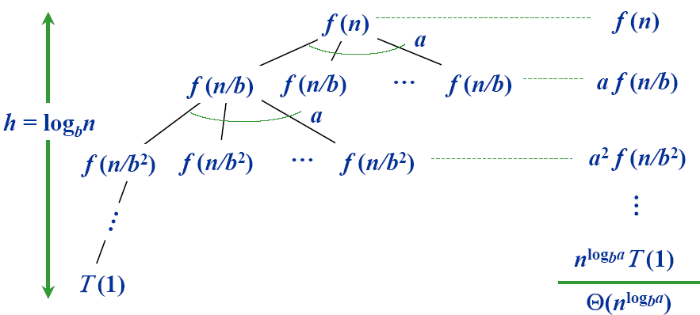
Idea of master theorem
Recursion tree
CASE 1: The weight increases geometrically from the root to the leaves. The leaves hold a constant fraction of the total weight.
Software School of XiDian University

Slide 21
Three common cases
Compare f(n) with n^{logba} :
-- 2. f(n) = Θ(n^{logba}lg^{k}n) for some constantk≥ 0
>> f(n) and n^{logba} grow at similar rates,
-- Solution: T(n) = Θ(n^{logba}lg^{k+1}n)
Software School of XiDian University

Slide 22
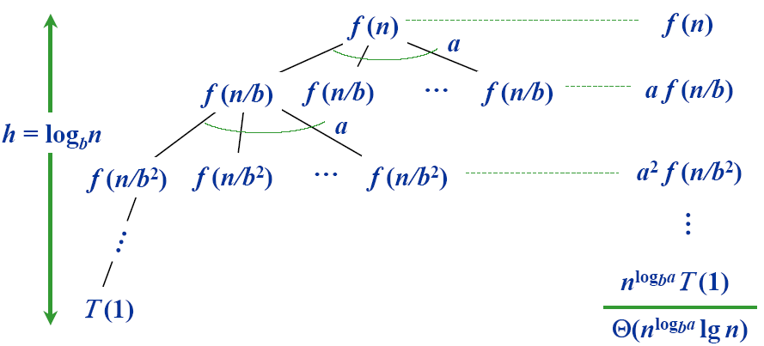
Idea of master theorem
Recursion tree
CASE 2: (k = 0) The weight is approximately the same on each of the log_{b}n levels.
Software School of XiDian University

Slide 23
Three common cases
Compare f(n) with n^{logba} :
-- 3. f(n) = Ω(n^{logba+ε}) for some constantε> 0
>> f(n) grows polynomially faster than n^{logba} (by an n^{ε} factor),
-- and f(n) satisfies the regularity condition that af(n/b) ≤cf(n) for some constant c < 1
-- Solution: T(n) = Θ(f(n))
Software School of XiDian University

Slide 24
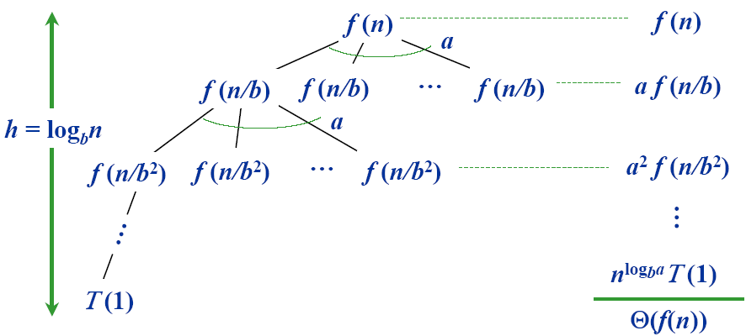
Idea of master theorem
Recursion tree
CASE 3: The weight decreases geometrically from the root to the leaves. The root holds a constant fraction of the total weight.
Software School of XiDian University

Slide 25
Three common cases
Compare f(n) with n^{logba} :
  1. f(n) = O(n^{logba -ε}) for some constantε> 0
    f(n) grows polynomially slower than n^{logba} (by an nε factor),
    Solution: T(n) = Θ(n^{logba})
  2. f(n) = Θ(n^{logba}lg^{k}n) for some constant k≥ 0
    f(n) and n^{logba} grow at similar rates,
    Solution: T(n) = Θ(n^{logba}lg^{k+1}n)
  3. f(n) = Ω((n^{logba+ε}) for some constantε> 0
    f(n) grows polynomially faster than n^{logba} (by an nε factor),
    and f(n) satisfies the regularity condition that af(n/b) ≤cf(n) for some constant c < 1
    Solution: T(n) = Θ(f(n))
Software School of XiDian University
Notes:
教材中有主定理的证明过程
Several researchers, including Akra and Bazzi [13], Roura [262], and Verma [306], have given methods for solving more general divide-and-conquer recurrences than are solved by the master method.
比如分解的多个子问题规模不相同的情况，给出了相应更为复杂形式的定理

Slide 26
Master theorem - examples
T(n)=9T(n/3)+n
  a=9, b=3, f(n) = n
    log_{b}a = 2, f(n) = O(n^{log}bª ^{–ε}) where ε=1, case 1
  T(n) = Θ(n^{log}bª) =Θ(n²)
T(n)=T(2n/3)+1
  a=1, b=3/2, f(n) = 1
    log_{b}a = 0, f(n) = Θ(n^{log}bªlg^{k}n) where k = 0, case 2
  T(n) = Θ(n^{log}bªlg^{k+1}n) =Θ(lgn)
T(n)=3T(n/4)+nlgn
  a=3, b=4, f(n) = nlgn
    log_{b}a = log₄3≈0.793, f(n) = Ω(n^{log}bª ^{–ε}) where ε≈ 0.2
    af(n/b) = 3f(n/4) = 3(n/4)lg(n/4)≤(3/4)nlgn = cf(n) where c = 3/4, case 3
  T(n) = Θ(f(n)) =Θ(nlgn)
Software School of XiDian University

Slide 27
Homework
4.1-1，4.1-6，4.2-1，4.3-2，4.3-3
Software School of XiDian University

