Slide 1
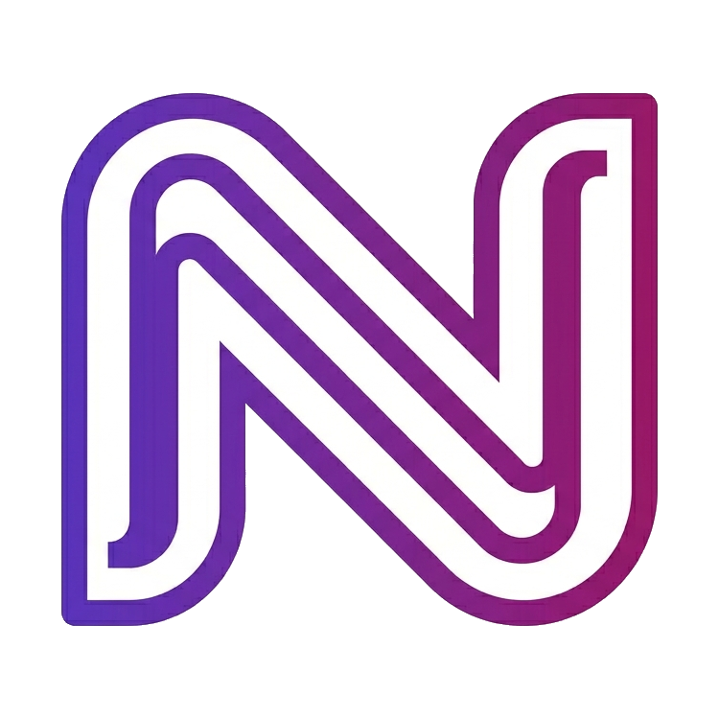
NEXA
The AI Workforce Operating System
Deploy autonomous AI employees that execute real work across your company — supervised by you, operated by them.
Investor overview · 2026

Slide 2
Manual operations break growing companies
⏳
👥
🧩
Hours lost
Hiring doesn’t scale
Tools don’t act
Teams spend thousands of hours a year on repetitive admin instead of judgement and growth.
Every new function means another headcount — slow, costly, hard to reverse.
Most software shows information. Almost none of it does the actual work.
“We don’t need more dashboards. We need the work done.”
NEXA
02

Slide 3
Meet NEXA
A digital labour platform: AI employees that read context, decide, and carry out real work inside the tools you already use.
1
2
3
Understand
Decide
Execute
Reads email, CRM, finance and chat to grasp the real situation.
Chooses the next best action against your goals and policies.
Carries it out in your live systems — and logs every step.
Supervised → autonomous. You dial up trust per employee.
NEXA
03

Slide 4
One platform. A whole digital team.
AI employees
Command Center
Marketplace
Named specialists for Operations, Sales, Finance, Support, Recruiting and Documents — each owns a function 24/7.
One cockpit: live activity, metrics, approvals and an audit trail of every action taken.
Install new AI employees like apps. One click hires them into your workforce.
Document engine
Approvals & audit
Integrations
Ava generates Excel, Word and PowerPoint automatically — real files, on demand and on schedule.
Human-in-the-loop approval queue plus a full, exportable audit log for trust and compliance.
Sits above your stack — Gmail, HubSpot, Calendar, Exact and more, with least-privilege access.
NEXA
04

Slide 5
The product already does real work
438
33h
98%
828%
actions / day
saved / day
avg performance
return on cost
Live figures from the NEXA Command Center — every action approved or autonomous, and fully audited.
NEXA
05

Slide 6
A large, fast-moving market
€400B+
€60B
€1.2B
TAM
SAM
SOM
Global spend on the back-office labour NEXA automates
SMB & mid-market ops, finance, sales & support software
Reachable EU mid-market in the first 5 years
Agentic AI is moving from copilots to coworkers — budget shifts from software seats to labour.
NEXA
06

Slide 7
Business model: priced like headcount
Starter
Growth
Scale
Enterprise
€499
€1,499
€4,999
Custom
/mo · 1 AI employee
/mo · 5 employees
/mo · 25 · free Mac
unlimited · private infra
Per-employee SaaS · expansion via more employees & seats · annual plans lift cash and retention.
NEXA
07

Slide 8
Why now — and why us
Why now
Our edge
Frontier models are finally reliable enough to act, not just suggest. Buyers want outcomes, not another tool. Budget is moving from seats to labour.
An execution engine with built-in trust: supervised→autonomous dial, human-in-the-loop approvals, and a full audit log — on a product surface customers already love.
NEXA
08

Slide 9
Roadmap
1
Now
2
Next
3
Later
Working product
Real connectors
Scale & network
Command Center, marketplace, document engine, approvals, audit and ROI — all live today.
Production Gmail, HubSpot & Calendar via OAuth; 2 pilot customers; usage-based add-ons.
Agent memory & learning, multi-agent hand-offs, community marketplace with revenue share.
NEXA
09

Slide 10
The ask
Raising a pre-seed round to turn a proven product into a fundable company.
Engineering
Go-to-market
Trust & security
Real connectors + reliability
2–3 lighthouse customers
SOC 2, audit, permissions
kkain25@gmail.com · nexa.ai
NEXA
10

