Slide 1

Department Of Computer Science

Slide 2
Software Design Document Project Title (Valid Title, reflecting scope and objectives)
Maha Farooqi
Fa20-bcs-029.
Kainat Mudassar
Fa20-bcs-027
Supervisor:
Tehseen Riaz Abbasi
Department Of Computer Science
Submission Date: 30-4-2022

Slide 3
Project Category
Our project is a web application

Slide 4
Introduction
The main purpose of this document is brief description about the “Save food stuff application” which is primarily developed for the distribution of extra food from restaurants to different shelter homes in order to help poor and needy people and to avoid food wastage. In last research, a drastic increase can be seen in wastage of food. As per data given by WHO, 20% of the population faces extreme food shortages. Therefore, it is important to come up with a solution that can avoid food waste and can help feed the needy.
Furthermore, such systems have been tremendously helpful in spreading awareness of the food waste issue but they also have some downsides. In addition, it has its useful features as well for example admin can track the history of the whole system, NGOS that are assisting poor communities in their fights against hunger and can use this app to request meals from restaurants. After approval of the request they deliver that food to shelter homes. In this way this save food stuff application will help the restaurant to reduce food waste and will help in feeding the needy and poor people.
Moreover, it also keeps the shelter homes, NGOs and people updated about the food availability from time to time. It also provides an opportunity to the food receiver to give reviews about the restaurants.

Slide 5
Tools and Technologies
Based on our proposed project type, here we have describe our tools and technologies which we will use in it.
Tools | Version | Relationale
MS Word | 2016 | Project Documentation
MS PowerPoint | 2015 | Project Presentation
Figma | 86.1.0 | Mockups Creation
Pencil | 3.0 | GUI Prototyping
Visual Studio | 1.63 | I.D.E
Adobe Photoshop | CSC 6 | Design Work
Mongo DB | 4.0.5 | Non-Relational Database
Technology | Version | Relationale
SQL | 2013 | Query Language
Java | 8.0 | Programming Language
CSS | 3 | Designing Language
HTML | 5 | Web Development

Slide 6
Scope
After downloading the application new user have to register using their usernames and login details along with the document attachment for verification by the admin. [1]
After successful registration user will see multiple options which includes “Find Food” to search for the restaurant which offer food , “Setting” Option have its own multiple sub options to help the user and “Reviews” area help to get the reviews from the user.
If someone want to donate something he/she can easily donate by using “Donate” option on the front login screen.

Slide 7
Modules
Module 1: Login and registration
Module 2: Admin
Module 3: Donation
Module 4: Settings
Module 5: Find Food
Module 6: Reviews
Module 7: Delivery
Module 8: Restaurant module

Slide 8
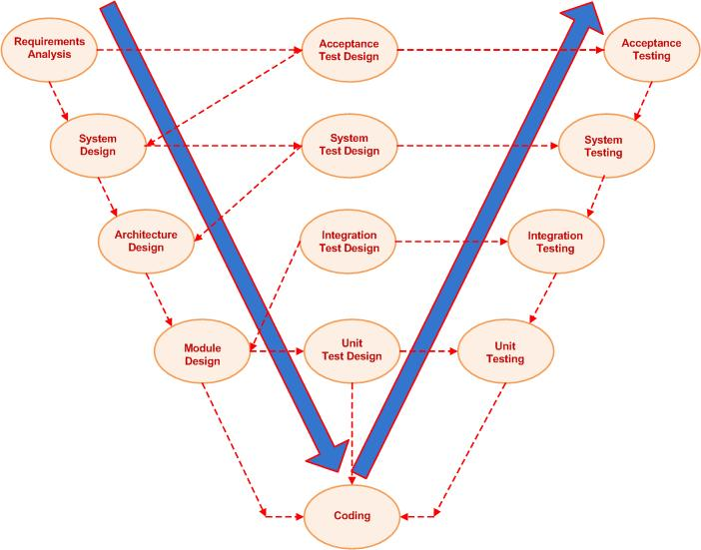
Software Process Methodology
Different process models have been identified for designing software which includes Waterfall/Modified Waterfall model, V-Shaped model, Evolutionary process model as well. But here V-shaped Process Model will be adopted in our project because the testing and production of features will be going side by side.

Slide 9
Software Design Methodology
Object Oriented approach will be used as the Design Methodology. Changes can be easily done in the Object Oriented, However, there are some basic concepts which are useful to this methodology which includes Inheritance, Polymorphism, Composition, Aggregation and reusability of code. These are helpful during implementation of designed software.

Slide 10
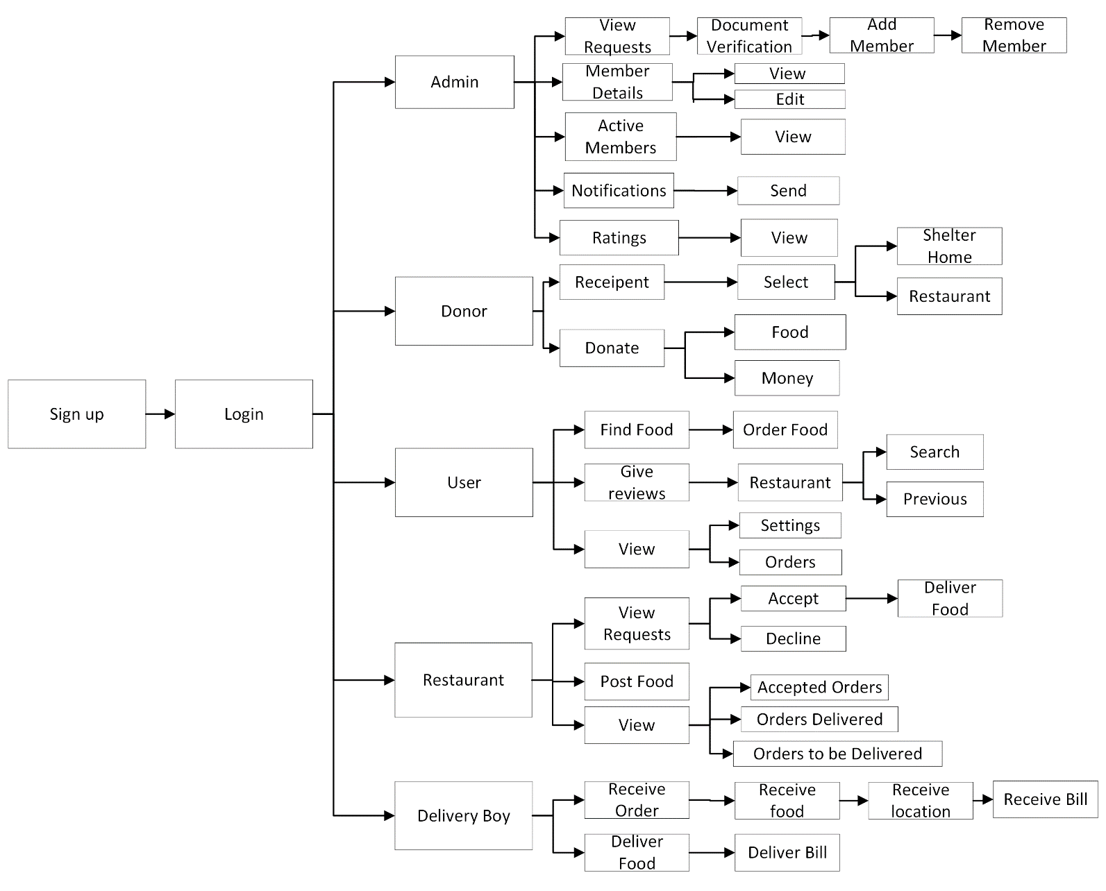
Process Flow Diagram of Proposed Project
Figure-1: Process Flow Diagram of our Syste.

Slide 11
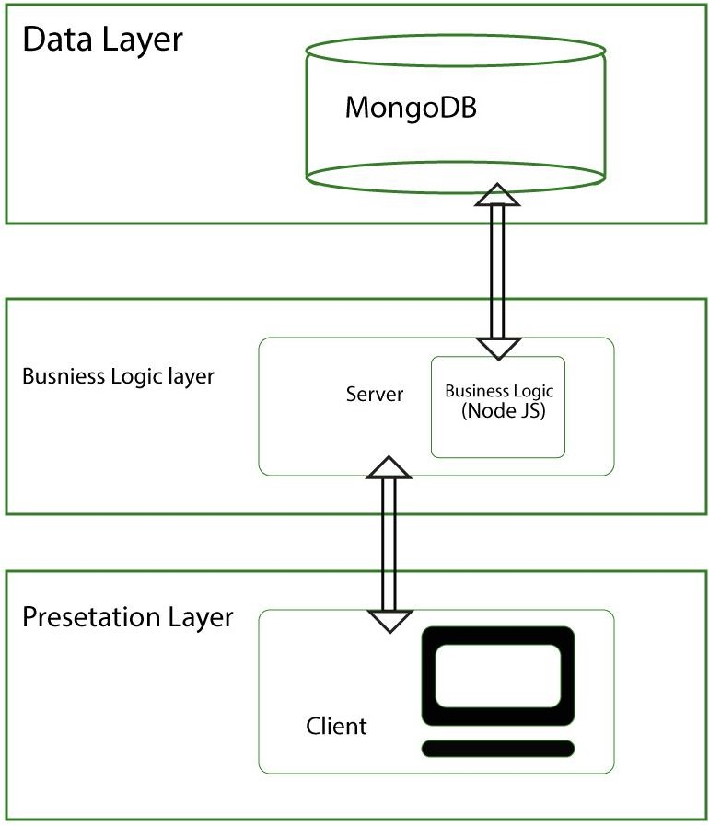
Architecture Diagram of Proposed Project
SQL
Business Logic (Java)
Figure-2: 3 tier Architecture Diagram

Slide 12
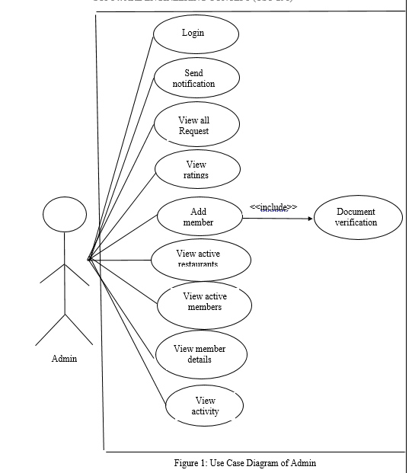
Use Case Diagram

Slide 13
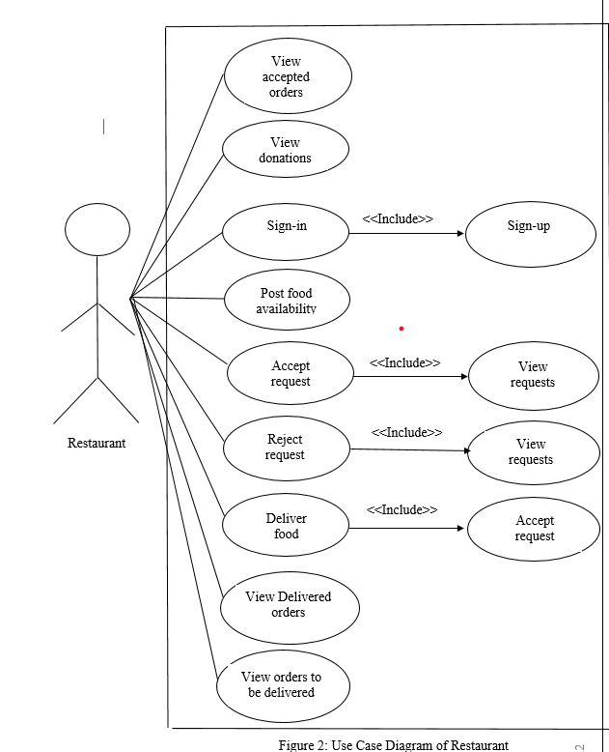
Use Case Diagram

Slide 14
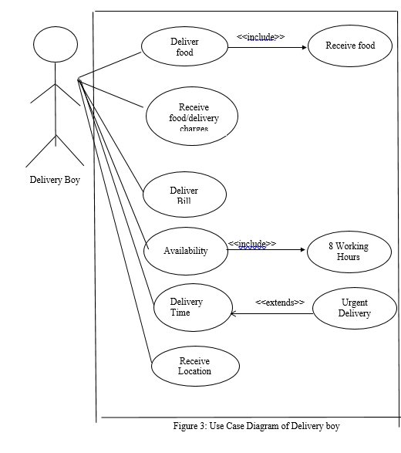
Use Case Diagram

Slide 15
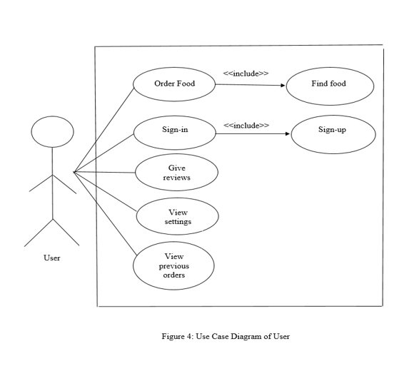
Use Case Diagram

Slide 16
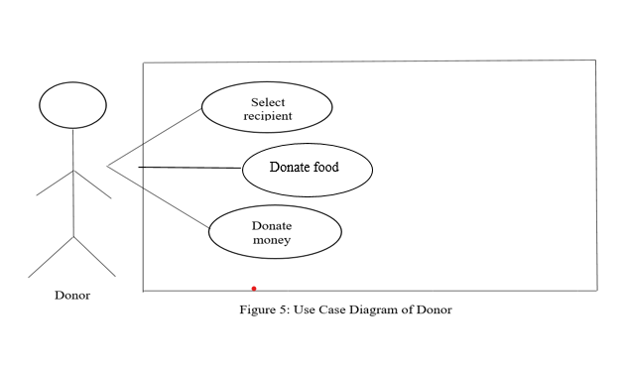
Use Case Diagram

Slide 17
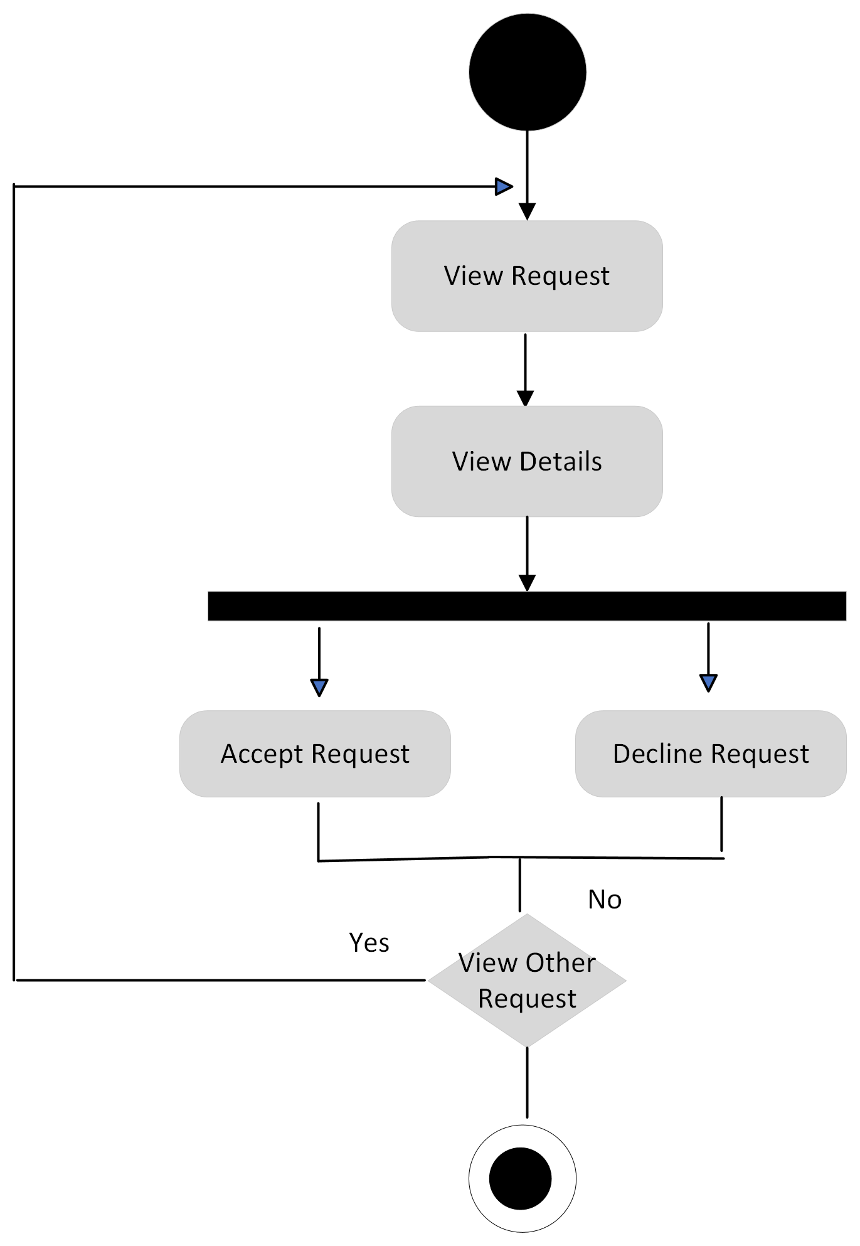
Activity Diagrams
Figure: Activity diagram of “Add Member”

Slide 18
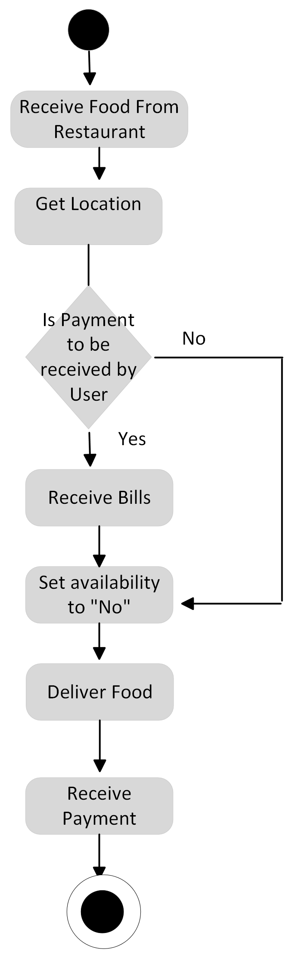
Activity Diagrams
Figure: Activity diagram of “Delivery Boy”

Slide 19
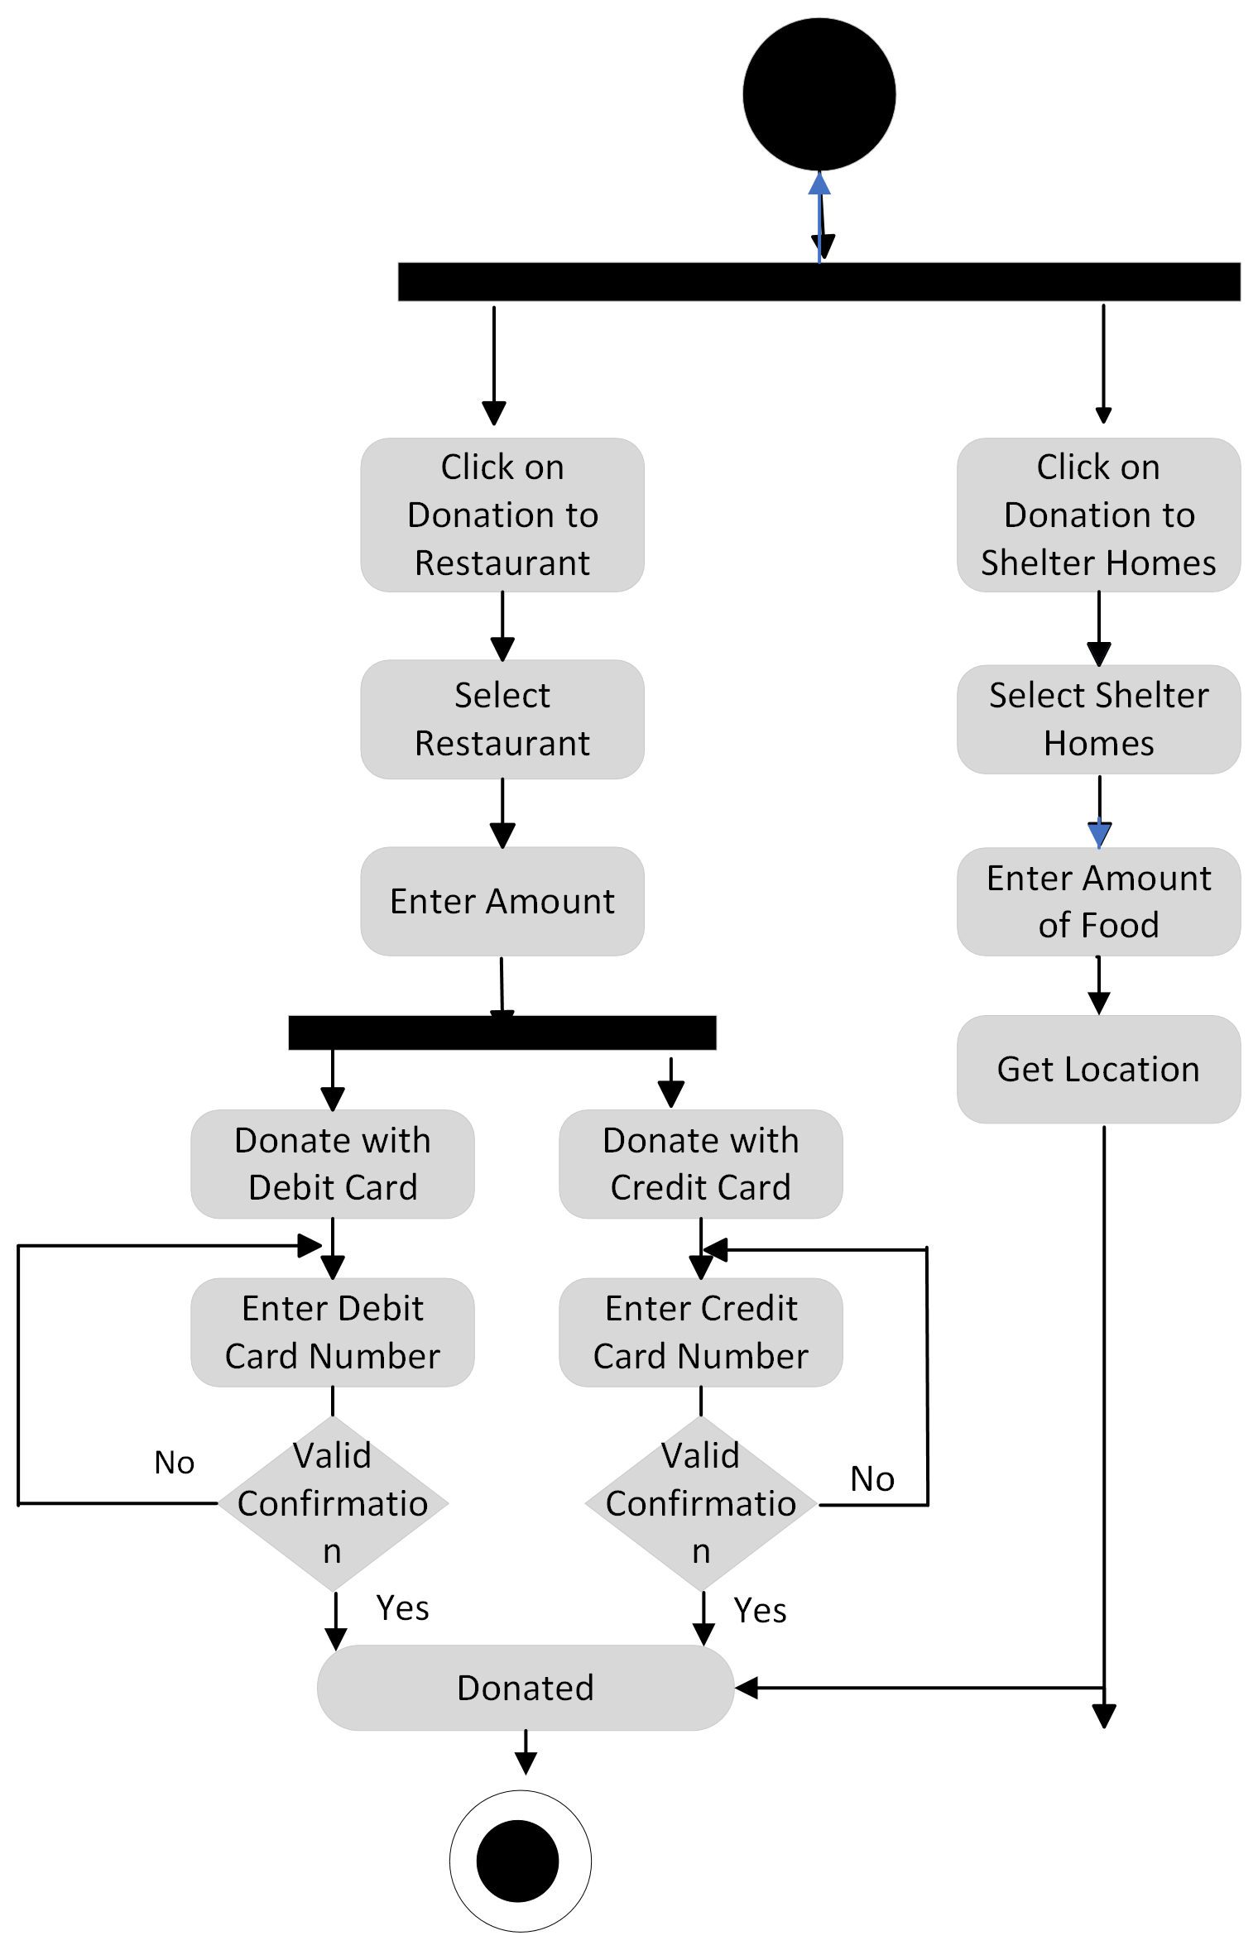
Activity Diagrams
Figure: Activity diagram of “Donation”

Slide 20
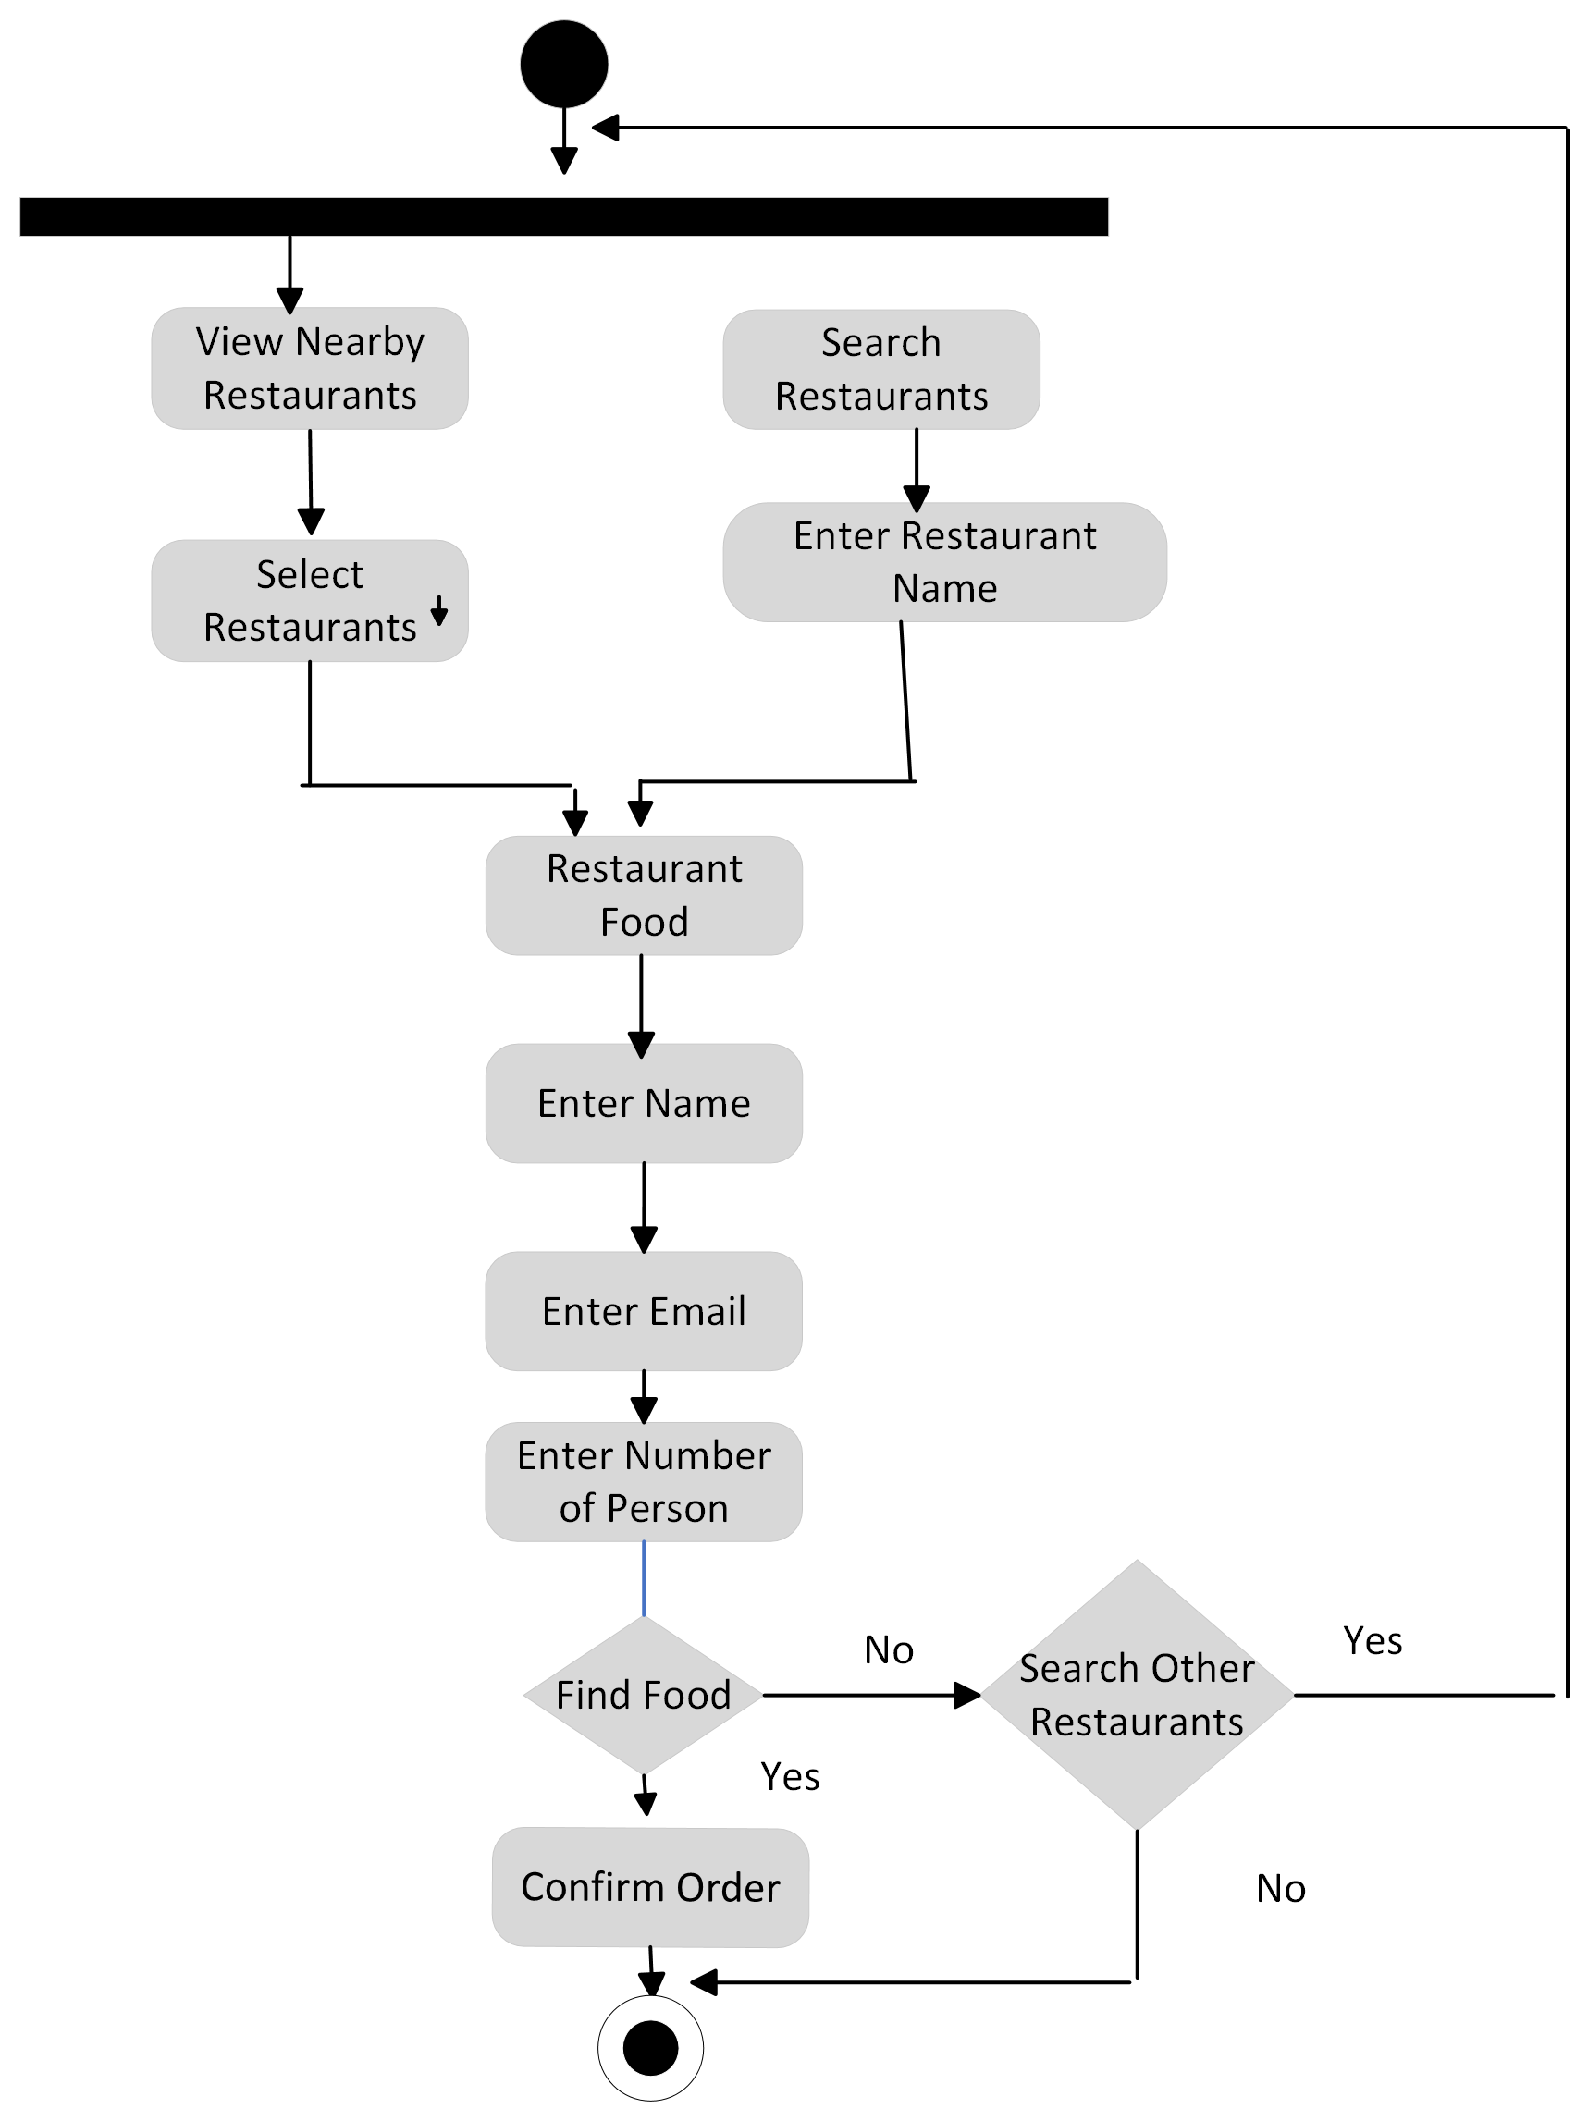
Activity Diagrams
Figure: Activity diagram of “Find Food”

Slide 21
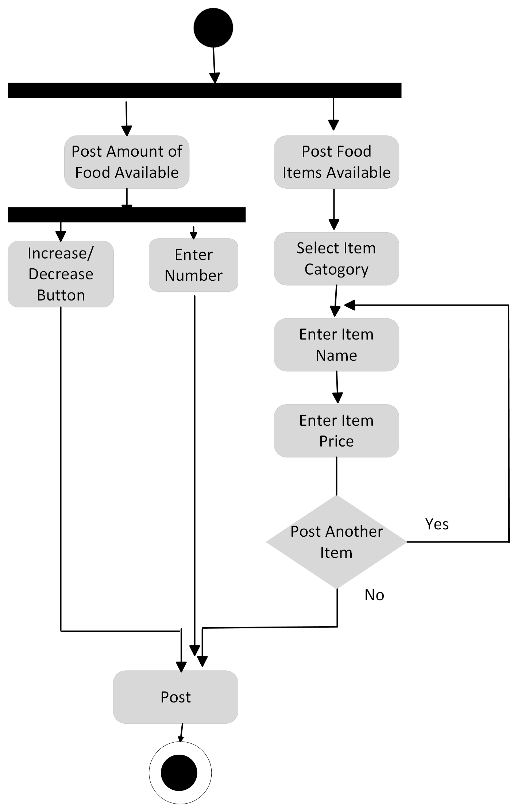
Activity Diagrams
Figure: Activity diagram of “Post Food”

Slide 22
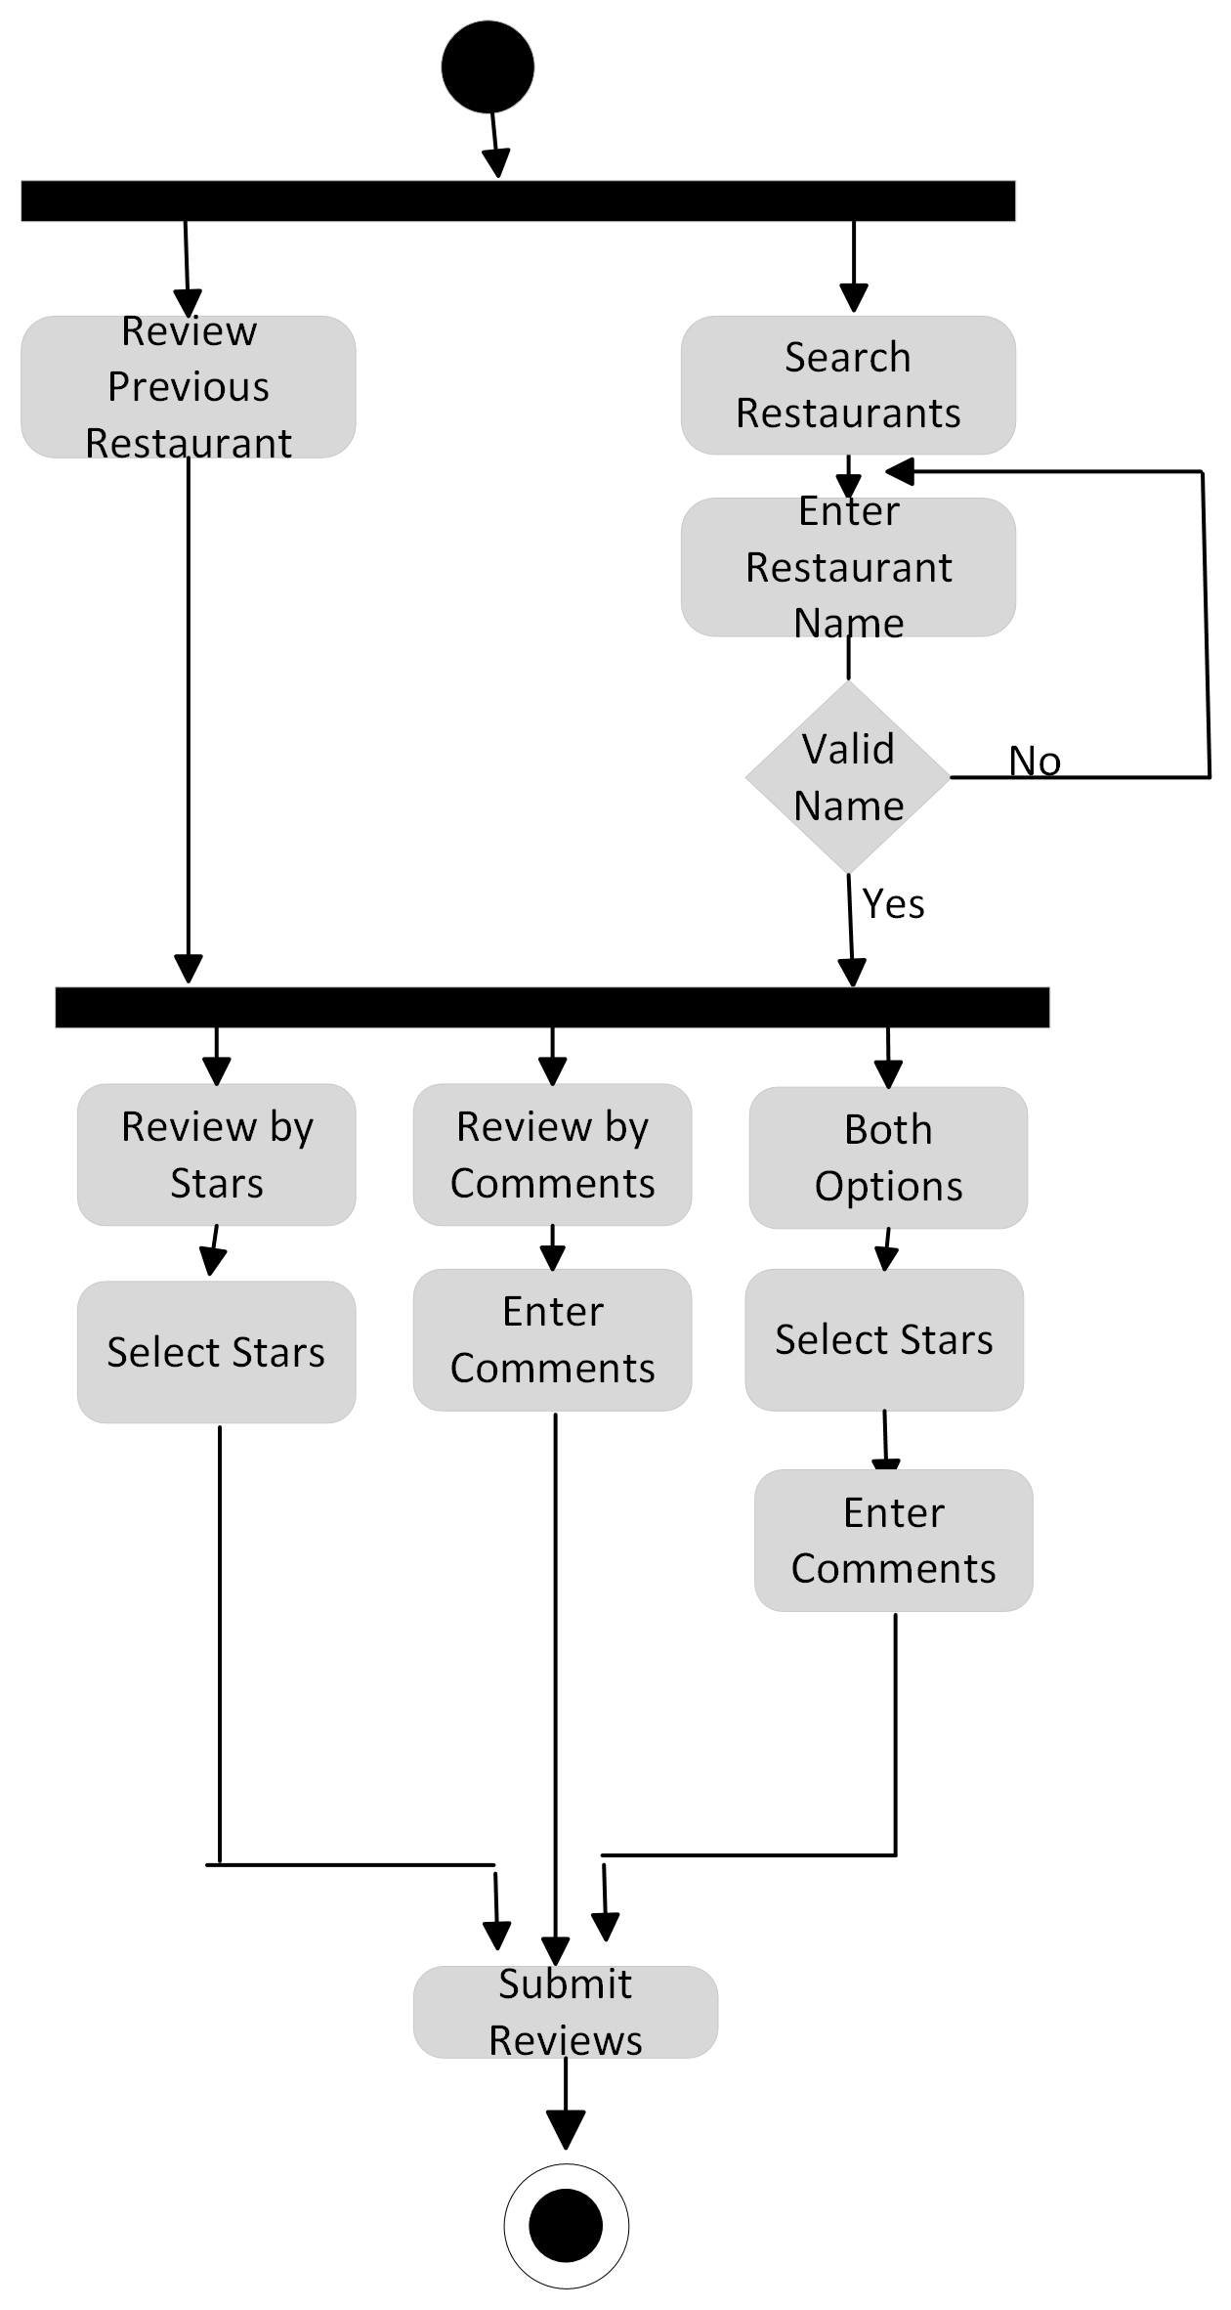
Activity Diagrams
Figure: Activity diagram of “Review”

Slide 23
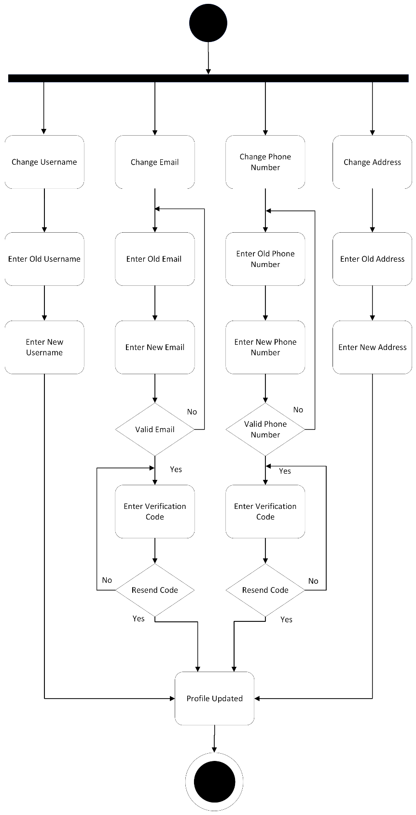
Activity Diagrams
Figure: Activity diagram of “Profile Management”

Slide 24
Data Representation [User Schema ]
const monggose= require( 'mongoose' )
const UserSchema= monggose.Schema({
"Id":
{ description: "this is a unique id of a record",
type: "Number"
required: "true"
},
"Username"
{
"description": "A user's Username",
"type": "string",
required: "true"
},
"email"
{
"description": "user's email",
"type": "email",
required: "true"
},
"password"
{
"description": "User’s password",
"type": "password",
required: "true"
},
"Location"
{
"description": “user's location",
"type": "string",
required: "true"
}
“Mobile No”
{
"description": “user's mobile no",
"type": "string"
required: "true"
}
})
module. Exports= monggose.model ( "User " , UserSchema)

Slide 25
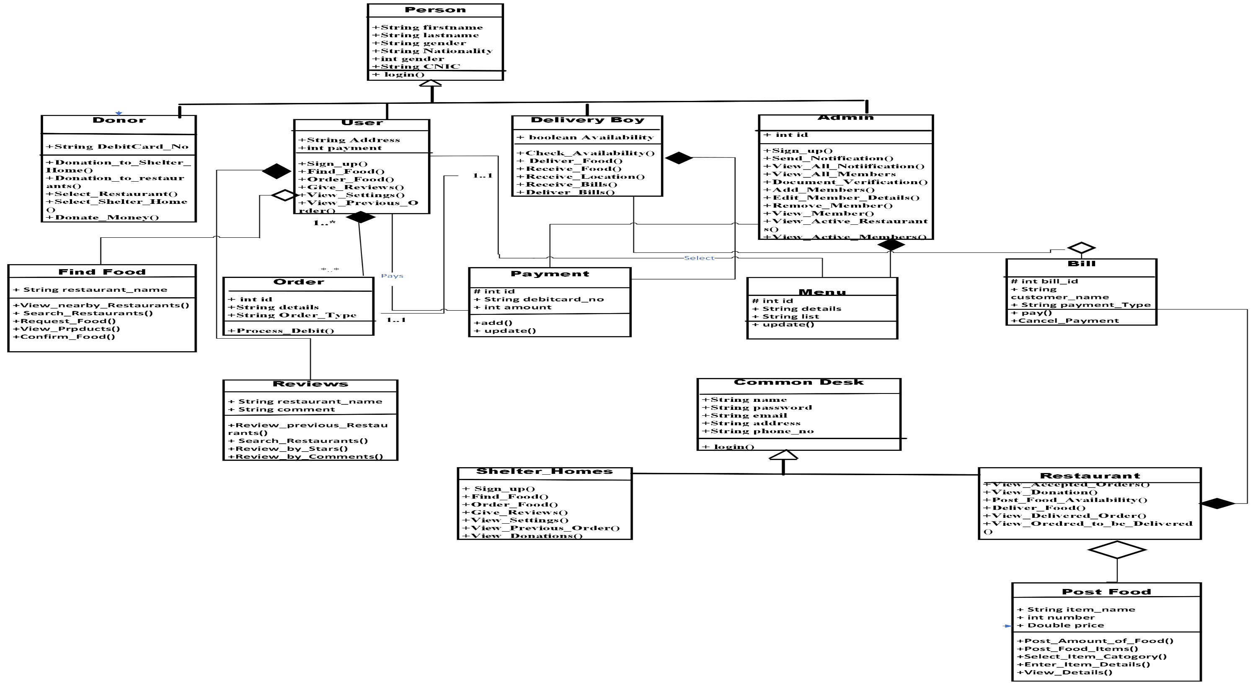
Class Diagram or Data Flow Diagrams
Figure: Class Diagram of “Save Food Stuff”

Slide 26
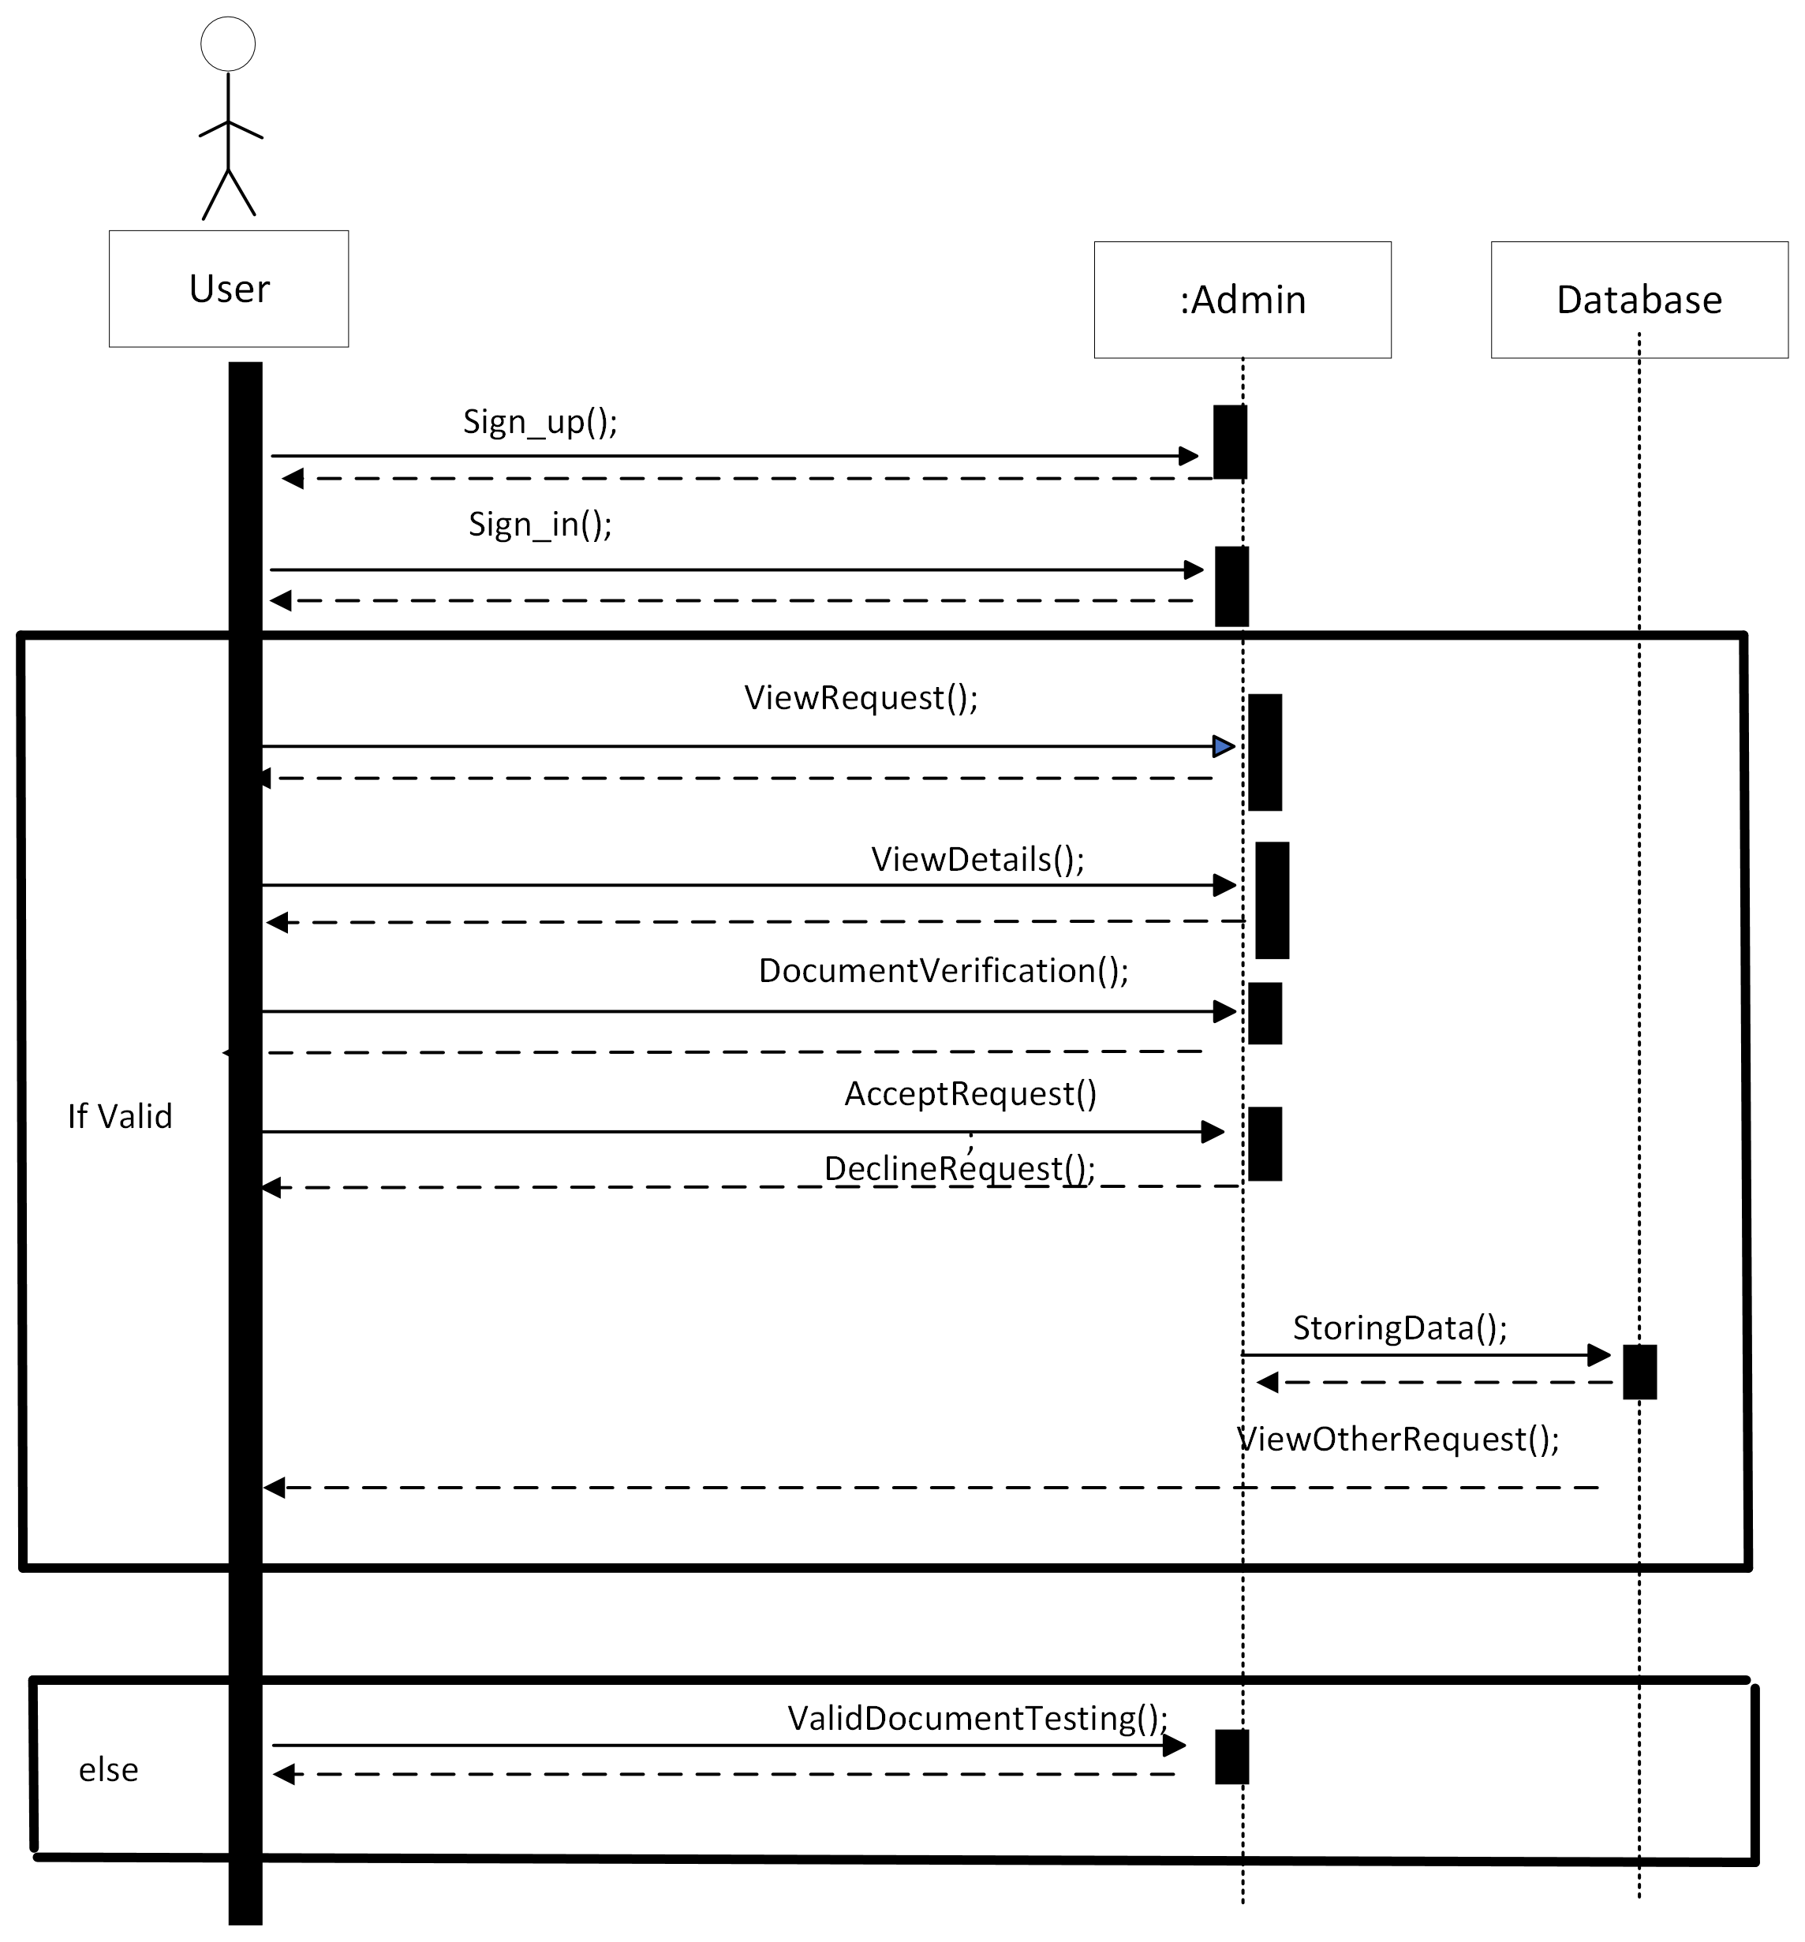
Sequence Diagram
Figure: Add Member Sequence Diagram

Slide 27
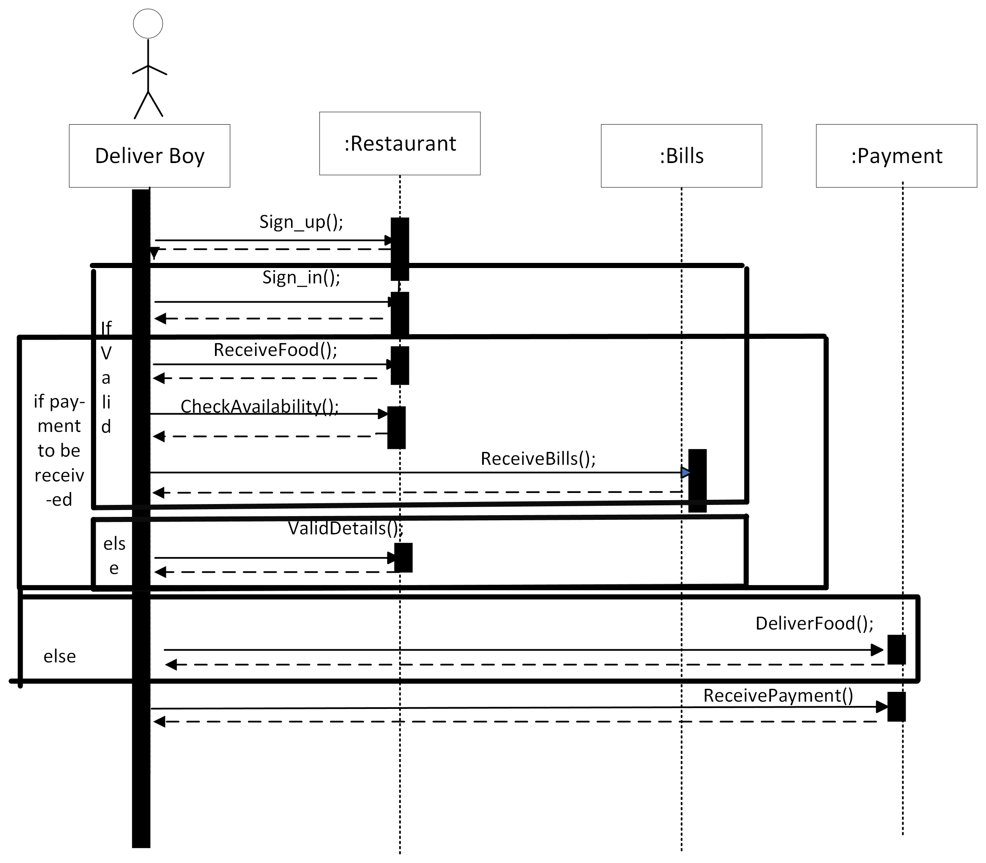
Sequence Diagram
Figure: Sequence Diagram of “Donation”

Slide 28
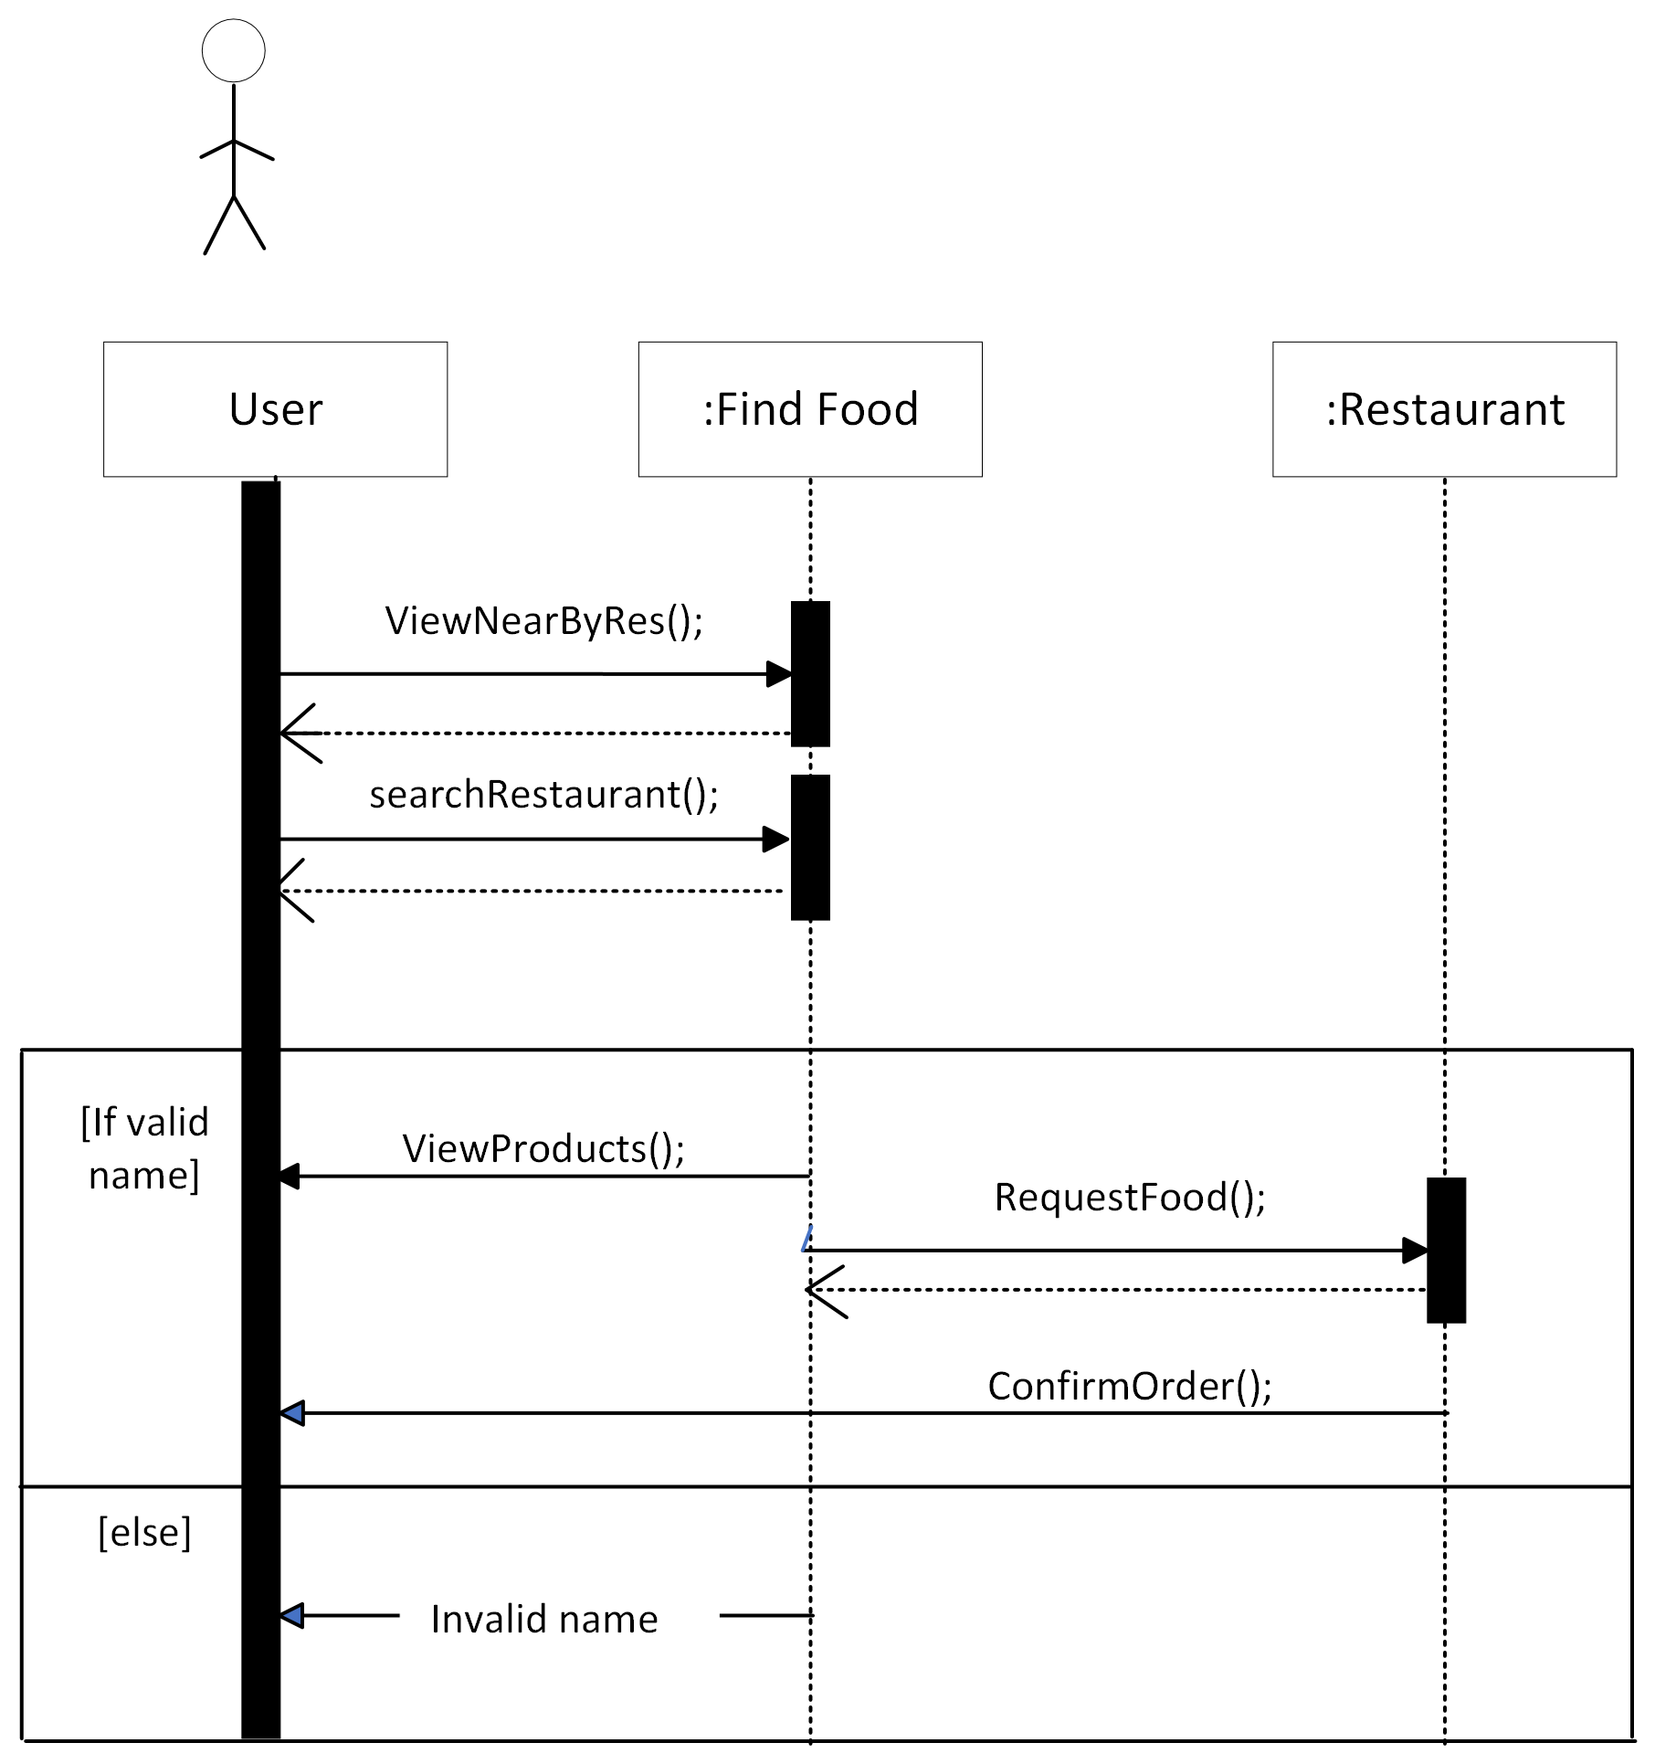
Sequence Diagram
Figure: Sequence Diagram of “Find Food”

Slide 29
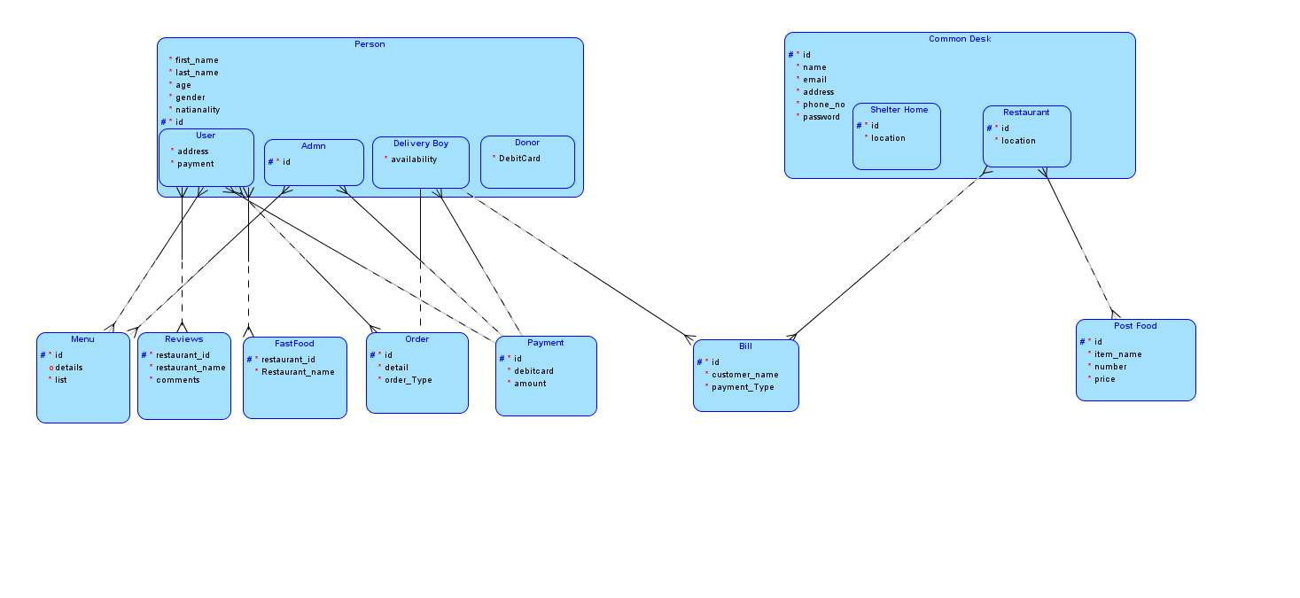
Entity Relationship Diagram

Slide 30
Algorithm User schema:
const monggose= require( 'mongoose' )
const UserSchema= monggose.Schema({
"Id":
{ description: "this is a unique id of a record",
type: "Number"
required: "true"
},
"Username"
{
"description": "A user's Username",
"type": "string",
required: "true"
},
"email"
{
"description": "user's email",
"type": "email",
required: "true"
},
"password"
{
"description": "User’s password",
"type": "password",
required: "true"
},
"Location"
{
"description": “user's location",
"type": "string",
required: "true"
}
“Mobile No”
{
"description": “user's mobile no",
"type": "string"
required: "true"
}
})
module. Exports= monggose.model ( "User " , UserSchema)

Slide 31
Algorithm Restaurant Schema:
const monggose= require( 'mongoose' )
const restaurantSchema= monggose.Schema({
"Id":
{ description: "this is a unique id of a record",
type: "Number"
required: "true"
},
"name"
{
"description": "A restaurant name",
"type": "string",
required: "true"
},
"email"
{
"description": "restaurant’s email",
"type": "email",
required: "true"
},
"password"
{
"description": "restaurant’s password",
"type": "password",
required: "true"
},
"address"
{
"description": “restaurant’s address ",
"type": "string",
required: "true"
}
“phoneNo”
{
"description": “restaurant's mobile no",
"type": "string"
required: "true"
}
})
module. Exports= monggose.model ( "Restaurant " , restaurantSche

Slide 32
Algorithm Reviews Schema:
const monggose= require( 'mongoose' )
const reviewsSchema= monggose.Schema({
"restaurantId":
{ description: "this is a unique id of restaurant to whom reviews are given",
type: "Number"
required: "true"
},
"restaurantName"
{
"description": "A restaurant name",
"type": "string",
required: "true"
},
"comments"
{
"description": "comment reviews given to restaurant",
"type": "string",
required: "true"
}

Slide 33
Algorithm Payment Schema:
const monggose= require( 'mongoose' )
const paymentSchema= monggose.Schema({
"Id":
{ description: "this is a unique id of a record",
type: "Number"
required: "true"
},
"debitCard"
{
"description": "debit card number through which payment is done",
"type": "string",
required: "true"
},
"amount"
{
"description": "the amount that is to be paid",
"type": "double",
required: "true"
}
})
module. Exports= monggose.model ( "Payment " , paymentSchema)

Slide 34
Implementation
Sign-in algorithm pseudo code:
Allows user to sign in to the system for further actions
Enter username
Enter password
Check if username correct
Check if password correct
Display message “Signed in successfully”

Slide 35
Implementation
2. Donation Algorithm pseudo code:
Allows user to donate to restaurants or shelter home
Donation to Restaurant
Select restaurant
Enter amount
Donate with credit card or debit card
Enter card number
Donation to shelter home
Select shelter home
Enter amount of food
Get location

Slide 36
Implementation
3. Reviews Algorithm pseudo code:
Allows user to give reviews to restaurants
Review previous restaurant
Search restaurant
Enter restaurant name
Select stars to give review
Enter comment to give review
Submit review

Slide 37
Implementation
4. Find Food Algorithm pseudo code:
Allows user to find and order food
View nearby restaurant
Select restaurant
Search restaurant
Enter restaurant name
Request food
Enter name
Enter email
Enter no. of persons
If food available
Order for free
Pay 10%
Pay 15%
Pay with debit card or COD
Enter card number
Confirm order

Slide 38
Implementation
5. Admin Algorithm pseudo code:
Allows admin to add new members.
Required Sign in
View all incoming requests
View the details of each request
Testing the documents for verification.
Monthly Expenses Records
Income Certificate
Accept user request if it is needy.
Decline request in case of wrong documents.
Store all the data in database using Sql/Mongo DB language.
Confirmation message send to user.

Slide 39
Implementation
6. User Algorithm pseudo code:
Allow User to Order food from restaurants.
Required User Sign in.
To order food user press Find Food button.
All available nearby restaurants will display.
User can also search it by name.
Payment can be paid by hand or by debit card according to user choice.
Go to setting to modify any profile data.
Press pre Order Buttons to view previous orders.
On receiving ordered food bill will paid to delivery boy.

Slide 40
Implementation
7. Delivery Algorithm pseudo code:
Allow Delivery boy to deliver food from restaurants.
On placing the order food request is reached delivery boy .
On requesting the check delivery boy’s availability first.
If delivery boy is available he accepts the offer.
Food will be delivered on required location.
Bill will be received after food is received by the user.
Delivery charges will paid according to user’s choice.
No charges.
10% charges of total payment.
15% charges of total payment.

Slide 41
Implementation
8. Restaurant Algorithm pseudo code:
Allow restaurants to transfer food to needy people.
On this site restaurants add specific amount of food per person.
By visiting restaurants user can easily viewed their profile.
It will serve Food on FIFO operation.
User have to register him first.
Go to find food Button.
List of restaurants appeared that offering food.
Ordered food will be delivered on required location in minimum time

Slide 42
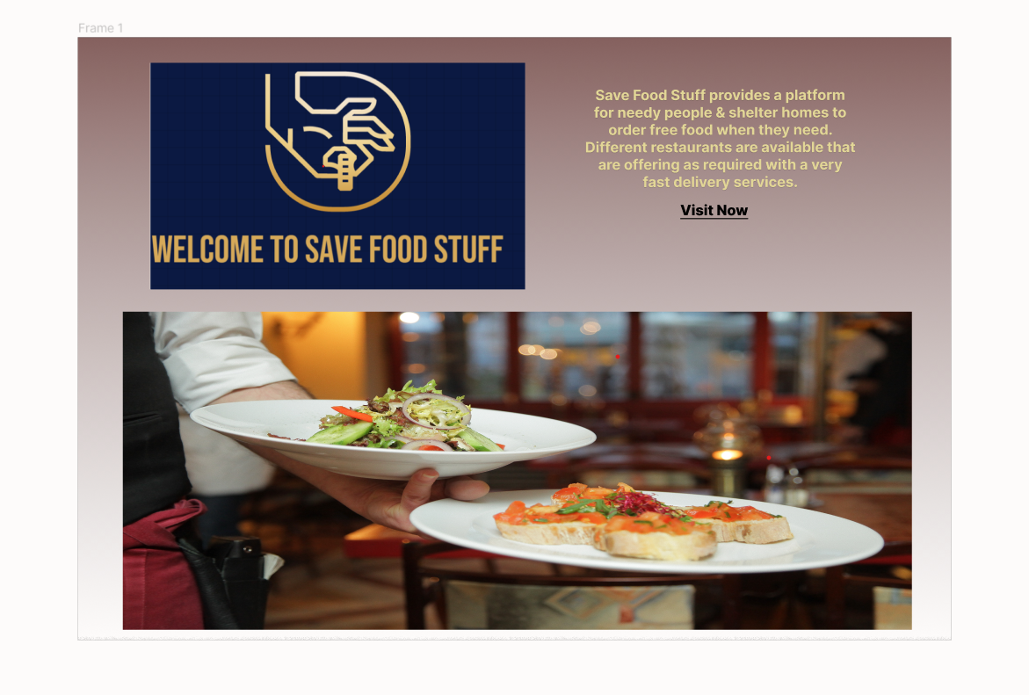
User Interfaces
Interface-1: Front Screen Of application

Slide 43
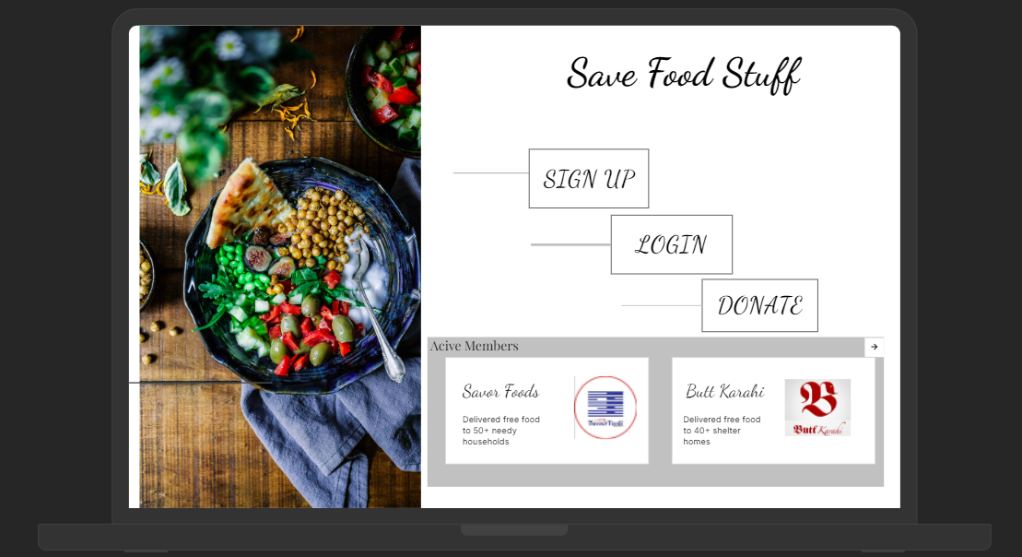
User Interfaces
Interface-2: Main Screen Of application

Slide 44
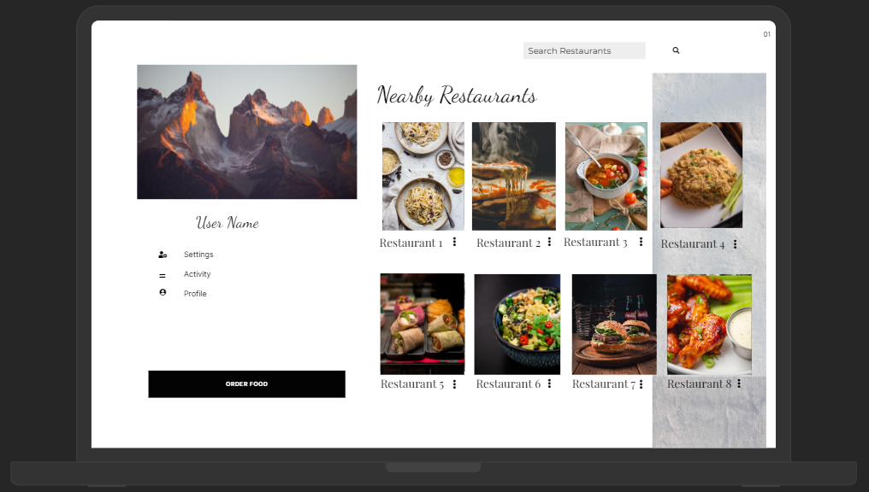
User Interfaces
Interface-3: Find Food

Slide 45
Conclusion
This document specifies the design, architecture and user interface of our project.

Slide 46
References
https://app.uizard.io/prototypes/rgLp11mKjnuVKgg9zBj5
https://pern-my.sharepoint.com/:u:/r/personal/fa20-bcs-029_isbstudent_comsats_edu_pk/_layouts/15/Doc.aspx?sourcedoc=%7B02241a2e-caa7-41b4-a398-39e8c9f346f1%7D&action=edit&or=PrevEdit&cid=c241ae5f-c708-4f2a-9154-c206132fea4e

Slide 47

Questions and Answers

Slide 48
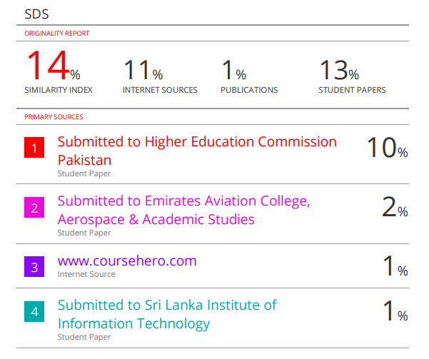
Plaragism Report

