Slide 1

Department Of Computer Science

Slide 2
Software Requirement Specification Project Title (Valid Title, reflecting scope and objectives)
Kainat Mudassar
FA20-BCS-027
Maha Farooqi
FA20-BCS-029
Supervisor:
Tahseen Riaz Abbasi
Department Of Computer Science
Submission Date: 2 April 2022

Slide 3
Project Category
Our system is a web application

Slide 4
Research Based Project
Based on our proposed project type, reading research papers is not a major component of our project.
We have gone through different websites and their working so that is how we got basic ideas which led us to development of our application.

Slide 5
Introduction
This project is primarily developed for the distribution of extra food from restaurants to different shelter homes in order to help poor and needy people and to avoid food wastage.
In last research, a drastic increase can be seen in wastage of food. As per data given by WHO, 20% of the population faces extreme food shortages.
Our project contributes in solving this problem.

Slide 6
Tools and Technologies
Based on our proposed project type, here we have describe our tools and technologies which we will use in it.
Tools And Technologies | Tools | Version | Rationale
 | MS Visual Studio | 2015 | IDE
 | MS SQL Server | 2015 | DBMS
 | Adobe Photoshop | CSC 6 | Design Work
 | MS Word | 2015 | Documentation
 | MS Power Point | 2015 | Presentation
 | Pencil | 2.0.5 | Mockups Creation
 | Technology | Version | Rationale
 | C# | 6.0 | Programming language
 | SQL | 2013 | Query Language
 | Html | 5 | Web Development

Slide 7
Scope
After downloading the application new user have to register using their usernames and login details along with the document attachment for verification by the admin. [1]
After successful registration user will see multiple options which includes “Find Food” to search for the restaurant which offer food , “Setting” Option have its own multiple sub options to help the user and “Reviews” area help to get the reviews from the user.
If someone want to donate something he/she can easily donate by using “Donate” option on the front login screen.

Slide 8
Modules
Module 1: Login and registration
Module 2: Donation
Module 3: Settings
Module 4: Find food
Module 5: Delivery
Module 6: Admin
Module 7: Reviews
Module 8: Restaurant module

Slide 9
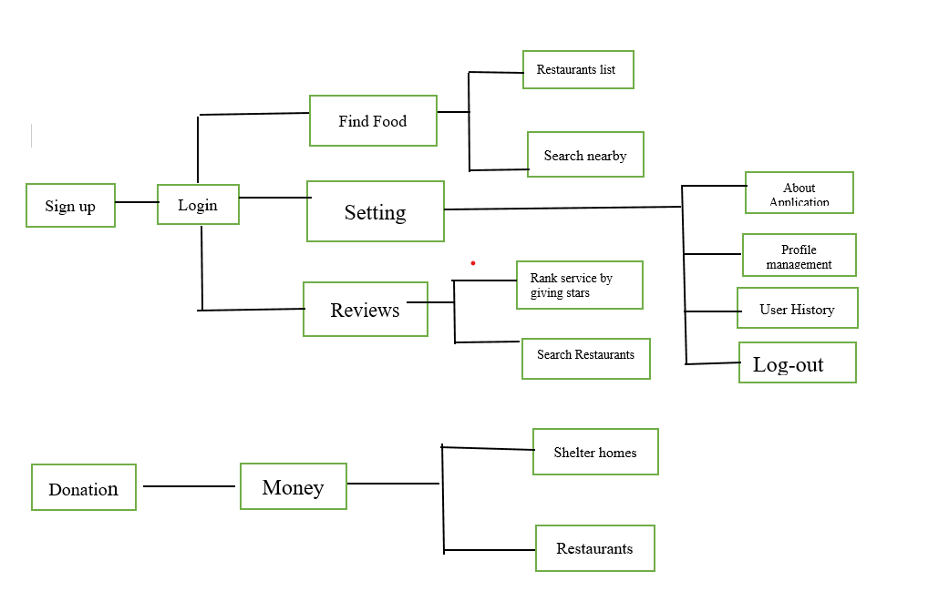
Block Diagram of Proposed Project
Block Diagram –Save Food Stuff System.

Slide 10
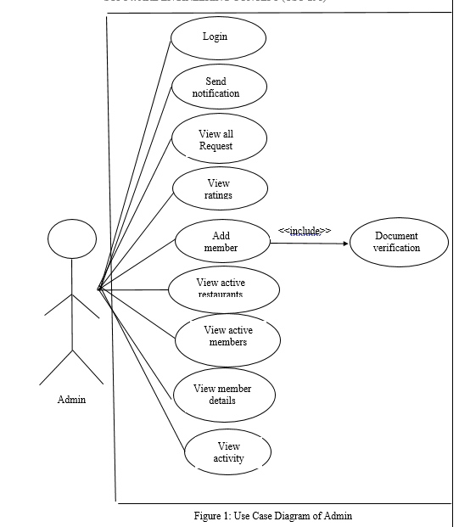
Use Case Diagram

Slide 11
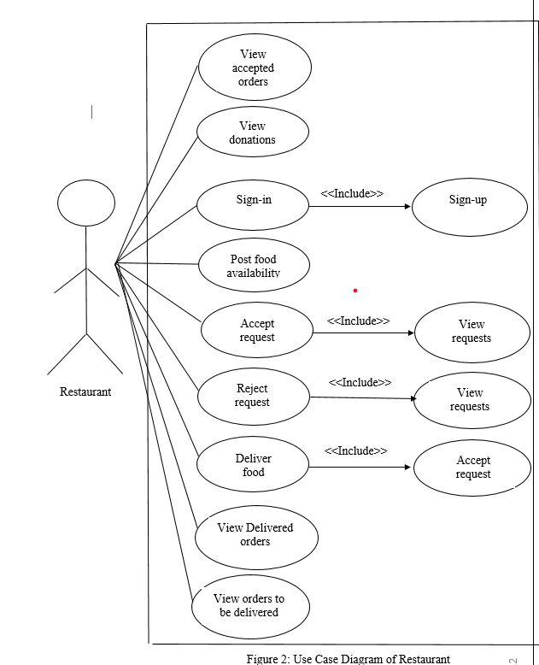
Use Case Diagram

Slide 12
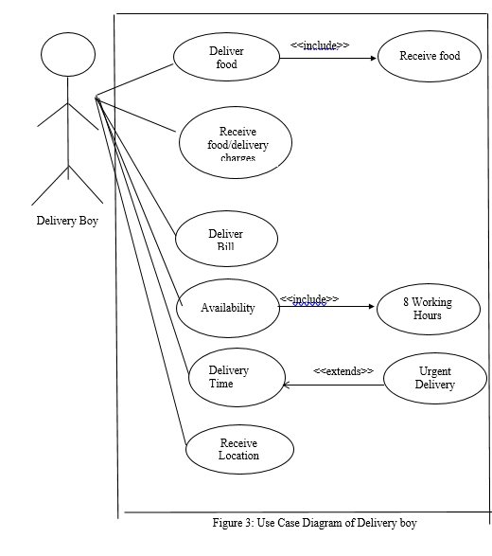
Use Case Diagram

Slide 13
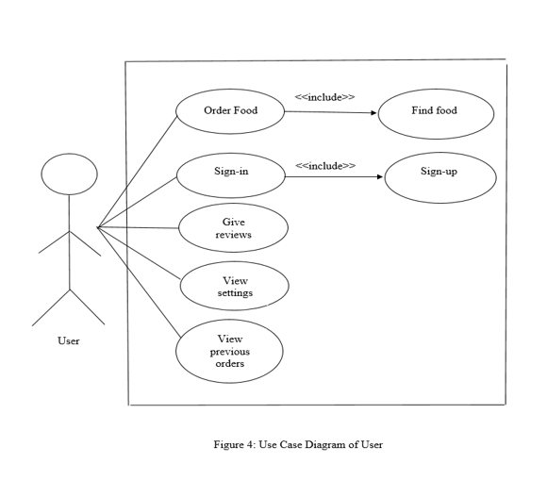
Use Case Diagram

Slide 14
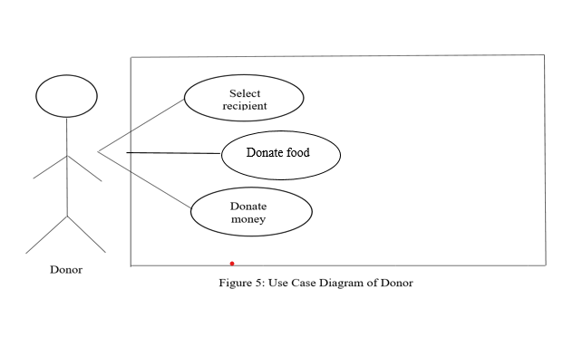
Use Case Diagram

Slide 15
Non-Functional Requirement
Non Functional Requirements are:
Title |  | Performance Requirements
NFR-1 |  | Loading time page of any website should not exceed from 5 seconds on DSL broadband connection. No of user using the system and internet speed are the main factors that involves in it’s working. The application should be able to support 100 concurrent users without any performance degradation. The website should have a refresh timer of almost 10 seconds.
Title |  | Reliability
NFR-2 |  | The system will be available on all time as availability is 24/7. So a user can access the website anytime. In the event that a server does down, the server will kick in inside an opportunity that the application doesn’t quit running. In case of a future that lead to a system outrage, the MTTR (Mean Time to Repair) should not be more than 2 hours.
Title |  | Usability
NFR-3 |  | 96% or the users will complete their task without any assistance. Interface of our designed system should be user friendly. If a new user is registering an account than it should not take more than 10 seconds to complete his/her request. User will have a self-explanatory interface to perform required task.
Title |  | Supportability
NFR-4 |  | The web application should support Google Chrome, Internet explorer, Opera and Mozilla Firefox web browsers. The framework should be cost effective.

Slide 16
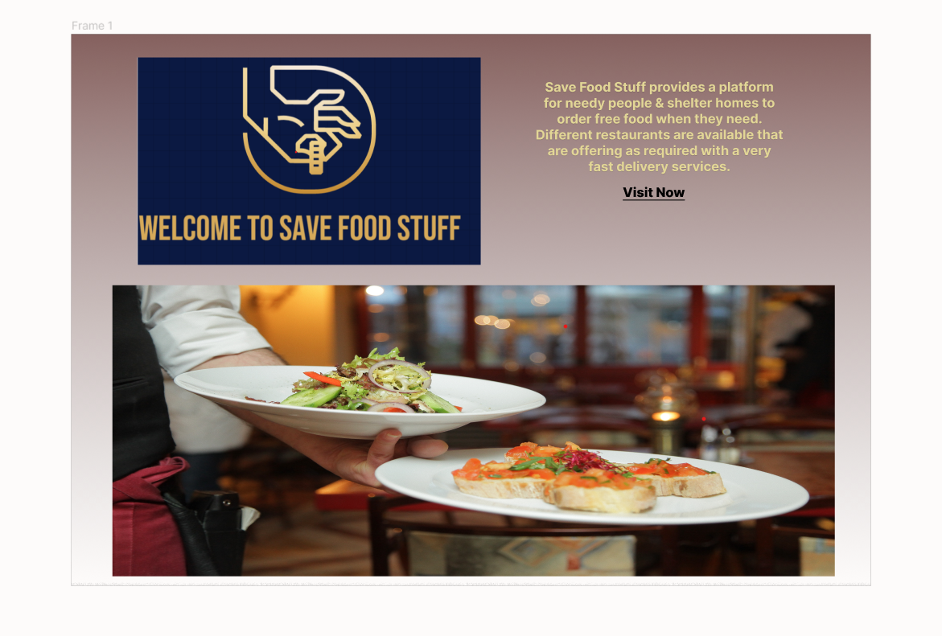
User Interfaces
Interface-1: Main Screen Of application

Slide 17
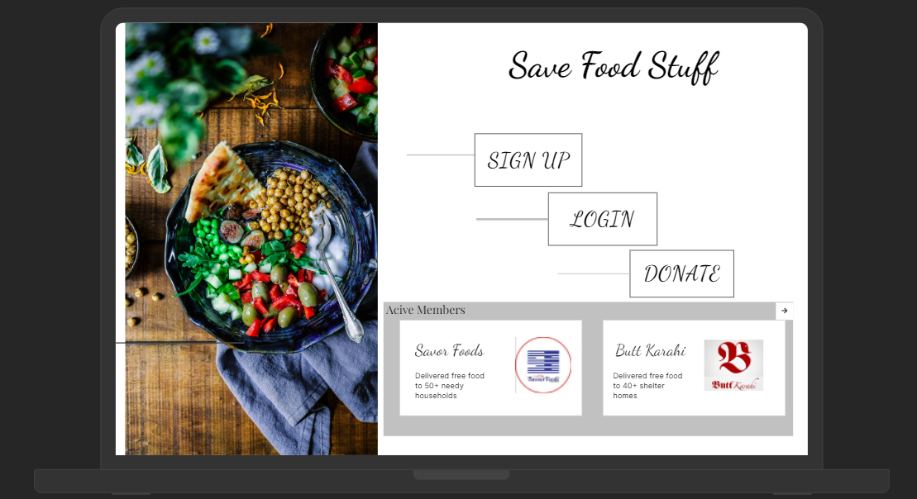
User Interfaces
Interface-2: Member Login Page.

Slide 18
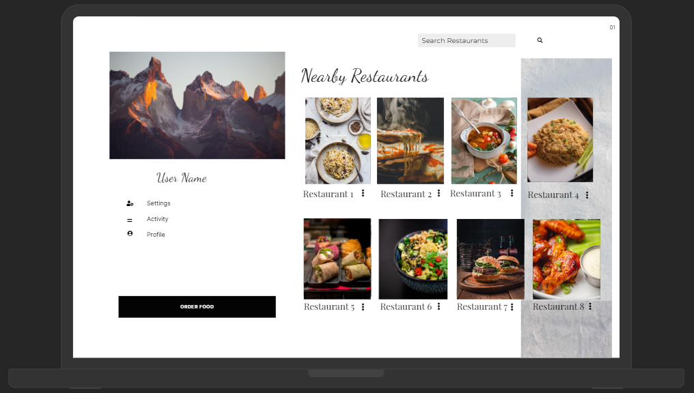
User Interfaces
Interface-3: Find Food Page For User.

Slide 19
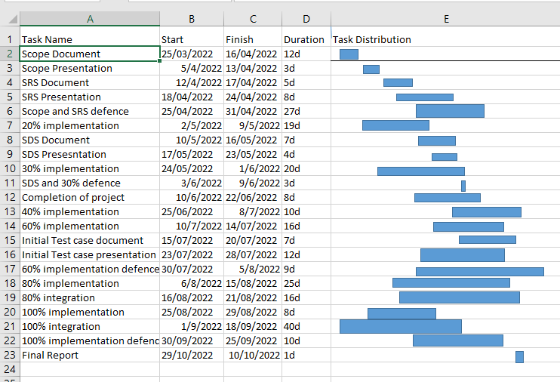
Gantt Chart
Grant Chart and provide estimated start and end dates of all proposed modules/tasks for each team member is shown below.

Slide 20
Conclusion To conclude, our app is specifically designed to minimize food wastage and feeding the hunger. It solves the issue of distribution of food that usually goes into waste. We try to make sure that this food is only delivered to those who actually need it. The app is designed in two ways, the user who is donating the food and the person/organization that is claiming the food.

Slide 21
References
References:
[1] https://www.unep.org/thinkeatsave/get-informed/worldwide-food-waste
[2]https://www.actionagainsthunger.org/world-hunger-facts-statistics#:~:text=Around%20the%20world%2C%20more%20than,9.9%20percent%20of%20people%20globally

Slide 22
Plaragism Report
Note: 1 Slide only
Attach the Plaragism report of your project SRS document from library staff of turnitin tool (http://turnitin.com)

Slide 23

Questions and Answers

