Slide 1
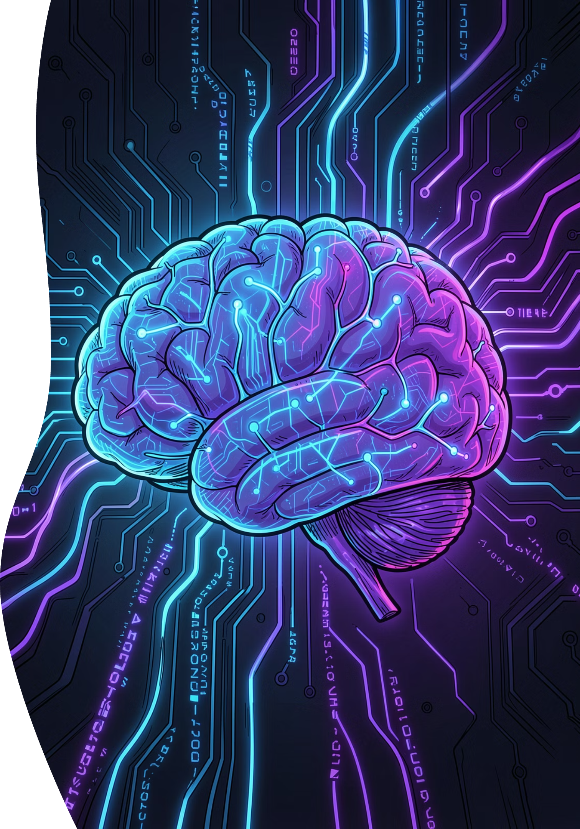
WEEK 2
AI Transformation
From Python to Intelligent Applications — your journey into Artificial Intelligence and Large Language Models begins here.

Slide 2
LEARNING OUTCOMES
What You'll Master This Week
01
02
Python & Tools
Machine Learning
Jupyter, Colab, Streamlit
ML pipeline & Iris dataset
03
04
Transformers & LLMs
Building AI Apps
Architecture, training, prompting
Hugging Face, RAG, deployment

Slide 3
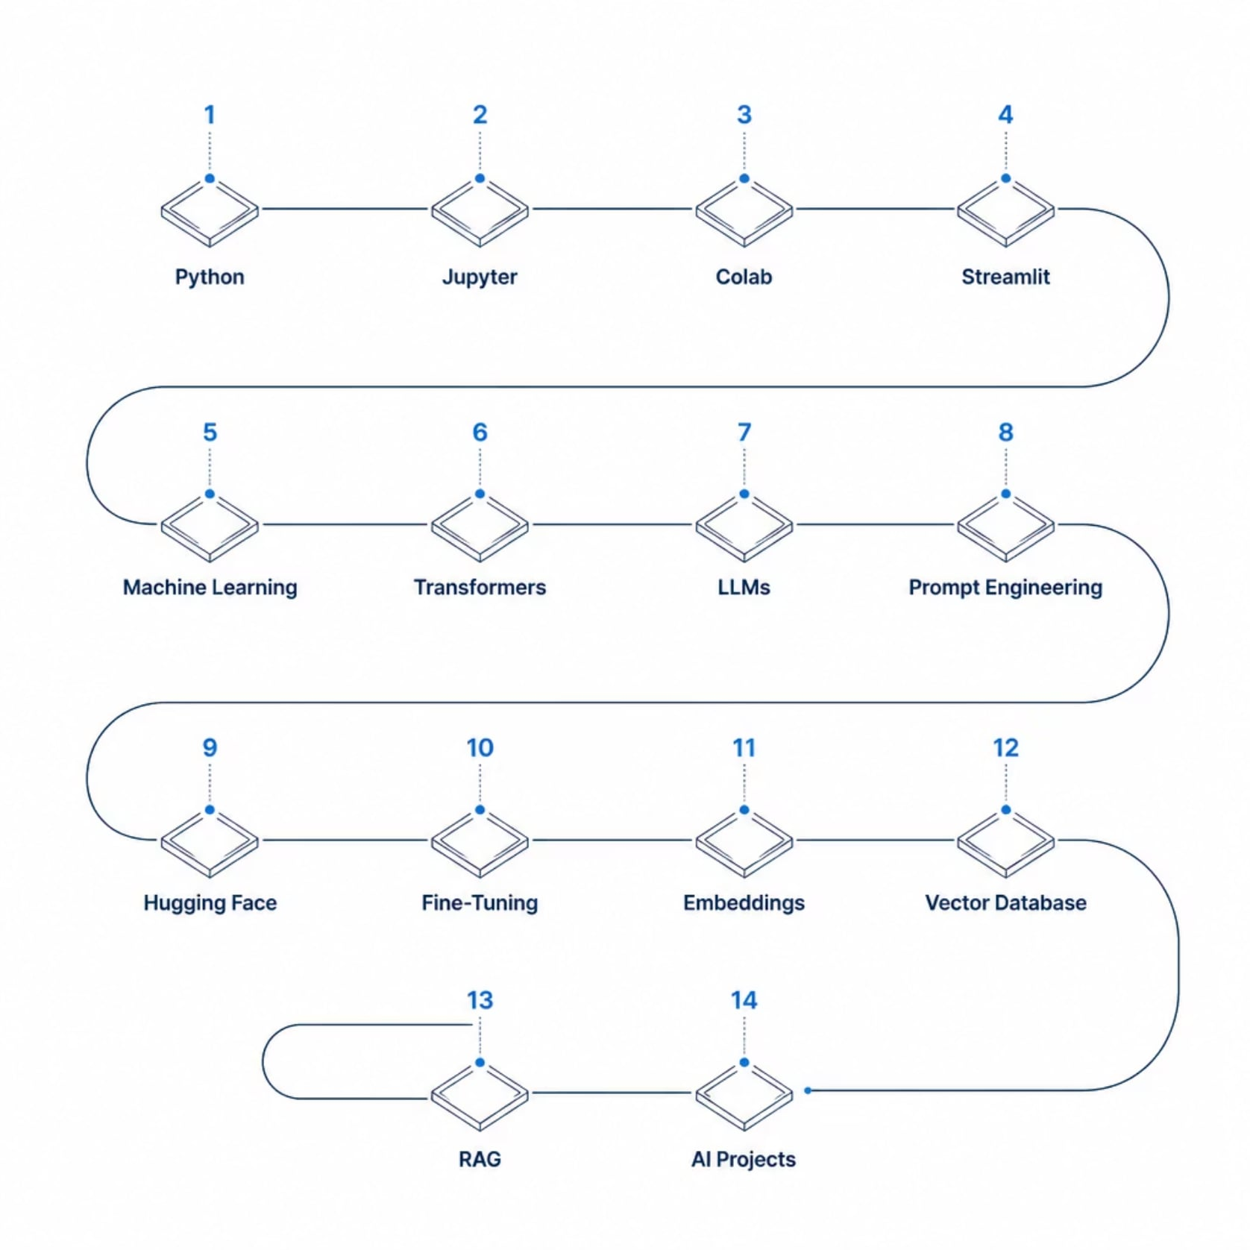
COURSE ROADMAP
Your AI Journey
Each step builds on the last — from writing your first Python script to deploying a RAG-powered AI application.
🎤 Presenter Note: Use this roadmap to orient students. Point out where we are today (Week 2) and where the course is headed. This is their full-stack AI map.

Slide 4
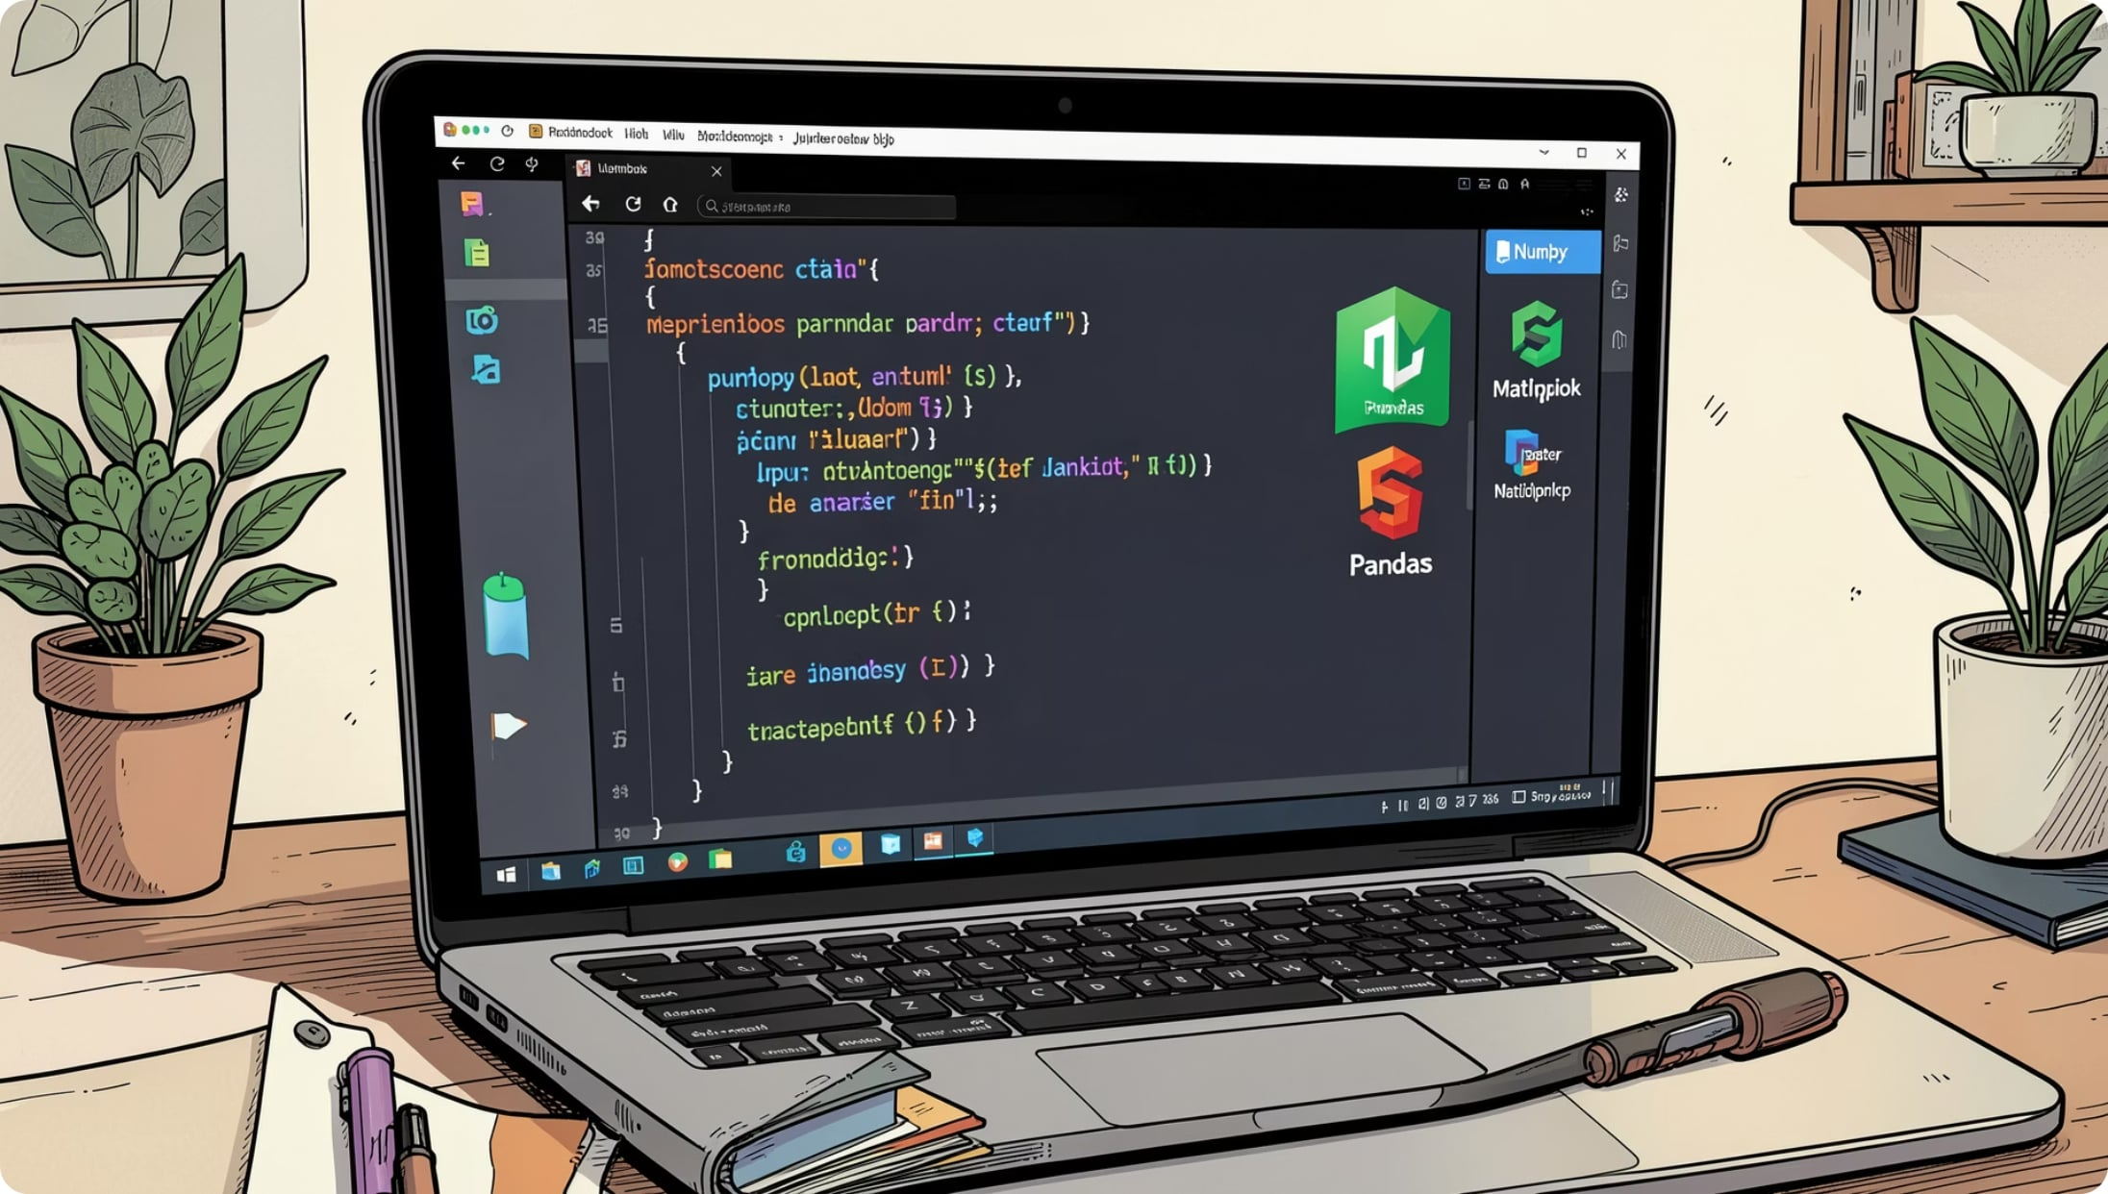



PYTHON & TOOLS
Python, Jupyter & Colab
Why Python?
Simple syntax, massive AI ecosystem
Jupyter Notebook
Interactive cells, Markdown, inline visuals
Google Colab
Cloud-based, free GPU, real-time collaboration
💡 Did You Know? Google Colab gives you free GPU access — no installation needed.
Note: Ask students: "Where have you seen Python used?" Discuss real-world examples like YouTube, Instagram, NASA. Demo a quick Colab notebook if time allows.

Slide 5
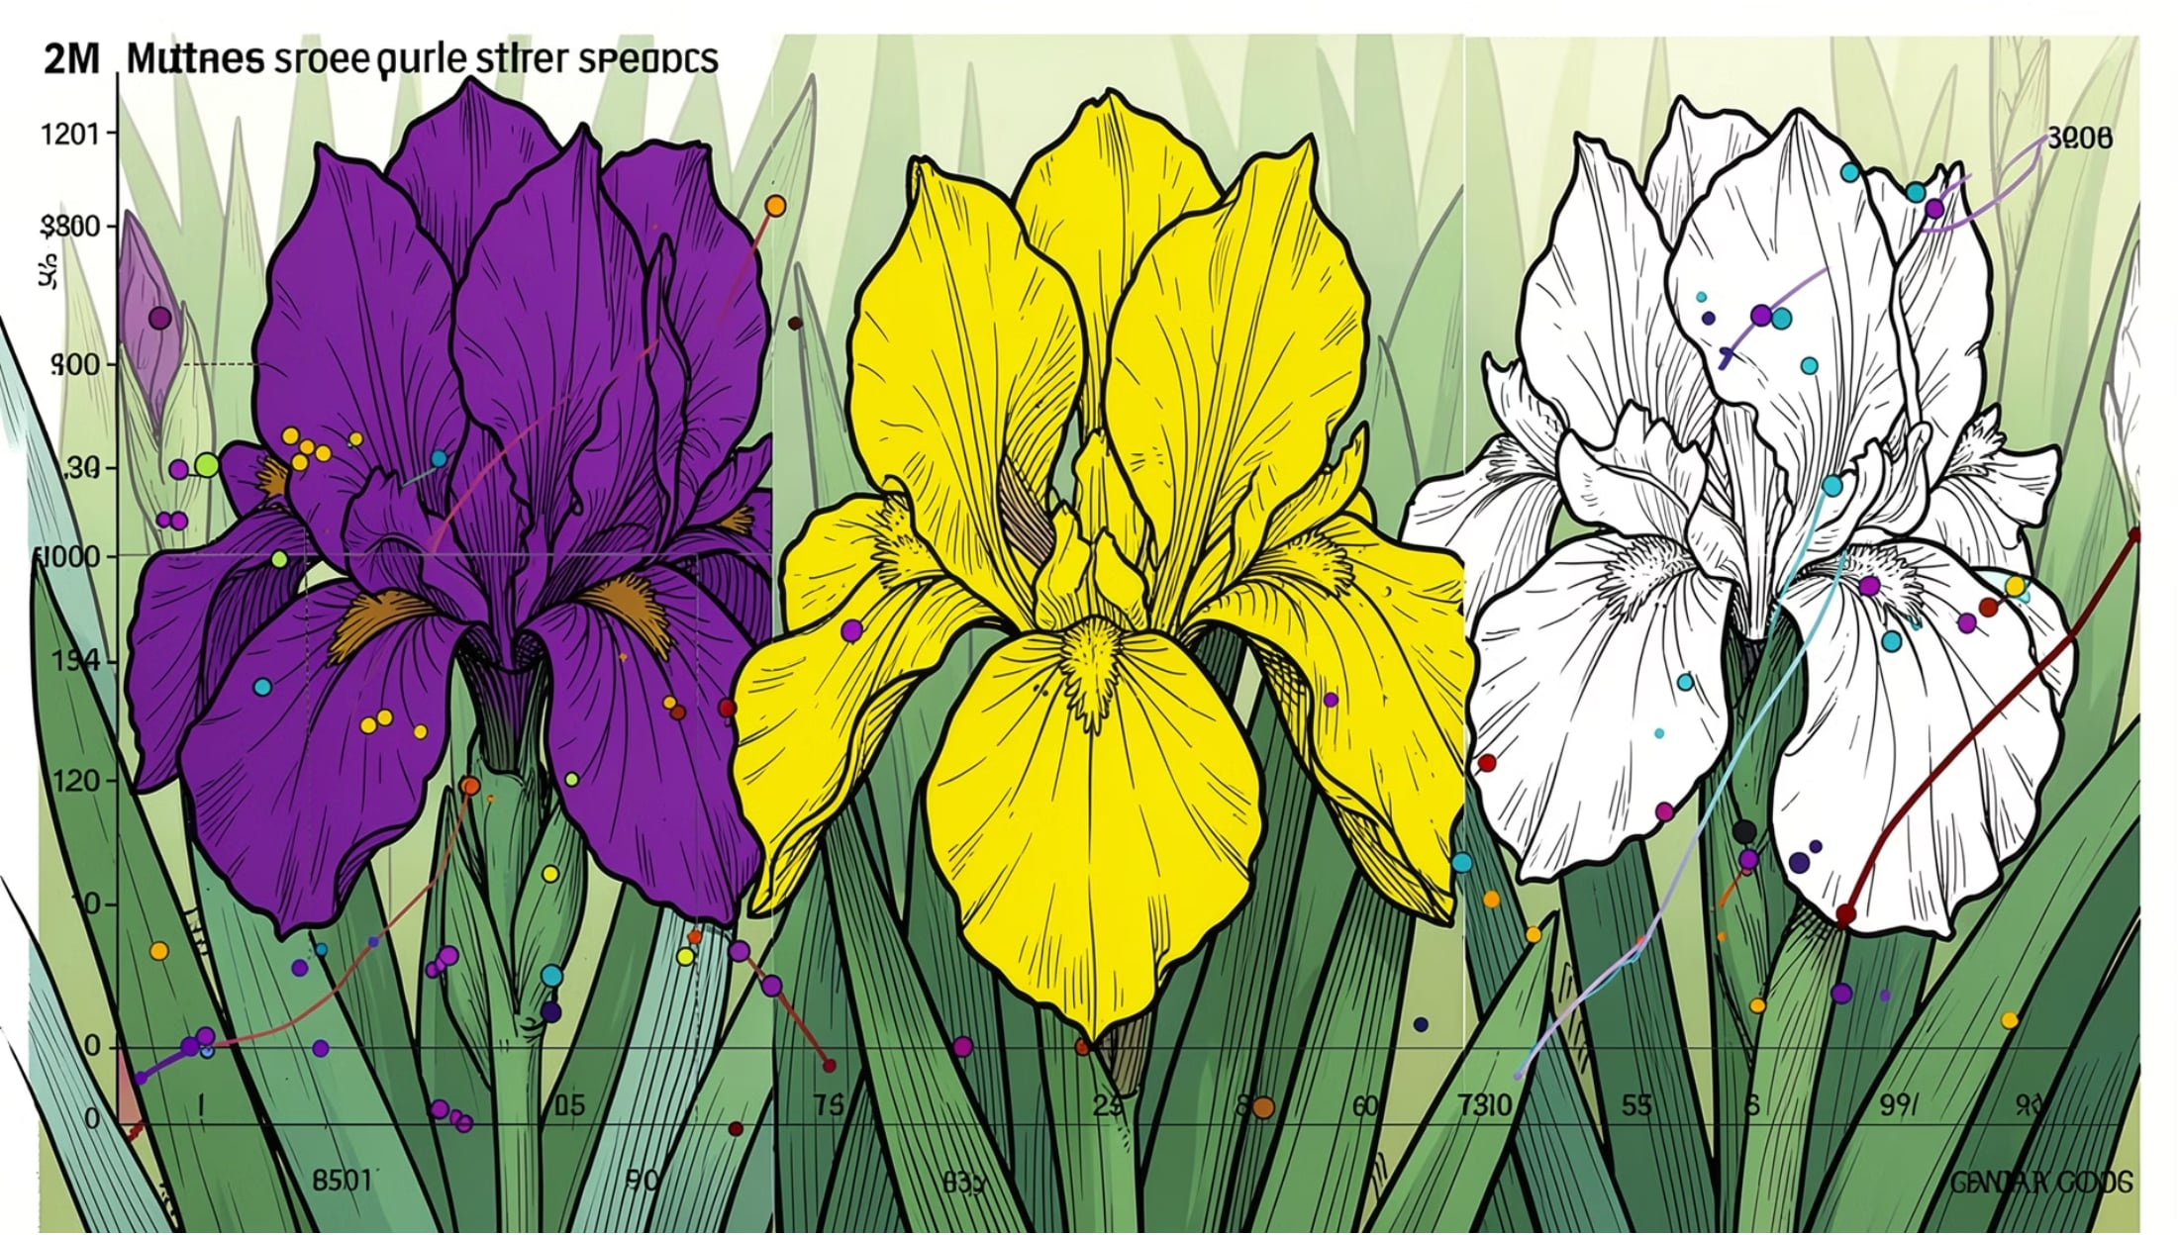
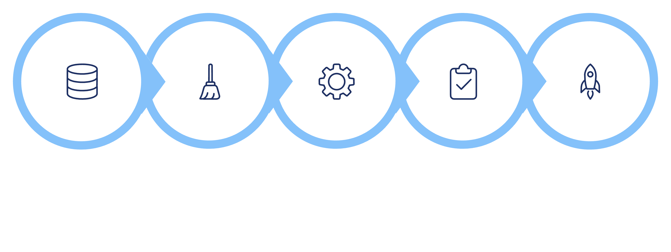
MACHINE LEARNING
From Data to Prediction
The Iris Dataset
150 flowers · 4 features · 3 species — the "Hello World" of ML classification.
Dataset
Clean
Train
Test
Predict
Every ML project follows this core loop — clean your data, train your model, evaluate, then predict.
🎤 Presenter Note: Walk through the Iris dataset as a concrete example. Explain features (sepal length, petal width) and labels (species). Emphasize that this pipeline applies to every ML problem they'll encounter.

Slide 6
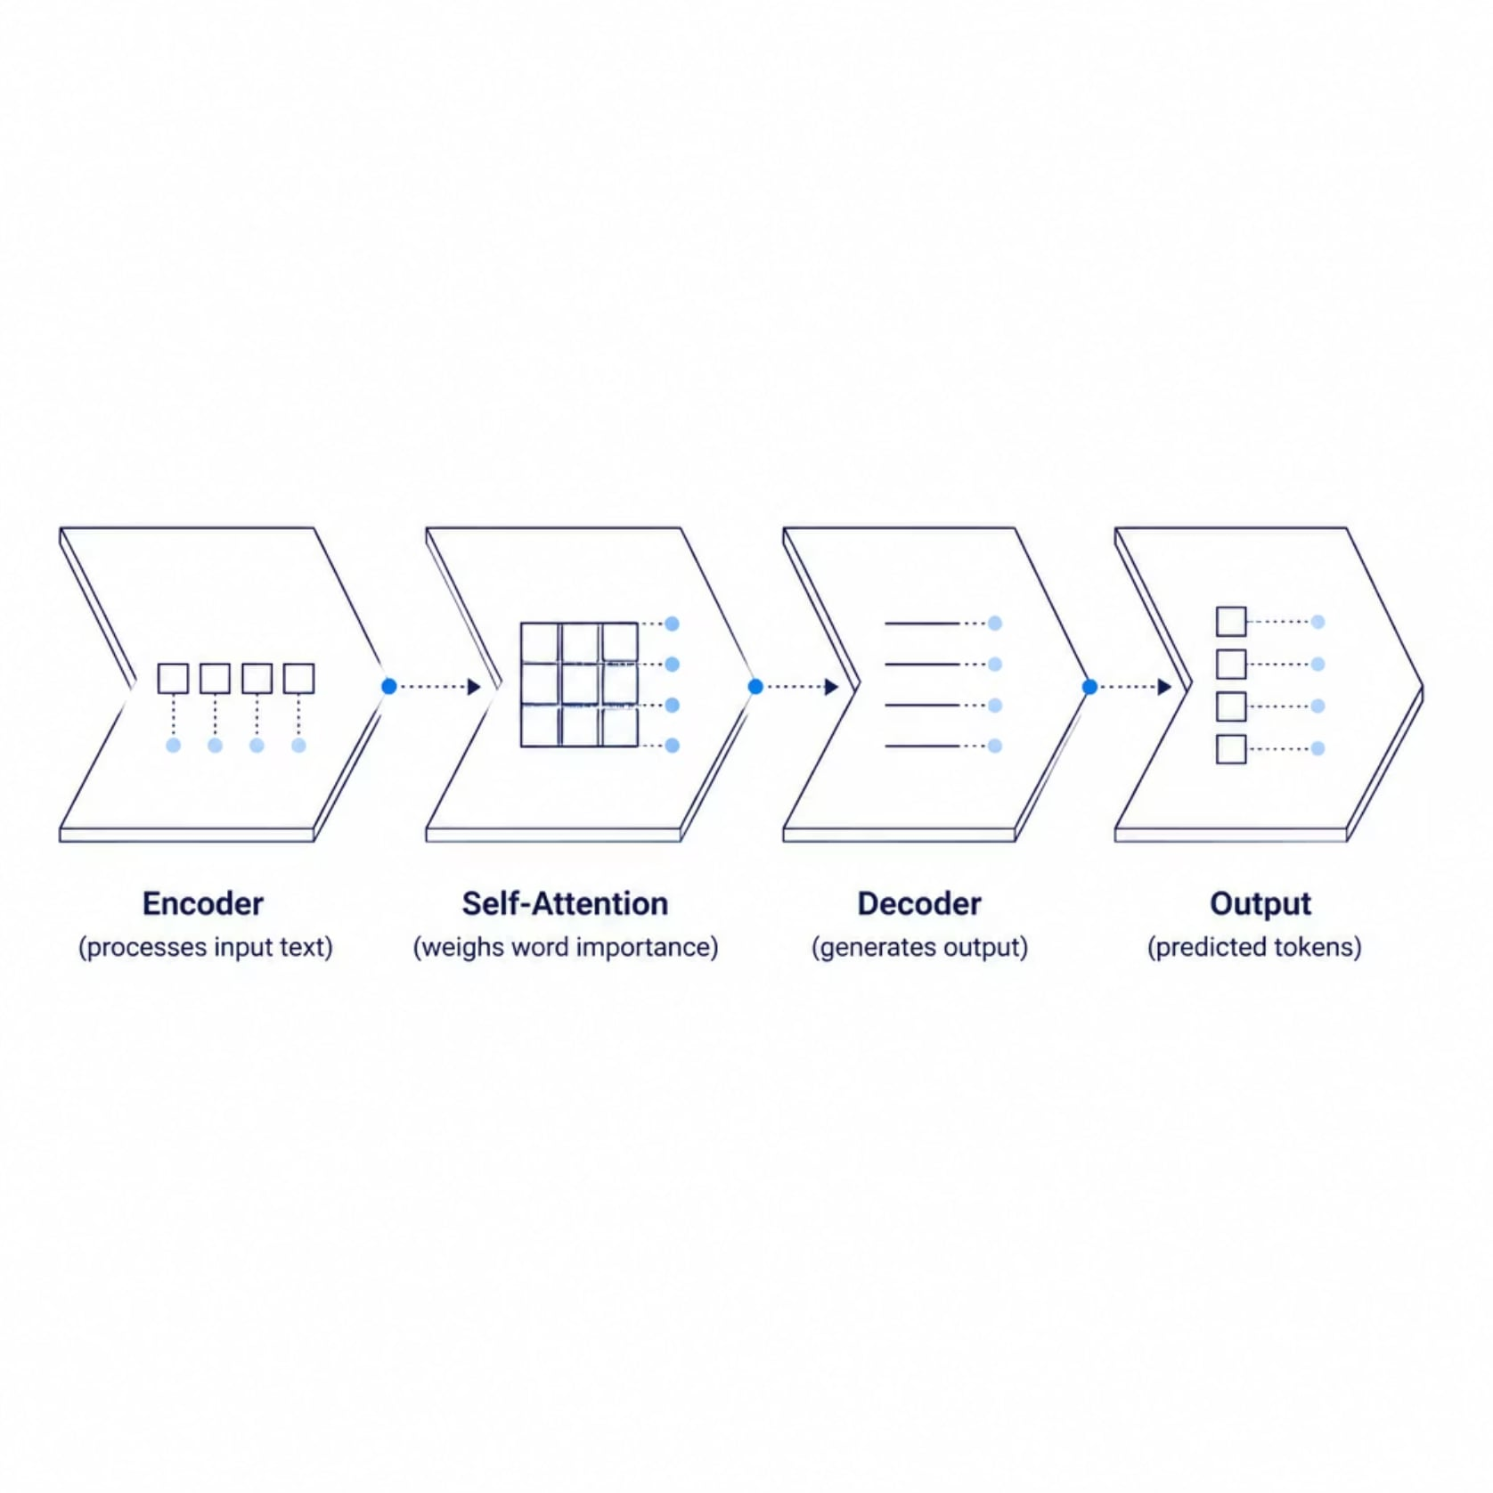
DEEP LEARNING
Transformers & Large Language Models
What Makes Transformers Special?
Self-Attention: understands word relationships
Parallel processing: faster than older architectures
Scale: billions of parameters
LLM Examples
ChatGPT, Claude, Gemini, LLaMA — all built on transformer architecture.
🎤 Presenter Note: Keep transformer explanation high-level. Use the analogy: "Self-attention is like reading a sentence and instantly knowing which words matter most to each other." Mention that GPT stands for Generative Pre-trained Transformer.

Slide 7





PROMPT ENGINEERING
Talk to AI Like a Pro
❌ Weak Prompt
Summarize this.
Role
Context
✅ Strong Prompt
Act as a teacher. Summarize in 3 bullet points for a 10-year-old.
Examples
Chain of Thought
🎤 Presenter Note: Live demo: show the same weak vs strong prompt in ChatGPT. Let students see the dramatic difference in output quality. Encourage them to experiment with role prompting.

Slide 8
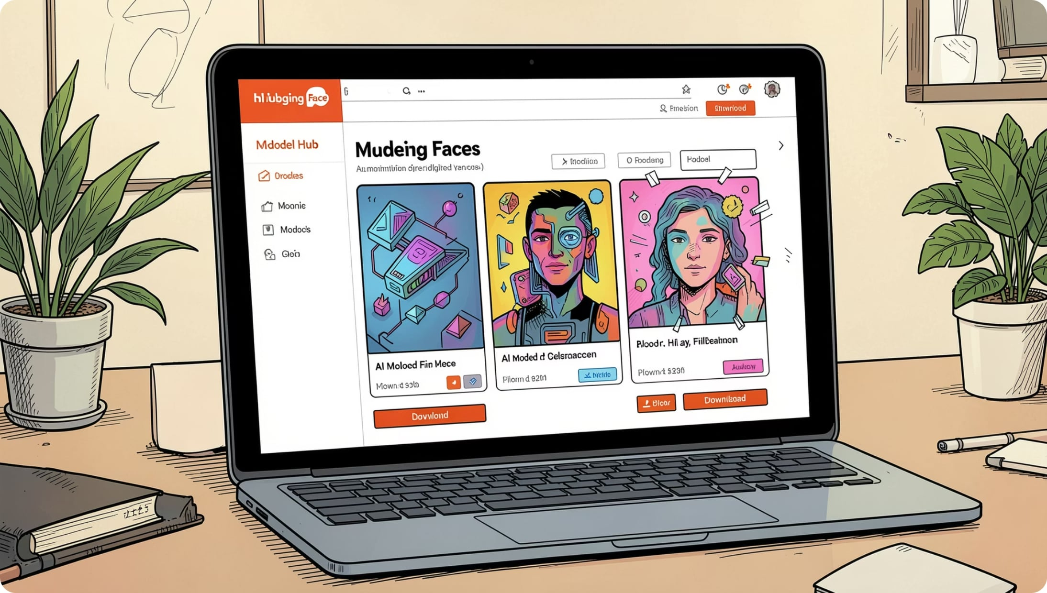




AI ECOSYSTEM
Hugging Face & Open-Source AI
Model Hub
500K+ pre-trained models — free to use
Pipeline API
One line of code to run any model
Fine-Tuning
Adapt base models to your data
🎤 Presenter Note: Navigate to huggingface.co live if possible. Show the Model Hub, search for a sentiment analysis model, and run a quick pipeline example. Emphasize that students don't need to train from scratch.

Slide 9

ADVANCED AI
Tokens, Embeddings & RAG
User Question
Embedding
Vector DB Search
Retrieved Docs
RAG combines the power of LLMs with your own data — no retraining needed.
Tokens
Embeddings
Vector DB
Text split into chunks (~4 chars each)
Words → numerical vectors capturing meaning
Stores embeddings for semantic search
🎤 Presenter Note: Use the library analogy: embeddings are like a card catalog — instead of keyword matching, the AI finds documents by meaning. RAG is how ChatGPT plugins and AI search engines work.

Slide 10





WEEK 2 WRAP-UP
Build Something Real
Form Teams
Hackathon groups
Pick a Project
Choose your AI problem
Build a POC
Proof of concept
Final Demo
Present to the class
Questions? Let's discuss your project ideas! 🚀

