Slide 1
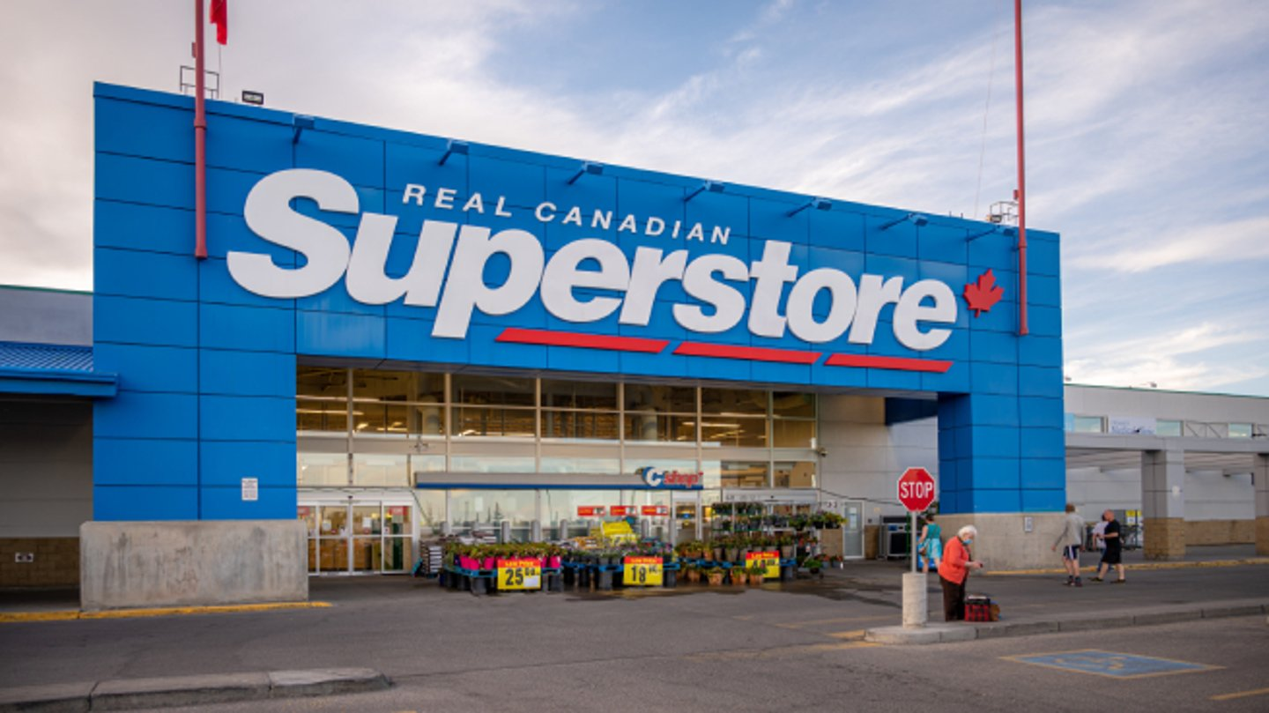
Superstore Sales And Performance Analysis Using SQL
Name : v balu
Institute : Besant Technologies
Guide : Mr. Kavi bharathi

Slide 2
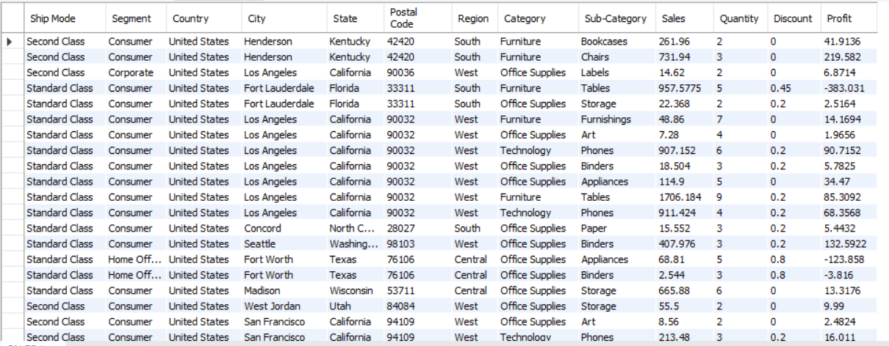
Project Overview:
This project analyzes supermarket sales data using SQL to uncover insights on sales performance, profit trends, customer segments and product categories .

Slide 3
Dataset Columns Overview – Superstore Sales
Dataset
• Ship-Mode– Method used to ship the order (e.g., Standard, First Class).
• segment–Type of customer (Consumer, Corporate, or Home Office).
• country– Country where the sale occurred.
• city– City where the order was placed.
• state– State or province of the customer.
• Postal-Code– Postal or ZIP code of the shipping address.
• region– Geographical region (East, West, Central, South, etc.).
• category– Main product category (Furniture, Office Supplies, Technology).
• Subcategory– More specific product type (e.g., Chairs, Phones, Binders).
• sales– Total revenue from the sale.
• quantity– Number of units sold.
• discount– Discount applied to the sale.
• profit– Profit earned after subtracting costs and discounts.

Slide 4
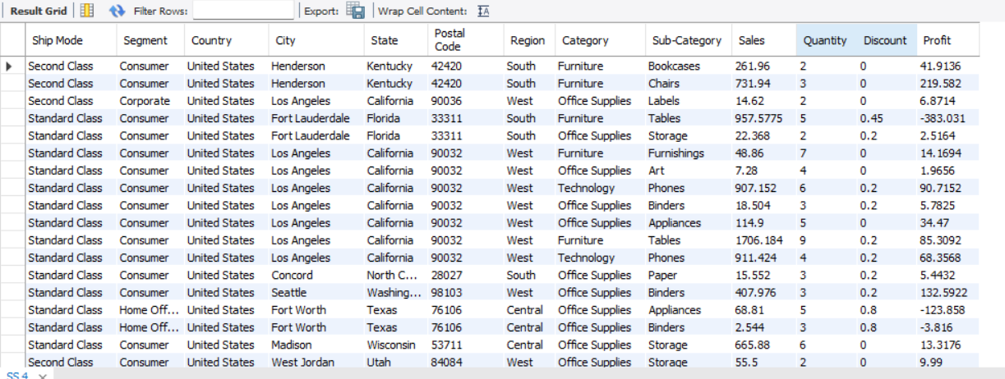
SQLQUERIES FOR SUPERMARKET SALES DATA
1. Display the entire details of the table?
SELECT * FROM SS;

Slide 5
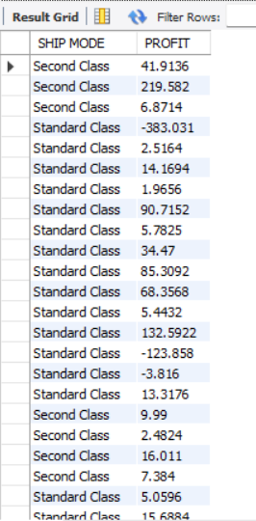
2 . Display ship mood and profits of the super store?
SELECT `SHIP MODE`,PROFIT
FROM SS;

Slide 6
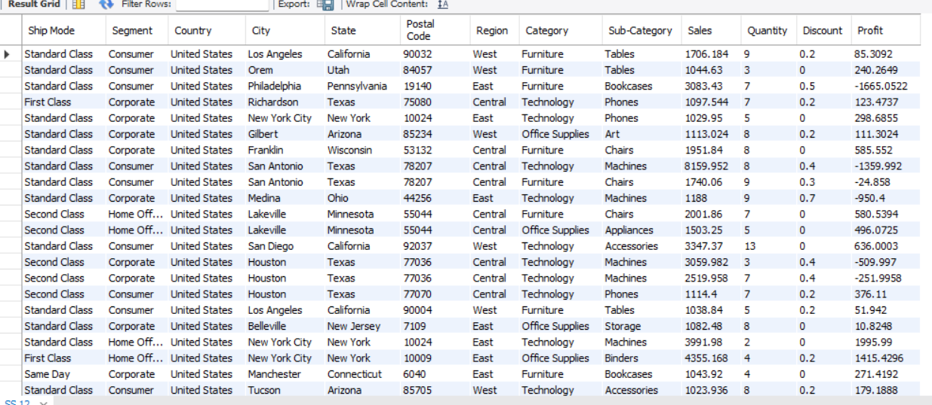
3 . Display sales greater than 1000?
SELECT *
FROM SS
WHERE SALES > 1000;

Slide 7
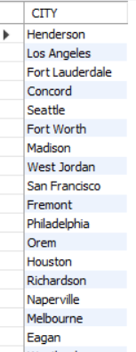
4 . Removing the repeated or duplicated values from the city?
SELECT DISTINCT CITY
FROM SS;

Slide 8
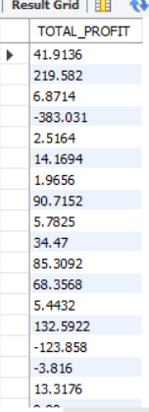
5 . Display name of profit change the name of total_profit?
SELECT PROFIT AS 'TOTAL_PROFIT’
FROM SS;

Slide 9
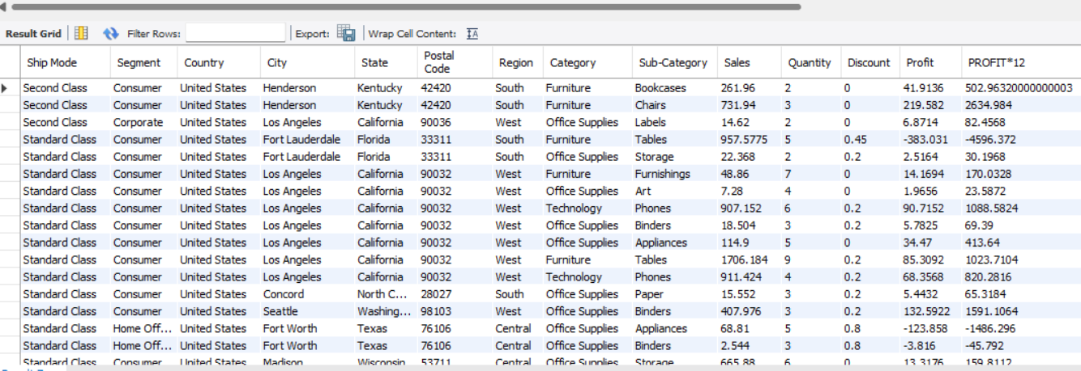
6 . write query to display details of the store and along with annual profit of the store?
SELECT *,PROFIT*12
FROM SS;

Slide 10
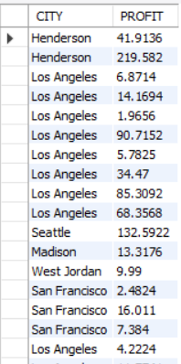
7. write a query to display city and profit which store contains s character in the city list?
SELECT CITY,PROFIT
FROM SS
WHERE CITY LIKE '%S%';

Slide 11
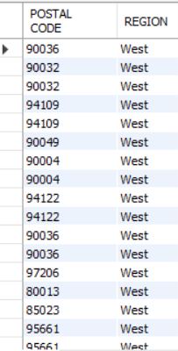
8. write a query to display postal code and region of store data who's region has west region in their list and sales under the 48.86?
SELECT`POSTAL CODE`,REGION
FROM SS
WHERE REGION ='WEST' AND SALES<48.86;

Slide 12
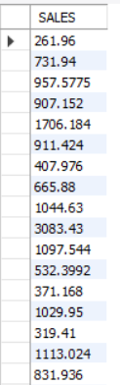
9. write query to display sales of the orders where sales greater than average sales?
SELECT SALES
FROM SS
WHERE SALES > (SELECT AVG(SALES)
FROM SS);

Slide 13
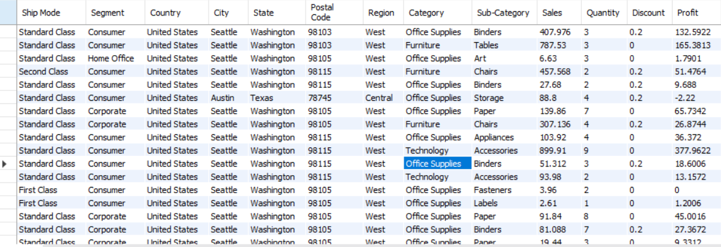
10. write a query to display the store who's city is seattle or austin ?
SELECT *
FROM SS
WHERE CITY IN ('SEATTLE','AUSTIN');

Slide 14
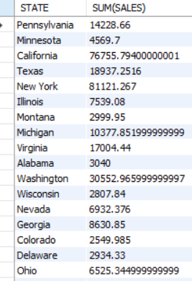
11. write a query to display the total sales in each state and where total sales in between 2000 to 5000?
SELECT STATE,SUM(SALES)
FROM SS
WHERE SALES BETWEEN 2000 AND 5000
GROUP BY STATE;

Slide 15
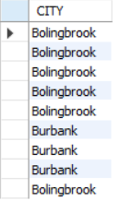
12 . write a query to display city whose city name starts with 'b' and end with 'k'?
SELECT CITY
FROM SS
WHERE CITY LIKE 'B%K';

Slide 16
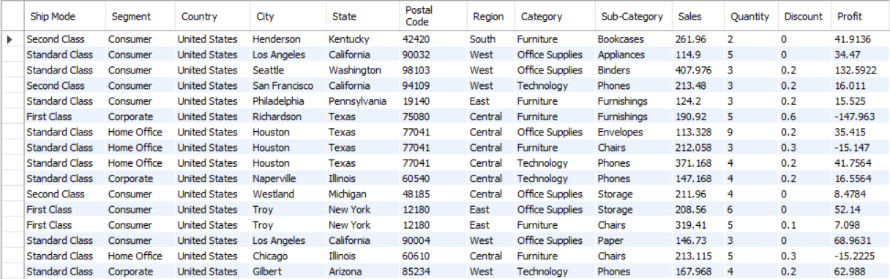
13 . write a query to display store data, whose sales are between 100 and 500?
SELECT *
FROM SS
WHERE SALES BETWEEN 100 AND 500;

Slide 17
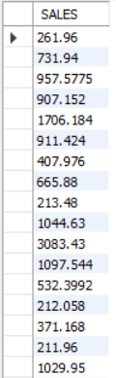
14 . write a query to display the orders of sales ,where sales are greater than 200?
SELECT SALES
FROM SS
WHERE SALES>200;

Slide 18

15 . write a query to display number of orders and Sales, where the profit getting more than 2000 in each sales and the total profit must excess with 5000 in each sales?
SELECT COUNT(*),SALES
FROM SS
WHERE PROFIT>2000
GROUP BY SALES
HAVING SUM(PROFIT)>5000;

Slide 19
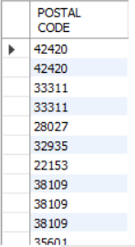
16 . write a query to display postal code which region has same postal code as "33311"?
SELECT `POSTAL CODE`
FROM SS
WHERE REGION IN (SELECT REGION
FROM SS
WHERE `POSTAL CODE`=33311);

Slide 20
17 . write a query to display orders of the store which order are getting third minimum sales in store ?
SELECT *
FROM SS
WHERE SALES IN (SELECT MIN(SALES)
FROM SS
WHERE SALES > (SELECT MIN(SALES)
FROM SS
WHERE SALES >(SELECT MIN(SALES)
FROM SS)));

Slide 21
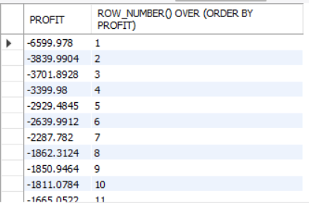
18 . Write a query to display profit and add the row numbers by order?
SELECT PROFIT, ROW_NUMBER() OVER (ORDER BY PROFIT)
FROM SS;

Slide 22
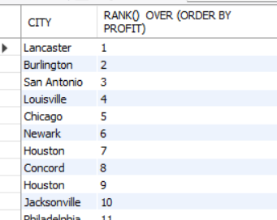
19 . Write a query to display city and add the rank by order?
SELECT CITY, RANK() OVER (ORDER BY PROFIT)
FROM SS;

Slide 23
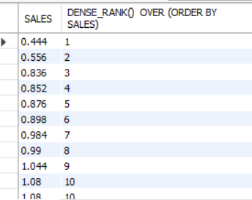
20 . Write a query to display sales by using dense-rank?
SELECT SALES, DENSE_RANK() OVER (ORDER BY SALES)
FROM SS;

Slide 24
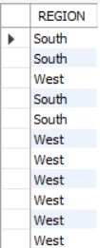
21 . write a query to display region from both two tables with the help of union all set operator?
SELECT O1.REGION
FROM SS O1
UNION ALL
SELECT O2.REGION
FROM SS O2;

Slide 25
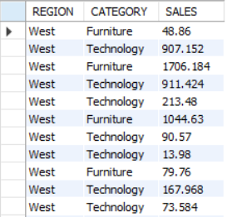
22 . write a query to display to Show records where region is West and category is Furniture or Technology?
SELECT REGION,CATEGORY,SALES
FROM SS
WHERE REGION = 'WEST' AND CATEGORY IN ('FURNITURE','TECHNOLOGY');

Slide 26
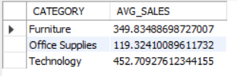
23 , write a query to display to Find average sales for each category?
SELECT CATEGORY,AVG(SALES) AS AVG_SALES
FROM SS
GROUP BY CATEGORY;

Slide 27
24 . write a query to display to Show the top 3 records with highest sales amount?
SELECT *
FROM SS
ORDER BY SALES DESC
LIMIT 3;

Slide 28
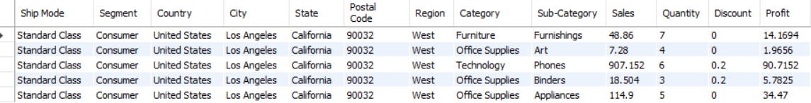
25 . Display next 5 records after first 5?
SELECT *
FROM SS
LIMIT 5
OFFSET 5;

