Slide 1
RL-Driven Interactive IoT Multi-Service Honeypot
Adaptive Attacker Engagement using Deep Neural Network.
Notes:
1.7.2013
1
‹#›

Slide 2
The Problem: Static Honeypots Fail in Seconds
Traditional honeypots respond identically to every connection — bots fingerprint them in ~19 seconds and disconnect. No adaptation, no human detection, and virtually zero intelligence collected.
No Adaptation
No Classification
Same response to every attacker — automated scanners detect and abandon sessions instantly
Cannot distinguish human operators from botnet scanners — all traffic treated identically
Zero Intelligence
Average session of 19 seconds yields almost no actionable threat data
Notes:
1.7.2013
2
‹#›

Slide 3

Research Foundation & The Gap We Fill
Key References
The Critical Gap
Survey Paper on Honeypots and IoT (2021) — Tells about the Honeypots and IOT Protocols , already published Architecture.
AIIOT (2023) — Interactive honeypot mainly focused on the Http Protocol. Main attack they focused on the DDOS and DOS attacks. Used Q learning and MDP algorithm.
Multiport Honeypot (2020) — RL for network defense. Closest prior work
CyberBattleSim operates entirely in simulation — no live protocol emulation, no real attacker traffic. This project deploys DQN agents against live, uncontrolled attacker sessions on real IoT services.
Our contribution: 4 independent DQN models, one per protocol, trained on live session data.
Notes:
1.7.2013
3
‹#›

Slide 4
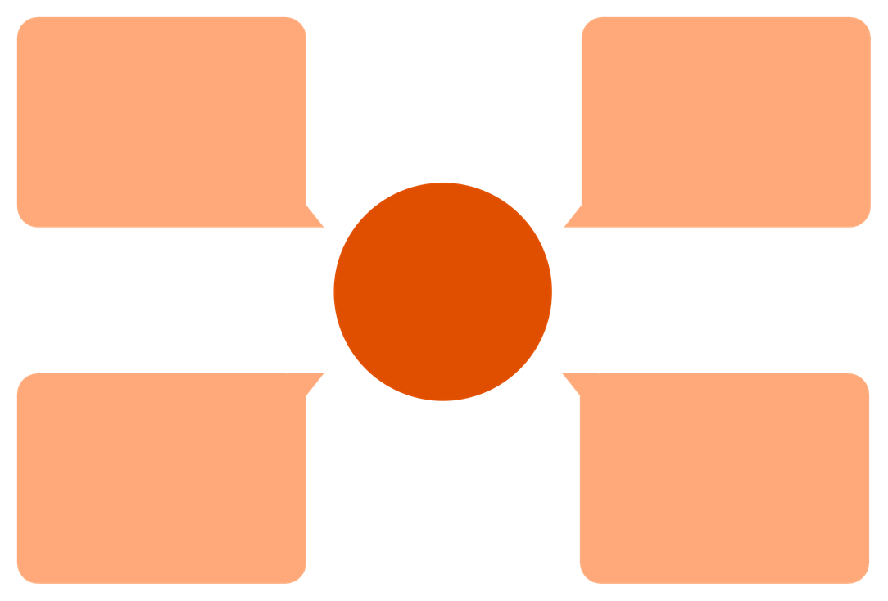
System Architecture
Zone 4: Offline Training
Zone 1: Attacker
DQN training loop reads MongoDB
External malicious traffic entry
Four‑Zone Architecture
Zones
Zone 3: Logging & Dashboard
Zone 2: Honeypot
MongoDB persistence and Streamlit UI
4 trap services + MQTT broker + AI Brain
The honeypot operates across four isolated zones: attacker traffic enters Zone 2, where per-service DQN models select engagement actions via MQTT. All session data is persisted to MongoDB for offline training and real-time dashboard visualization.
Notes:
1.7.2013
4
‹#›

Slide 5
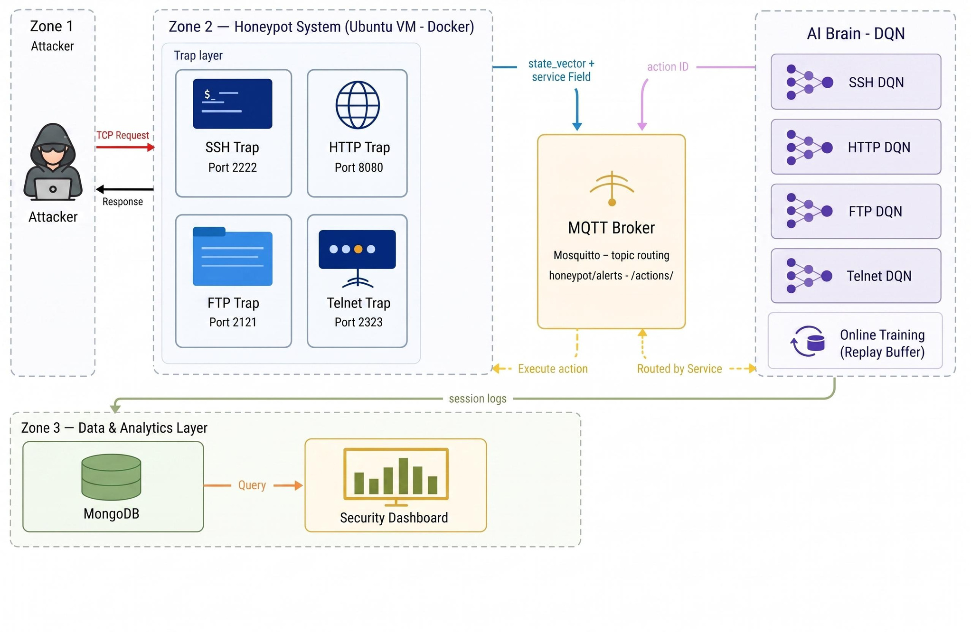

Slide 6




The 4 Trap Services
SSH — Port 2222
HTTP — Port 5000
FTP — Port 2121
Telnet — Port 2323
Paramiko server with fake shell, sudo trap, honeytokens. 6 actions.
SCADA portal with live dashboard and firmware upload capture. 5 actions.
vsFTPd emulation, fake filesystem, malware capture via STOR. 5 actions.
BusyBox shell, NVRAM credential dump, Mirai wget bait. 5 actions.
Notes:
1.7.2013
5
‹#›

Slide 7


Action Execution: SSH Example
Each trap maps action IDs to specific attacker experiences. The DQN selects the action that maximizes expected session duration.
ID
Action
Attacker Experience
0
Limited Shell
Read-only commands — attacker frustration builds
2
Fake Sudo
Password loop; wget succeeds after 3 attempts
3
Honeytoken Expose
AWS keys dropped into working directory
4
Tarpit
5–8 second freeze per command
Q-value example: act=3 (HONEYTOKEN_EXPOSE) | Q=[[4.2 0.8 16.3 28.4 4.1 1.1]] — action 3 has the highest Q-value, so the brain chose it.
Notes:
1.7.2013
6
‹#›

Slide 8
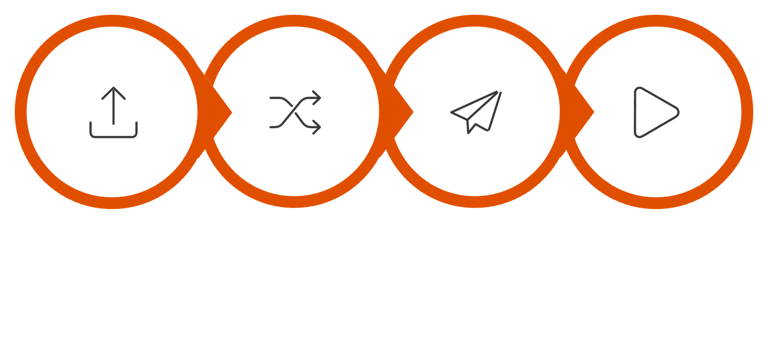




MQTT Broker: Sub-50ms Message Routing
Route to DQN
Publish Action
Execute Action
Publish Alert
Entire round-trip — from trap command to DQN action execution — completes in under 50ms. MQTT was chosen over REST for its lightweight pub-sub model, zero polling overhead, and native support for inter-container communication.
Notes:
1.7.2013
7
‹#›

Slide 9
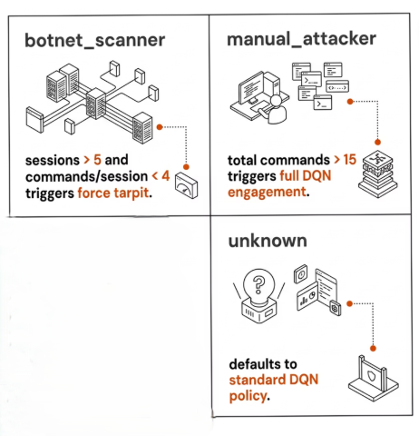

The AI Brain: Classification & Decision
State Vector → DQN → Action
Each trap sends a 5-element state vector per command. The DQN (5→64→64→N) outputs one Q-value per action and selects the highest.
Also used NSL - KDD dataset for offline traning the DQN. so it can have piror knowledge
I
Attacker Classification
botnet_scanner: sessions >5, avg commands <4 → force tarpit
manual_attacker: total commands >15 → full DQN engagement
unknown: default DQN policy
Notes:
1.7.2013
8
‹#›

Slide 10

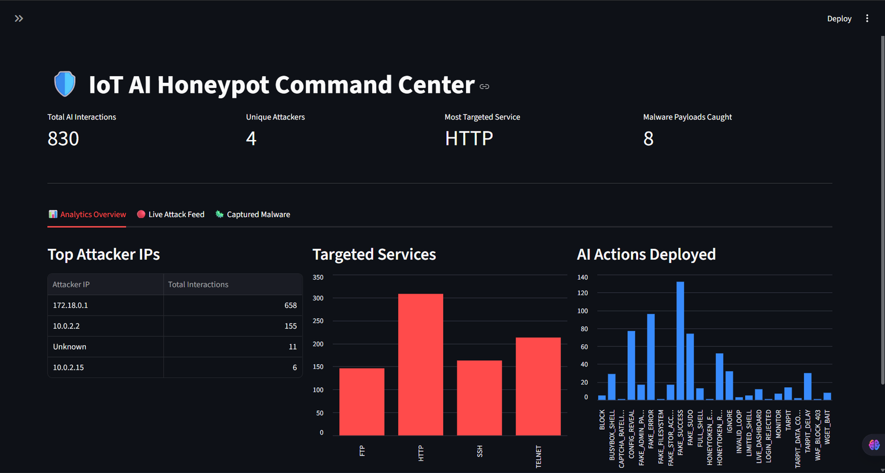
Dashboard, MongoDB & Results
MongoDB stores attacker IP, service, all commands, actions chosen, session duration, attacker type, and uploaded files. The Streamlit dashboard displays live attack feeds, Q-value trends, and a malware file viewer — every brain decision is logged with its Q-values.
Session Duration: Model
Service
Model
SSH
87s
FTP
150s
Telnet
218s
Http
12s
Overall
117s
Notes:
1.7.2013
9
‹#›

Slide 11
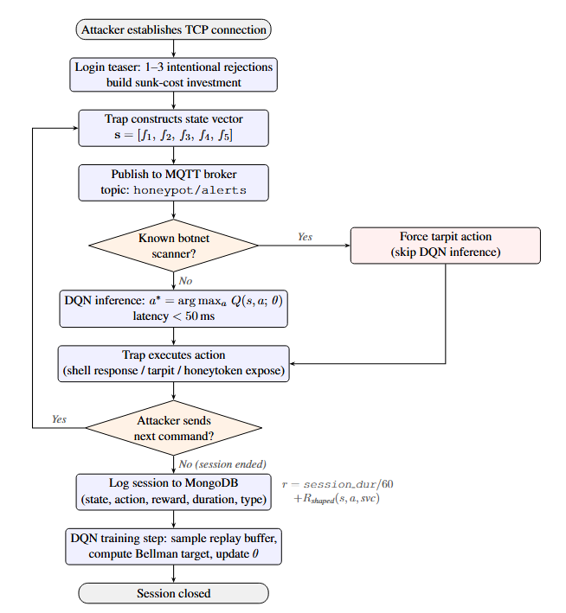
Work Flow of Architecture
Notes:
1.7.2013
9
‹#›

Slide 12
Conclusion & Future Work
Key Findings
Future Directions
Adaptavie DQN performs better than a Static Honeypot.
Sunk-cost funnel emerges without explicit programming — DQN learns to escalate engagement
Real malware samples and C2 infrastructure captured from live attackers
LLM-powered shells for natural-language attacker engagement
Redis for cross-restart IP memory and long-term attacker profiling
SIEM integration for automatic IOC report generation
Notes:
1.7.2013
10
‹#›

