Slide 1
YouTube What’s Trending?
Introduction to Business Analytics
Siming Chen,Yike Lyu, Jason Liu
Kaiqi Chen, Stone Shi
Oct 10, 2019

Slide 2
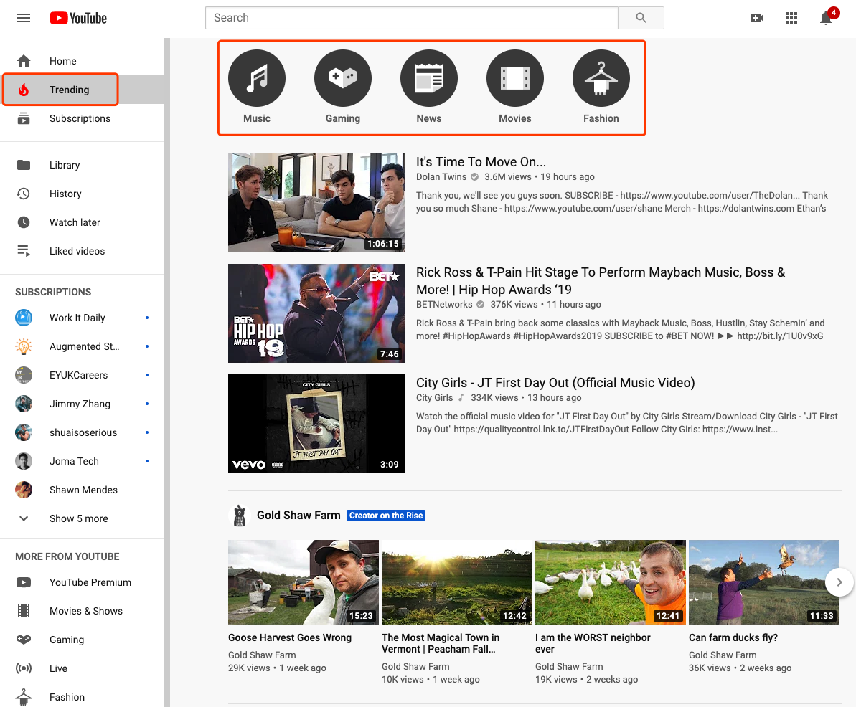

Slide 3
What determines if a video can go on trending?
View count
How quickly the video is generating views
The age of the video

Slide 4
Video views at weekend vs. weekday
Hypothesis:
Is there a significant difference in video views?
µ(𝑤𝑒𝑒𝑘𝑒𝑛𝑑) = µ(𝑤𝑒𝑒𝑘day)
µ(𝑤𝑒𝑒𝑘𝑒𝑛𝑑) ≠ µ(𝑤𝑒𝑒𝑘day)
Two-sample t test
t = -0.53223, df = 6135, p-value = 0.5946
 | Weekend | Weekday
Mean | 891428.7 | 851510.9

Slide 5
The means of views when each video goes on trending first time for each category

